Slide 1
Artificial Intelligence in Games
Week 2.5
CLASS WEBSITE: gameaipro.com/digipen
STEVE RABIN (steve.rabin@gmail.com)
TA: CHI-HAO KUO (chihao.kuo@digipen.edu)

Slide 2
Behavior Trees

Slide 3


Behavior Trees
  Popularized by Damian Isla at GDC 2004
  Halo 2 had 50 different behavior trees

Slide 4
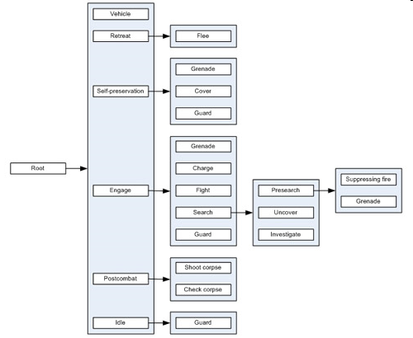

Slide 5
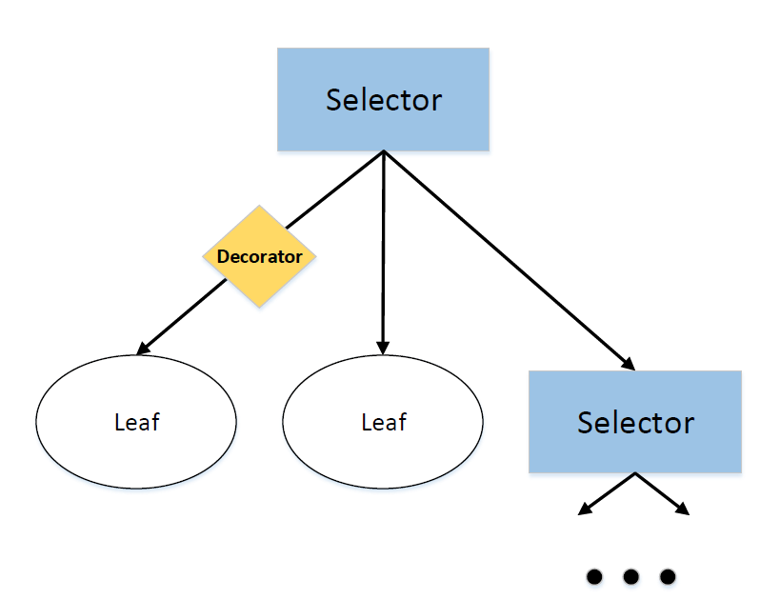
Behavior Tree
Tree of control flow nodes and execution nodes
Control flow nodes are on the interior
  Selector, sequence, decorator
Execution nodes (tasks) are the leaves
  Tasks are the options that do actual work

Slide 6

Selector Node
Execute tasks in order until success
?
Attack
Taunt
Stare
Succeed, Fail,
or Working?
Succeed, Fail,
or Working?
Succeed, Fail,
or Working?

Slide 7
Selector Node
Execute random tasks until success
~?
Attack
Taunt
Stare
Succeed, Fail,
or Working?
Succeed, Fail,
or Working?
Succeed, Fail,
or Working?

Slide 8
Sequence Node
Execute each task in order, unless fail
Enemy
Visible?
Turn
away
Run
away
Succeed, Fail,
or Working?
Succeed, Fail,
or Working?
Succeed, Fail,
or Working?

Slide 9
Non-Deterministic Sequence Node
Random until all executed, unless fail
Get
Matches
Get
Gasoline
Succeed, Fail,
or Working?
Succeed, Fail,
or Working?

Slide 10
Parallel Node
Execute all tasks in parallel, until success or fail
Run to
Enemy
Battle
cry
Succeed, Fail,
or Working?
Succeed, Fail,
or Working?

Slide 11
Decorator Node
Change the logic between parent/child
Repeat
3x
Shoot
Battle
cry
Succeed, Fail,
or Working?
Succeed, Fail,
or Working?

Slide 12
Decorator Nodes http://aigamedev.com/open/article/decorator/
Control Modifiers
  Force a return status (always fail or succeed)
  Invert status
  Rerun until success, Rerun until fail
  Fake a certain behavior
    (keep running instead of failing or succeeding)

Slide 13
Decorator Nodes http://aigamedev.com/open/article/decorator/
Filters
  Limit the # of times it can run
  Prevent from firing too often with a timer
  Temporarily deactivate
  Restrict number of simultaneous running behaviors

Slide 14
Decorator Nodes http://aigamedev.com/open/article/decorator/
Managers & Handlers
  Store information for nodes to access as a blackboard
  Deal with the error status code
    Restart planning/execution

Slide 15
Decorator Nodes http://aigamedev.com/open/article/decorator/
Meta Operations
  Debug breakpoint
    (pause execution and prompt the user)
  Logging
    (track this node execution and print to the console)

Slide 16
Example
?
Door
open?
Move
(into room)
Move
(to door)
?
Move
(into room)
Door
locked?
Open
door
Barge
door
Door
open?

Slide 17
Example
Enemy
visible?
Select enemy
(write to blackboard)
?
Engage enemy
(read from blackboard)
Always
succeed
High ground
available?
Move to
high ground

Slide 18
Example
Enemy
visible?
Select enemy
(write to blackboard)
Always
Succeed
Engage enemy
(read from blackboard)
High ground
available?
Move to
high ground

Slide 19
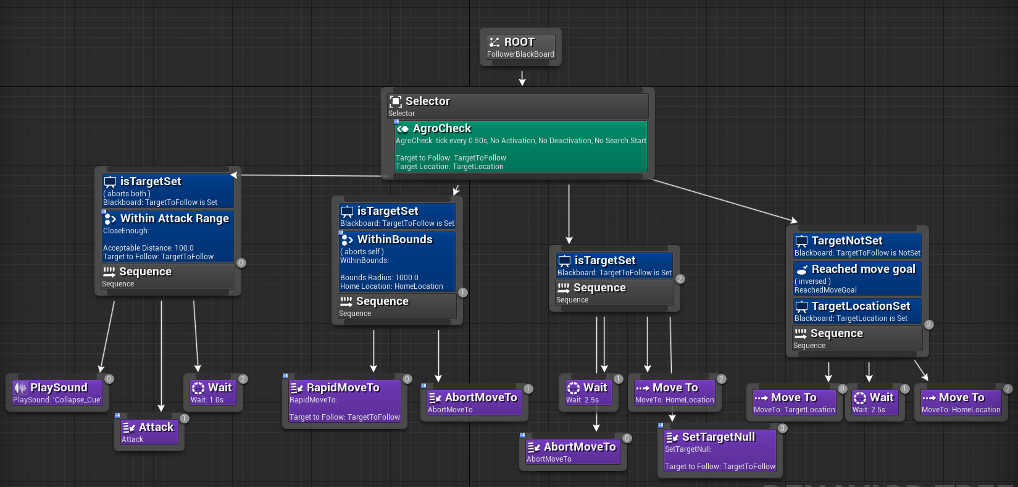

Slide 20
Behavior Tree / FSMs
More scalable than simple FSMs
More composable than FSMs
  Code reuse
Less brittle than FSMs

Slide 21
Behavior Tree Criticism
Clunky with state-based behavior
  Hard to design in term of states
  AI based on behavior trees tends to avoid this behavior

Slide 22
Behavior Tree Criticism
Doesn't deal nicely with interruptions
  Cumbersome to implement
  Examples:
    Interrupting patrol route to hide or raise alarm
    Switching strategies when ammo low
Option stack for entire Behavior Tree?

Slide 23
Project 1: Behavior Trees
SWITCH SLIDES

Slide 24
State Machines

Slide 25

Let’s Start Simple
Agent
FSM

Slide 26
Let’s Start Simple
Agent
Manager
FSM

Slide 27
Let’s Start Simple
Agent
Manager
Tank
RTS
Example

Slide 28
Queued State Machines
Agent
Manager
FSM
Active
Planned
Sequence
Of Actions
FSM
Inactive
FSM
Inactive

Slide 29
Queued State Machines
Agent
Manager
Fight
Active
Planned
Sequence
Of Actions
Goto
Inactive
Build
Inactive

Slide 30
Queued State Machines
(Push operation enables HFSM)
Agent
Manager
FSM 2
Active
FSM 1
Inactive

Slide 31
Queued State Machines
(Push operation enables HFSM)
Agent
Manager
Attack
Active
RTS
Example
Guard
Base
Inactive

Slide 32
Concurrent State Machines
Agent
Manager
FSM
FSM
FSM

Slide 33
Concurrent State Machines
(Subsumption Architecture)
Agent
Manager
FSM
FSM
FSM
Highest
Layer
Middle
Layer
Lowest
Layer
Requests

Slide 34
Queued and Concurrent
State Machines
Agent
Manager
FSM
FSM
FSM
Active
FSM
FSM
FSM
Inactive
FSM
FSM
FSM
Inactive

Slide 35
Inside a State Machine:
State Machine Events
State( Attack )
OnEnter
//code to execute
OnUpdate
//code to execute
OnExit
//code to execute

Slide 36
Event Flow
Update
World
Update
Agent
Agent
Update
Update
Manager
Manager
Update
Update
HFSM
HFSM
Enter State
or
Exit State
Enter State
or
Exit State

Slide 37
External State Machine Events
(Communication from the outside)
State( Attack )
OnEvent( HealthLow )
//code to execute
OnEvent( TargetDead )
//code to execute
OnEvent( BuddyRequestForHelp )
//code to execute

Slide 38

Message
FROM?
Delivery Time?
Repeat?
TO?
NAME?
Data Payload?

Slide 39
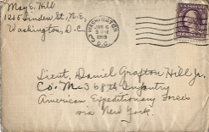



Message Flow
Repeating Timer
World
Deliver Delayed
Agent
Agent
Msg
MSG Router
Msg
Msg
Msg
Manager
Manager
Msg
Msg
HFSM
HFSM
Msg
Msg

Slide 40
Event and Message Flow
Update
World
Update
Deliver Delayed
Agent
Agent
Msg
MSG Router
Msg
Update or Msg
Update or Msg
Manager
Manager
Update or Msg
Update or Msg
HFSM
HFSM
Enter
Exit
Msg
Msg
Enter
Exit

Slide 41
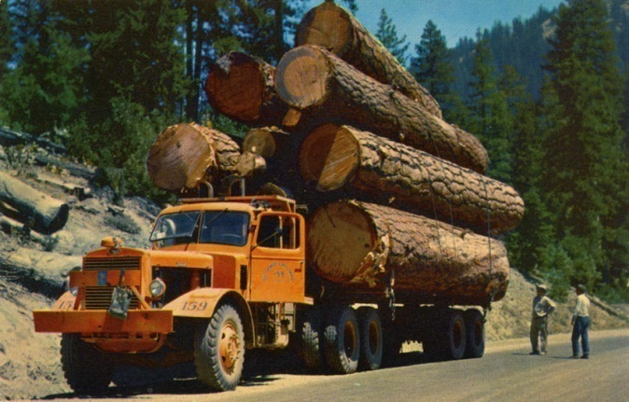
Event and Message Flow:
Everything is Logged in Debug Mode
Update
World
Update
Deliver Delayed
Agent
Agent
Msg
MSG Router
Msg
Update or Msg
Update or Msg
Manager
Manager
Update or Msg
Update or Msg
HFSM
HFSM
Enter
Exit
Msg
Msg
Enter
Exit

Slide 42

Load Balancing
World
Deliver Delayed
Agent
Deliver Ready
Msgs While
Still Time Left
Msg
MSG Router
Msg
Manager
State( Attack )
OnPeriodicTimeInState( 1.0 )
Think();
Msg
HFSM
Msg

Slide 43
Load Balancing
World
Deliver Delayed
Agent
Msg
MSG Router
Msg
Manager
Msg
Msgs Should Always
Be Delayed By a Little
To Avoid a Frame Hitch
HFSM
Msg

Slide 44
Events Based on
Load Balanced Messages
State( Attack )
OnUpdate
//not load balanced
OnPeriodicTimeInState ( 0.1 )
//load balanced
//code to execute every 0.1 seconds
OnTimeInState( 5.0 )
//load balanced
//code to execute after 5s in state

Slide 45
Sending Messages to Yourself:
Duplicate Message Policy
State( Attack )
OnPeriodicTimeInState( 0.1s )
if( SeeEnemy() )
SendMsgToMe( 1.0s, RunAway )
OnMsg( RunAway )
ChangeState( RunAway )

Slide 46
Sending Messages to Yourself:
The Need for Time Scoping
State( Attack )
OnEnter
SendMsgToMe( 5.0s, TimeOut )
OnMsg( TimeOut )
ChangeState( RunAway )
OnMsg( HealthLow )
ChangeState( RunAway )
State( RunAway )
OnMsg( TimeOut )
ChangeState( Attack )

Slide 47
Sending Messages to Yourself:
Message Scoped to Instance of State
State( Attack )
OnEnter
SendMsgToState( 5.0s, TimeOut )
OnMsg( TimeOut )
ChangeState( RunAway )
OnMsg( HealthLow )
ChangeState( RunAway )
State( RunAway )
OnMsg( TimeOut )
ChangeState( Attack )

Slide 48
Mashup Idea
State Machine as 1st class C++ enforced language feature
Pros
  Easy to read and write
  Debugging in C++
    Full power of debugger (breakpoints, etc)
Cons
  Not designer friendly
  Can’t be loaded at runtime (must be compiled)

Slide 49
C++ State Machine Code
DeclareState( Attack )
OnEnter
//real C++
OnPeriodicTimeInState( 0.1s )
//real C++
OnMsg( SomeMessage )
//real C++
OnExit
//real C++

Slide 50
C++ State Machine Code
BeginStateMachine
DeclareState( Wander )
OnPeriodicTimeInState( 0.1 )
Wander();
if( SeeEnemy() ) ChangeState( Attack );
OnMsg( Attacked )
ChangeState( Attack );
DeclareState( Attack )
OnEnter
PrepareWeapon();
OnPeriodicTimeInState( 0.1 )
Attack();
OnMsg( LowHealth )
ChangeState( RunAway );
OnMsg( TargetLost )
ChangeState( RunAway );
DeclareState( RunAway )
OnPeriodicTimeInState( 0.1 )
RunAway();
if( NoEnemies() ) ChangeState( Wander );
EndStateMachine

Slide 51
C++ State Machine Code
BeginStateMachine
State( STATE_Name )
OnEnter
//C++ code 1
OnMsg( MSG_Name )
//C++ code 2
EndStateMachine
if( state < 0 ) {
if(0) {
return( true );
}
} else if( STATE_Name == state ) {
if(0) {
return( true );
} else if( EVENT_Enter == event ) {
//C++ code 1
return( true );
} else if( EVENT_Message == event &&
MSG_Name == msg->GetMsgName() ) {
//C++ code 2
return( true );
}
} else {
assert( 0 && "Invalid State" );
return( false );
}
return( false );

Slide 52
State-of-the-Art
State Machines
Hierarchical Finite-State Machine (HFSM)
  Push/Pop/Replace State Machine
OnEnter, OnExit, OnUpdate, OnEvery(Xs)
PopState (option stack design pattern)

Slide 53
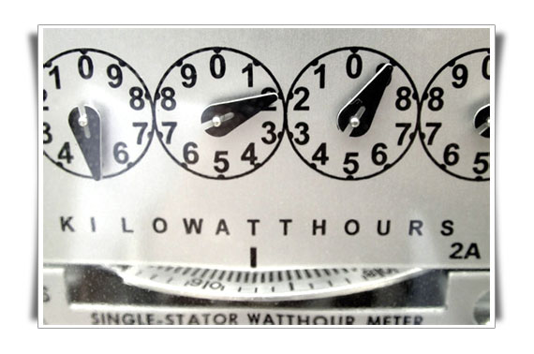
Utility

Slide 54

Utility
Score choices to choose the best
Utility score is NOT value
Do I want:
  $4.99 cat toy – 2 days to be delivered
  $2.99 cat toy – 5 days to be delivered

Slide 55
Expected Utility
Utility Scores are Normalized: [0, 1]
  Makes scores comparable
Expected Utility
  Utility * Probability
Maximum Expected Utility
  Choose one with highest Expected Utility

Slide 56


Expected Utility
Attack with dagger
  Utility: 0.4
  Probability of hit: 95%
  Attack with dagger: 0.4 x 0.95 = 0.38
Attack with two handed sword
  Utility: 0.9
  Probability of hit: 60%
  Attack with sword: 0.9 x 0.60 = 0.54

Slide 57
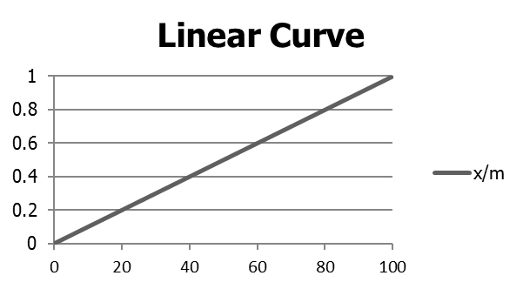
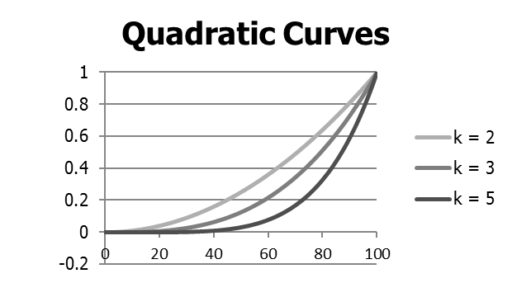
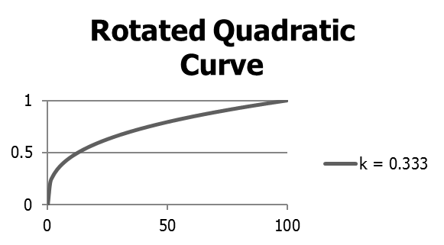
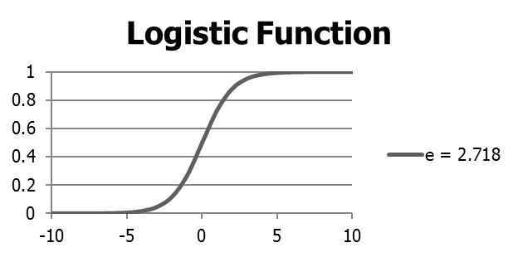
Transforming Utility with
Response Curves

Slide 58
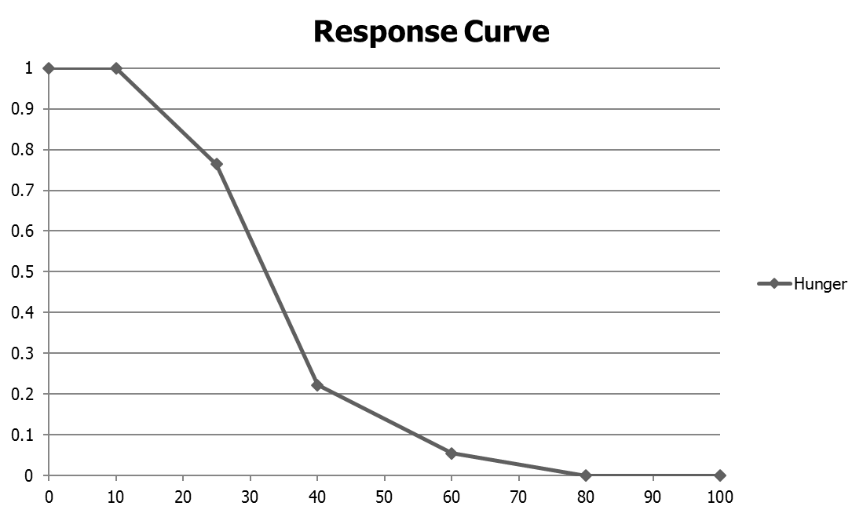
Transforming Utility with
Response Curves

