Slide 1
Artificial Intelligence in Games
Week 3.5
Movement and Philosophy of AI
CLASS WEBSITE: gameaipro.com/digipen
STEVE RABIN (steve.rabin@gmail.com)
TA: CHI-HAO KUO (chihao.kuo@digipen.edu)

Slide 2

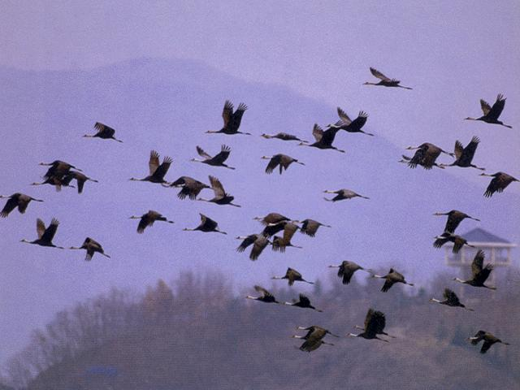
Flocking

Slide 3
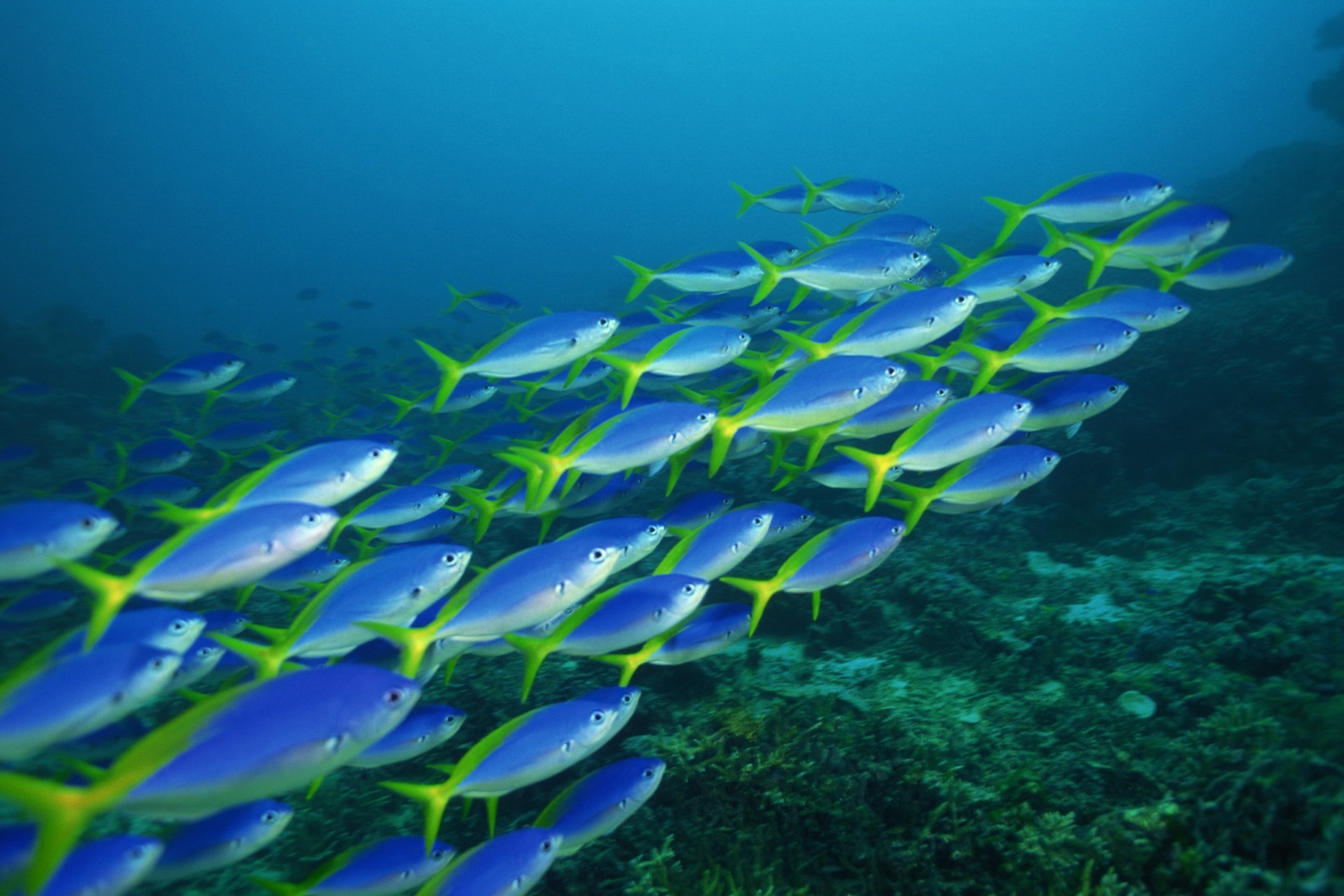
Flocking

Slide 4
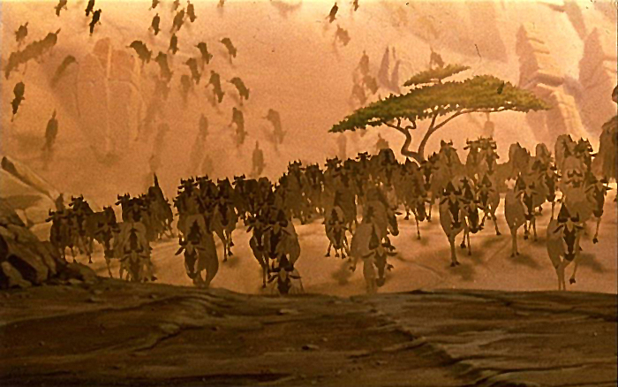
Flocking

Slide 5
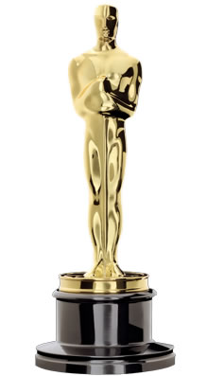

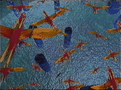
Flocking
First demonstrated by Craig Reynolds in his 1987 SIGGRAPH paper and movie
  “Flocks, Herds, and Schools: A Distributed Behavior Model”
  Film: Stanley and Stella in "Breaking the Ice"
1997
Scientific and Technical Award

Slide 6
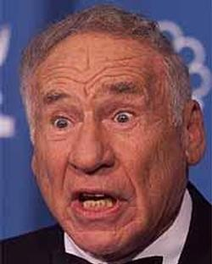
Boids
“The name had three influences. One was based on a Brooklyn accent, particularly this scene from Mel Brooks' original 1968 film The Producers:”
  “You used to be able to sit on the stoop like a normal person, but not any more, ‘cause of da BOIDS. Dirty, lousy, stinkin’ BOIDS.”

Slide 7
Boids
“Another was a very early (~1978?) 3D modeling/rendering system built by Tom Duff (then of the pioneering Graphics Lab of New York Institute of Technology, now at Pixar). The basic modeling primitive of Tom's system were arbitrary ellipsoids in 3D. He called the system "soids" which I thought was a cool sounding name.”

Slide 8
Boids
“The least fanciful aspect of the name was that the individuals in my flocks were meant to simulation a small part of a real bird's behavioral repertoire, so they were "bird-like autonomous agents". I briefly considered calling them bird-oid, but for the two reasons above I quickly slipped into calling them "boids".”
-Craig Reynolds (personal email May 24, 2013)

Slide 9
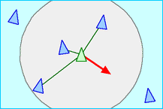
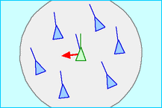
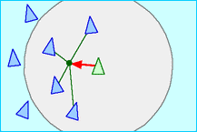
Flocking: 3 Simple Rules
Separation
Alignment
Cohesion

Slide 10
Flocking: 3 Other Rules
  Obstacle avoidance
  Changing goals
  Wandering
Also, each boid should have random properties (within a small range)
  Speed
  Acceleration

Slide 11
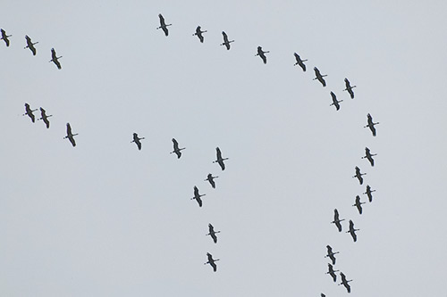
How do you get this?

Slide 12
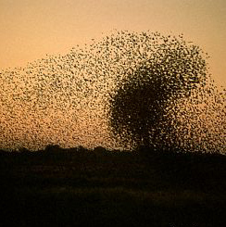
Swarms
  Just Cohesion?
  Some Alignment?
  Any Separation?

Slide 13
Swarm Intelligence
Technique based on collective behavior in decentralized, self-organized systems
  Beni & Wang (1989)
Simple agents interact locally
Global behavior emerges
  Ant colonies, bird flocking, animal herding
Swarm Robotics
  Combining swarm intelligence with robotics

Slide 14
Swarm Intelligence
U.S. military
  Swarm techniques for controlling unmanned vehicles
  Strategic Defense Initiative (tiny pebbles = satellite-based lasers)
NASA
  Swarm technology for planetary mapping
Medical
  Kill cancer tumors with swarming nanobots (1992 paper by M. Anthony Lewis and George A. Bekey)
Movies
  Flocking in Disney's The Lion King was the first movie to make use of swarm technology (the stampede scene).
  Lord of the Rings used emergent behavior during the battle scenes.
Benefits of swarm technology
  Cheap, robust, and simple

Slide 15
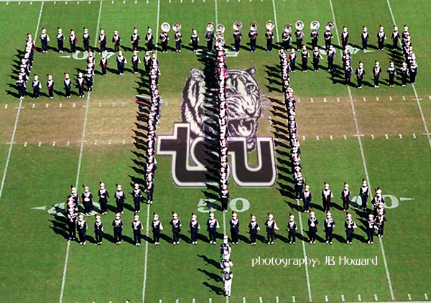
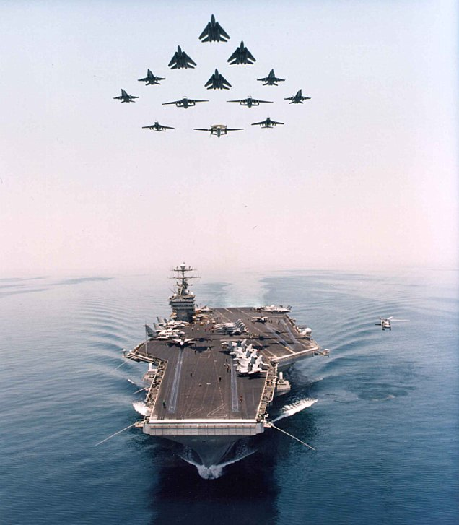
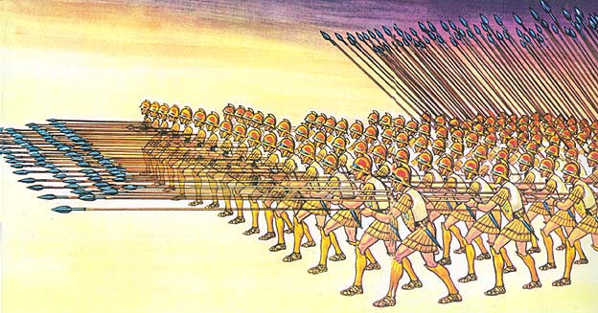
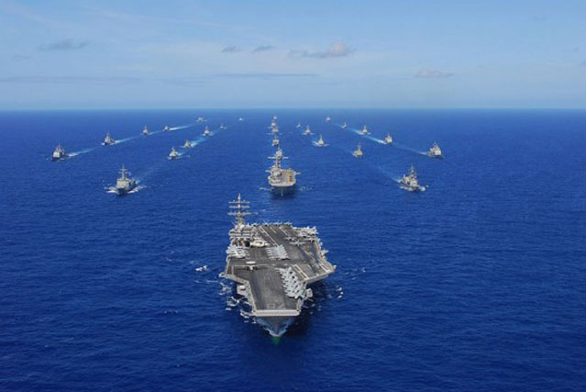
Formations
  Mimics military formations
  How is it similar to flocking?
  How is it different from flocking?

Slide 16
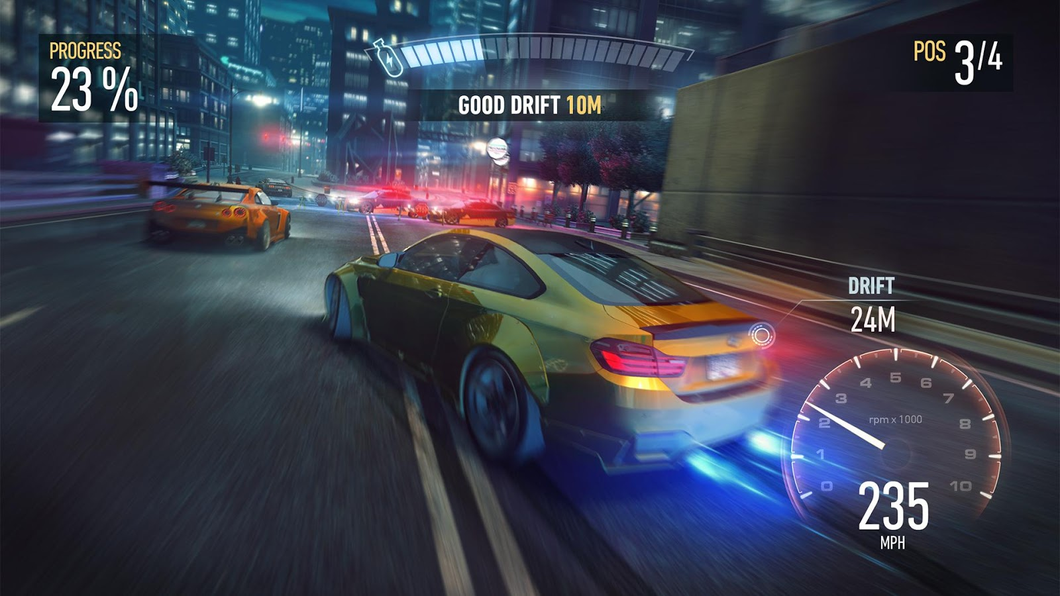
PID Controller for Steering
  Proportional-Integral-Derivative
  Feedback-based algorithm
  50 year old technique
Used in most car racing games to steer cars

Slide 17
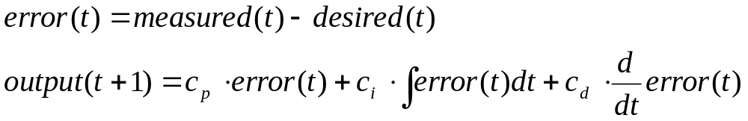
PID Controller for Steering
1st term is proportional to the current error
2nd term is proportional to the integral of the error
3rd term is proportional to the derivative of the error

Slide 18
PID Controller for Steering
1st is value of current error
2nd is last several values of the error, multiplied by their time-steps, and all added up
3rd is approximated by taking the current error, subtracting previous error, and dividing by time-step

