Slide 1
Artificial Intelligence in Games
Week 4
Pathfinding
CLASS WEBSITE: gameaipro.com/digipen
STEVE RABIN (steve.rabin@gmail.com)
TA: CHI-HAO KUO (chihao.kuo@digipen.edu)

Slide 2
Questions
Name as many steering behaviors as you can.
What does group emergent behavior emerge from?
Flow fields work best in what kind of environments?
Flocking: What are the individual agents called?
Flocking: Name the 3 primary steering behaviors.
Flocking: Name the other 3 helpful steering behaviors.
Flocking: How is the leader chosen?
Formations: Describe the 2 levels of steering.

Slide 3
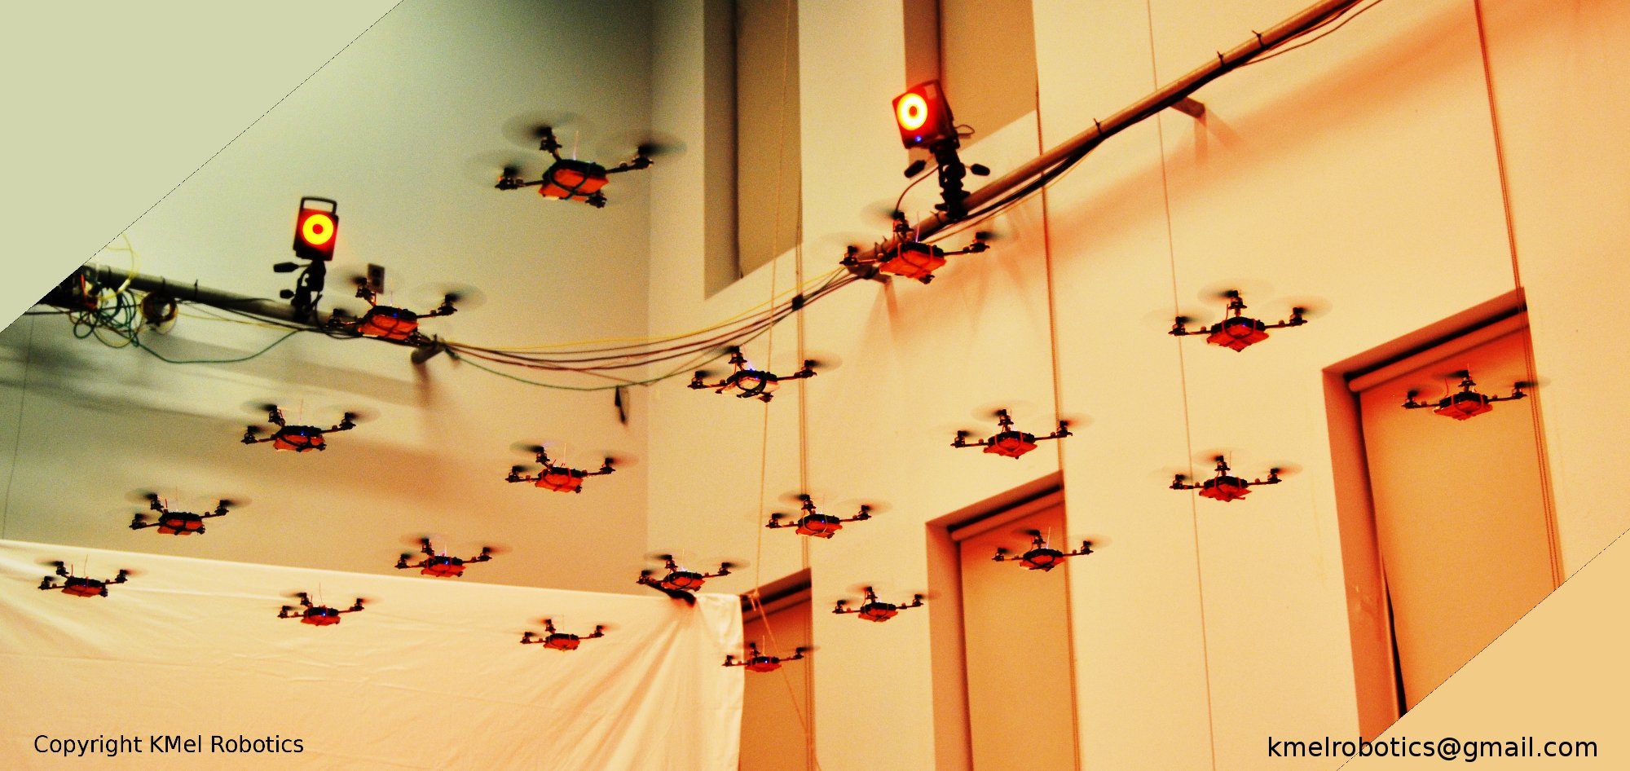
Swarm of Nano Quadcopters
http://www.youtube.com/watch?v=YQIMGV5vtd4

Slide 4
News Flash!!!
“Cars may one day mimic fish to avoid collisions”
Dateline: Thu Oct 1, 6:06 AM
http://ca.news.yahoo.com/s/afp/091001/oddities/japan_auto_technology_offbeat

Slide 5

“Cars may one day mimic fish to avoid collisions”
TOKYO (AFP) - Engineers in Japan say they are a step closer to developing technology they hope will cut the risk of car crashes -- by mimicking the behavior of fish.
The experts at Nissan Motor have been studying fish and the way they are able to swim in schools and avoid colliding with each other.

Slide 6

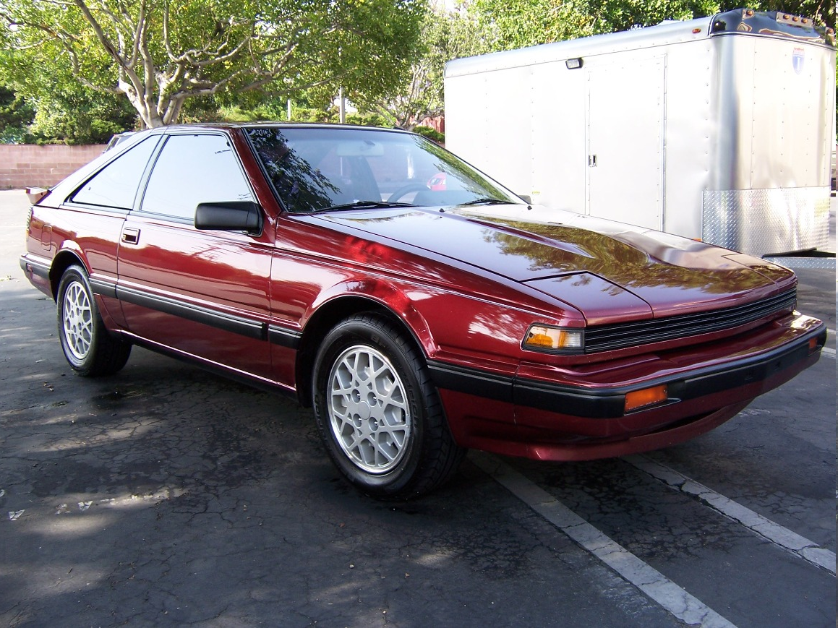
Nissan:
Welcome back to 1987!!!

Slide 7
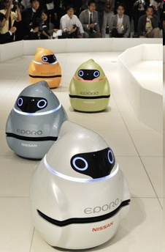
“Cars may one day mimic fish to avoid collisions”
The result is a robot that can travel in a group of up to seven, avoiding bumps by sharing information with its peers.
The firm hopes to use the technology in its vehicles in future.
The three-wheeled robot uses a laser range finder, which measures the distance to an obstacle, and radio communications to recreate the behavior of fish, which can change direction and travel side by side without colliding.

Slide 8
“Cars may one day mimic fish to avoid collisions”
Last year Nissan unveiled a similar robot inspired by the bumblebee, which is also highly adept at avoiding collisions but travels solo.
"We, in a motorized world, have a lot to learn from the behavior of a school of fish in terms of each fish's degree of freedom and safety," said Toshiyuki Andou, the principal engineer in the project.
By sharing information, the group can travel safely, changing its shape as needed, Andou said.
Nissan will demonstrate the technology at the CEATEC electronics trade fair in Japan next week.

Slide 9
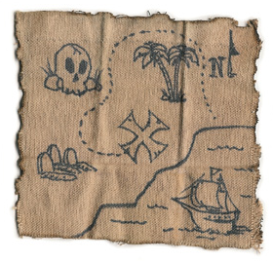
Planned Movement
Define a search space representation
Apply a search algorithm to find a path
Post-process path
Agent follows path

Slide 10
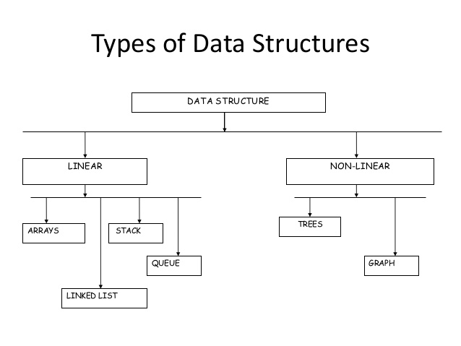
Search Space Representations

Slide 11
Search Space Representations
Types of Graphs?
Types of Trees?

Slide 12
Search Space Representations
  Grids
  Quadtree / Octree
  Waypoint graphs
  Corner graphs
  Circle-based waypoint graphs
  Navigation meshes

Slide 13
Important Questions to Ask
How well does the search space scale?
  Larger search space = slower search
Who makes the search space?
  Level Designer or Algorithm?
Does the search space represent
  Safe paths?
  Safe walkable areas?
2D or 3D?

Slide 14
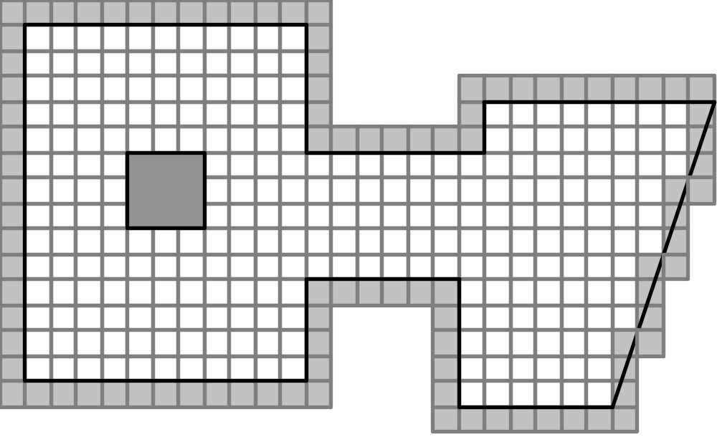
Grids

Slide 15
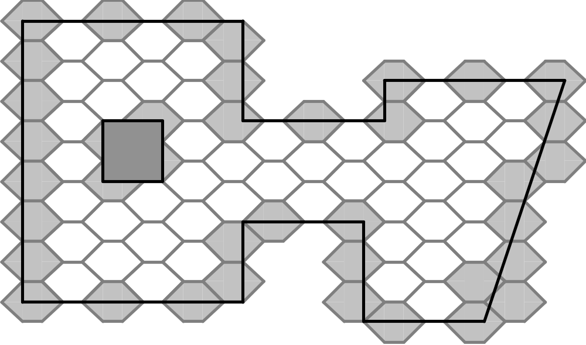
Grids

Slide 16
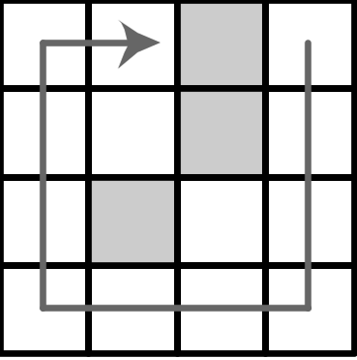
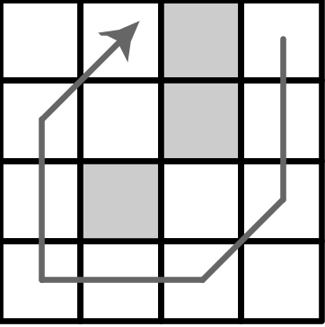
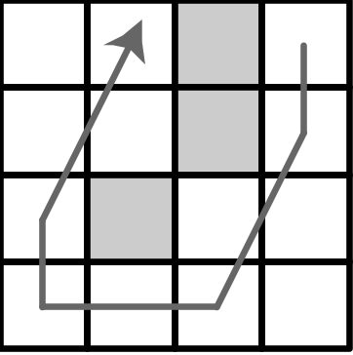
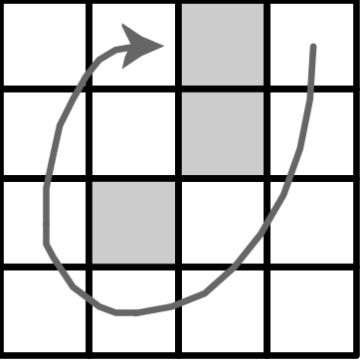
Grids

Slide 17
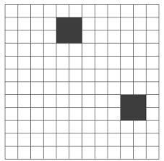

Quadtrees

Slide 18
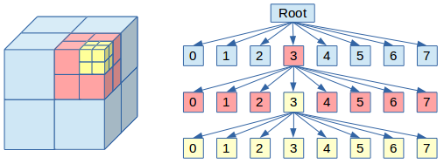
Octrees

Slide 19
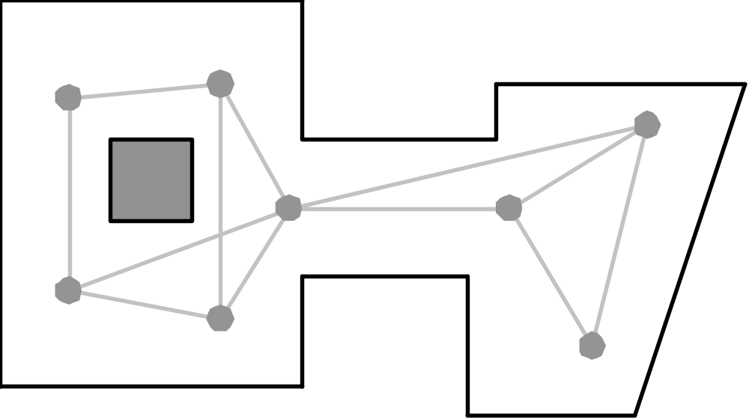
Waypoint Graphs

Slide 20
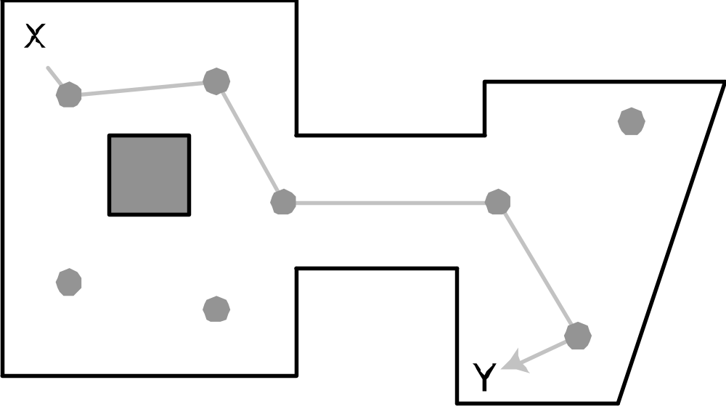
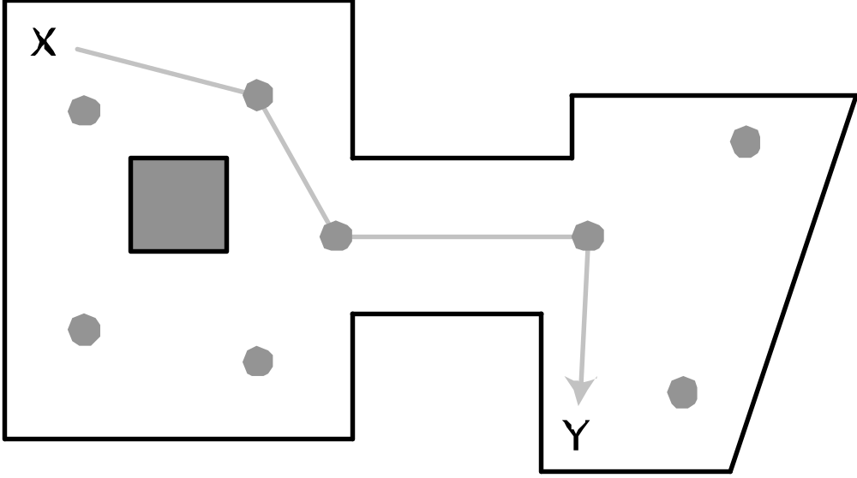
Waypoint Graphs

Slide 21
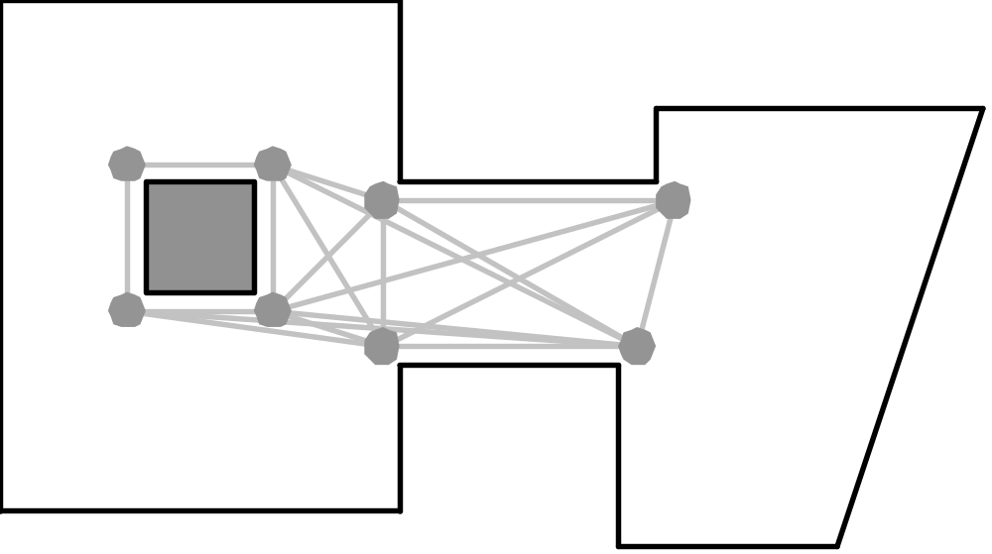
Corner Graphs (Points of Visibility)

Slide 22
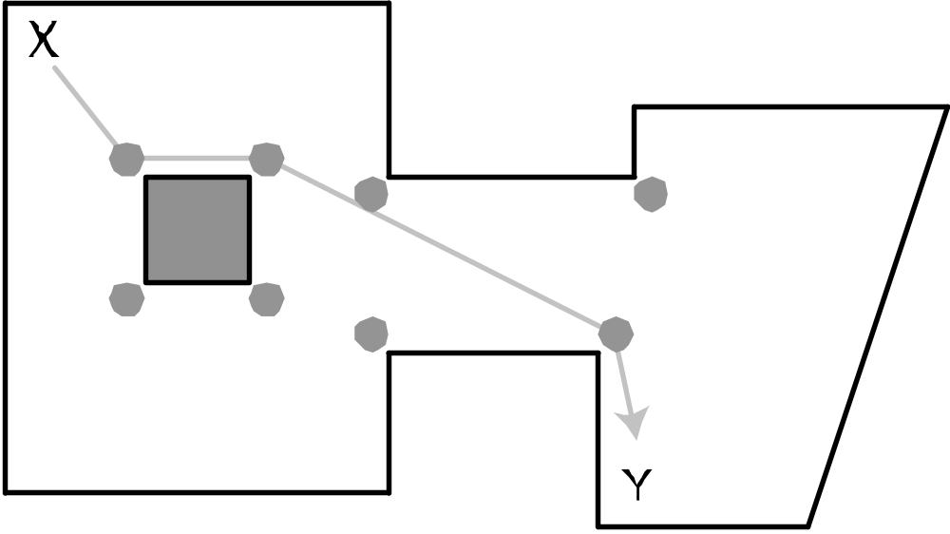
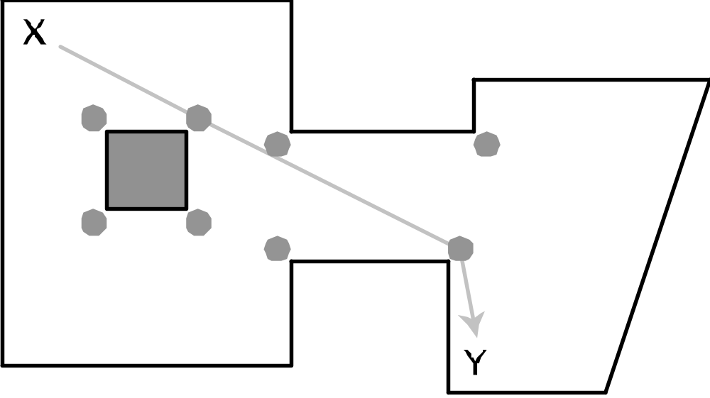
Corner Graphs (Points of Visibility)

Slide 23
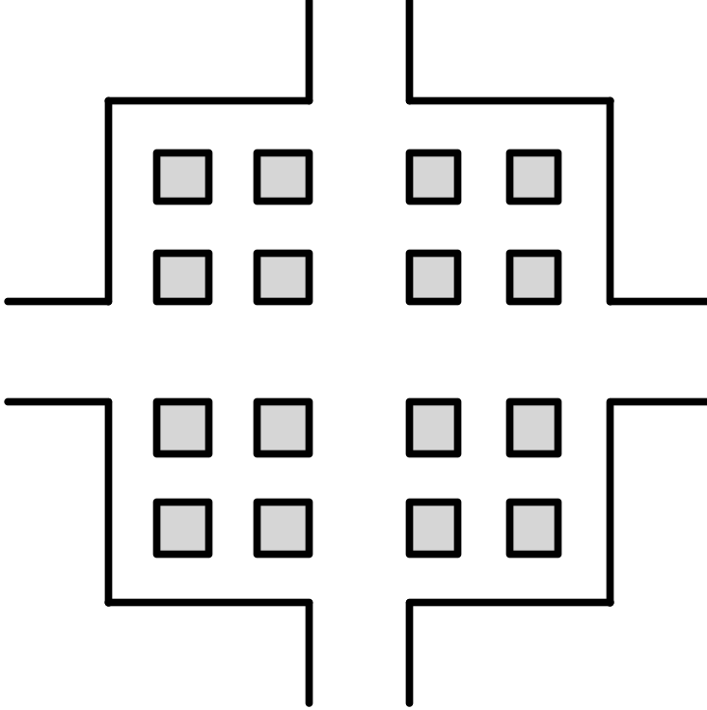
Corner Graphs (Points of Visibility)

Slide 24
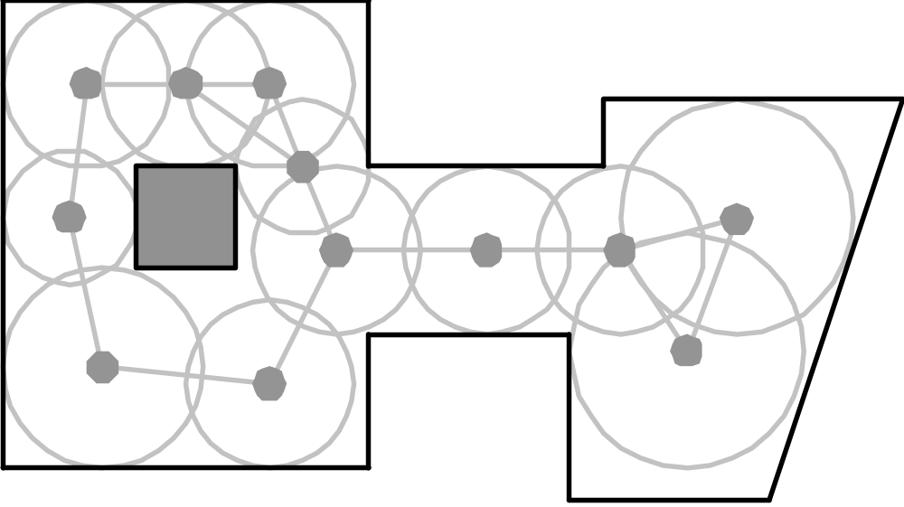
Circle-Based Waypoint Graph

Slide 25
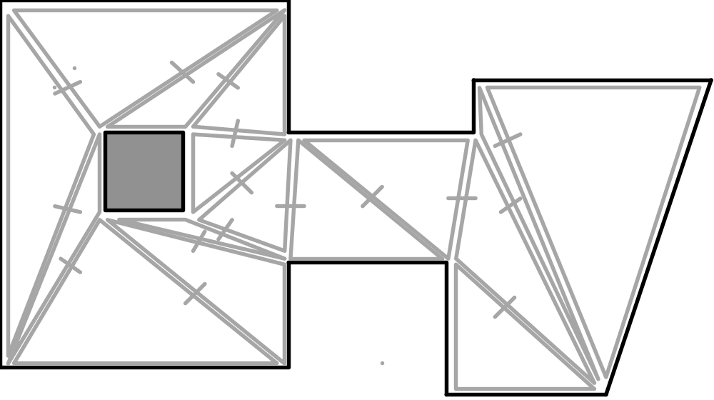
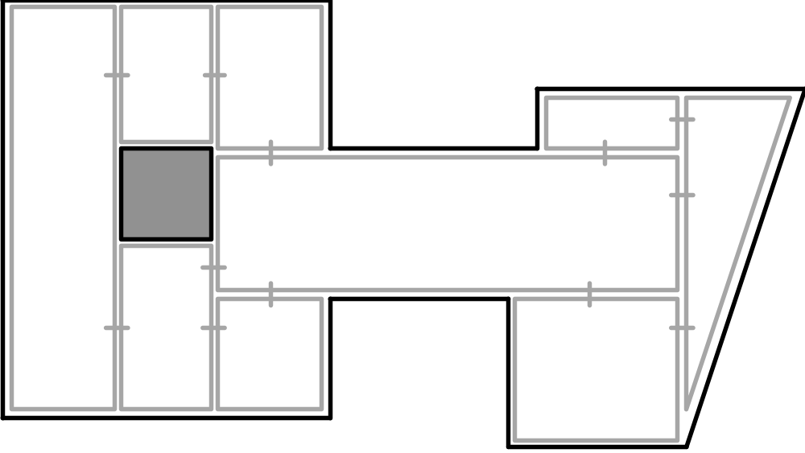
Navigation Meshes (Nav Mesh)

Slide 26
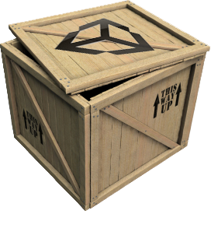
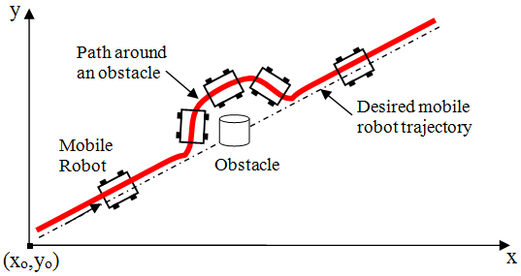
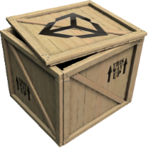
Local Obstacle Avoidance

Slide 27
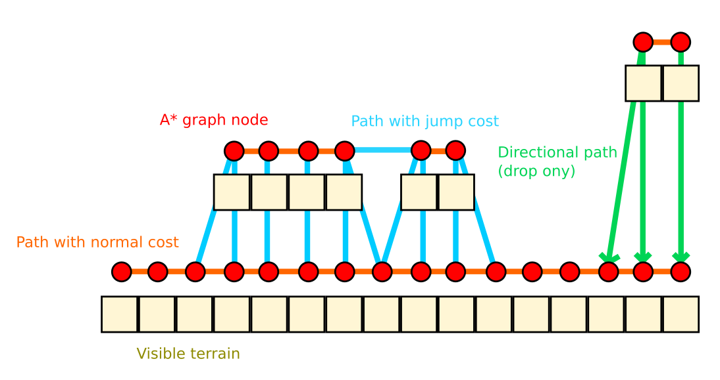
Ledges and Jumps

Slide 28
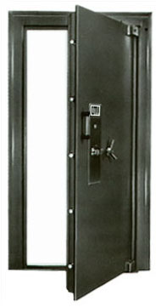
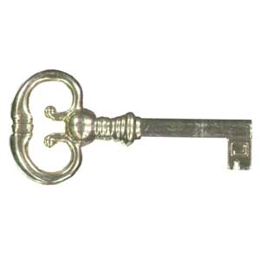
Doors, Elevators, etc.
Smart pathfinding nodes
  Annotated with required action

Slide 29
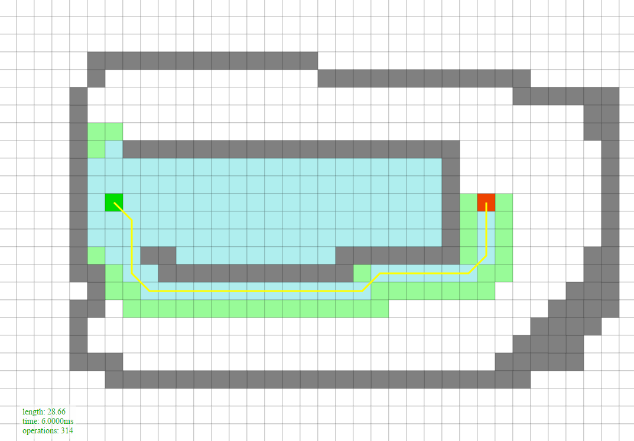
Search

Slide 30
Judging Search Algorithms
Quality of path
  Shortest?
  Optimal, near-optimal, or a reasonable path
Resource requirements
  CPU, memory
Completeness
  Will find a path if one exists

Slide 31
Pathfinding Search Algorithms
  Random Bounce
  Robust Trace
  Breadth-First
  Depth-First
  Dijkstra
  Greedy Best-First
  A*
  Jump Point Search
  JPS+
  JPS+ w/ Goal Bounding
  Roy-Floyd-Warshall

Slide 32
Open and Closed Lists
  Open List
      Promising nodes not yet explored
  Closed List
      Nodes already explored

Slide 33
Grid Search Space: Node Structure
  Node* parent; // Parent (in general)
  float cost; // Total cost

Slide 34
Grid Search Space: Node Structure
  int xParent, yParent; // Parent (grid only)
  float cost; // Total cost
  float given; // Given cost (A*)
  enum onList; // On open/closed list?
  unsigned int iteration; // Valid data?

Slide 35
Search Algorithm Structure
1. Push Start Node onto the Open List
2. While (Open List not empty)
a. Pop a node from the Open List (parent node)
b. If node is Goal Node, then return path
c. Find neighboring child nodes and score them
d. Conditionally add them to the Open List
e. Place parent node on the Closed List

Slide 36
PathDemo

Slide 37
A*
Combines Dijkstra and Greedy Best-First
  Given cost and Heuristic cost
Open List sorted by:
  Final cost = Given cost + Heuristic cost
  f(x) = g(x) + h(x)
  Final cost = Given cost + (Heuristic cost * weight)
  f(x) = g(x) + (h(x) * weight)

Slide 38
A*
Completeness
Heuristic Search
Admissible heuristic = Optimal path

