Slide 1
Artificial Intelligence in Games
Week 4.5
Pathfinding
CLASS WEBSITE: gameaipro.com/digipen
STEVE RABIN (steve.rabin@gmail.com)
TA: CHI-HAO KUO (chihao.kuo@digipen.edu)

Slide 2
A* Algorithm
Push Start Node onto the Open List
While (Open List is not empty) {
  Pop cheapest node off Open List (parent node)
  If node is the Goal Node, then path found (RETURN “found”)
  For (all neighboring child nodes) {
    Compute its cost, f(x) = g(x) + h(x)
    If child node isn’t on Open or Closed list, put it on Open List.
    If child node is on Open or Closed List, AND this new one is cheaper,
    then take the old expensive one off both lists and put this new cheaper one on the Open List.
  }
  Place parent node on the Closed List (we’re done with it)
  If taken too much time this frame (or in single step mode),
  abort search for now and resume next frame (RETURN “working”)
  }
  Open List empty, thus no path possible (RETURN “fail”)

Slide 3
Exit Points
Push Start Node onto the Open List
While (Open List is not empty) {
  Pop cheapest node off Open List (parent node)
  If node is the Goal Node, then path found (RETURN “found”)
  For (all neighboring child nodes) {
    Compute its cost, f(x) = g(x) + h(x)
    If child node isn’t on Open or Closed list, put it on Open List.
    If child node is on Open or Closed List, AND this new one is cheaper,
    then take the old expensive one off both lists and put this new cheaper one on the Open List.
  }
  Place parent node on the Closed List (we’re done with it)
  If taken too much time this frame (or in single step mode),
  abort search for now and resume next frame (RETURN “working”)
  }
  Open List empty, thus no path possible (RETURN “fail”)

Slide 4
Push Start Node onto the Open List
While (Open List is not empty) {
  Pop cheapest node off Open List (parent node)
  If node is the Goal Node, then path found (RETURN “found”)
  For (all neighboring child nodes) {
    Compute its cost, f(x) = g(x) + h(x)
    If child node isn’t on Open or Closed list, put it on Open List.
    If child node is on Open or Closed List, AND this new one is cheaper,
    then take the old expensive one off both lists and put this new cheaper one on the Open List.
  }
  Place parent node on the Closed List (we’re done with it)
  If taken too much time this frame (or in single step mode),
  abort search for now and resume next frame (RETURN “working”)
  }
  Open List empty, thus no path possible (RETURN “fail”)

Slide 5
Push Start Node onto the Open List
While (Open List is not empty) {
  Pop cheapest node off Open List (parent node)
  If node is the Goal Node, then path found (RETURN “found”)
  For (all neighboring child nodes) {
    Compute its cost, f(x) = g(x) + h(x)
    If child node isn’t on Open or Closed list, put it on Open List.
    If child node is on Open or Closed List, AND this new one is cheaper,
    then take the old expensive one off both lists and put this new cheaper one on the Open List.
  }
  Place parent node on the Closed List (we’re done with it)
  If taken too much time this frame (or in single step mode),
  abort search for now and resume next frame (RETURN “working”)
  }
  Open List empty, thus no path possible (RETURN “fail”)

Slide 6
Push Start Node onto the Open List
While (Open List is not empty) {
  Pop cheapest node off Open List (parent node)
  If node is the Goal Node, then path found (RETURN “found”)
  For (all neighboring child nodes) {
    Compute its cost, f(x) = g(x) + h(x)
    If child node isn’t on Open or Closed list, put it on Open List.
    If child node is on Open or Closed List, AND this new one is cheaper,
    then take the old expensive one off both lists and put this new cheaper one on the Open List.
  }
  Place parent node on the Closed List (we’re done with it)
  If taken too much time this frame (or in single step mode),
  abort search for now and resume next frame (RETURN “working”)
  }
  Open List empty, thus no path possible (RETURN “fail”)

Slide 7
Push Start Node onto the Open List
While (Open List is not empty) {
  Pop cheapest node off Open List (parent node)
  If node is the Goal Node, then path found (RETURN “found”)
  For (all neighboring child nodes) {
    Compute its cost, f(x) = g(x) + h(x)
    If child node isn’t on Open or Closed list, put it on Open List.
    If child node is on Open or Closed List, AND this new one is cheaper,
    then take the old expensive one off both lists and put this new cheaper one on the Open List.
  }
  Place parent node on the Closed List (we’re done with it)
  If taken too much time this frame (or in single step mode),
  abort search for now and resume next frame (RETURN “working”)
  }
  Open List empty, thus no path possible (RETURN “fail”)

Slide 8
Push Start Node onto the Open List
While (Open List is not empty) {
  Pop cheapest node off Open List (parent node)
  If node is the Goal Node, then path found (RETURN “found”)
  For (all neighboring child nodes) {
    Compute its cost, f(x) = g(x) + h(x)
    If child node isn’t on Open or Closed list, put it on Open List.
    If child node is on Open or Closed List, AND this new one is cheaper,
    then take the old expensive one off both lists and put this new cheaper one on the Open List.
  }
  Place parent node on the Closed List (we’re done with it)
  If taken too much time this frame (or in single step mode),
  abort search for now and resume next frame (RETURN “working”)
  }
  Open List empty, thus no path possible (RETURN “fail”)

Slide 9
Push Start Node onto the Open List
While (Open List is not empty) {
  Pop cheapest node off Open List (parent node)
  If node is the Goal Node, then path found (RETURN “found”)
  For (all neighboring child nodes) {
    Compute its cost, f(x) = g(x) + h(x)
    If child node isn’t on Open or Closed list, put it on Open List.
    If child node is on Open or Closed List, AND this new one is cheaper,
    then take the old expensive one off both lists and put this new cheaper one on the Open List.
  }
  Place parent node on the Closed List (we’re done with it)
  If taken too much time this frame (or in single step mode),
  abort search for now and resume next frame (RETURN “working”)
  }
  Open List empty, thus no path possible (RETURN “fail”)

Slide 10
Push Start Node onto the Open List
While (Open List is not empty) {
  Pop cheapest node off Open List (parent node)
  If node is the Goal Node, then path found (RETURN “found”)
  For (all neighboring child nodes) {
    Compute its cost, f(x) = g(x) + h(x)
    If child node isn’t on Open or Closed list, put it on Open List.
    If child node is on Open or Closed List, AND this new one is cheaper,
    then take the old expensive one off both lists and put this new cheaper one on the Open List.
  }
  Place parent node on the Closed List (we’re done with it)
  If taken too much time this frame (or in single step mode),
  abort search for now and resume next frame (RETURN “working”)
  }
  Open List empty, thus no path possible (RETURN “fail”)

Slide 11
Push Start Node onto the Open List
While (Open List is not empty) {
  Pop cheapest node off Open List (parent node)
  If node is the Goal Node, then path found (RETURN “found”)
  For (all neighboring child nodes) {
    Compute its cost, f(x) = g(x) + h(x)
    If child node isn’t on Open or Closed list, put it on Open List.
    If child node is on Open or Closed List, AND this new one is cheaper,
    then take the old expensive one off both lists and put this new cheaper one on the Open List.
  }
  Place parent node on the Closed List (we’re done with it)
  If taken too much time this frame (or in single step mode),
  abort search for now and resume next frame (RETURN “working”)
  }
  Open List empty, thus no path possible (RETURN “fail”)

Slide 12
Push Start Node onto the Open List
While (Open List is not empty) {
  Pop cheapest node off Open List (parent node)
  If node is the Goal Node, then path found (RETURN “found”)
  For (all neighboring child nodes) {
    Compute its cost, f(x) = g(x) + h(x)
    If child node isn’t on Open or Closed list, put it on Open List.
    If child node is on Open or Closed List, AND this new one is cheaper,
    then take the old expensive one off both lists and put this new cheaper one on the Open List.
  }
  Place parent node on the Closed List (we’re done with it)
  If taken too much time this frame (or in single step mode),
  abort search for now and resume next frame (RETURN “working”)
  }
  Open List empty, thus no path possible (RETURN “fail”)

Slide 13
Push Start Node onto the Open List
While (Open List is not empty) {
  Pop cheapest node off Open List (parent node)
  If node is the Goal Node, then path found (RETURN “found”)
  For (all neighboring child nodes) {
    Compute its cost, f(x) = g(x) + h(x)
    If child node isn’t on Open or Closed list, put it on Open List.
    If child node is on Open or Closed List, AND this new one is cheaper,
    then take the old expensive one off both lists and put this new cheaper one on the Open List.
  }
  Place parent node on the Closed List (we’re done with it)
  If taken too much time this frame (or in single step mode),
  abort search for now and resume next frame (RETURN “working”)
  }
  Open List empty, thus no path possible (RETURN “fail”)

Slide 14
Push Start Node onto the Open List
While (Open List is not empty) {
  Pop cheapest node off Open List (parent node)
  If node is the Goal Node, then path found (RETURN “found”)
  For (all neighboring child nodes) {
    Compute its cost, f(x) = g(x) + h(x)
    If child node isn’t on Open or Closed list, put it on Open List.
    If child node is on Open or Closed List, AND this new one is cheaper,
    then take the old expensive one off both lists and put this new cheaper one on the Open List.
  }
  Place parent node on the Closed List (we’re done with it)
  If taken too much time this frame (or in single step mode),
  abort search for now and resume next frame (RETURN “working”)
  }
  Open List empty, thus no path possible (RETURN “fail”)

Slide 15
Push Start Node onto the Open List
While (Open List is not empty) {
  Pop cheapest node off Open List (parent node)
  If node is the Goal Node, then path found (RETURN “found”)
  For (all neighboring child nodes) {
    Compute its cost, f(x) = g(x) + h(x)
    If child node isn’t on Open or Closed list, put it on Open List.
    If child node is on Open or Closed List, AND this new one is cheaper,
    then take the old expensive one off both lists and put this new cheaper one on the Open List.
  }
  Place parent node on the Closed List (we’re done with it)
  If taken too much time this frame (or in single step mode),
  abort search for now and resume next frame (RETURN “working”)
  }
  Open List empty, thus no path possible (RETURN “fail”)

Slide 16
A* Worksheet

Slide 17
Project Code

Slide 18
Grid Search Space: Node Structure
  int xParent, yParent; // Parent
  float cost; // Total cost
  float given; // Given cost
  enum onList; // On open/closed list?
  unsigned int iteration; // Valid data?
  SMALLER DATA STRUCTURE = FASTER SEARCH

Slide 19
Project 2: Grading
Due Week 6: Thursday 6PM
Absolute requirement:
  Draw the open list of quads as one color, the closed list of quads as another color, draw the final path, and have Tiny follow the path

Slide 20
Project 2: Grading
  (20%) Draw one step of A* each frame (use toggle)
  (15%) A path is always found if it exists (completeness)
  (15%) The path is optimal with a heuristic weight of 1.0
  (15%) The path is optimal with a weight of 0.0, and search grows in a circular pattern
  (5%) The path uses diagonals and doesn't run into corners
  (5%) Calculate heuristic using Euclidean, Octile, Chebyshev, and Manhattan methods (use toggle)
  (5%) Straightline optimization when possible (use toggle)
  (10%) Rubberband final path where possible (use toggle)
  (10%) Smooth using a Catmull-Rom spline (use toggle)
  (-10%) If it crashes at any time

Slide 21
Project 2: Extra Credit
  20% Implement Roy-Floyd-Warshall algorithm
  In addition to A*
  Must offer on-screen button to toggle on/off.
  20% Implement Goal Bounding
  Must offer an on-screen toggle to switch between A* and Goal Bounding. Hook it up to the timing.

Slide 22
Project 2: Extra Credit
10% Be in top 3 fastest class times on an A* search
  A*, Octile, No rubberbanding or smoothing
Beat 10% exe (Rabin) or
Beat 15% exe (Fernando) or
Beat 20% exe (Trent Reed) or
Beat 30% exe (Chi-Hao)

Slide 23
Project 2: WARNING
ONLY PathfindingExampleSolution.exe is the correct solution!
The other exe’s are only there for the speed contest!

Slide 24

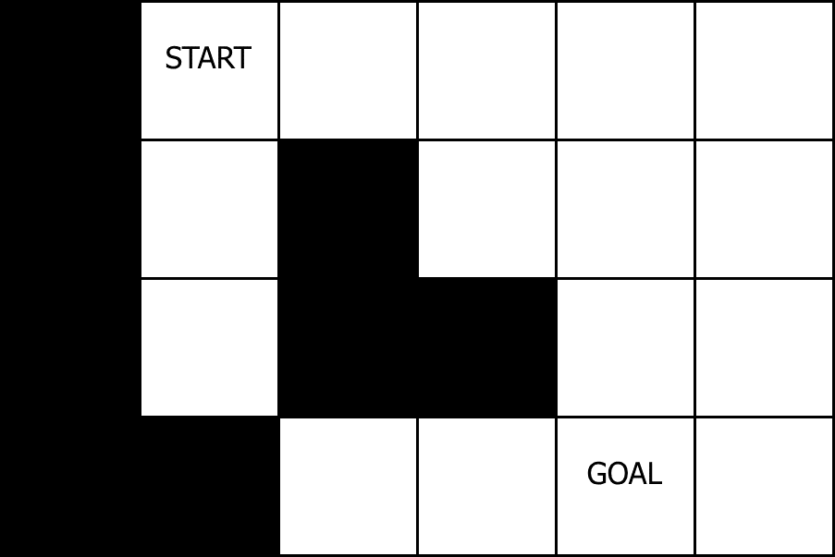
Diagonal Correctness

Slide 25
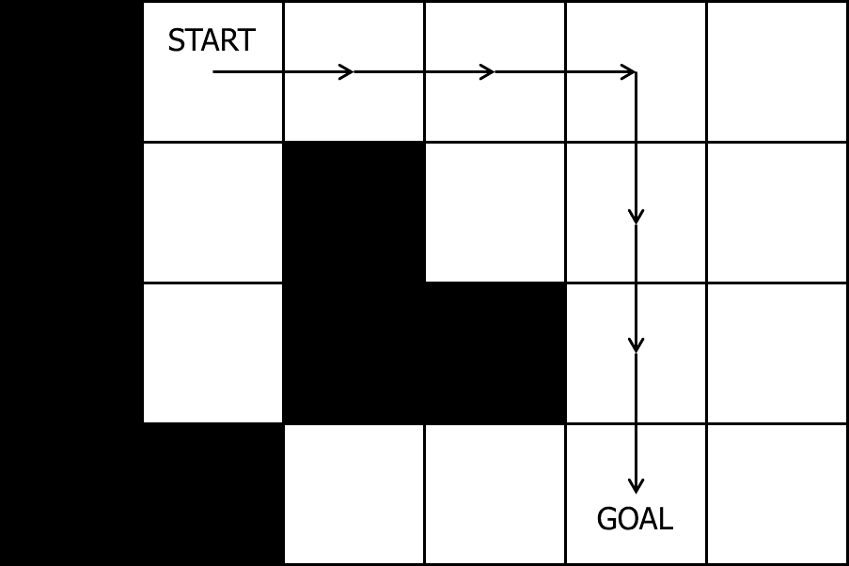
Diagonal Correctness: Wrong

Slide 26
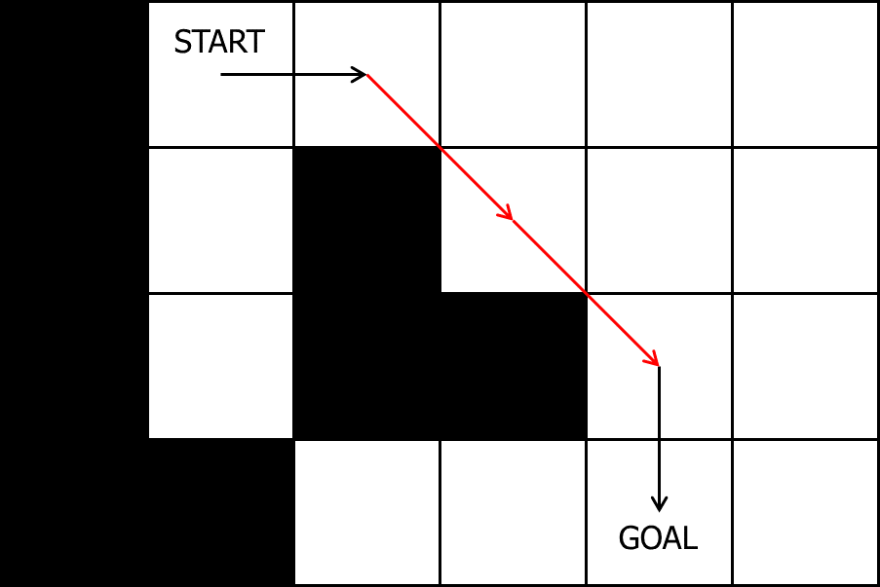
Diagonal Correctness: Wrong

Slide 27
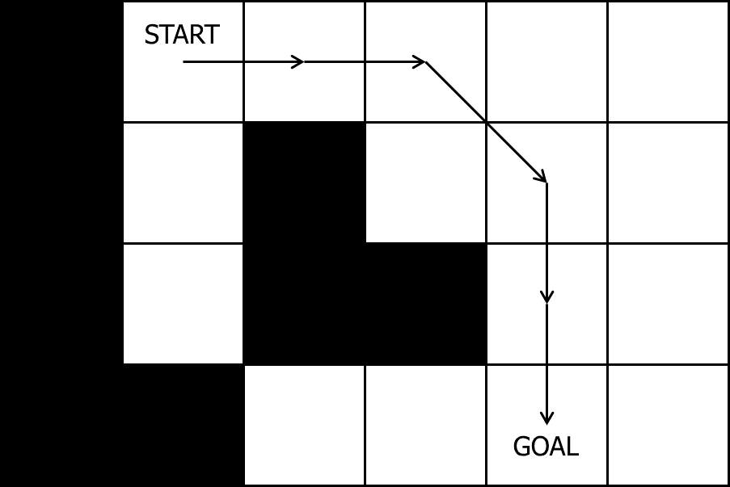
Diagonal Correctness: Correct

Slide 28
Grid Heuristic Calculations

Slide 29
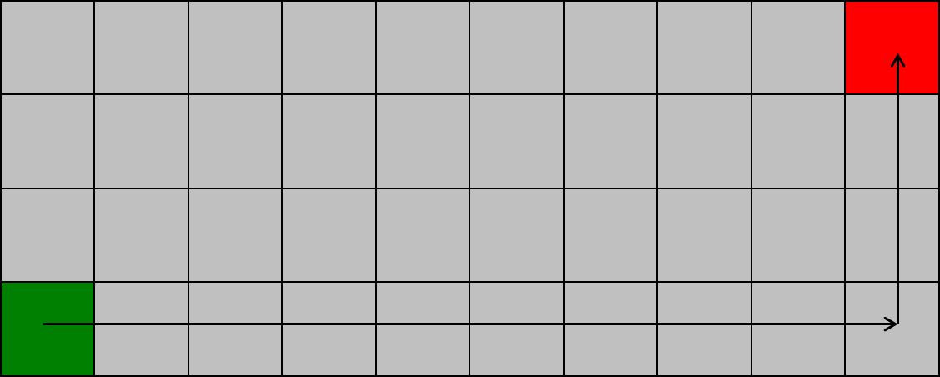
Manhattan distance
xDiff + yDiff = 9 + 3 = 12

Slide 30
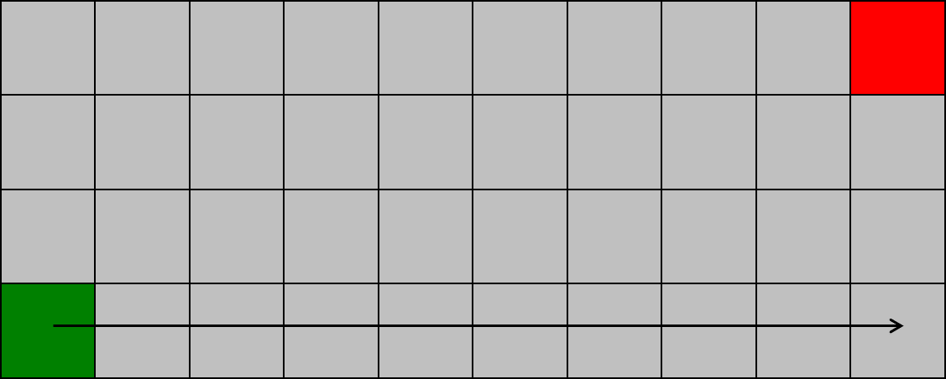
Chebyshev distance
max(xDiff, yDiff) = max(9, 3) = 9

Slide 31
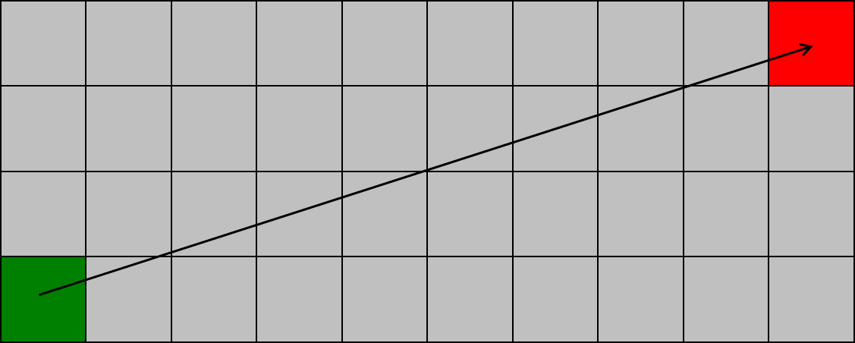
Euclidean distance
sqrt(xDiff² + yDiff²) = sqrt(9² + 3²) = 9.48

Slide 32
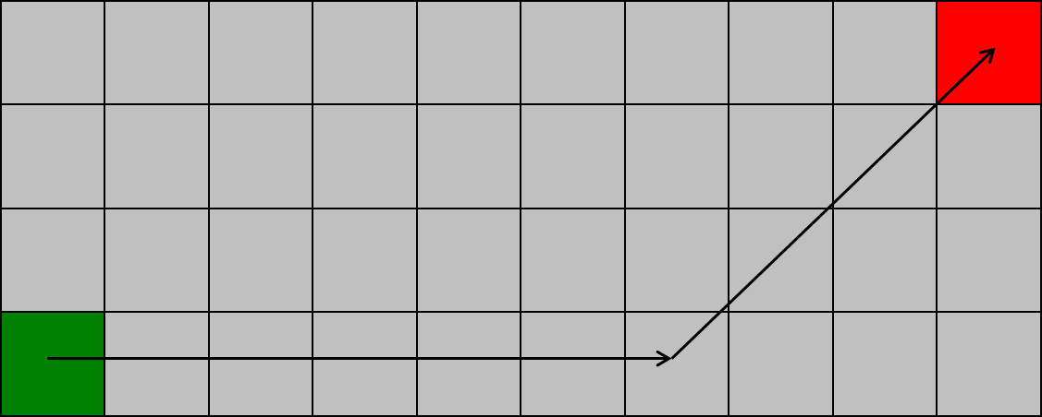
Octile distance
min(xDiff, yDiff) * sqrt(2) + max(xDiff, yDiff) – min(xDiff, yDiff)
min(9, 3) * 1.41 + max(9, 3) – min(9, 3) = 10.24

Slide 33
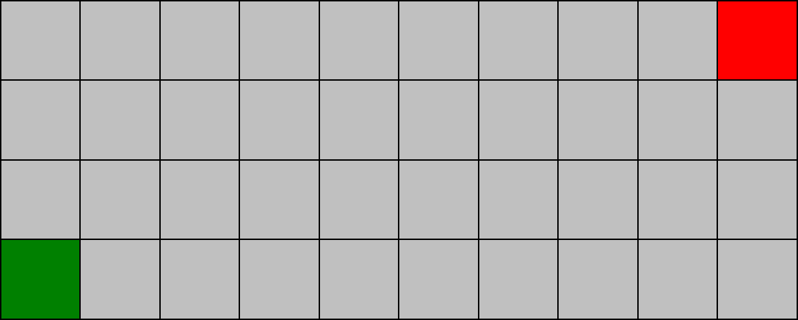
Which is Admissible?
Which is Most Accurate?
Manhattan
Chebyshev
Euclidean
Octile

Slide 34
Which is Admissible?
Which is Most Accurate?
Manhattan = 12
Chebyshev = 9
Euclidean = 9.48
Octile = 10.24

Slide 35
Overestimating the Heuristic Cost
A* combines Dijkstra and Best-First
  Given cost and Heuristic cost
Final cost = Given cost + (Heuristic cost * weight)
  f(x) = g(x) + (h(x) * weight)
Demo

Slide 36
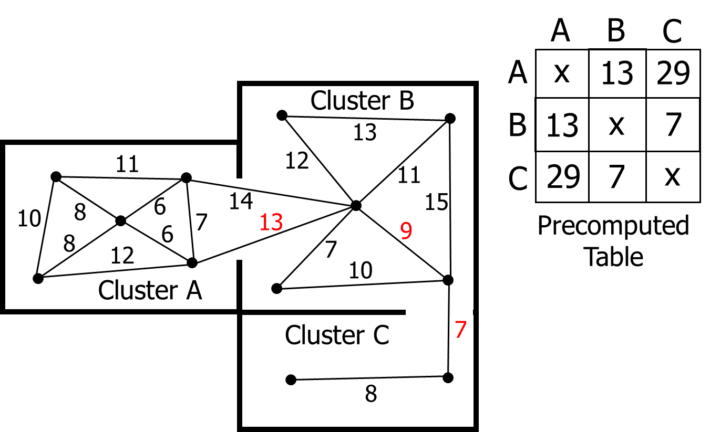
Cluster Heuristic

Slide 37
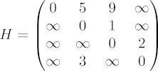
Roy-Floyd-Warshall
All-Pairs Shortest Path
Pre-compute ALL paths
Just look up answer in a table!
1959 Bernard Roy
1962 Robert Floyd
1962 Stephen Warshall

Slide 38
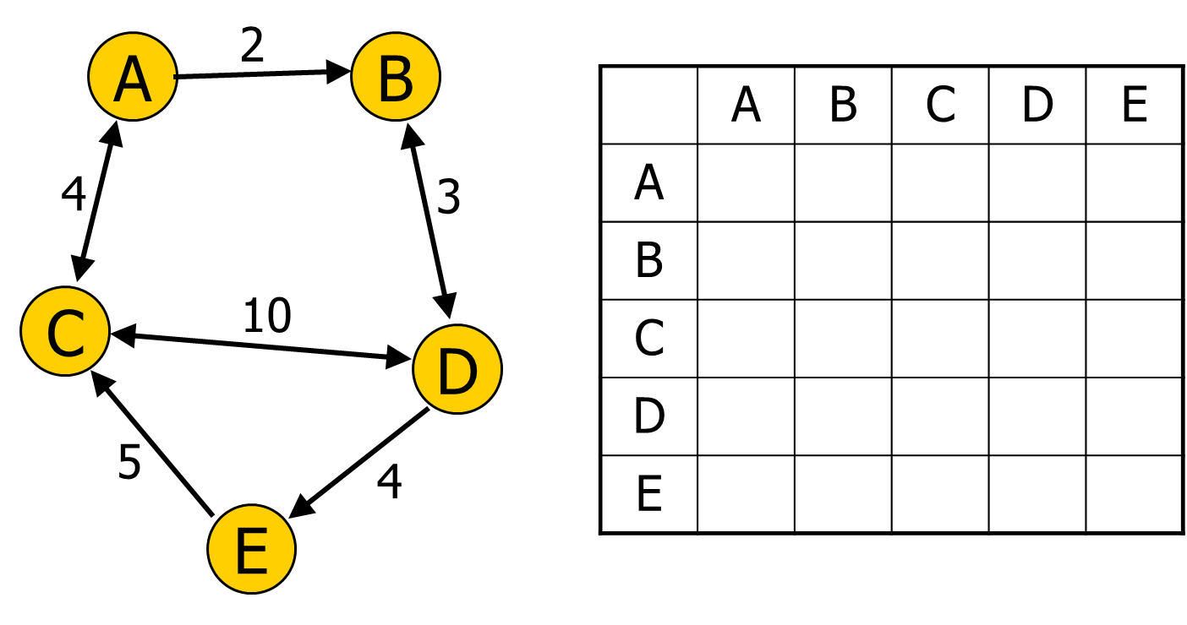
All-Pairs Shortest Path Table

Slide 39
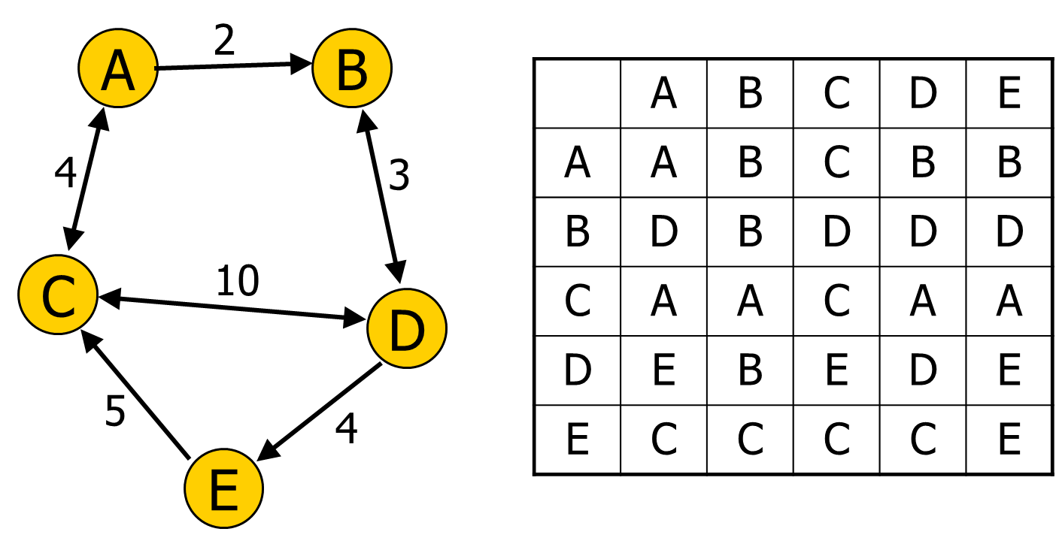
All-Pairs Shortest Path Table

Slide 40
int path[][]; //initialize to starting costs
void FloydWarshall()
{
for (k = 1 to n)
{
for each (i,j) in (1..n)
{
path[i][j] = min ( path[i][j],
path[i][k] + path[k][j] );
}
}
}

Slide 41
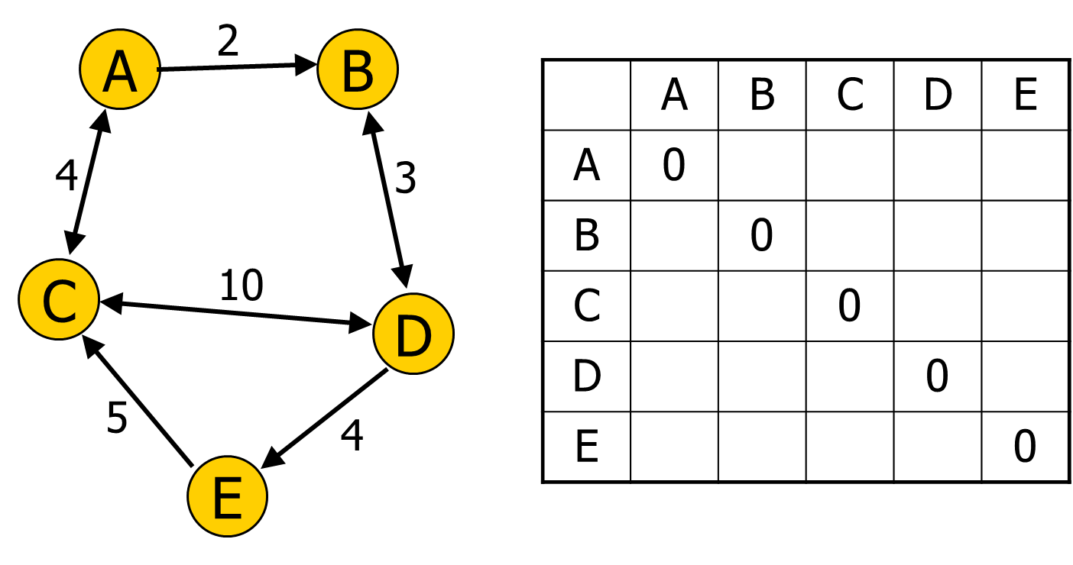
All-Pairs Shortest Path Table

Slide 42

All-Pairs Shortest Path Table

Slide 43

All-Pairs Shortest Path Table

Slide 44

All-Pairs Shortest Path Table

Slide 45
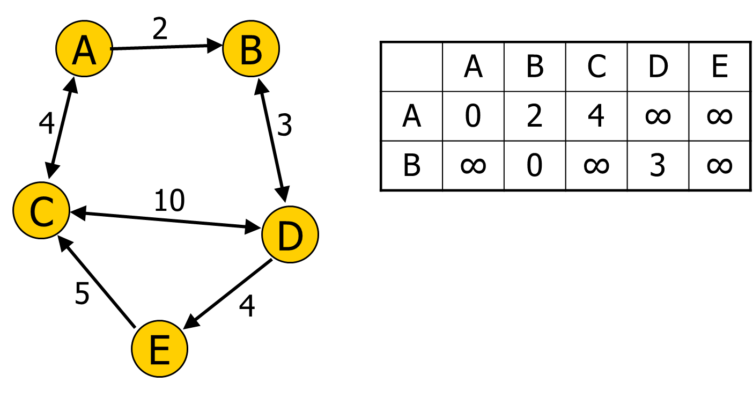
All-Pairs Shortest Path Table
for (k = 1 to n)
{
for each (i,j) in (1..n)
{
path[i][j] = min (path[i][j],
path[i][k] + path[k][j]);
}
}

Slide 46
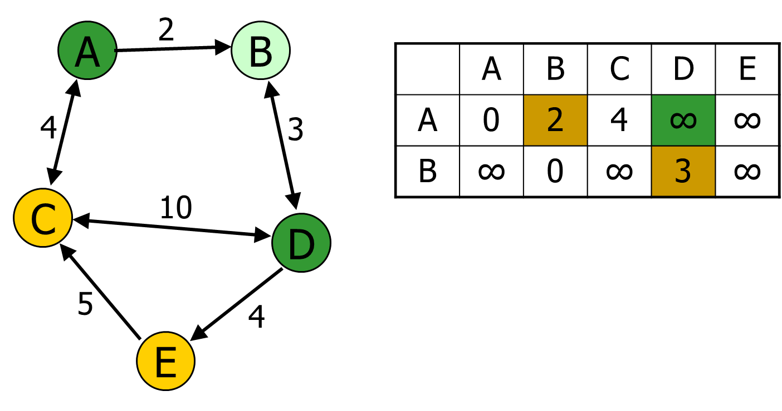
All-Pairs Shortest Path Table
for (k = 1 to n)
{
for each (i,j) in (1..n)
{ //example i=A, j=D, k=B
path[i][j] = min (path[i][j],
path[i][k] + path[k][j]);
}
}

Slide 47

All-Pairs Shortest Path Table
for (k = 1 to n)
{
for each (i,j) in (1..n)
{ //example i=A, j=D, k=B
path[i][j] = min (path[i][j],
path[i][k] + path[k][j]);
}
}

Slide 48

All-Pairs Shortest Path Table

Slide 49
All-Pairs Shortest Path Table

Slide 50
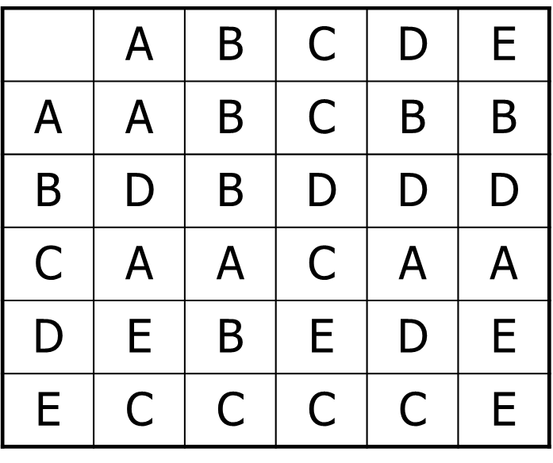
Roy-Floyd-Warshall
All-Pairs Shortest Path
Speed of search?
Cost to compute?
What's the downside during runtime?
Which search space representations does it work on?

Slide 51
Open List Sorting
Unsorted List
  Pop: O(n) Brute force search for cheapest
  Push: O(1) Trivial to push
  Update: O(0) No work needed – List is not sorted
Priority Queue (binary tree)
  Pop: O(log n)
  Push: O(log n)
  Update: O(n) Note: Typical P-Queues don’t support this

Slide 52

Unordered List Fast Array

Slide 53
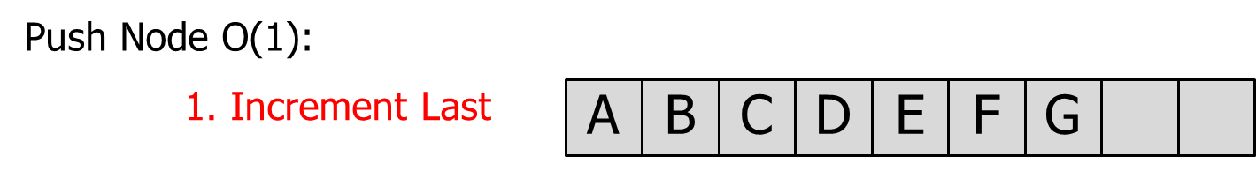
Unordered List Fast Array

Slide 54
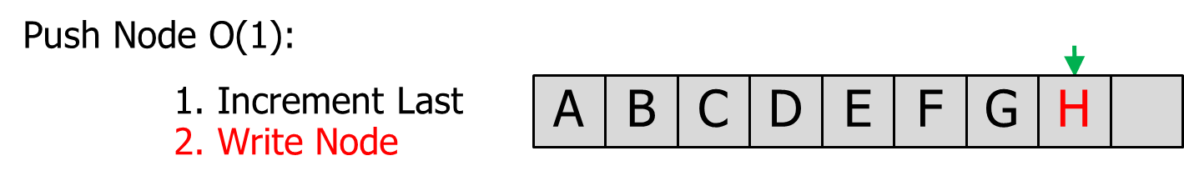
Unordered List Fast Array

Slide 55
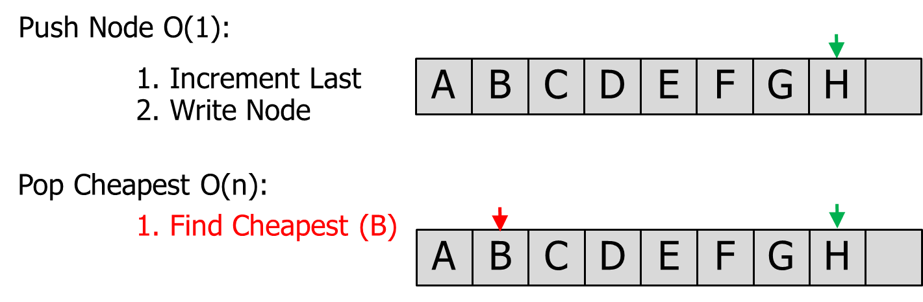
Unordered List Fast Array

Slide 56
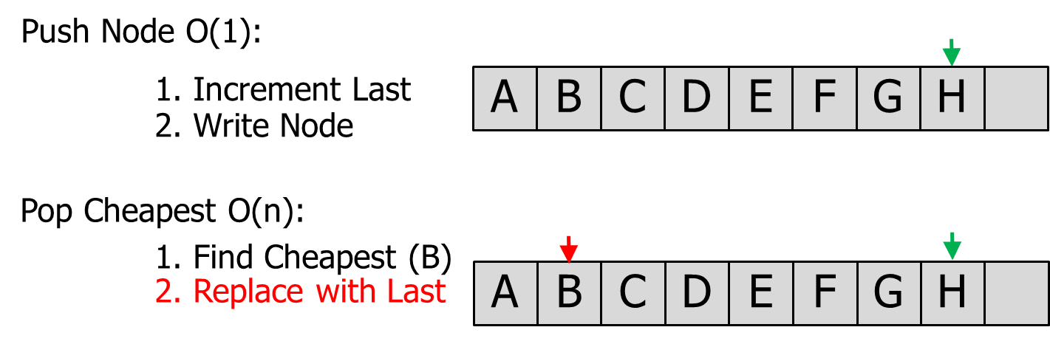
Unordered List Fast Array

Slide 57

Unordered List Fast Array
H

Slide 58
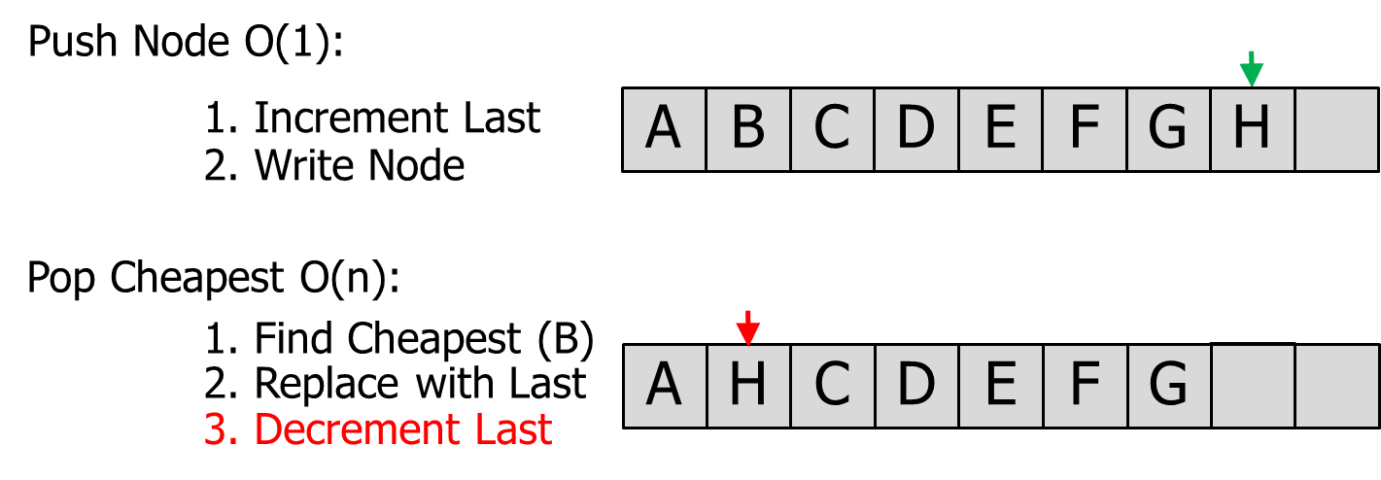
Unordered List Fast Array

Slide 59
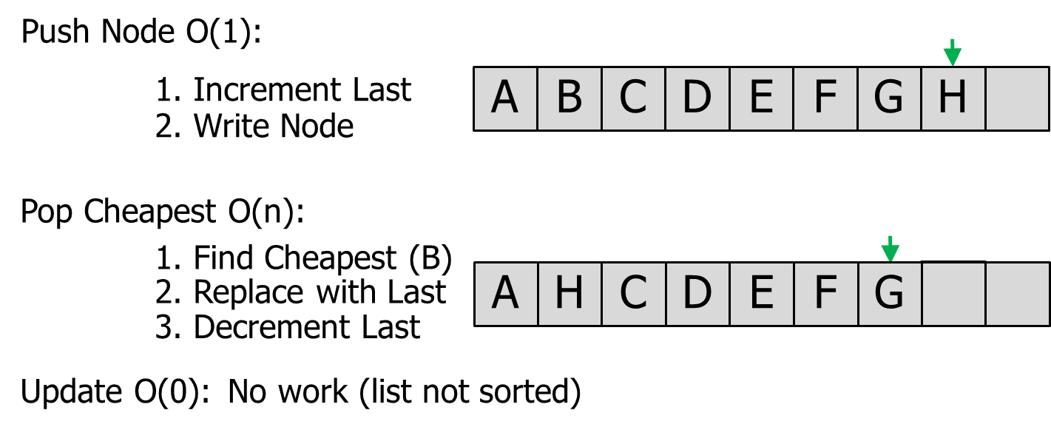
Unordered List Fast Array

