Slide 1
Artificial Intelligence in Games
Week 6
Agent Awareness and Cooperation
CLASS WEBSITE: gameaipro.com/digipen
STEVE RABIN (steve.rabin@gmail.com)
TA: CHI-HAO KUO (chihao.kuo@digipen.edu)

Slide 2
Questions
How smooth is a Catmull-Rom spline?
Why should you only work on one path request at a time?
Why is hierarchical pathfinding so much faster?
In JPS+, jumping accounts for 50% of the speed up. What accounts for the other 50%?
What are the restrictions of: a) JPS+? b) Goal Bounding?
In Goal Bounding, what is stored on every node edge?
In Company of Heroes, describe an impass map and precise map.
How did Company of Heroes calculate vehicle turns?

Slide 3
Announcement: Linked In
Send me a link request!
  Helps with networking
  I have 1000+ links
I was congratulated as being in the top 1% of all viewed people
  Out of 200 million

Slide 4
On Class Webpage
GenericHeap.zip
Priority Queue with Hash Lookup!
Note: DecreaseKey is for “Update node”

Slide 5
Game Agents

Slide 6

Game Agents
Continually loops through the
Sense-Think-Act cycle

Slide 7
Sense – Think – Act
Agent has access to perfect information of the game world
  May be expensive/difficult to tease out useful info
Game World Information
  Complete terrain layout
  Location and state of every game object
  Location and state of player
But isn’t this cheating???

Slide 8
Sense – Think – Act
Human limitations?
Limitations such as
  Not knowing about unexplored areas
  Not seeing through walls
  Not knowing location or state of player
Can only know about things seen, heard, or told about
Must create a sensing model

Slide 9
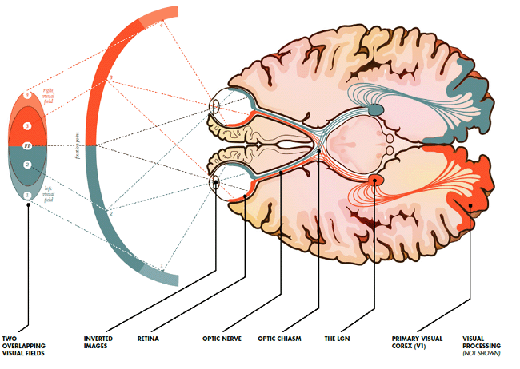
[Human] Agent Vision Model
How should we
model agent vision?

Slide 10
[Human] Agent Vision Model
Get a list of all objects or agents; for each:
  Is it within the viewing distance of the agent?
  Is it within the viewing angle of the agent?
  Is it unobscured by the environment?
What does the code look like?

Slide 11
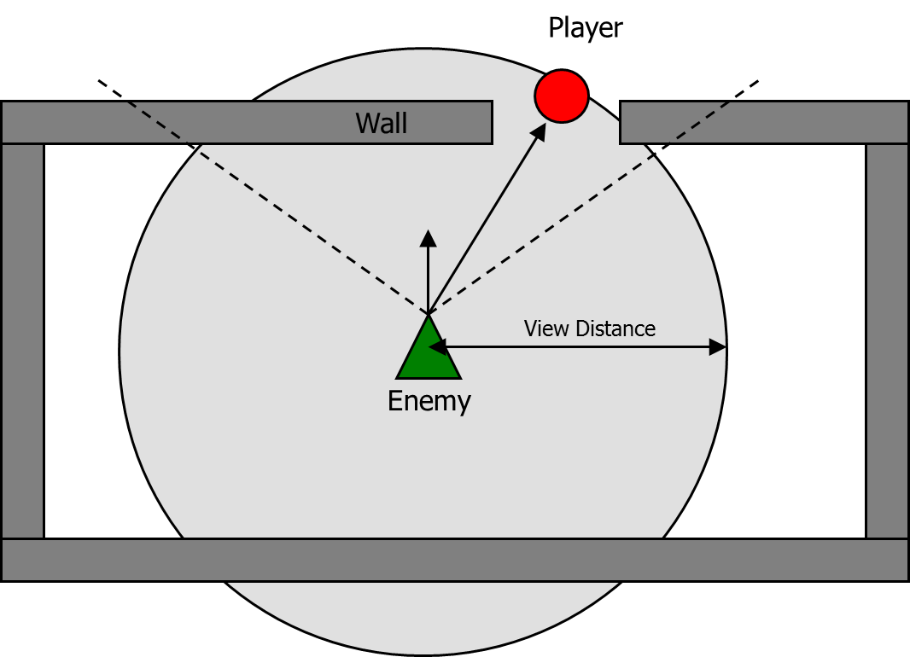

Slide 12
Viewing Angle
60°
90°
120°
180°

Slide 13
Viewing Angle
Dot Product
60°
0.866
90°
0.707
120°
0.5
180°
0.0

Slide 14
Obscured by the Environment
One ray cast?
Many ray casts?
How would you do it perfectly?

Slide 15
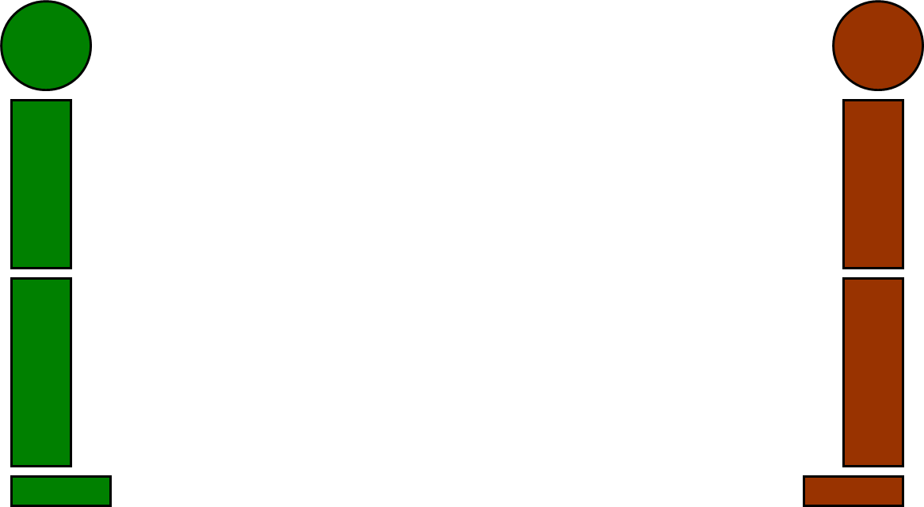

Slide 16
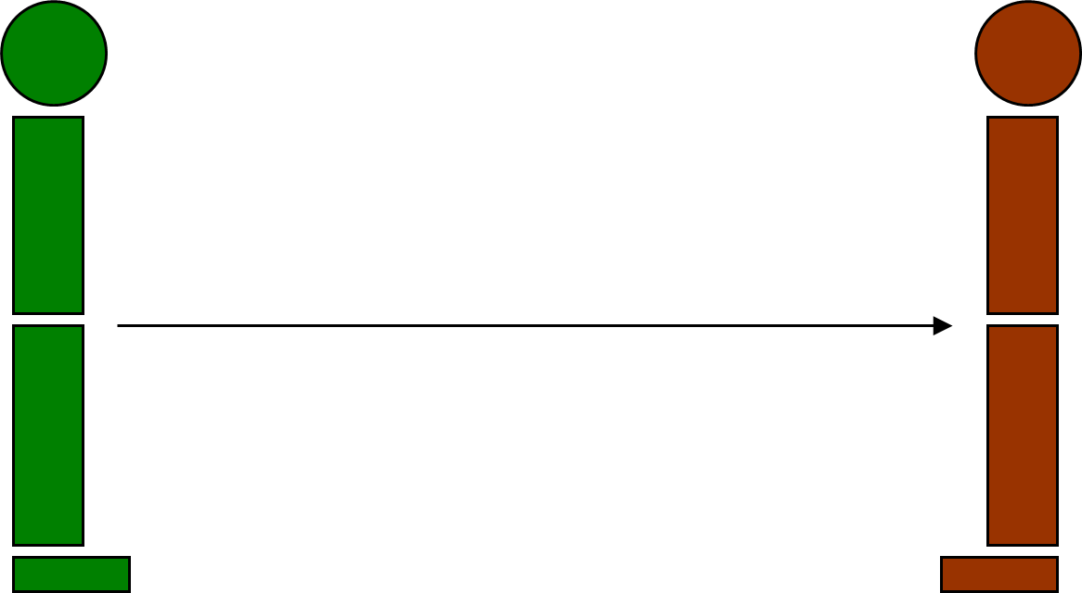

Slide 17
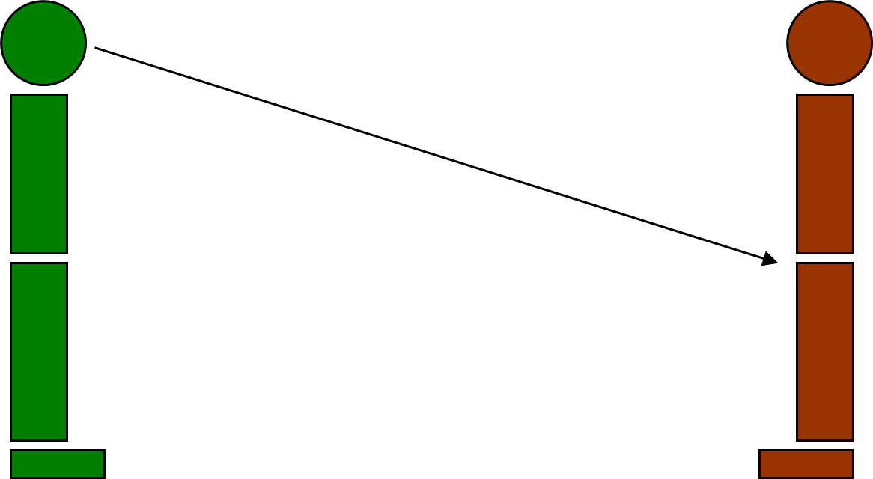

Slide 18
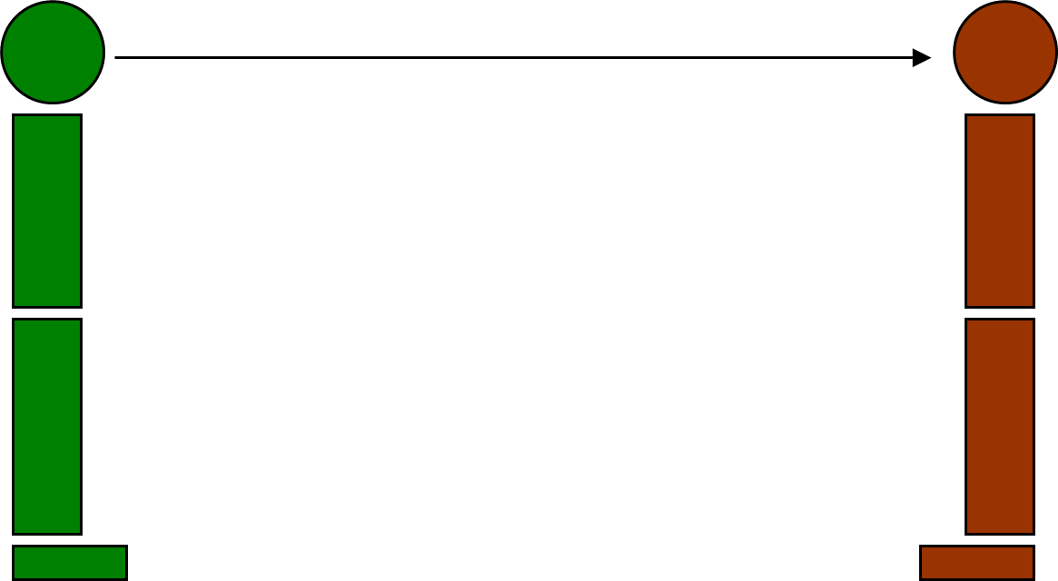

Slide 19
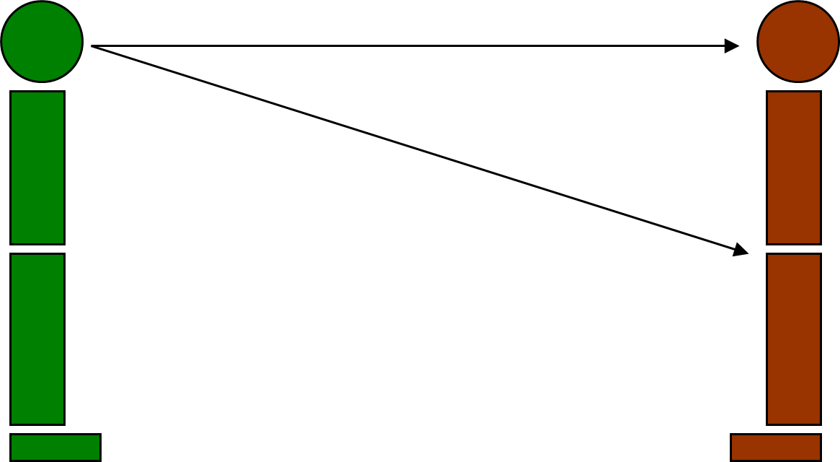

Slide 20
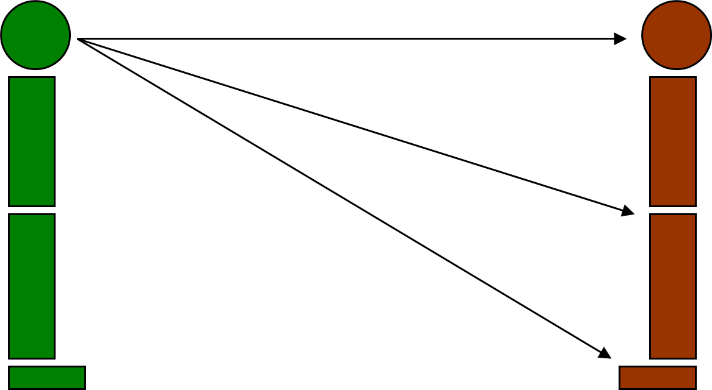

Slide 21
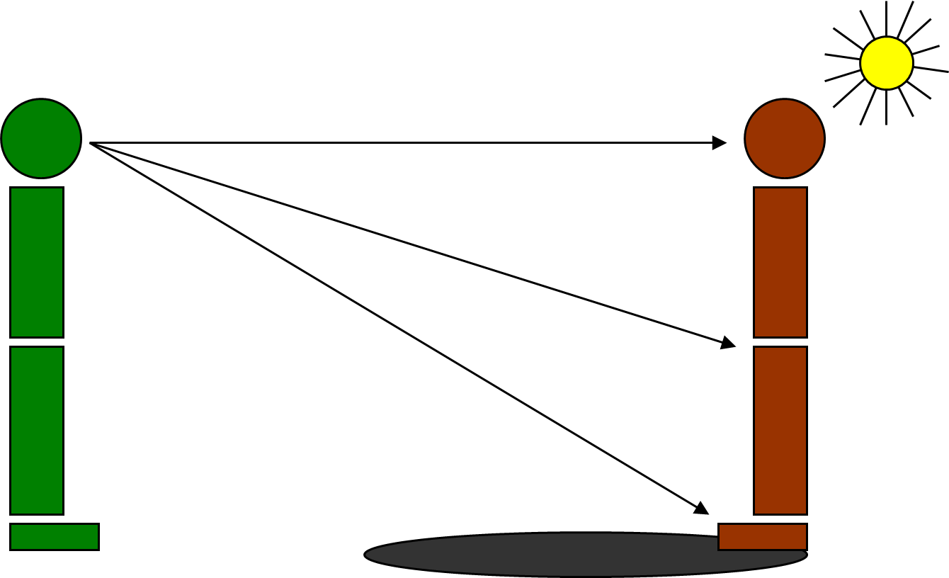

Slide 22


Slide 23
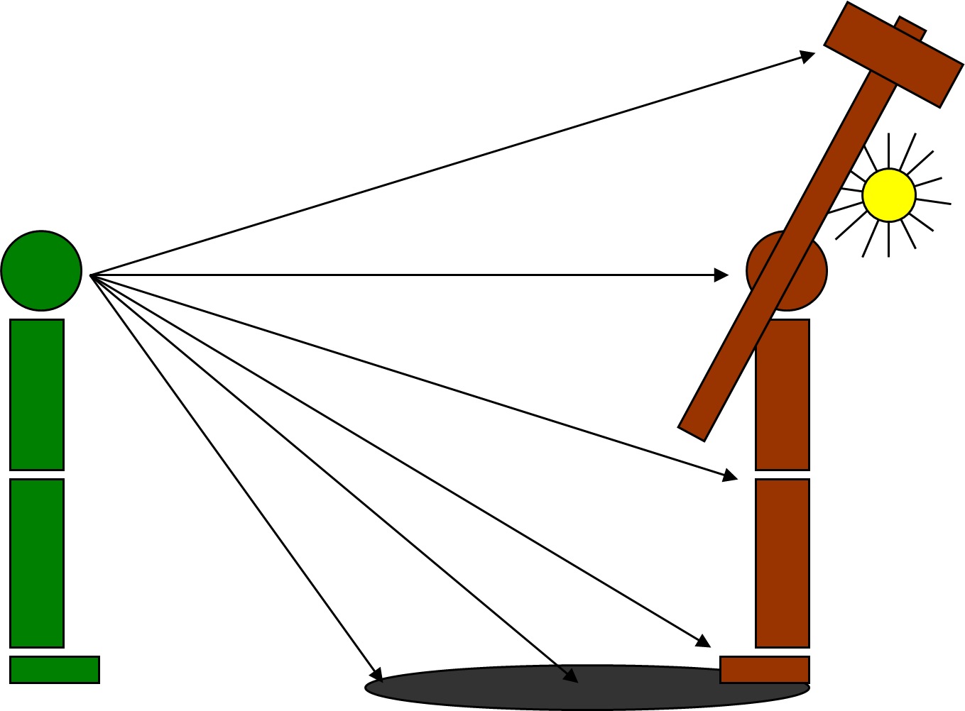

Slide 24
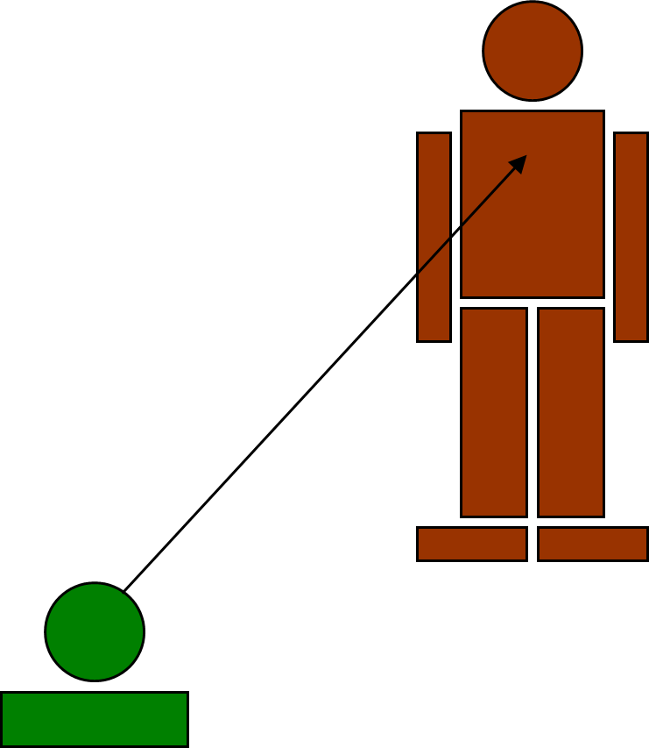

Slide 25
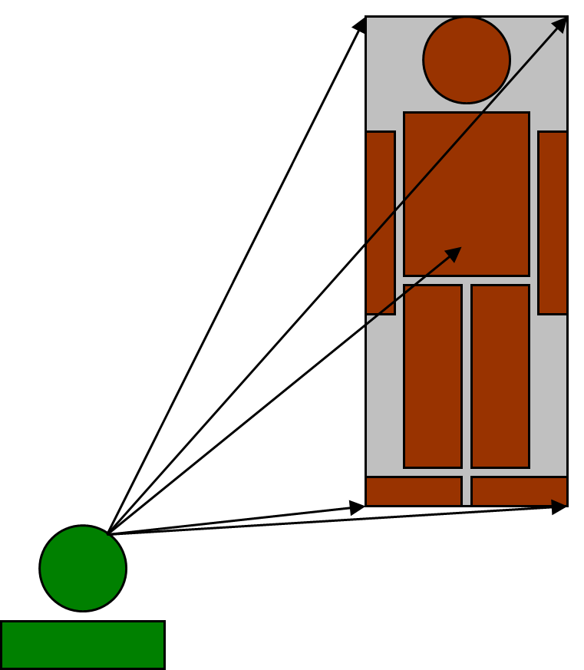

Slide 26
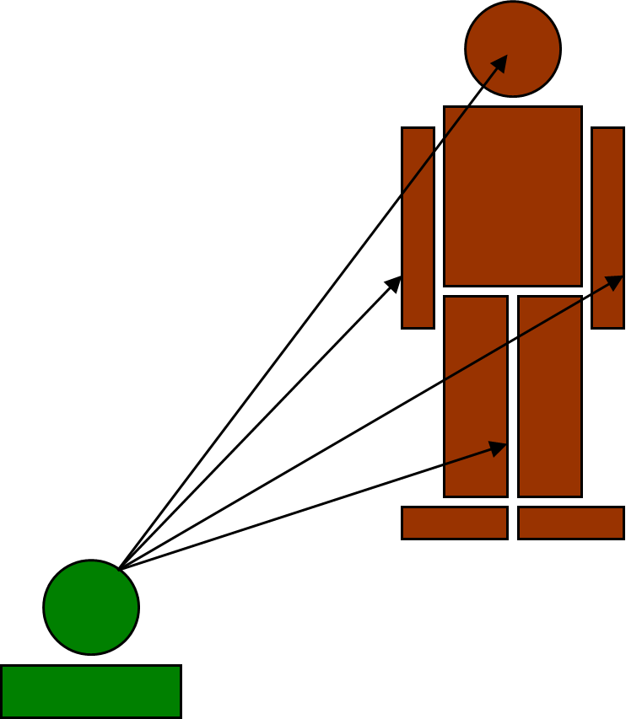

Slide 27
Splinter Cell Vision When Standing

Slide 28
Splinter Cell Vision When Crouched

Slide 29
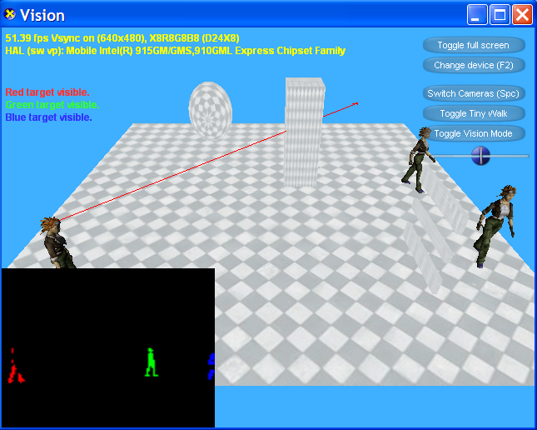
Research Project

