Slide 1
Artificial Intelligence in Games
Week 6.5
Agent Awareness and Cooperation
CLASS WEBSITE: gameaipro.com/digipen
STEVE RABIN (steve.rabin@gmail.com)
TA: CHI-HAO KUO (chihao.kuo@digipen.edu)

Slide 2
[Human] Agent Vision Model
Get a list of all objects or agents; for each:
  Is it within the viewing distance of the agent?
  Is it within the viewing angle of the agent?
  Is it unobscured by the environment?

Slide 3
Let’s Get More Real
  Hard to see camouflaged objects
  Hard to see non-moving characters
  Hard to identify peripheral objects
  Hard to identify far away objects

Slide 4
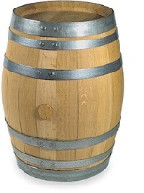
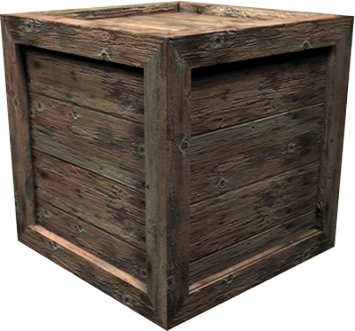
Hide and Shoot Algorithm

Slide 5
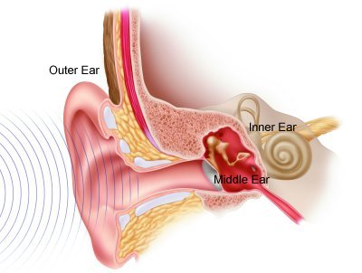
Human Hearing
Can recognize sounds
  Knows what emits each sound
Can sense volume
  Indicates distance of sound
Can sense pitch
  Sounds muffled through walls have more bass
Can sense location
  Where sound is coming from

Slide 6
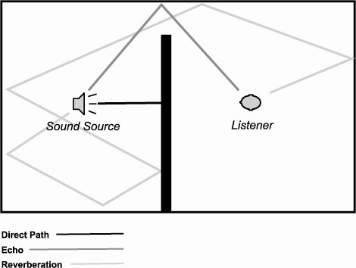
Modeling Hearing
  How should an agent know about sounds?
  Reflect off every surface?
  How do you model hearing efficiently?

Slide 7
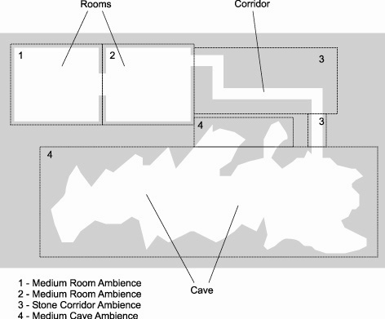
Efficient
Hearing Model
  Event-based
  Distance
  Zones

Slide 8

Agent Communication
Agents might talk amongst themselves!
  Guards might alert other guards
  Agents witness player location and spread the word
Model sensed knowledge through communication
  Event-driven when agents close to each other

Slide 9
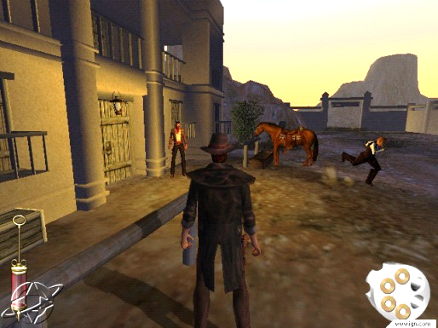
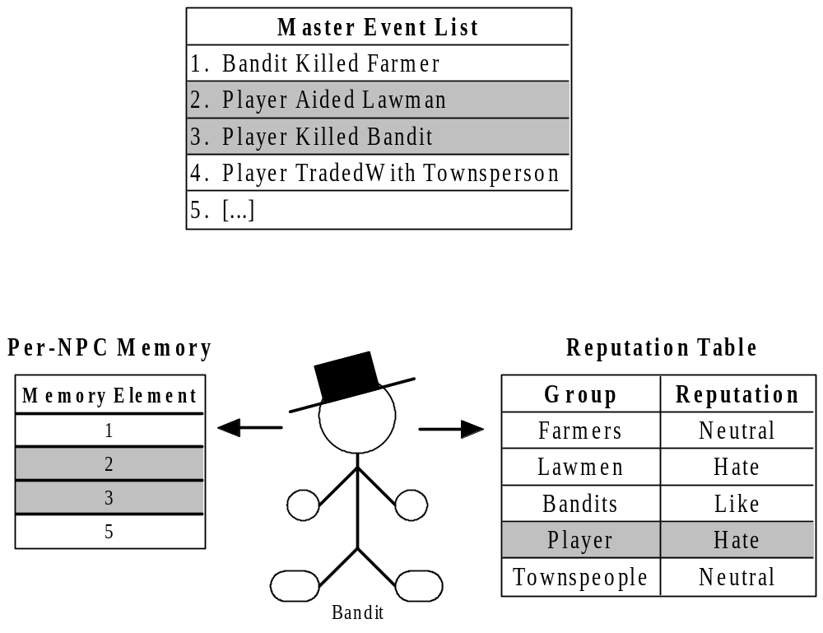
Reputations in
Gunslinger (PS2)

Slide 10
Reputation
Event
Subject Group | Player
Verb | DidViolenceTo
Object Group | Bandit
Object Individual | Joe
Magnitude | 75 (Killed)
Where | 50, 20, 138 (In front of Saloon)
When | High noon
Template | KilledBanditTemplate
Reference Count | Known by 11 NPCs
Reputation Effects | Bandits hate player more. Lawmen like player more. Farmers like player more.

Slide 11
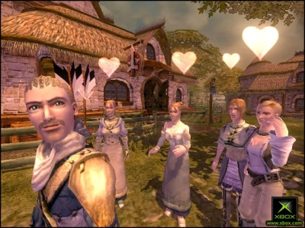
Player Reputation in Fable
Hero Stats: 5 opinion values in range [-1,1]
  Morality [Evil, Good]
  Renown [Contemptible, Renowned]
  Scariness [Ridiculous, Scary]
  Agreeableness [Offensive, Agreeable]
  Attractiveness [Ugly, Attractive]

Slide 12
Player Reputation in Fable
5 global opinion values are Hero Stats
Each NPC has a Relative Opinion
  Only directly witnessed acts or overheard acts
Absolute opinion = Hero Stats + Relative Opinion

Slide 13
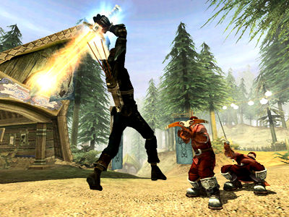
Fable’s Event-Driven Opinion Deeds
  DEED_CRIME_WEAPON_OUT
  DEED_CRIME_VANDALISM
  DEED_EXPRESSION_HEROIC_STANCE
  DEED_EXPRESSION_FLIRT
  DEED_RECEIVE_GIFT_ROMANTIC
  DEED_RECEIVE_GIFT_FRIENDLY

Slide 14
Simplest AI Trick in the Book
Steve Rabin
Principal Lecturer
DigiPen Institute of Technology

Slide 15
Agent Reaction Time

Slide 16
Agent Reaction Time
AI sees the player…
How long before the AI reacts?
Somewhere between 0 and 1 seconds…
Quarter of a second? Half a second?

Slide 17
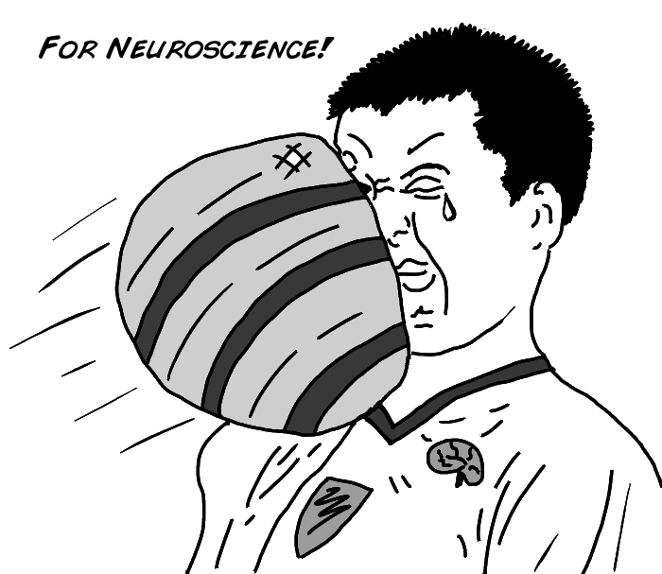

Slide 18
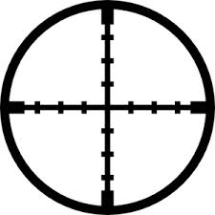
Simple Reaction Time

Slide 19
Simple Reaction Time
0.2 seconds

Slide 20
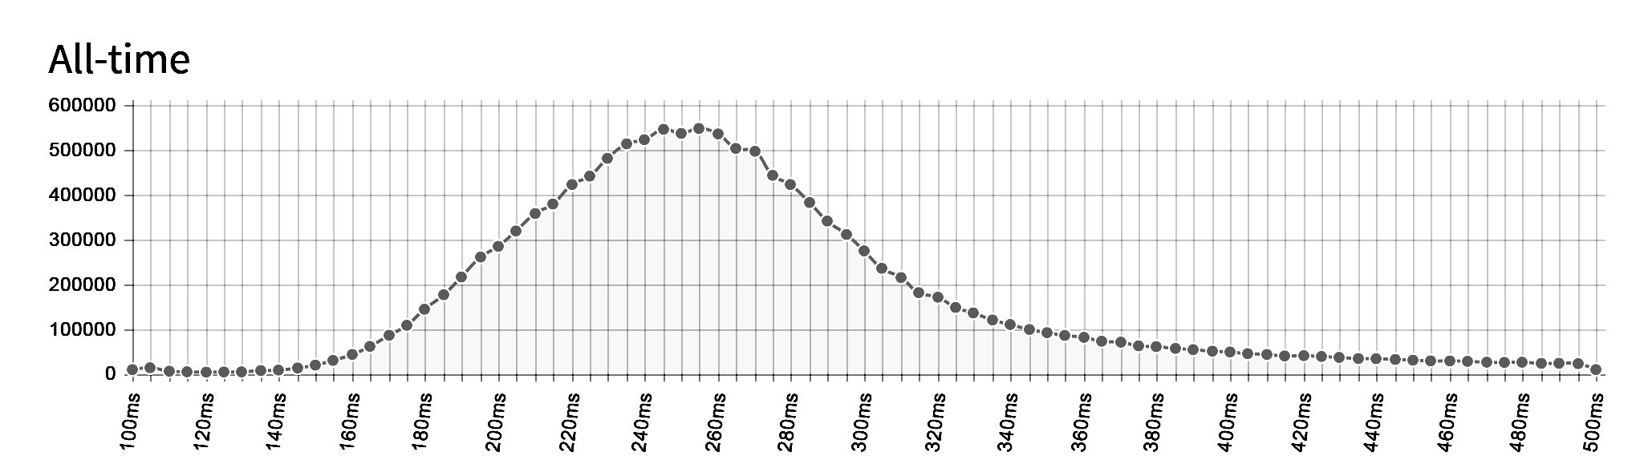
14,736,176 clicks
0.250s median reaction time http://www.humanbenchmark.com/

Slide 21
Go / No Go Reaction Time

Slide 22
Go / No Go Reaction Time
0.4 seconds

Slide 23
It’s always worse…
Add more time for:
  Distracted
  Hard to identify stimuli
  Complex reaction action

Slide 24
Sense – Think – Act
Sensed information gathered
Must process sensed information
Two primary methods
  Process using pre-coded expert knowledge
  Use search to find an optimal solution

Slide 25
Think: Expert Knowledge
Many different systems
  Finite-state machines, Behavior Trees
  Production systems, Logical inference
Encoding expert knowledge is relatively easy
  Can ask just the right questions
  As simple as if-then statements
Problems with expert knowledge
  Not very scalable

Slide 26
Think: Search
Search algorithm to find an optimal or near-optimal solution
  A* pathfinding common use of search
  Company of Heroes’ turn search
  Planning

Slide 27
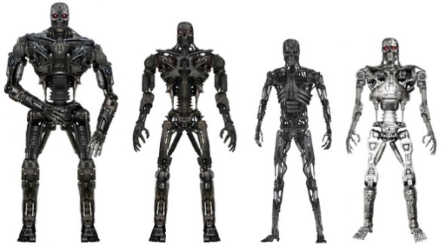
Think: Machine Learning
If imparting expert knowledge and search are both not reasonable/possible, then machine learning might work
Examples:
  Reinforcement learning
  Neural networks
  Decision tree learning
Not often used by game developers

Slide 28
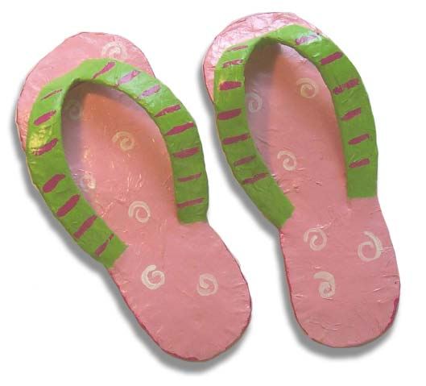
Think: Flip-Flopping
Must prevent flip-flopping of decisions
Reaction times might help keep it from happening every frame
Must make a decision and stick with it
  Until situation changes enough
  Until enough time has passed
  Baseball example

Slide 29

Sense – Think – Act
Sensing and thinking steps invisible to player
Acting is how player witnesses intelligence
Numerous agent actions, for example:
  Change locations
  Pick up object
  Play animation
  Play sound effect
  Converse with player
  Fire weapon

Slide 30
Act: Showing Intelligence
Adeptness and subtlety of actions impact perceived level of intelligence
Enormous burden on asset generation
Agent can only express intelligence in terms of vocabulary of actions
Current games have huge sets of animations/assets
  Must use scalable solutions to make selections

Slide 31
Extra Step in Think Cycle:
Learning and Remembering
Not necessary in many games
  Agents don’t live long enough
  Game design might not desire it

Slide 32

Learning
Remembering outcomes and generalizing to future situations
Simplest approach: gather statistics
  If 80% of time player attacks from left
  Then expect this likely event
Adapts to player behavior

Slide 33
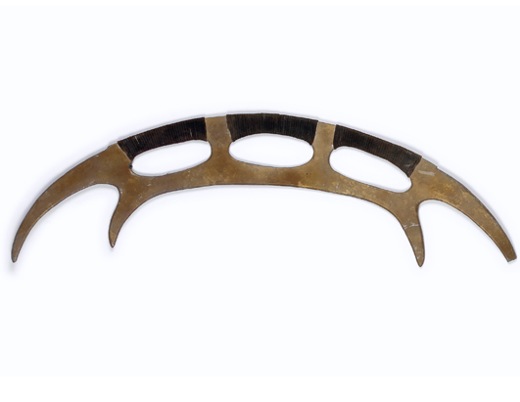
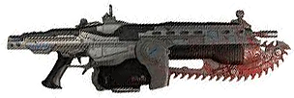

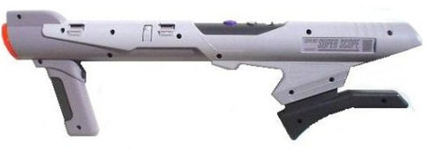


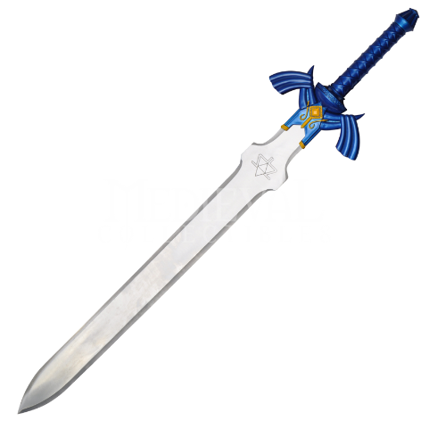

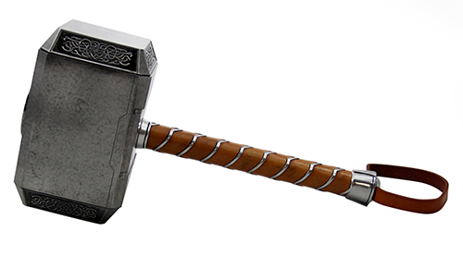
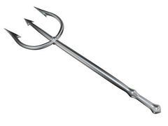
Remembering
Remember hard facts
  Observed states, objects, or players
For example
  Where was the player last seen?
  Where did I last see a health pack?
  What weapon did the player have?
Memories should fade
  Helps keep memory requirements lower
  Simulates poor, imprecise, selective human memory
  How many things can you remember?

Slide 34

Can you remember?

Slide 35

Remembering in the World
All memory doesn’t need to be stored in the agent – can be stored in the world
For example:
  Agents get slaughtered in a certain area
  Area might begin to “smell of death”
  Agent’s path planning will avoid the area
  Simulates group memory

Slide 36
Agent Cooperation

Slide 37
Agent Cooperation
How might agents cooperate?
  With one other NPC?
  In a mob "kung-fu" style?
  In a squad?
  On a baseball team?
  As part of a 5000 person invasion?

Slide 38
Agent Cooperation
Three interesting methods
  Individuals communicate and arbitrate between themselves
  Invisible manager coordinates
  Blackboard architecture

Slide 39
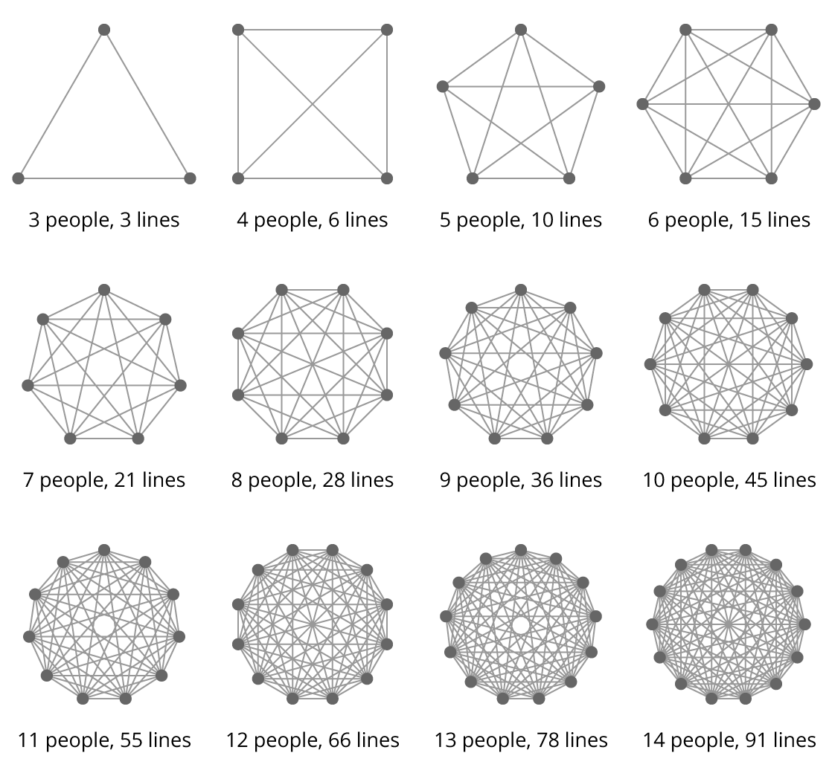
Decentralized Cooperation
Scalability problem
Requires handshaking and arbitration
What is necessary for optimal cooperation?

Slide 40
Centralized Cooperation
Agent assignment
  Get list of agents
  Assign each agent a task
Task assignment (Rabin’s made-up term)
  Compose list of tasks
  Prioritize
  Assign tasks to best candidate

Slide 41
Centralized Cooperation
Playbook cooperation
  Preplanned assignments based on situation
Exhaustive analysis
  Some permutation of tasks/agents is optimal
  Score and pick best

Slide 42
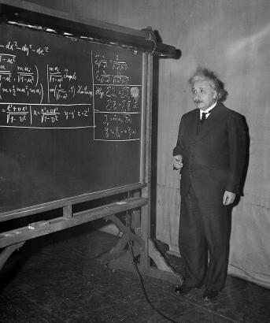
Blackboard Cooperation
Complex problem is posted on a shared communication space
  Agents propose solutions
  Solutions scored and selected
  Continues until problem is solved
Alternatively, use concept to facilitate communication and cooperation

Slide 43
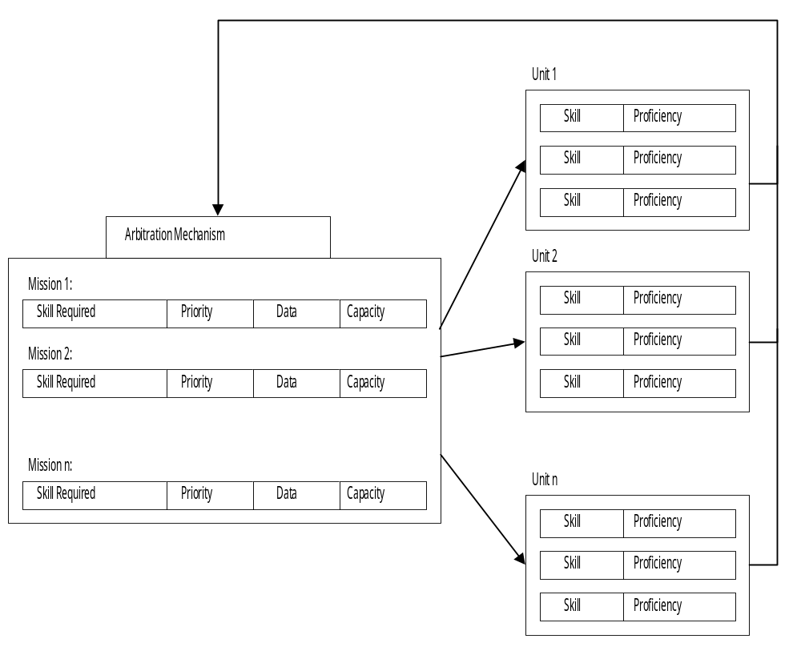
Units Compete for Missions

Slide 44
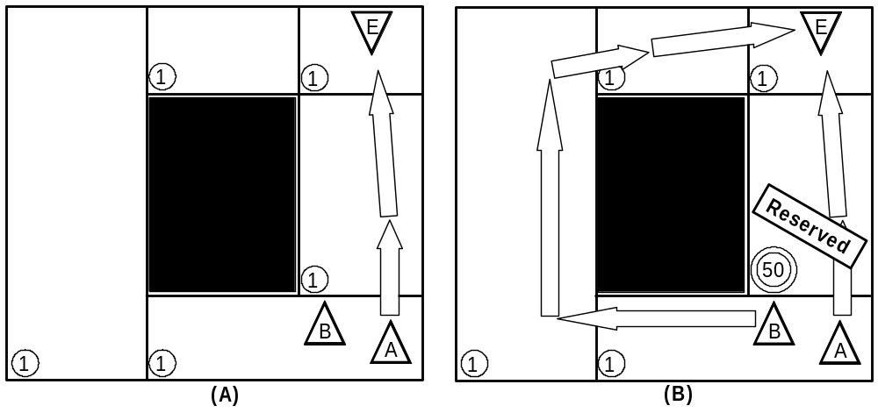
F.E.A.R. Blackboard for Pathfinding

