Slide 1
Artificial Intelligence in Games
Week 6.5
Tactics and Terrain Analysis
Class Website: gameaipro.com/digipen
Steve Rabin (steve.rabin@gmail.com)
TA: Chi-Hao Kuo (chihao.kuo@digipen.edu)

Slide 2
Squad Tactics

Slide 3

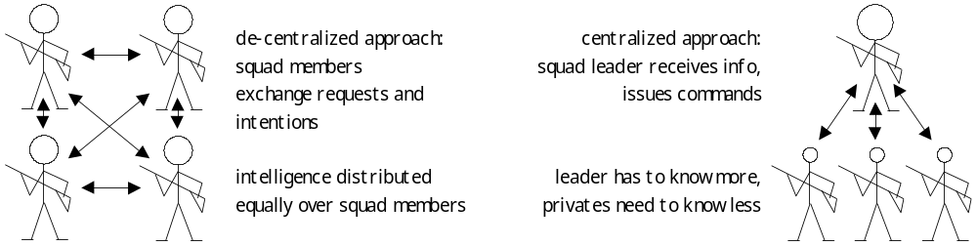
Decentralized vs Centralized

Slide 4
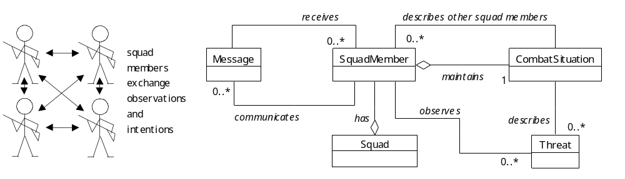
Decentralized Squad

Slide 5
Decentralized Squad
Key points:
  Extension of individual AI
    Easy to add to existing AI
  Robustly handles many situations
  Deals well with a variety of capabilities within the team
  Can be easily combined with scripted squad member actions
Cooperation and group behavior emerges from individual behaviors
Technique used in original Half-Life

Slide 6
void SoloAI::Think() {
CombatSitiation* sit =
GetSituation():
sit->Observe();
for each available action {
if(action.IsApplicable(sit))
{
determine value of action
in sit;
if better than best action,
make best action
}
}
execute best action();
}
void SoloAI::Think() {
CombatSitiation* sit =
GetSituation():
sit->Observe();
sit->ProcessTeamIntentions();
sit->ProcessTeamObservations();
for each available action {
if(action.IsApplicable(sit))
{
determine value of action
in sit;
if better than best action,
make best action
}
}
nearbySqdMembers->AnnounceAction();
execute best action();
}

Slide 7
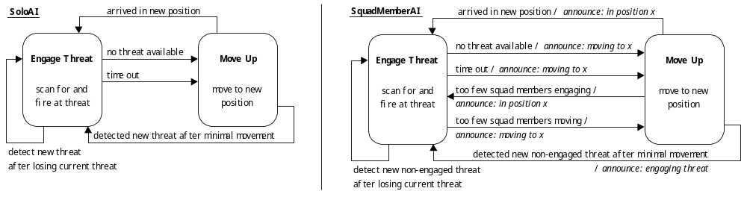
Fire-and-Maneuver Behavior
  If too many static squad members, move up
  If too many engaging threat, won't stop to engage same threat
  Robust against squad member casualties
  Interactions easily translated to audio for effect/realism

Slide 8
Tactical Behavior (on top of fire/move)
  Stay close to cover
  Don't block other's line-of-fire
  Take weapon ability into account
  Maintain team cohesion / line-of-sight
  Spread out to avoid being a single target
  Keep a line-of-sight on enemy

Slide 9
Squad Member’s Mental Picture
For each squad member
  Current pos and activity
  Claimed destination
  Line-of-fire
For each opponent
  Last known position and state
  Estimated position
  Squad members engaging this opponent
  Line-of-fire
For other threats (grenades, fires)
  Known/estimated position
  Damage radius

Slide 10
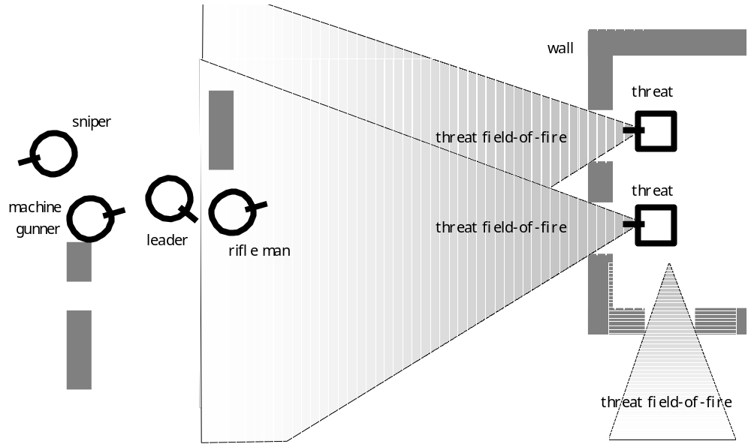
Four-Man Patrol in Hostile Situation

Slide 11
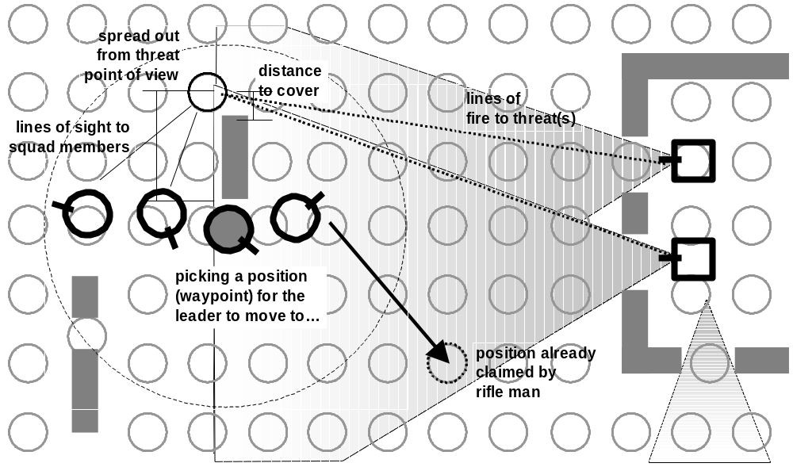
Four-Man Patrol in Hostile Situation

Slide 12
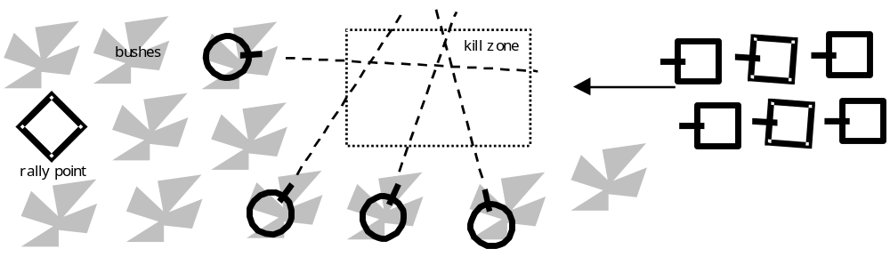
Executing L-Shaped Ambush
Decentralized squad can’t do it…

Slide 13
Decentralized Squad

Slide 14
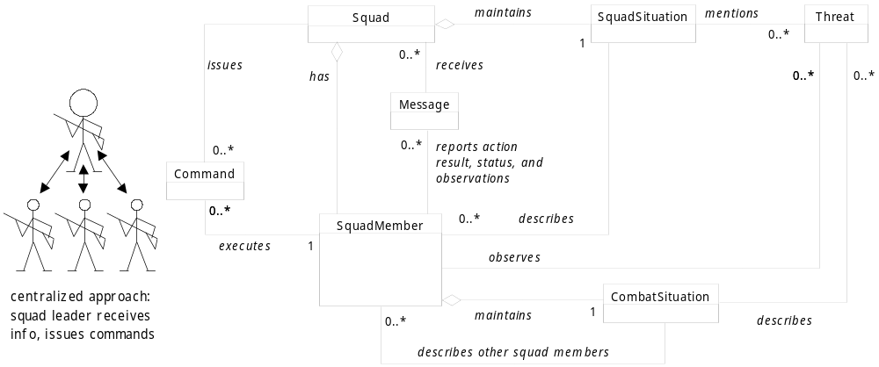
Centralized Squad

Slide 15
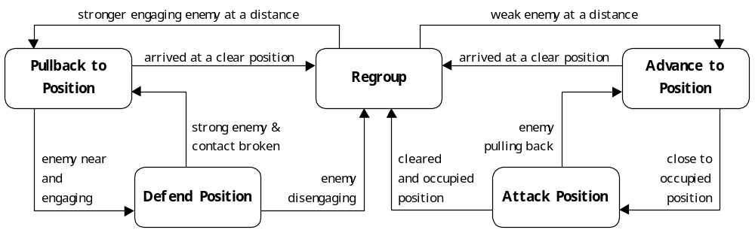
Avoid Oscillations (Flip-Flopping)

Slide 16
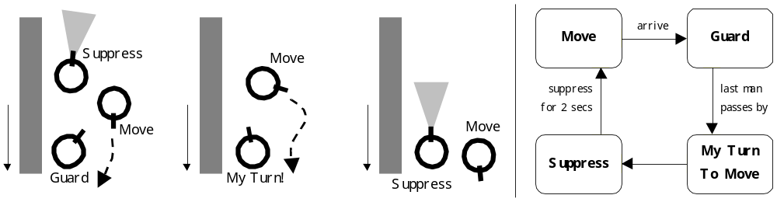
Bounding Overwatch Pullback

Slide 17
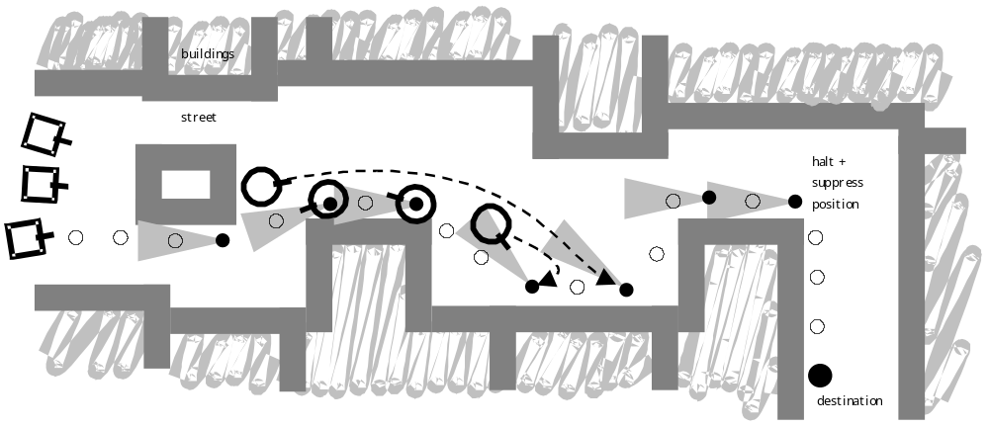
Bounding Overwatch Pullback

Slide 18
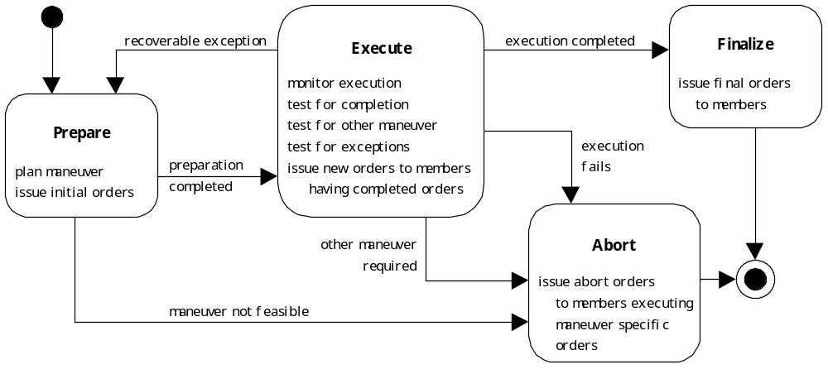
Stages of Performing a Maneuver

Slide 19
Planning
Find series of actions:
  Change the current configuration of the game world into a target configuration
Actions
  Preconditions
  Effects
Only interesting when the world is rich
  More than one way to accomplish a task

Slide 20
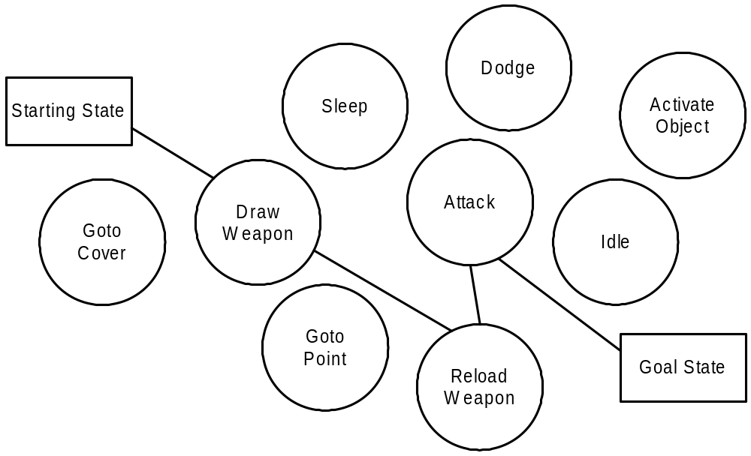

Slide 21
