Slide 1

OCCUPANCY MAP FRAMEWORK

Slide 2
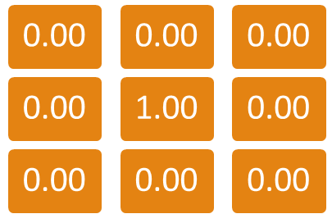
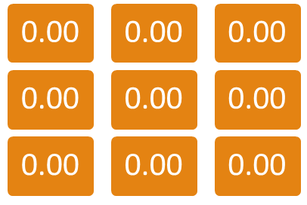
Propagation Algorithm
Pseudo Code
For each tile on the map
Get the influence value of each neighbor after decay
Keep the maximum decayed influence value of all neighbors
Apply linear interpolation to the influence value of the tile, and the maximum decayed influence value from all neighbors, with growing factor as coefficient
Store the result to the temp layer
Store influence value from temp layer
Influence Layer
Temp Layer

Slide 3
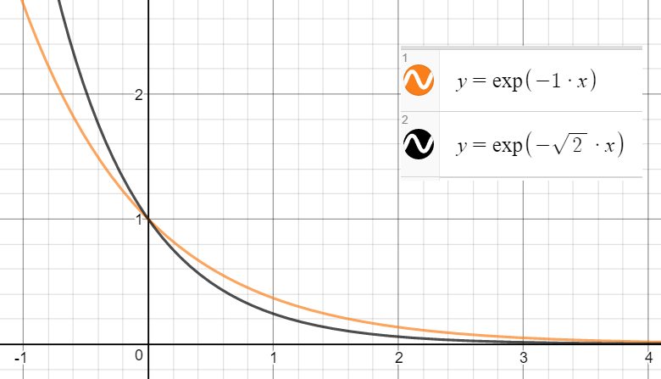
Propagation Algorithm
Parameters
  Decay Factor
    How quickly should the influence decay with distance.
    uses exponential decay function for project 3.
    Decay function formula:
      New_Influence = Old_Influence * exp(-1 * Distance * Decay_Coefficient)
    Influence fades out faster with higher decay value.
decay | distance | old influence | new influence
0.00 | 1.00 | 1.00 | 1.00
0.20 | 1.00 | 1.00 | 0.82
0.40 | 1.00 | 1.00 | 0.67
0.60 | 1.00 | 1.00 | 0.55
0.80 | 1.00 | 1.00 | 0.45
1.00 | 1.00 | 1.00 | 0.37
1.20 | 1.00 | 1.00 | 0.30
1.40 | 1.00 | 1.00 | 0.25
1.60 | 1.00 | 1.00 | 0.20
1.80 | 1.00 | 1.00 | 0.17
2.00 | 1.00 | 1.00 | 0.14

Slide 4
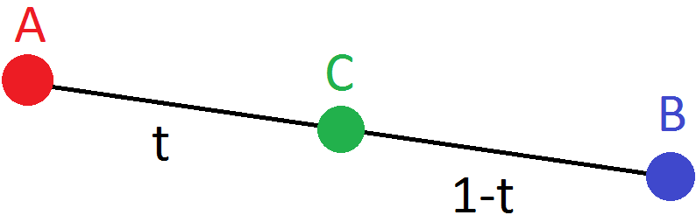
Propagation Algorithm
Parameters
  Growing Factor
    When updating the influence value, how much to bias the update towards the existing value compared to the new value.
    In the closed unit interval [0, 1].
    Linear interpolation formula:
      New_Influence = (1 – Growing_Coefficient) * Old_Influence + Growing_Coefficient * Max_Neighbor_Influence
    Propagation happens quicker with lower growing value.
old influence | neighbor influence | growing | new influence
1.00 | 0.50 | 0.00 | 1.00
1.00 | 0.50 | 0.10 | 0.95
1.00 | 0.50 | 0.20 | 0.90
1.00 | 0.50 | 0.30 | 0.85
1.00 | 0.50 | 0.40 | 0.80
1.00 | 0.50 | 0.50 | 0.75
1.00 | 0.50 | 0.60 | 0.70
1.00 | 0.50 | 0.70 | 0.65
1.00 | 0.50 | 0.80 | 0.60
1.00 | 0.50 | 0.90 | 0.55
1.00 | 0.50 | 1.00 | 0.50

Slide 5

Propagation Algorithm
Parameters
  Update Frequency
    How often to update the influence map.
    Have the least control.
    Better to have a tweakable time for debugging purpose.
    No need to be update 30FPS in most cases.

Slide 6
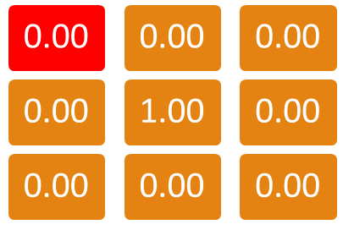
Propagation Algorithm
Pseudo Code
For each tile on the map
Get the influence value of each neighbor after decay
Keep the maximum decayed influence value of all neighbors
Apply linear interpolation to the influence value of the tile, and the maximum decayed influence value from all neighbors, with growing factor as coefficient
Store the result to the temp layer
Store influence value from temp layer
Influence Layer
Temp Layer
decay factor: 0.2, growing factor: 0.3

Slide 7
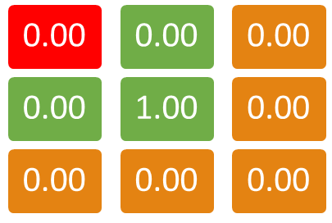
Propagation Algorithm
Pseudo Code
For each tile on the map
Get the influence value of each neighbor after decay
Keep the maximum decayed influence value of all neighbors
Apply linear interpolation to the influence value of the tile, and the maximum decayed influence value from all neighbors, with growing factor as coefficient
Store the result to the temp layer
Store influence value from temp layer
Influence Layer
Temp Layer
decay factor: 0.2, growing factor: 0.3
neighbor influences:
R – 0 * exp(-1 * 0.2) = 0
B – 0 * exp(-1 * 0.2) = 0
BR – 1 * exp(-sqrt(2) * 0.2) = 0.75

Slide 8
Propagation Algorithm
Pseudo Code
For each tile on the map
Get the influence value of each neighbor after decay
Keep the maximum decayed influence value of all neighbors
Apply linear interpolation to the influence value of the tile, and the maximum decayed influence value from all neighbors, with growing factor as coefficient
Store the result to the temp layer
Store influence value from temp layer
Influence Layer
Temp Layer
decay factor: 0.2, growing factor: 0.3
neighbor influences:
R – 0 * exp(-1 * 0.2) = 0
B – 0 * exp(-1 * 0.2) = 0
BR – 1 * exp(-sqrt(2) * 0.2) = 0.75 **MAX**

Slide 9
Propagation Algorithm
Pseudo Code
For each tile on the map
Get the influence value of each neighbor after decay
Keep the maximum decayed influence value of all neighbors
Apply linear interpolation to the influence value of the tile, and the maximum decayed influence value from all neighbors, with growing factor as coefficient
Store the result to the temp layer
Store influence value from temp layer
Influence Layer
Temp Layer
decay factor: 0.2, growing factor: 0.3
max neighbor influence: 0.75
lerp(0, 0.75, 0.3) =
(1-0.3)*0 + 0.3*0.75 = 0.23

Slide 10
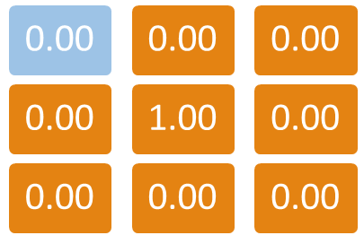
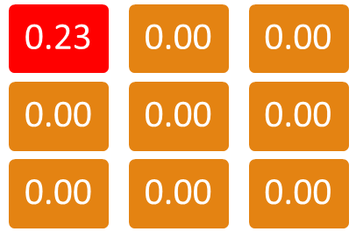
Propagation Algorithm
Pseudo Code
For each tile on the map
Get the influence value of each neighbor after decay
Keep the maximum decayed influence value of all neighbors
Apply linear interpolation to the influence value of the tile, and the maximum decayed influence value from all neighbors, with growing factor as coefficient
Store the result to the temp layer
Store influence value from temp layer
Influence Layer
Temp Layer
decay factor: 0.2, growing factor: 0.3
max neighbor influence: 0.75
lerp(0, 0.75, 0.3) =
(1-0.3)*0 + 0.3*0.75 = 0.23

Slide 11
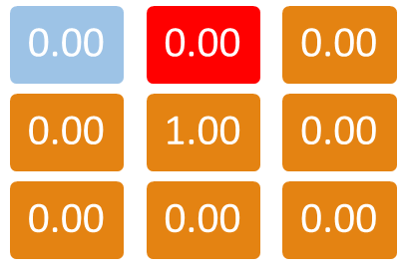
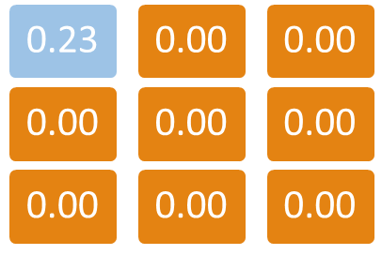
Propagation Algorithm
Pseudo Code
For each tile on the map
Get the influence value of each neighbor after decay
Keep the maximum decayed influence value of all neighbors
Apply linear interpolation to the influence value of the tile, and the maximum decayed influence value from all neighbors, with growing factor as coefficient
Store the result to the temp layer
Store influence value from temp layer
Influence Layer
Temp Layer
decay factor: 0.2, growing factor: 0.3

Slide 12
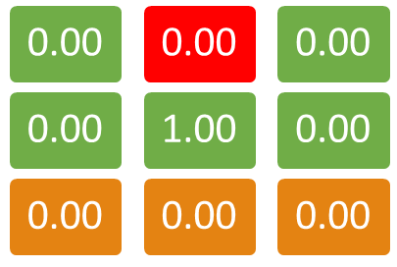
Propagation Algorithm
Pseudo Code
For each tile on the map
Get the influence value of each neighbor after decay
Keep the maximum decayed influence value of all neighbors
Apply linear interpolation to the influence value of the tile, and the maximum decayed influence value from all neighbors, with growing factor as coefficient
Store the result to the temp layer
Store influence value from temp layer
Influence Layer
Temp Layer
decay factor: 0.2, growing factor: 0.3
max neighbor influence:
B - 1 * exp(-1* 0.2) = 0.82

Slide 13
Propagation Algorithm
Pseudo Code
For each tile on the map
Get the influence value of each neighbor after decay
Keep the maximum decayed influence value of all neighbors
Apply linear interpolation to the influence value of the tile, and the maximum decayed influence value from all neighbors, with growing factor as coefficient
Store the result to the temp layer
Store influence value from temp layer
Influence Layer
Temp Layer
decay factor: 0.2, growing factor: 0.3
max neighbor influence: 0.82
lerp(0, 0.82, 0.3) =
(1-0.3)*0 + 0.3*0.82 = 0.25

Slide 14
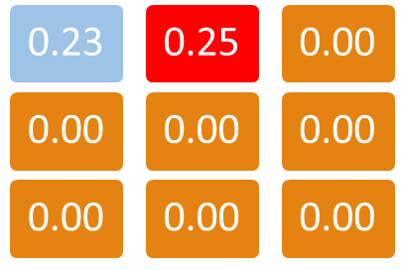
Propagation Algorithm
Pseudo Code
For each tile on the map
Get the influence value of each neighbor after decay
Keep the maximum decayed influence value of all neighbors
Apply linear interpolation to the influence value of the tile, and the maximum decayed influence value from all neighbors, with growing factor as coefficient
Store the result to the temp layer
Store influence value from temp layer
Influence Layer
Temp Layer
decay factor: 0.2, growing factor: 0.3
max neighbor influence: 0.82
lerp(0, 0.82, 0.3) =
(1-0.3)*0 + 0.3*0.82 = 0.25

Slide 15
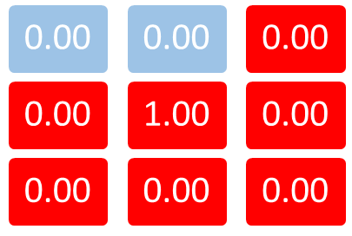
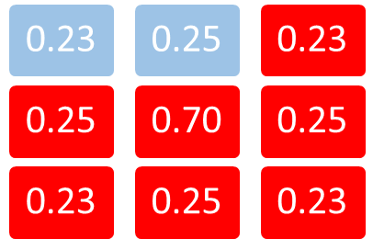
Propagation Algorithm
Pseudo Code
For each tile on the map
Get the influence value of each neighbor after decay
Keep the maximum decayed influence value of all neighbors
Apply linear interpolation to the influence value of the tile, and the maximum decayed influence value from all neighbors, with growing factor as coefficient
Store the result to the temp layer
Store influence value from temp layer
Influence Layer
Temp Layer
decay factor: 0.2, growing factor: 0.3

Slide 16
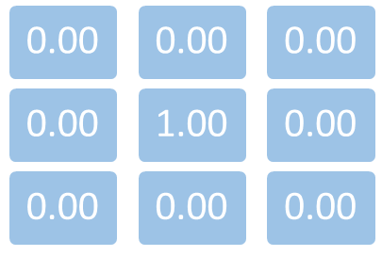
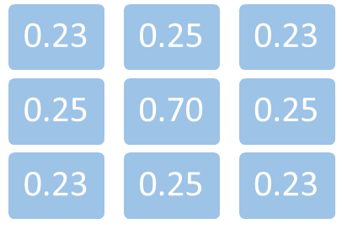
Propagation Algorithm
Pseudo Code
For each tile on the map
Get the influence value of each neighbor after decay
Keep the maximum decayed influence value of all neighbors
Apply linear interpolation to the influence value of the tile, and the maximum decayed influence value from all neighbors, with growing factor as coefficient
Store the result to the temp layer
Store influence value from temp layer
Influence Layer
Temp Layer
decay factor: 0.2, growing factor: 0.3

Slide 17
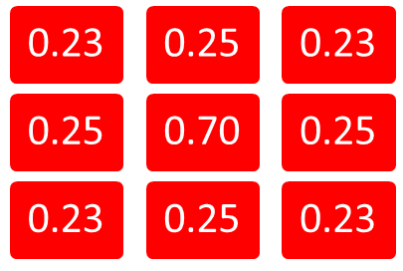
Propagation Algorithm
Pseudo Code
For each tile on the map
Get the influence value of each neighbor after decay
Keep the maximum decayed influence value of all neighbors
Apply linear interpolation to the influence value of the tile, and the maximum decayed influence value from all neighbors, with growing factor as coefficient
Store the result to the temp layer
Store influence value from temp layer
Influence Layer
Temp Layer
decay factor: 0.2, growing factor: 0.3

Slide 18
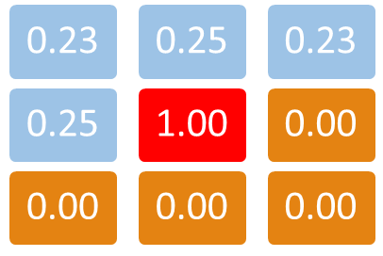
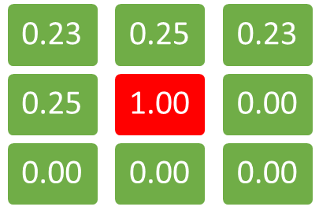
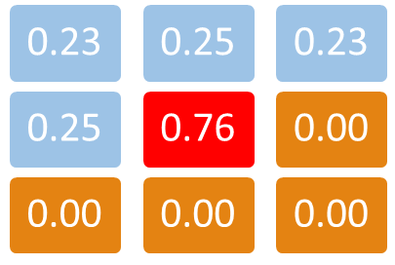
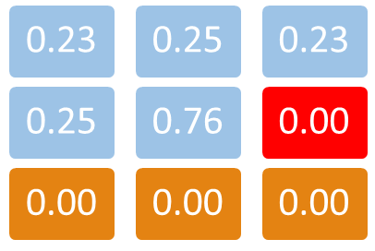
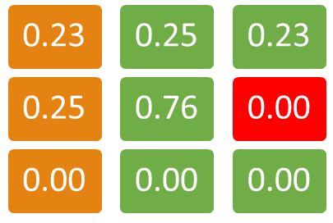
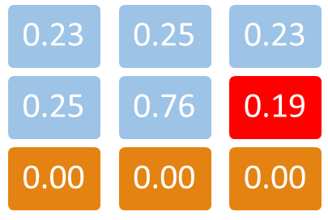

Propagation Algorithm
Double Buffering
  To ensure influences are calculated correctly.
  Without double buffering, the influence may propagate differently depending on the order of processing.

Slide 19
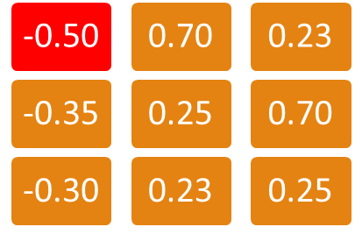
Propagation Algorithm
Two Agents
For each tile on the map
Get the influence value of each neighbor after decay
If old influence is negative, keep the minimum neighbor influence. If old influence is positive, keep the maximum neighbor influence. If old influence is 0, keep the decayed influence WITH THE HIGHEST ABSOLUTE.
Apply linear interpolation with growing factor. Store the result to the temp layer.
Store influence value from temp layer
Influence Layer
Temp Layer
decay factor: 0.2, growing factor: 0.3

Slide 20
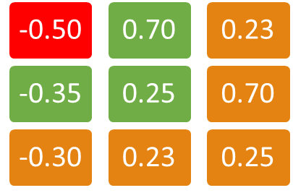
Propagation Algorithm
Two Agents
For each tile on the map
Get the influence value of each neighbor after decay
If old influence is negative, keep the minimum neighbor influence. If old influence is positive, keep the maximum neighbor influence. If old influence is 0, keep the decayed influence WITH THE HIGHEST ABSOLUTE.
Apply linear interpolation with growing factor. Store the result to the temp layer.
Store influence value from temp layer
Influence Layer
Temp Layer
decay factor: 0.2, growing factor: 0.3
neighbor influences:
R – 0.7 * exp(-1 * 0.2) = 0.57
B – -0.35 * exp(-1 * 0.2) = -0.29 **MAX**
BR – 0.25 * exp(-sqrt(2) * 0.2) = 0.19

Slide 21
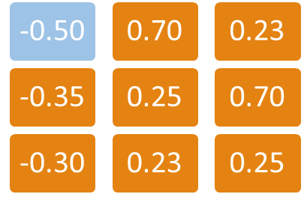
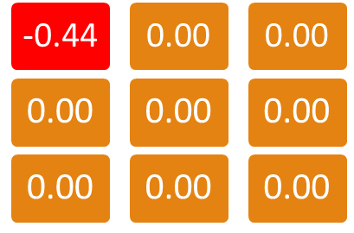
Propagation Algorithm
Two Agents
For each tile on the map
Get the influence value of each neighbor after decay
If old influence is negative, keep the minimum neighbor influence. If old influence is positive, keep the maximum neighbor influence. If old influence is 0, keep the decayed influence WITH THE HIGHEST ABSOLUTE.
Apply linear interpolation with growing factor. Store the result to the temp layer.
Store influence value from temp layer
Influence Layer
Temp Layer
decay factor: 0.2, growing factor: 0.3
max neighbor influence: -0.29
lerp(-0.5, -0.29, 0.3) =
(1-0.3)*-0.5 + 0.3*-0.29 = -0.44

Slide 22
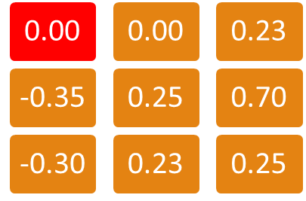
Propagation Algorithm
Two Agents
For each tile on the map
Get the influence value of each neighbor after decay
If old influence is negative, keep the minimum neighbor influence. If old influence is positive, keep the maximum neighbor influence. If old influence is 0, keep the decayed influence WITH THE HIGHEST ABSOLUTE.
Apply linear interpolation with growing factor. Store the result to the temp layer.
Store influence value from temp layer
Influence Layer
Temp Layer
decay factor: 0.2, growing factor: 0.3

Slide 23
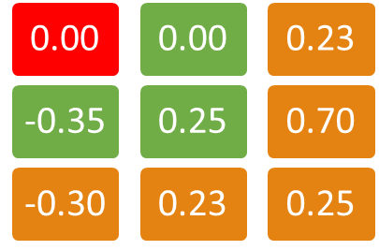
Propagation Algorithm
Two Agents
For each tile on the map
Get the influence value of each neighbor after decay
If old influence is negative, keep the minimum neighbor influence. If old influence is positive, keep the maximum neighbor influence. If old influence is 0, keep the decayed influence WITH THE HIGHEST ABSOLUTE.
Apply linear interpolation with growing factor. Store the result to the temp layer.
Store influence value from temp layer
Influence Layer
Temp Layer
decay factor: 0.2, growing factor: 0.3
neighbor influences:
R – 0 * exp(-1 * 0.2) = 0
B – -0.35 * exp(-1 * 0.2) = -0.29 **MAX**
BR – 0.25 * exp(-sqrt(2) * 0.2) = 0.19

Slide 24
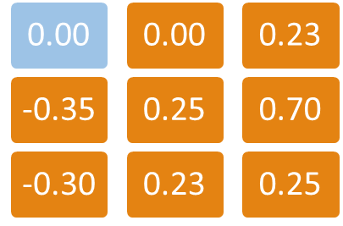

Propagation Algorithm
Two Agents
For each tile on the map
Get the influence value of each neighbor after decay
If old influence is negative, keep the minimum neighbor influence. If old influence is positive, keep the maximum neighbor influence. If old influence is 0, keep the decayed influence WITH THE HIGHEST ABSOLUTE.
Apply linear interpolation with growing factor. Store the result to the temp layer.
Store influence value from temp layer
Influence Layer
Temp Layer
decay factor: 0.2, growing factor: 0.3
max neighbor influence: -0.29
lerp(0, -0.29, 0.3) =
(1-0.3)*0 + 0.3*-0.29 = -0.09

Slide 25
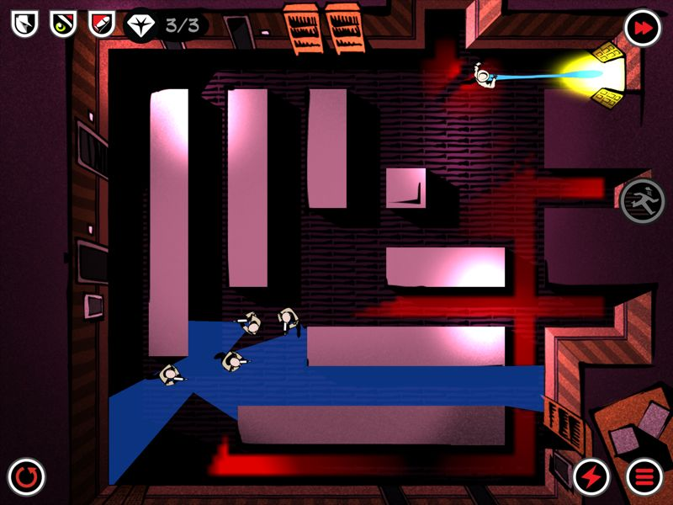
Occupancy Map
Overview
  Run propagation algorithm on occupancy layer.
  Normalize the occupancy value after each propagation.
  So the highest occupancy value is always 1.0.
  The tile with the highest occupancy value is the most likely location for the player.
    Need to find the closest tile to AI with1.0 influence value, to make sure AI searches the closer area first.
  If no tile has occupancy value >= 1.0 after normalizing, means there is no propagation.
    AI “loses” the player.
    AI should go back to its old behavior.

Slide 26
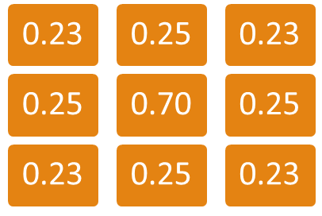
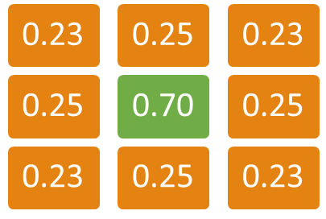
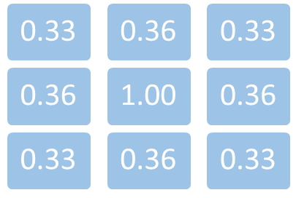
Occupancy Map
Normalize Influence Value
  Find highest influence value x.
  Divide all tiles with positive influence value by x.
    Ignore negative values, because it is used by enemy’s field of view.
  So the highest influence value of the map is always 1.0.

Slide 27
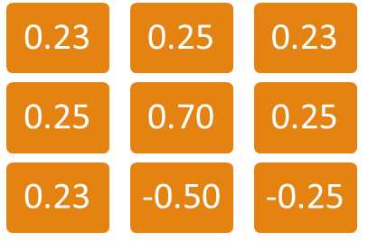
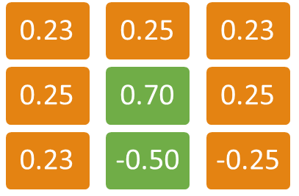
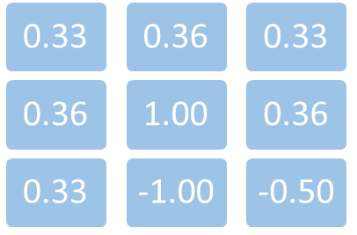
Occupancy Map
Normalize Influence Value / Two Agents
  Find highest positive influence value x and lowest negative influence value y.
  Divide all tiles with positive influence value by x.
  Divide all tiles with negative influence value by -y.
  So the highest influence value of the map is always 1.0, and the lowest is -1.0.

Slide 28
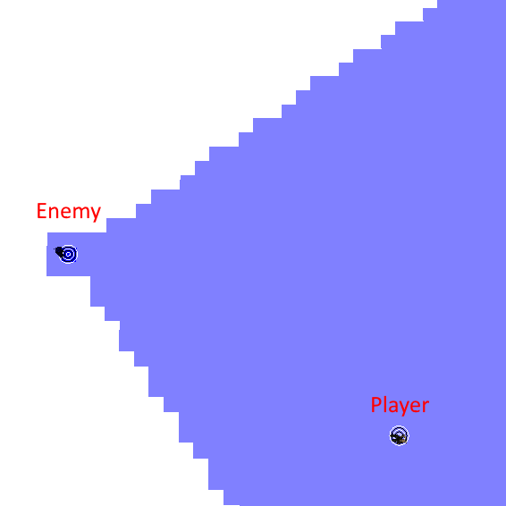
Occupancy Map
Field of View
  Similar to Search layer.
    Check if the tile is visible to AI, and is within the view angle.
  But for all tiles that are close enough to the AI, do not check view angle.
    Still need to check if the AI is visible to the tile, to prevent AI from seeing through walls.
  Mark all tiles the AI can see with negative influence value.
    -0.50 : enemy alert.
    -0.25 : enemy patrol.

Slide 29
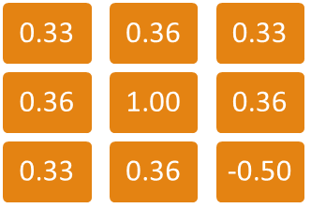
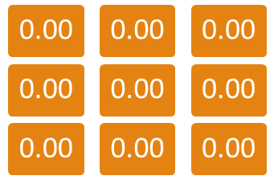
Occupancy Map
Pseudo Code
Update occupancy with propagation algorithm on the temp layer, if value < 0.0, use 0.0
Apply FOV layer
Normalize the occupancy map, ignore all values <= 0.0
Store occupancy value from temp layer
Occupancy Layer
Temp Layer

Slide 30
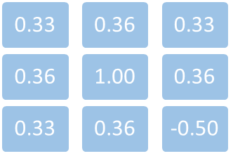
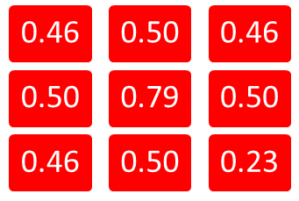
Occupancy Map
Pseudo Code
Update occupancy with propagation algorithm on the temp layer, if value < 0.0, use 0.0
Apply FOV layer
Normalize the occupancy map, ignore all values <= 0.0
Store occupancy value from temp layer
Occupancy Layer
Temp Layer

Slide 31
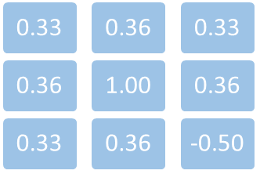
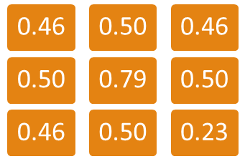
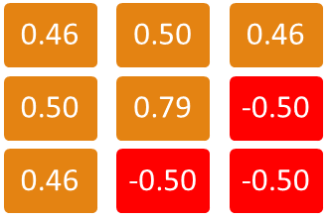
Occupancy Map
Pseudo Code
Update occupancy with propagation algorithm on the temp layer, if value < 0.0, use 0.0
Apply FOV layer
Normalize the occupancy map, ignore all values <= 0.0
Store occupancy value from temp layer
Occupancy Layer
Temp Layer

Slide 32

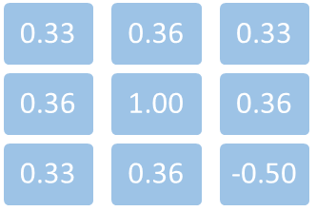
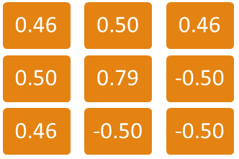
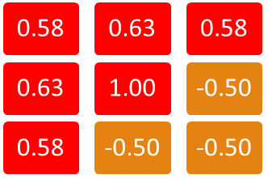
Occupancy Map
Pseudo Code
Update occupancy with propagation algorithm on the temp layer, if value < 0.0, use 0.0
Apply FOV layer
Normalize the occupancy map, ignore all values <= 0.0
Store occupancy value from temp layer
Occupancy Layer
Temp Layer

Slide 33

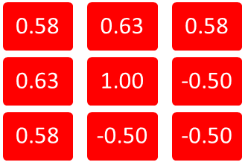

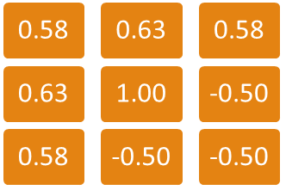

Occupancy Map
Pseudo Code
Update occupancy with propagation algorithm on the temp layer, if value < 0.0, use 0.0
Apply FOV layer
Normalize the occupancy map, ignore all values <= 0.0
Store occupancy value from temp layer
Occupancy Layer
Temp Layer

Slide 34
Occupancy Map
AI Logic for Hide and Seek
Compute FOV layer
If the AI sees the player (player’s tile has negative occupancy value), behavior : RUN TO PLAYER
Pick the player’s position as goal
If the AI can’t see the player, behavior : SEEK PLAYER
If the player moves out of sight, use its last known position to start propagation
Update occupancy map
Pick the closest tile with 1.0 occupancy value as goal
If no tile has 1.0 occupancy value, AI loses the player
If AI loses player, behavior : PATROL
AI picks a random position within certain distance as goal, and walk to it

Slide 35
Project 3:
Terrain Analysis & Occupancy Map

Slide 36
Project 3:
Terrain Analysis & Occupancy Map
Assigned week 7, due week 9 (by 6:00pm).
Download starting code from webpage.
No sharing code on this assignment.

Slide 37
Project 3:
Grading (1)
Terrain Analysis:
(10%) Openness Closest Wall
(10%) Visibility
(10%) Visible to Player (with 50% sniper spots)
(10%) Search
(5%) A* with Analysis

Slide 38
Project 3:
Grading (2)
Occupancy Map:
(15%) Propagation
(10%) Normalize Occupancy
(10%) Field of View (Hide and Seek)
(10%) Find Player (Hide and Seek)
(10%) Seek Player (Hide and Seek)

Slide 39
Project 3:
Grading (3)
Project 2:
(-30%) If A* solution doesn't beat required time
(-10%) If it crashes at any time
(0 to -100%) Project 2 requirements regraded
(extra credit) All Project 2 extra credit still available
Detailed instruction in Project3_Instruction.docx.

Slide 40
Project 3:
Extra Credit
(15%) Pathfinding with Fog of War

Slide 41
Terrain Analysis & Occupancy Map
Reference :
  The Mechanics of Influence Mapping: Representation, Algorithm & Parameters
  By Alex J. Champandard on May 19, 2011
  http://aigamedev.com/open/tutorial/influence-map-mechanics/

