Slide 1
PPF Curve: Production Possibility Frontier
The PPF is
a diagram
that shows the
combinations of
two goods that are possible for a society
to produce at full employment.

Slide 2
Trade-Offs: The Production Possibility Frontier
Quantity of
Dreamliners
All points under (inside) the curve are feasible,
but there are some idle/unemployed resources
And all points above the curve are not feasible.
All points ON the curve are feasible and efficient.
The PPF line
D
30
Production Possibilities
Dreamliners | Small Jets
30 | 0
15 | 20
9 | 28
0 | 40
A
15
B
9
C
20
28
40
Quantity of Small Jets
When we move from A to B, what happened?
What is the opportunity cost of one small jet?
What is the opportunity cost of one Dreamliners?

Slide 3
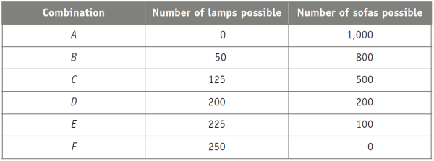
What is the opportunity cost of each lamp?
One-fourth of a sofa
1 sofa
4 sofas
200 sofas
To Next
Active Learning
Notes:
Correct answer is C

Slide 4
The Law of Increasing Relative Cost When the Opportunity Cost is “Increasing “
Quantity of
Dreamliners
What is the slope of this “increasing” opportunity cost?
Producing the first
20 small jets . . .
…requires giving up
5 Dreamliners
35
30
But producing
20 more small jets . . .
A
25
20
…requires giving up
25 more Dreamliners…
15
10
5
PPF
0
10
20
30
40
50
Quantity of small jets

Slide 5
PPF and Economic Growth
When the PPF curve shifts upward, the economy can now produce more of everything.
What factors that might shift that PPF?
Quantity of
Dreamliners
35
E
30
A
25
20
15
10
5
Original
New
PPF
PPF
0
10
20
25
30
40
50
Quantity of small jets
Notes:
Economic growth results in an outward shift of the production possibility frontier because production possibilities are expanded. The economy can now produce more of everything. For example, if production is initially at point A (25 Dreamliners and 20 small jets), economic growth means that theeconomy could move to point E (30 Dreamliners and 25 small jets).

Slide 6
What Causes Economic Growth?
Two possibilities:
An increase in factors of production: resources used to produce goods and services.
Better technology: the technical means for producing goods and services.
Factors of Production
Land: incl. natural resources
Labor: mental and physical abilities of the workforce
Physical Capital: machineries used to produce other goods/services
Human Capital: education/skills
Financial Capital
Technology

Slide 7
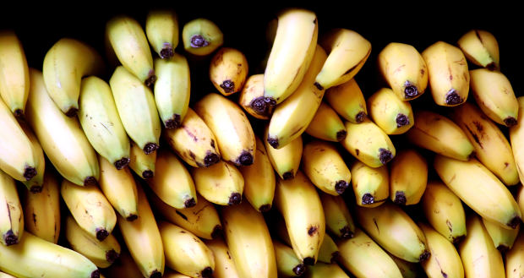
Comparative Advantage and Gains from Trade
Theory of Comparative Advantage:
It makes sense to produce the things you’re especially good at producing and buy from other people the things you aren’t as good at producing.
The U.S. imports bananas from Ecuador.

Slide 8
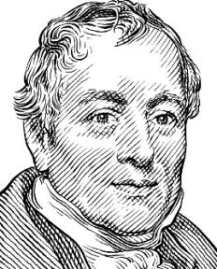
Origin of the Idea
David Ricardo (1772–1823)
Argued against Corn Laws in British Parliament.
Corn Laws: high tariffs on imported grain that protected British landowners.
His theory of comparative advantage is still the ideological foundation for
free trade.

Slide 9






Comparative Advantage : Lower Opportunity Cost
each country has a different opportunity cost for each good.
Take a look at the opportunity costs for computers:
Would there be a benefit to trade?
If so, who should produce what?

Slide 10
Comparative Advantage and Gains from Trade
Mexico’s Production Possibilities Frontier
Computers
6
Production Possibilities
Computers | Shirts
2 | 0
1 | 6
0 | 12
5
The PPF
4
3
Suppose there’s 24 man-hours available.
The slope = the trade-off (“cost”) of one good for the other.
(One-sixth of a computer = 1 shirt;
Or 6 shirts “cost” 1 computer.)
2
1
2
4
6
8
10
12
Shirts
Suppose in the U.S., there’s also 24 man-hours available.
But one man-hour can produce one computer or one shirt.
What’s the slope (the opportunity cost)? Graph the PPF for U.S.

Slide 11
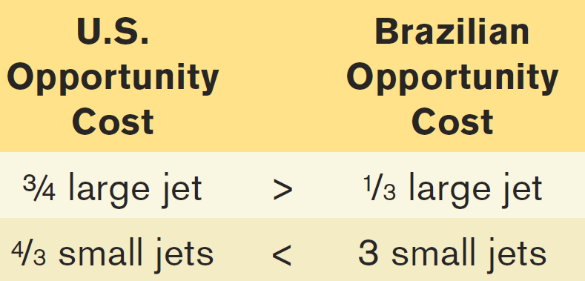
Comparative Advantage and Gains from Trade
(a) U.S. Production Possibilities
(b) Brazilian Production Possibilities
Quantity of
large jets
Quantity of
large jets
For 1 small jet:
For 1 large jet:
30
U.S. consumption
without trade
18
Brazilian consumption
without trade
10
8
U.S.
PPF
Brazilian
PPF
0
16
40
0
6
30
Quantity of small jets
Quantity of small jets
Since each country has a different opportunity cost, it makes sense to specialize and trade…

Slide 12
Comparative Advantage and Gains from Trade
(a) U.S. Production Possibilities
(b) Brazilian Production Possibilities
Quantity of
large jets
If the U.S. specializes in large jets…
Quantity of
large jets
And Brazil specializes in small jets…
30
U.S. consumption
without trade
18
Brazilian consumption
without trade
10
8
U.S.
PPF
Brazilian
PPF
0
16
40
0
6
30
Quantity of small jets
Quantity of small jets
More airplanes will be produced with the same resources (up from 26 (18 + 8) to 30 large jets and up from 22 (16+6) to 30 small jets).

Slide 13
Comparative Advantage and Gains from Trade
Both countries gain.
(a) U.S. Production Possibilities
(b) Brazilian Production Possibilities
Then the U.S. will send some large jets to Brazil in return for small jets…
And Brazil will send some small jets to the U.S. in return for large jets…
Quantity of
large jets
Quantity of
large jets
30
U.S. consumption
without trade
U.S. consumption
with trade
20
Terms of Trade:
Both are happy with 1 large jet trading for 2 small jets.
Brazilian consumption
without trade
18
10
Brazilian consumption
with trade
8
U.S.
PPF
Brazilian
PPF
0
16
20
40
0
6
10
30
Quantity of small jets
Quantity of small jets
Both countries will be happy to export their goods for any price ABOVE their cost of production and import for any price BELOW their cost of production.

Slide 14
Comparative Advantage vs. Absolute Advantage
Absolute advantage: a country can produce more output per worker than other countries.
Comparative advantage: a country has lower opportunity cost in producing an output compare to other countries.
Quantity of
large jets
(a) U.S. Production Possibilities
Quantity of
large jets
(b) Brazilian Production Possibilities
U.S. has the absolute advantage in BOTH large and small jets.
30
10
U.S.
PPF
Brazilian
PPF
0
40
0
30
Quantity of small jets
Quantity of small jets

Slide 15
Let’s try this
Bert can complete one batch of cookies in 60 minutes, but it took him 30 minutes to make one glass of lemonade. Ernie can make one batch of cookies in 45 minutes, and it took him 15 minutes to make a glass of lemonade.
Graph the PPF for each, Bert and Ernie.
Who has “Absolute Advantage” in Lemonade?
Who has “Absolute Advantage” in Cookies?
Who has “Comparative Advantage” in Lemonade?
Who has “Comparative Advantage” in Cookies?

Slide 16
Let’s Try This
Suppose that in Australia, it takes 2 hours to harvest 10 bushels of apples and 4 hours to harvest 10 bushels of tomatoes. Suppose a worker in Brazil can harvest 10 bushels of apples in 4 hours or 10 bushels of tomatoes in 5 hours. (hint: “eliminate” the resources, in this case, the “hour”).
Graph the PPF lines for each countries
Determine the opportunity costs of each country in producing a bushel of tomatoes
Which country has the comparative advantage in tomato? In Apple?
Which country has the absolute advantage in tomato? In Apple?
To Next
Active Learning
Notes:
This a more difficult question because it requires a two-step calculation of cost. A is correct. In Australia, the opportunity cost of harvesting 10 bushels of tomatoes is 20 bushels of apples. In Brazil, the opportunity cost of harvesting 10 bushels of tomatoes is 12.5 bushels of apples. Australia has the absolute advantage in both goods, but also exhibits the higher opportunity cost of growing tomatoes.

Slide 17
Discussion
The Globalization started in the1980s, and since then countries have been engaging in international trade from one corner of the world to the other, buying and selling goods and services from fruits to super chip semi-conductors. Discuss with your pair-up partner the following:
Why do consumers in the United States import so much cheap clothing from poor countries? State three reasons.
b) Why are some countries poor? And stay poor even after engaging in trade with other countries? State three reasons.
c) How would you rate U.S. economy: in 1950, in 2000, and in 2014.
Sketch a PPF that shows three different eras of US economy.
d) How would Game Design, as an industry, contribute to the overall US economy? You can write your reasonings in terms of: financial, education, job market, psychological, time management, people’s relationships, etc.

Slide 18
Exercise : Comparative Advantage and International Trade
(a) The U.S. Production Possibilities Frontier
(b) Canadian Production Possibilities Frontier
Quantity of aircraft
Quantity of aircraft
3,000
U.S. consumption without trade
U.S. consumption with trade
Canadian consumption without trade
2,000
1,500
1,500
Canadian consumption with trade
1,000
U
.S.
Canadian
PPF
PPF
0
1
2
3
0
0.5
1
1.5
Quantity of pork (millions of tons)
Quantity of pork (millions of tons)
Determine the per unit opportunity cost of 1 mil.ton of pork in the US and Canada.
Determine which country should specialize in which product
Determine the terms of trade between the two countries in order to achieve
the new level of consumption with trade.
Notes:
In this hypothetical example, Canada and the United States produce only two goods: pork and aircraft. Aircraft are measured on the vertical axis and pork on the horizontal axis. Panel (a) shows the U.S. production possibility frontier. It is relatively flat, implying that the United States has a comparative advantage in pork production. Panel (b) shows the Canadian production possibility frontier. It is relatively steep, implying that Canada has a comparative advantage in aircraft production. Just like two individuals, both countries gain from specialization and trade.

