Slide 1

TAXES & Elasticities
The effects of Excise taxes on supply and demand
Incidence of Taxes:
who really bears the burden of a tax
The costs and benefits of taxes and why taxes impose a cost that is larger than the tax revenue they raise
To First
Active Learning
To Video

Slide 2
The Importance of TAX
“Only Two Things are certain in life: Death and Taxes”
Taxes are necessary; without taxes, governments could not provide the services that we want or need, from national defense to public parks.
Taxes can distort the incentives of the producers and consumers in the market to achieve efficiency.
In most (if not all) cases, it will provoke the sense of fairness.
Tax policy, if designed well, it can be used to create incentives: to change negative behaviors (or to stimulate positive behaviors).

Slide 3
Excise Tax and Incidence of Tax
Taxes drive a wedge between the price buyers pay and the price sellers receive.
To analyze the effects, we’ll graph two scenarios:
when the tax is levied on sellers
when the tax is levied on buyers
The incidence of a tax is a measure of who really pays it, and how the tax is divided, and how much consumers pay portion of the tax, and how much portion of the tax is absorbed by the producers.

Slide 4
An Excise Tax Imposed on PRODUCERS
The $40 excise tax is shared between buyers and sellers.
Price
The equilibrium price of hotel rooms rises to $100 a night.
$140
Supply curve shifts upward by the amount of the tax.
S₂
Hotel guests bear some of the burden as price RISES from $80 to $100.
120
A
S₁
100
Excise tax = $40 per room
E
80
Hotel owners also bear some of the burden as their price (net of the tax paid) FALLS from $80 to $60.
60
B
D
40
20
0
5,000
10,000
15,000
Quantity of hotel rooms
And the quantity falls to 5,000

Slide 5
An Excise Tax Imposed on CONSUMERS
The incidence of an excise tax doesn’t depend on who officially pays the tax.
Price
The equilibrium price of hotel rooms falls to $60 a night.
$140
Hotel guests also bear some of the burden as price RISES from $80 to $100 (after taxes are paid).
Demand curve shifts downward by the amount of the tax.
120
A
S
100
E
Excise tax = $40 per room
80
Hotel owners bear some of the burden as their price FALLS from $80 to $60.
60
D
B
1
40
20
D
2
0
5,000
10,000
15,000
And the quantity falls to 5,000.
Quantity of hotel rooms

Slide 6
Active Learning
Price
If A is the buyer price and B the seller price, how large is the per-unit tax imposed on the graph?
$5
$10
$15
$50
$1,000
$35
30
A
S
25
E
20
15
D₁
B
10
5
0
100
200
300
To Next
Active Learning
Quantity

Slide 7

Price Elasticities and Tax Incidence
Although both buyer and seller share the burden of the tax, it’s not always an equal burden.
In a long-distance relationship, who will do more of the driving?
Does the “tax” fall more heavily to the more committed partner?

Slide 8
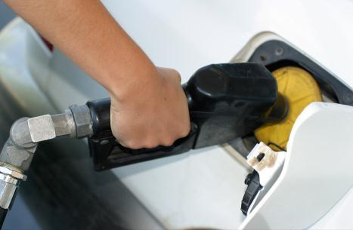
When an Excise Tax Is Paid Mainly by Consumers
When the price elasticity of demand is low and the price elasticity of supply is high, the burden of an excise tax falls mainly on consumers. The 95c (out of $1 tax) is paid by consumers as consumers are “inelastic” in demand for gas. Notice the steep demand curve.
Price of gasoline (per gallon)
$2.95
Tax burden falls mainly on consumers.
Excise tax = $1 per gallon
2.00
S
1.95
D
0
Quantity of gasoline (gallons)

Slide 9
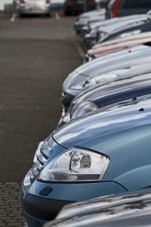
When an Excise Tax Is Paid Mainly by Producers
When the price elasticity of demand is high and the price elasticity of supply is low, the burden of an excise tax falls mainly on producers.
Price of parking space
S
$6.50
6.00
D
Excise tax =
$5 per
parking space.
Tax burden falls mainly on producers.
1.50
0
Quantity of parking spaces

Slide 10
Active Learning
If demand of some good is more elastic than supply and a tax is imposed on the consumption of the good, who will bear more of the burden of the tax?
Producers, because consumers have a greater ability to change their behavior in response to the tax.
Both parties will share the burden equally.
Consumers, because they pay the tax out of pocket.
The government, because the tax will cause less of the good to be produced and consumed.
To Next
Active Learning

Slide 11
Incidence of Tax & Elasticities
A $10 excise tax is imposed on a certain good, determine the “incidence of tax” – who pays how much the portion of tax, if:
The price elasticity of demand of consumers and the price elasticity of supply of the producers can be represented by a ratio of 1:1.
The price elasticity of demand of consumers and the price elasticity of supply of the producers can be represented by a ratio of 3:1.
The price elasticity of demand of consumers and the price elasticity of supply of the producers can be represented by a ratio of 3:2.
The price elasticity of demand of consumers is completely elastic and the price elasticity of producers can be represented by 2.
The price elasticity of demand of consumers is completely inelastic and the price elasticity of producers can be represented by 2.
Notes:
Answers: The $10 tax:
$5 paid by consumer, and $5 by the producer.
$2.50 paid by consumer, and $7.50 by the producer. (consumer is more elastic – 3 to 1, pay less)
$4 paid by consumer, and $6 paid by the producer.
All $10 tax will be paid by the producer (or the producer will absorb all $10), and consumer pays zero (or price to consumer does not change).
All $10 tax will be paid by the consumer (the price to consumer increases by $10).

Slide 12
Tax on Boat, Yacht, Cruises
A cruise - ---The pleasure boat seems like a good thing to tax…
Or not: The Omnibus Budget Reconciliation Act of 1990 applied a 10% federal luxury tax to the retail sale of luxury goods like pleasure boats with a sales price above $100,000.
Expected tax revenue? $9 billion. Reality?
Sales of boats went down 52.7%.
Net 30,000 jobs were lost.
The federal government paid out more than $7 million more in unemployment benefits to those workers than it collected in luxury tax revenues.
The federal luxury tax was repealed in 1993.
To Next
Active Learning

Slide 13
The Revenue from an Excise Tax
Price of hotel room
The tax revenue collected =
$40 per room × 5,000 rooms = $200,000
$140
120
A
S
100
Excise tax = $40 per room.
E
80
Area = tax revenue
60
D
B
40
20
0
6
5,000
10,000
15,000
Quantity of hotel rooms

Slide 14
Increasing the Tax Rate Does Not Necessarily Increase Revenue
(a) An excise tax of $20
(b) An excise tax of $60
Price of hotel room
Price of hotel room
Tax revenue= $150,000
Tax revenue= $150,000
$140
$140
120
120
110
S
S
Excise tax = $20 per room.
90
E
E
Area = tax revenue
Excise tax = $60 per room.
80
80
Area = tax revenue
70
D
D
50
40
40
20
20
0
6
,000
7,500
10,000
15,000
0
2,500
5,000
10,000
15,000
Quantity of hotel rooms
Quantity of hotel rooms

Slide 15
Total Surplus Is Maximized at Market Equilibrium
Total surplus: the sum of the producer and consumer surpluses.
Price of book
$55
S
Consumer surplus
Equilibrium price
E
$30
Producer surplus
$10
D
0
1,000
Quantity of books
Equilibrium quantity

Slide 16
Consumer Surplus
Consumer surplus is the area beneath the demand curve and above the price.
Price of widgets
Area of triangle
Height
80
Total consumer surplus at a price of $20
Area: ½(base x height)
Base
½(80 – 20) × 90 = $2,700
20
D
90
Quantity of widgets
Notes:
Teaching Tip:You can easily personalize consumer surplus. Look for a student
with a Coke, coffee, or water. Ask how much he or she paid for it.
Then ask if that was the maximum they would have paid or if the store
had been charging a little more would they still have bought it. They likely
will admit they still would have bought it.Then ask what is the maximum
price they would have paid before walking away without buying. Calculate
their consumer surplus from the transaction and relate this to how it
would be measured on a demand diagram.

Slide 17
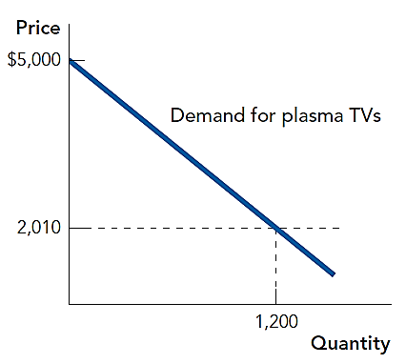
If the price is $2010, what is the consumer surplus?
$3.588 million
$1.794 million
$6 million
$3 million
To Next
Active Learning

Slide 18
Total Surplus is Maximized at Market Equilibrium
What is the total surplus when price is at equilibrium?
$480
$720
$1,080
$1,440
$22
S
Price of Lobster
Equilibrium price
E
10
4
D
0
120
Quantity of lobster
To Next
Active Learning
Equilibrium quantity
Notes:
(22-4)/2 = 1080

Slide 19
The Costs of Taxation: Deadweight Loss Reduction in Consumer and Producer Surplus
Price
Fall in consumer surplus due to tax
S
Govt Tax revenue: A + C
Lost surplus is called deadweight loss: B+F.
P_{C}
A
B
Excise tax = T
P_{L}
E
C
F
P_{P}
Fall in producer surplus due to tax
D
Q_{T}
Q_{E}
Quantity

Slide 20
The Effects of a Tax
A Tax generates revenue and creates a deadweight loss.
Price
Consumer surplus— consumers get this.
Deadweight loss—no one gets this.
Supply
Price buyer pays = $2.65.
Tax Revenue
= $500
Tax
tax = $1
Price seller receives = $1.65.
Tax revenue—the government gets this.
Demand
Producer surplus—producers get this.
Quantity
500 = Q_{T}
700 = Q_{E}

Slide 21
In-Class Exercise
Price
According to this graph, A is the buyer price and B the seller price, calculate:
What is the amount of per unit tax?
The consumer surplus before and after tax.
The producer surplus before and after tax.
The total tax revenue collected by the government.
the deadweight loss
$35
30
A
S
26
E
20
15
D₁
B
10
5
0
100
200
300
To Next
Active Learning
Quantity

Slide 22
Deadweight Loss and Elasticities
(a) Elastic demand
(b)
Inelastic demand
Price
S
Price
S
Deadweight loss is larger when demand is elastic.
P_{C}
P_{C}
Excise tax = T.
P_{E}
E
P_{E}
E
Deadweight loss is smaller when demand is inelastic.
Excise tax = T.
P_{P}
D
P_{P}
D
Q_{T}
Q_{E}
Quantity
Q_{T}
Q_{E}
Quantity

Slide 23
Deadweight Loss and Elasticities
(c) Elastic Supply
(d)
Inelastic Supply
Price
Price
S
Deadweight loss is larger when supply is elastic
P
C
S
P
Excise tax = T
C
P
E
P
E
Deadweight loss is smaller when supply is inelastic
E
Excise tax = T
E
P
P
P
P
D
D
Q
Q
Quantity
Q
Q
Quantity
T
E
T
E

Slide 24
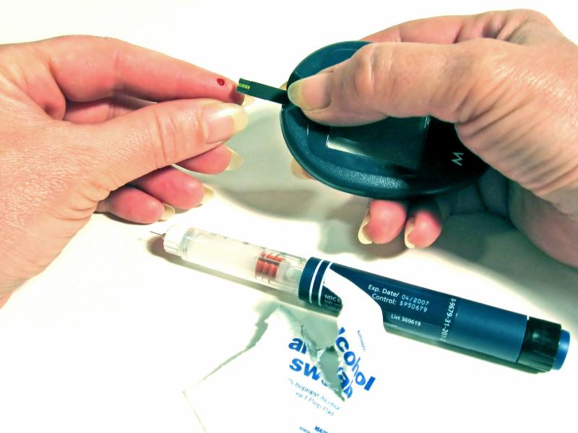
Deadweight Loss and Elasticities
If the goal in in tax policy is efficiency (minimizing deadweight loss), then policymakers should choose the goods with the lowest price elasticities or inelastic goods.
A tax on insulin would be efficient—but not necessarily fair.

Slide 25
Minimizing deadweight loss?
If the government wants to minimize the deadweight loss of taxation, which of the following items are good candidates for an excise tax?
Bottled water
Prescription drugs
Oranges
Batteries
Luxury cars

Slide 26
Example
The US government would like to help the American carmaker compete internationally, especially for trucks market in the United States. It imposes an excise tax on foreign truck sold in the US. The table below shows the pre-tax demand and supply schedules for imported trucks.
a) In the absence of government interference, what is the equilibrium quantity and price of an imported truck?
b) Assume that the US government imposes the consumers an excise tax of $3,000 each. Sketch a diagram showing this tax. Figure out the ratio of elasticity between producers and consumers, and which one is more elastic to the change in price?
c) How many imported trucks are now sold and at what price? How much the foreign truck-maker receive per truck?
d) Calculate the government revenue raised by the excise tax.
e) Assess the impact of this tax: Who benefits? Who does it hurt?
f) Calculate the deadweight loss that arises due to this tax.
Price ($) Qd Qs
32,000 100 400
31,000 200 350
30,000 300 300
29,000 400 250
28,000 500 200
27,000 600 150

Slide 27
Example
The so called “Sin Tax” is a kind of tax levied on consumption of tobacco, cigarettes, liquor, marijuana, etc.
The following are the demand and supply equations of alcoholic beverages respectively; Qd = 53 – 3P; and Qs = -10 + 6P; suppose the government imposed an excise tax on the sellers by $3 per drink.
Calculate the equilibrium price and quantity before tax is levied.
Graph the curves, and show what happened when excise tax is levied, which curve will shift?
What is the incidence of tax (who pays how much)? (hint: look at the slopes of demand/supply)
Calculate the government tax revenue, and the deadweight loss.

