Slide 1
MSHI-GEO
Soil Microbial Respiration:
A Three-Tier Monitoring Stack
Continental gridded prediction · Held-out cross-continental validation · Electrochemical biosensor integration
[Author Name] · [Affiliation] · Genius Olympiad 2026

Slide 2
01 · THE PROBLEM
Soil respiration is the second-largest carbon flux. We can't see it at the resolution that matters.
Globally, soils release ~91 Pg C yr⁻¹ to the atmosphere — second only to ocean exchange. Continental upscaling models (Hashimoto 2015; Warner 2019; Stell 2021) report uncertainty as Pg C yr⁻¹ intervals on the global sum, not as held-out site-level transfer.
The decision-relevant question — does a model trained on one continent predict the next? — has not been answered. This work addresses that gap, then shows what the answer implies for the kind of ground-truth network the field needs.
MSHI-GEO · The problem
2 / 12

Slide 3
02 · FRAMEWORK
One biology, three scales of measurement.
cm
Electrochemical biosensor
Electron-transfer current proxy for substrate oxidation; centimetre footprint, continuous deployment, low cost.
m
Chamber + eddy-covariance
Direct CO₂ flux (μmol m⁻² s⁻¹); metre-scale footprint, sparse network, high instrument cost.
km
Satellite + ML upscaling (this work)
5 km grid, climate + soil + (pending) MODIS NPP features; held-out cross-continental validation.
Same biological flux. Three resolutions. The middle tier is where most chamber data lives; the satellite tier struggles to generalise; the centimetre tier is what's missing.
MSHI-GEO · Three-tier framework
3 / 12

Slide 4
03 · METHODS
Open community data, gradient-boosted trees, held-out continent.
Training data
Features
Model & validation
615 Asia sites (605 SRDB v5 + 10 COSORE) for cross-continental training.
274 CONUS sites (253 SRDB + 21 COSORE) reserved as held-out validation.
Target: log(Rs_annual), g C m⁻² yr⁻¹.
8 WorldClim 2.1 bioclim variables (T, P, seasonality).
8 SoilGrids 2.0 5-15 cm topsoil layers (SOC, N, pH, texture, ρ, CEC).
4 engineered (C/N, clay/sand, pH-optimality, aridity). MODIS NPP pending.
XGBoost regression (depth 3, n_est 250, L2 = 2 to 8).
5-fold spatial-block CV (5° blocks) on Asia.
Asia → US transfer R² + 2,000-iteration bootstrap CI.
MSHI-GEO · Methods overview
4 / 12

Slide 5
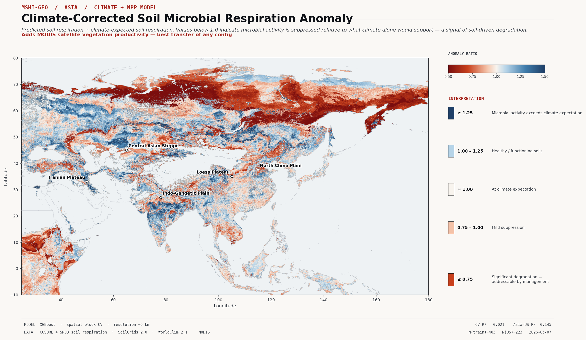
04 · RESULT 1
Climate + NPP transfers Asia → US.
R² = +0.145
95 % bootstrap CI (+0.026, +0.241)
best of any configuration · NPP is rank-1 SHAP driver
Trained on 463 Asian sites with 8 WorldClim bioclim variables plus MODIS NPP, LST_day, LST_night, and the engineered LST diurnal range. Tested on 223 held-out US sites. NPP becomes the dominant driver (mean |SHAP| = 0.128) — but climate gradients still carry the cross-continental signal: bio04 (T seasonality) and bio12 (annual precipitation) hold ranks 2 and 3.
MSHI-GEO · Climate-only model transfers
5 / 12

Slide 6
05 · RESULT 2
Adding more features doesn't help — even with MODIS.
B · 20 features (Run A baseline)
Soil + climate features
Transfer R² = +0.020
95 % CI [-0.141, +0.146] — includes zero
Full+MODIS · 34 features (Item 1)
B + MODIS NPP, LST_day, LST_night, LST diurnal range, IGBP land-cover one-hot
Transfer R² = +0.072
95 % CI [-0.084, +0.189] — still includes zero CV jumps to +0.079 (Δ = +0.162) but transfer doesn't follow.
PATTERN
Every configuration that includes the SoilGrids texture features (clay, sand, silt, or their ratios) lands transfer with a 95 % CI spanning zero. The soil-feature confound is robust to satellite augmentation — adding NPP, LST, and IGBP land-cover does not resolve it.
MSHI-GEO · Full-feature models still fail to transfer
6 / 12

Slide 7
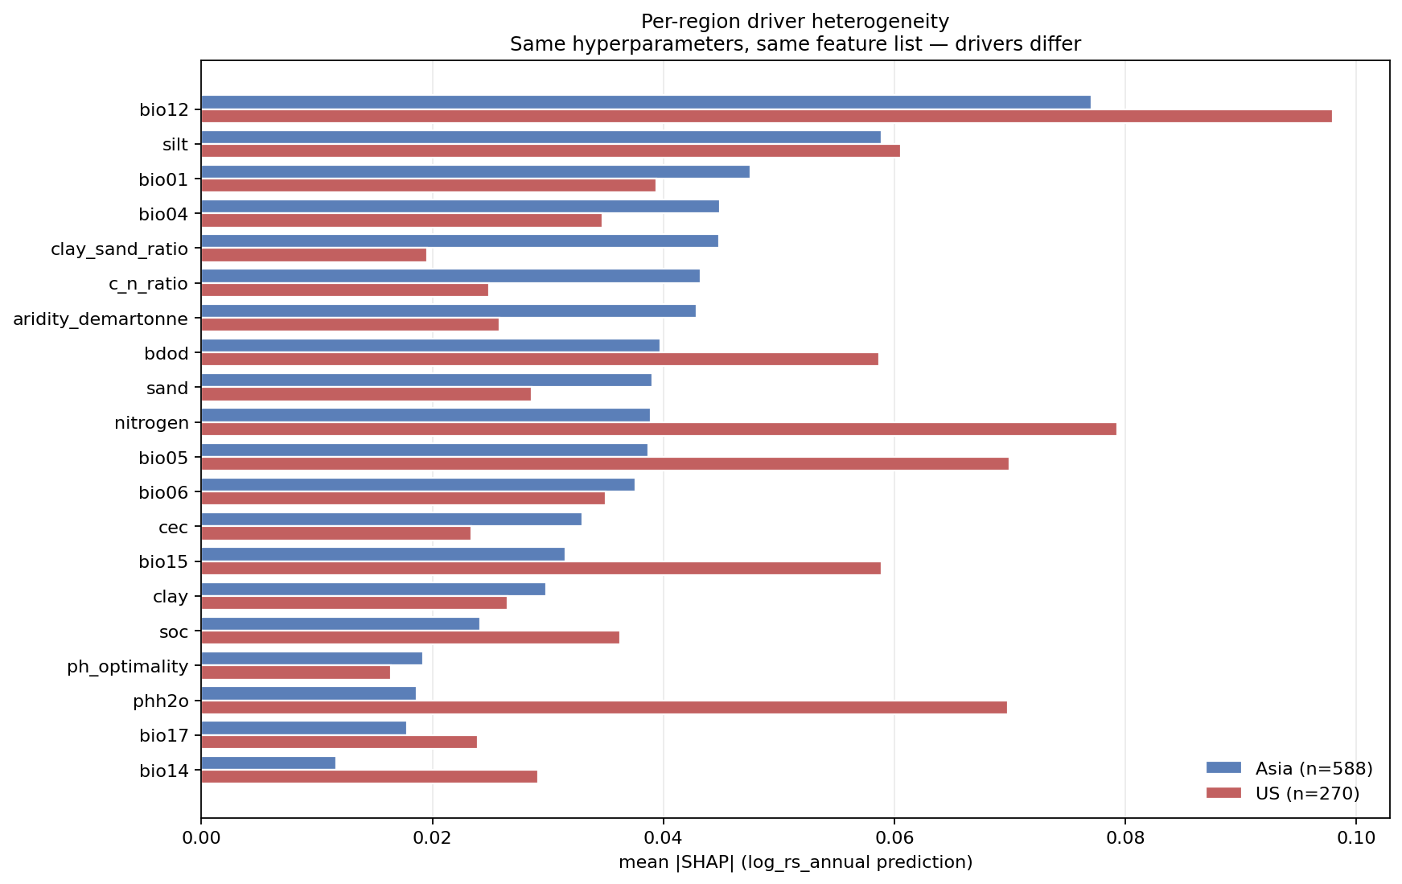
06 · MECHANISM
Same features, different drivers. The clay correlation flips.
When the same XGBoost is trained separately on Asia and on US sites, the feature → Rs relationship changes. Annual precipitation (bio12) is the only feature with stable rank in both regions.
Clay correlation with log Rs:
Asia r = +0.302 (top driver in Asia)
US r = -0.048 (no relationship)
A model that learns 'more clay → more Rs' from
Asia and applies it to US fails by construction.
Item 1 update — adding MODIS NPP shifts the rank-1 driver to NPP itself (mean |SHAP| = 0.128 in F+NPP), with bio04 and bio12 holding climate ranks 2-3. But the clay sign-flip persists in Full+MODIS — satellite augmentation does NOT resolve the regional driver heterogeneity.
MSHI-GEO · Regional driver heterogeneity
7 / 12

Slide 8
07 · STRATIFICATION TEST
Climate-zone stratification makes transfer worse, not better.
If the feature → Rs relationship differs cross-region, train one sub-model per Köppen-Geiger climate zone. Both qualifying zones underperform the cross-zone baseline.
Configuration | n_Asia | n_US | Transfer R² | 95 % CI | Verdict
F cross-zone (reference) | 600 | 272 | +0.127 | (+0.019, +0.216) | ✓ significant
F Köppen C (temperate) | 247 | 89 | −0.336 | (−1.06, +0.04) | ✗ spans 0
F Köppen D (continental) | 244 | 159 | −0.199 | (−0.39, −0.06) | ✗ negative
The cross-zone +0.127 IS the cross-zone precipitation gradient. Stratify it away and there is no transferable signal left.
MSHI-GEO · Stratification doesn't rescue transfer
8 / 12

Slide 9
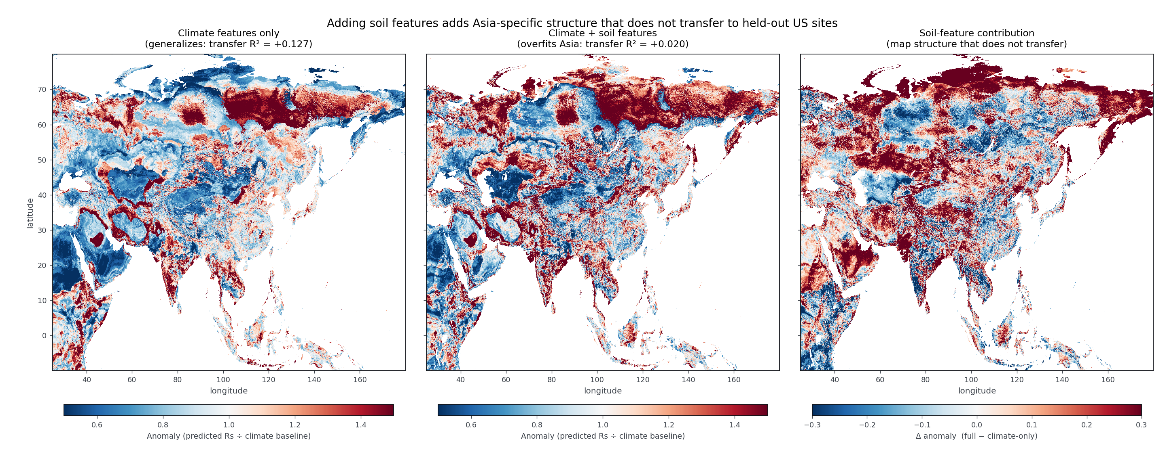
08 · IMPLICATION
Continental Rs maps need ground truth that current data products can't supply.
Two of three components in the standard upscaling recipe — gridded climate, gridded soil, gridded vegetation — are themselves modelled, not measured, at the resolution that matters.
SoilGrids 2.0 carries soil signal that varies by region in ways that don't reflect the actual Rs response.
MODIS NPP (pending) will help. But continental maps will continue to under-represent soil-driven variability without an in-situ measurement layer at the resolution where soil heterogeneity actually lives.
MSHI-GEO · Implication for monitoring infrastructure
9 / 12

Slide 10
09 · SENSOR CONNECTION
The biosensor measures the same flux, at the resolution the satellite can't.
[Sensor connection figure — pending Checkpoint 2 render]
Electrochemically active biofilms (EAB) on a low-cost electrode yield a current directly proportional to substrate oxidation rate — the biological process that Rs_annual integrates. Centimetre footprint, continuous deployment, no laboratory.
MSHI-GEO · EAB-Rs linkage
10 / 12

Slide 11
10 · ROADMAP
Three deliverables, three months.
1. MODIS NPP integration
≤ 2 weeks
GEE export queued; expected lift in transfer R² documented in literature.
2. Earth System Science Data submission
≤ 6 weeks
Manuscript draft in repository; 5 verified references; data and code public.
3. Co-located biosensor deployment
≤ 12 weeks
Pilot at 2 SRDB-listed sites; first paired EAB current vs chamber Rs measurement.
MSHI-GEO · Roadmap
11 / 12

Slide 12
Three scales.
One biology.
One missing instrument.
Genius Olympiad 2026 · MSHI-Geo · github.com/Sparkxt-0318/MSHI

