Slide 1
PRASHANTH
From knp

Slide 2

A BEATIFUL HOUSE IN WORLD
prashanth
A beautiful house in earth. It is beside to the sea

Slide 3
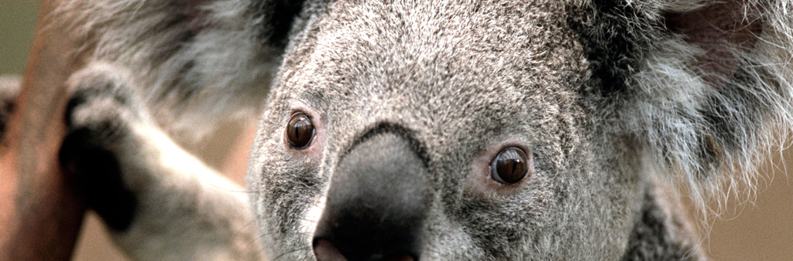
FHUILTFIFVUIU
HF8ILRFUIFVUITTIO

