Slide 1
Heart Failure Prediction
Tai sparrow
Dsi 1010 capstone

Slide 2
Problem Statement:
Cardiovascular diseases (CVDs) are the number 1 cause of death globally, taking an estimated 17.9 million lives each year, which accounts for 31% of all deaths worldwide. Heart failure is a common event caused by CVDs and this dataset contains 12 features that can be used to predict mortality by heart failure.
Most cardiovascular diseases can be prevented by addressing behavioral risk factors such as tobacco use, unhealthy diet and obesity, physical inactivity, and harmful use of alcohol using population-wide strategies.
People with cardiovascular disease or who are at high cardiovascular risk (due to the presence of one or more risk factors such as hypertension, diabetes, hyperlipidemia, or already established disease) need early detection and management wherein a machine learning model can be of great help.

Slide 3
Columns | Min | Max | Avg | Concerns
age | 40 | 95 | 60
anaemia | Yes 43% | No 57%
creatinine_phosphokinase | 23 | 7861 | 581 | Normal range:1,500 – 10,000
diabetes | Yes 41% | No 59%
ejection_fraction | 14 | 80 | 38 | Normal range: 55-70 Low range: 40-55
high_blood_pressure | Yes 35% | No 65%
platelets | 251,000 | 850,000 | 263,358 | Normal range: 150,000 – 400,000
serum_creatinine | 05 | 9.4 | 1.39
serum_sodium
sex | Female 35% | Male 65% |  | Male dominant data
smoking | Yes 32% | No 68%
time | 4 | 285 | 130 | Follow-up period (days)
DEATH_EVENT | Yes 32% | No 68% |  | If the patient deceased during the follow-up period (boolean)

Slide 4
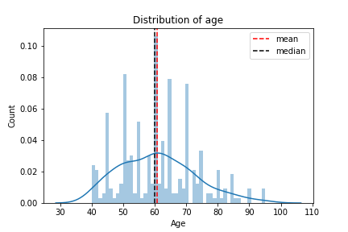
Columns : Age

Slide 5
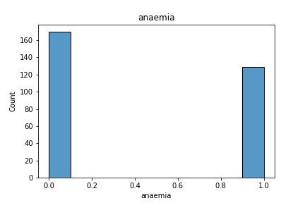
Columns : Anaemia

Slide 6
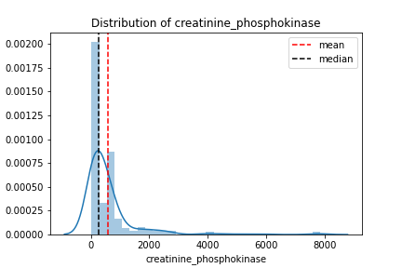
Columns : creatinine_phosphokinase

Slide 7
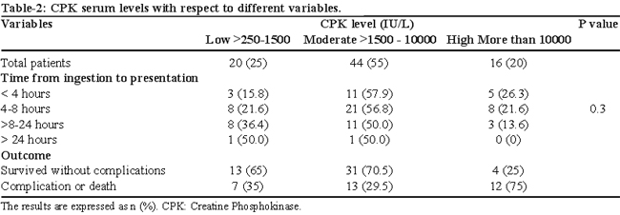
Columns : creatinine_phosphokinase

Slide 8
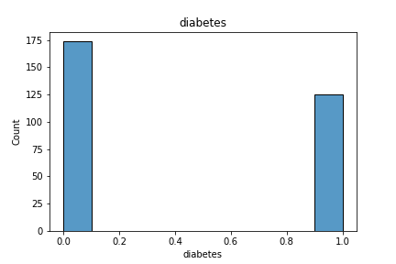
Columns : diabetes

Slide 9
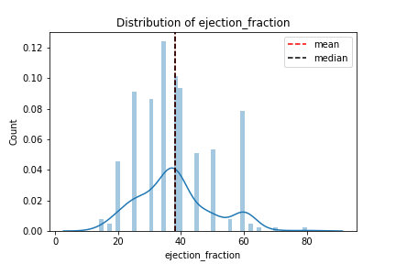
Columns : ejection_fraction

Slide 10
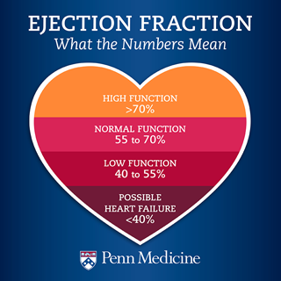

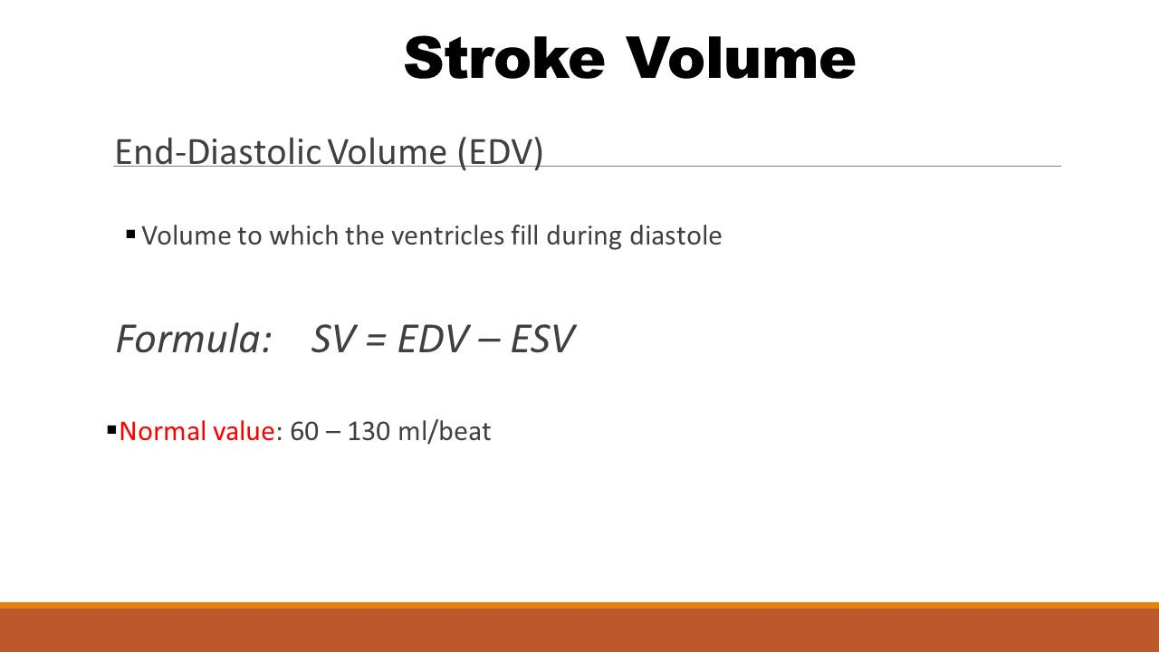
Columns : ejection_fraction

Slide 11
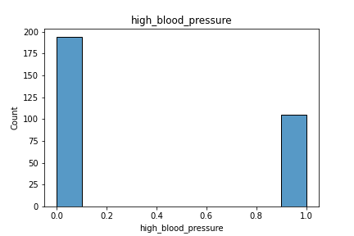
Columns : high_blood_pressure

Slide 12
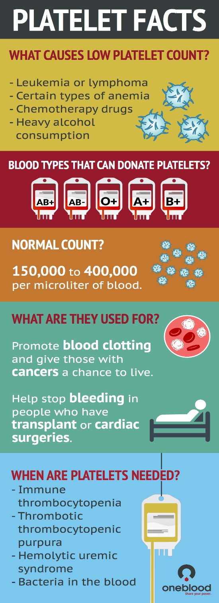
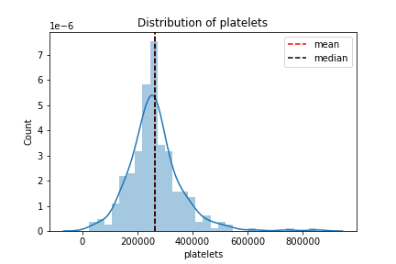
Columns : platelets
https://newsnetwork.mayoclinic.org/discussion/mayo-clinic-q-and-a-what-causes-a-high-platelet-count/

Slide 13
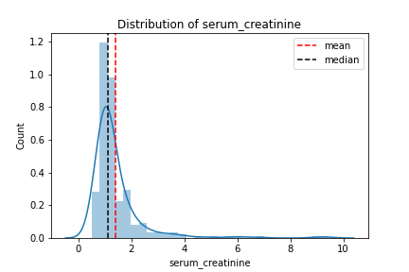
Columns : serum_creatinine

Slide 14
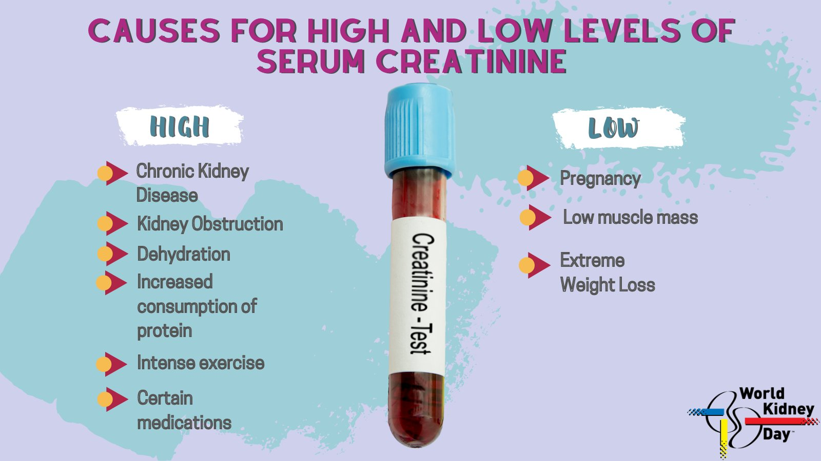
Columns : serum_creatinine

Slide 15
Columns : serum_sodium
A normal blood sodium level is between 135 and 145 milliequivalents per liter (mEq/L).
Hyponatremia occurs when the sodium in your blood falls below 135 mEq/L.
https://www.mayoclinic.org/diseases-conditions/hyponatremia/symptoms-causes/syc-20373711#:~:text=A%20normal%20blood%20sodium%20level,liter%20(mEq%2FL).

Slide 16
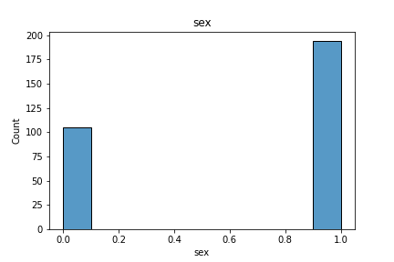
Columns : sex

Slide 17
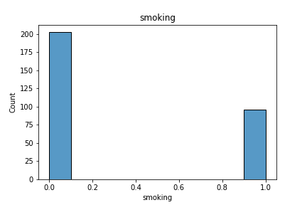
Columns : smoking

Slide 18
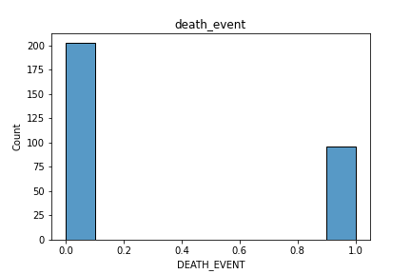
Columns : DEATH_EVENT

Slide 19
Models
Model | Train Score | Test Score
Dummy Classifier | 0.6746411483253588 | 0.6888888888888889
Logistic Regression | 0.861244019138756 | 0.7888888888888889
Naive Bayes | 0.7942583732057417 | 0.7444444444444445
Gradient Descent | 0.8229665071770335 | 0.7444444444444445
KNN | 0.7942583732057417 | 0.6555555555555556
Decision Tree | 1.0 | 0.7777777777777778
Random Forest | 1.0 | 0.7777777777777778
SVM | 0.9138755980861244 | 0.7

Slide 20
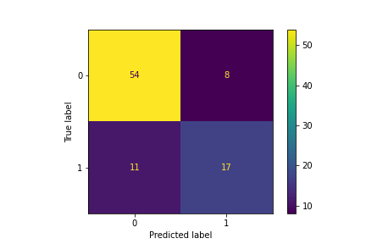
Model Performance
Logistic Regression
Classification Report
 | Precision | Recall | F1-score | Support
0 | 83% | 87% | 95% | 62
1 | 68% | 61% | 64% | 28

Slide 21
Recap
Problem Statement:
EDA
Logistic Regression
Modeling
Interpretation
Coefficients
Answer

