Slide 1
Python: Lesson #2
Functions
By: Marc Geffroy

Slide 2
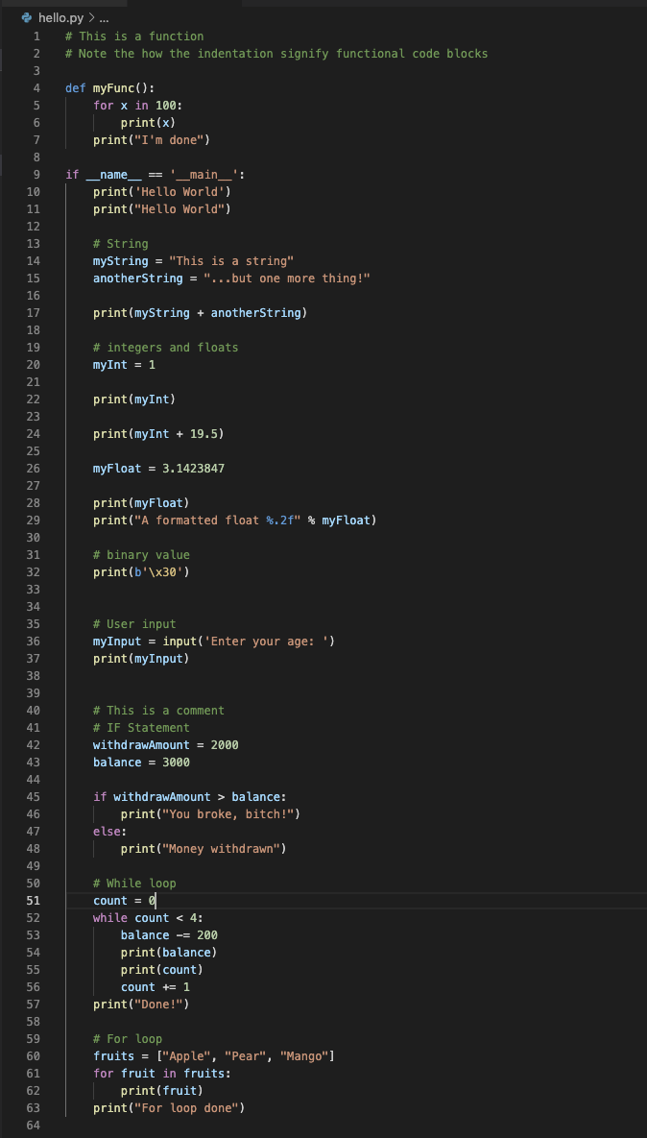
What was covered last lesson?
What is Python.
Where it’s used.
How to get started.
Variables.
Operators.
Your first Python app.
Conditional statements.
Loops.
User input.

Slide 3
Functions
What is a function?
A function is a group of related statements that perform a specific task.
Why use functions?
Functions break our programs into smaller more modular chunks. Making larger programs more organised and manageable.
Allows reusability and avoids repetition.
Defining a basic function:
Def greet(AName): ‘’’ This is a basic function ‘’’ print(‘Hello, ’ + AName + ‘welcome!’)
# Calling a function greet(‘Jude’)
>>> Hello, Jude welcome!

Slide 4
Defining syntax
Keyword def marks the start of the function header.
Function name.
Parameters (arguments), optional.
Colon, marking the end of the function header.
Optional documentation string (docstring).
Valid python statement.
Optional return statement.
def greet(AName): ‘’’ This is a basic function ‘’’ return ‘Hello, ’ + AName + ‘welcome!’

Slide 5
Function Syntax
To call a function just type the function name. You may need a parameter or to assign the return value.
Always define your function before calling it. You cannot call a function that is defined below it.
def greet(AName): ‘’’ This is a basic function ‘’’ return ‘Hello, ’ + AName + ‘welcome!’
welcomeString = greet(‘Byron’) print(welcomeString)
>>> Hello, Byron welcome!

Slide 6
Function Syntax #2
Docstrings: Documentation strings come directly after the function header. They’re a comment used to describe the function.
Return statement. The return statement is used to exit a function and go back to a place from where it was called.
def greet(AName: str) -> str: ‘’’ This function returns a string with a welcome note using the parameter. ‘’’ return ‘Hello, ’ + AName + ‘welcome!’
welcomeString = greet(‘Kyle’) print(welcomeString)
>>> Hello, Byron welcome!

Slide 7
Function syntax #3
Scope and Lifetime of variables
Scope: The scope of a variable is the portion of the program where the variable is recognised.
Parameters and variables defined inside a function are not visible from outside the function. They have a local scope.
Lifetime: The period throughout which the variable exists in memory. The lifetime of a variable inside a function is as long as the variable exists.
def my_func(): x = 10 print("Value inside function:", x) x = 20 my_func() print("Value outside function:", x)
>>>Value inside function: 10 >>>Value outside function: 20

Slide 8
Function Arguments
Multiple arguments.
Parameters are comma separated.
Default values.
If the parameter is not defined in the function call it’ll default to the defined value.
Typed values.
You can assign types to the parameters to ensure only a particular type is accepted.
def greet(name: str, msg="Good morning!"): """ This function greets to the person with the provided message. If the message is not provided, it defaults to "Good Morning!" """ print("Hello" + name + ', ' + msg) greet("Kate") greet("Bruce", "How do you do?")
>>>Hello, Kate, Good Morning! >>>Hello, Bruce, How do you do?

