Slide 1


CHURCH TV OS
Every screen at your church, run from your phone.
Live on Fire TV, Google TV and Roku. LG and Samsung coming soon.
Notes:
I'm Keith. I'm a worship pastor in Cambridge, Ontario. I built this to run our kids rooms, and it's now open to any church.

Slide 2
Sunday, ten to nine
Somebody is behind the nursery TV, hunting for an adapter.
The countdown video is on a laptop.
The laptop is in the car.
Does that sound familiar?
Notes:
A concrete Sunday scene. Ask the question and let them talk.

Slide 3
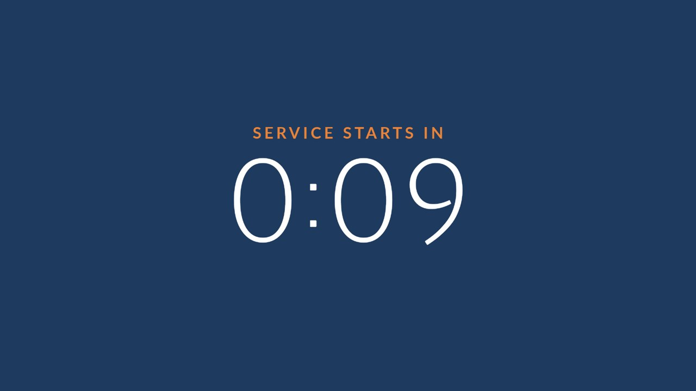
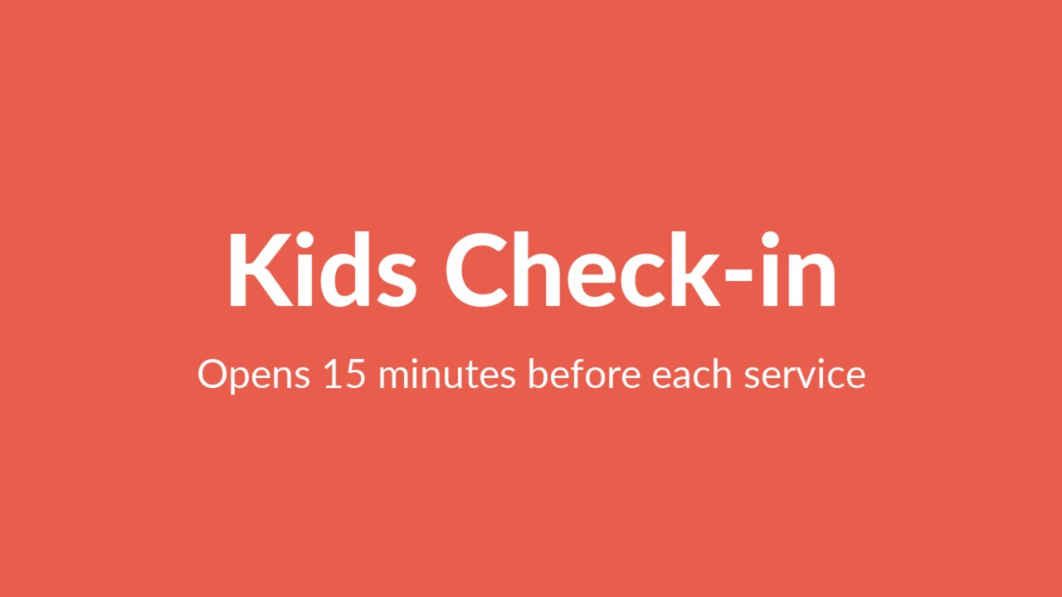
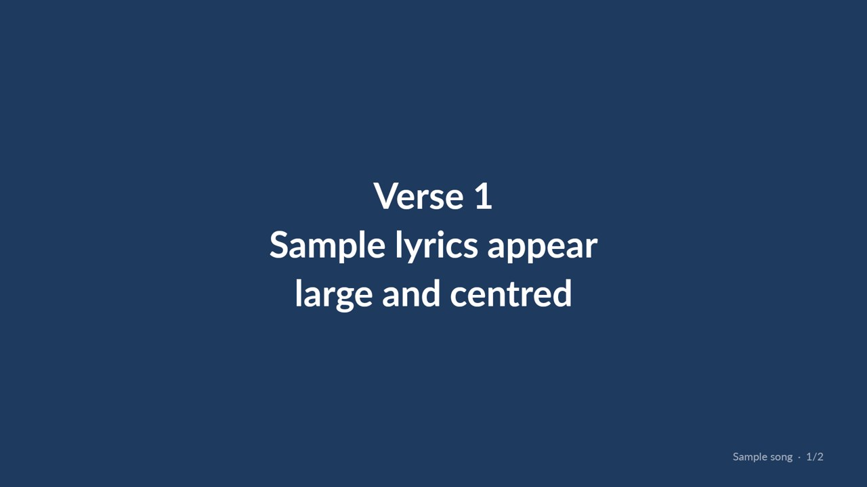
One system, three jobs
Kids
Signage
Slides
Playlists, countdowns, lyrics and YouTube, scheduled per room, with a weekly rotation.
Pictures, video and text signs on a weekly loop. Landscape or portrait.
Songs, lyrics, pictures and video for chapels and small rooms. Import a PDF or PowerPoint.
Notes:
One system, three jobs. A TV can switch between them on a schedule: Signage on weekdays, Kids on Sunday.

Slide 4
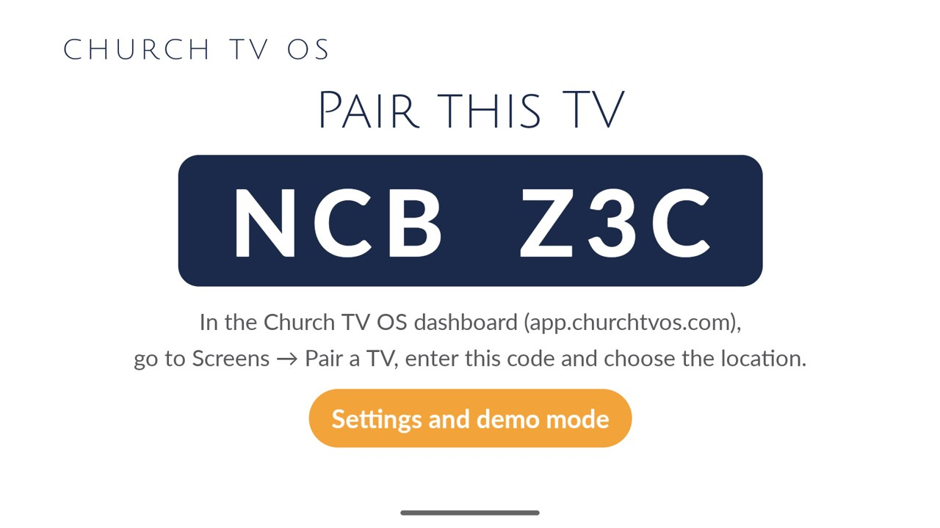
Pair a TV in a minute
1
Plug in a Fire TV, Google TV or Roku and open the app.
2
Read the six-character code on the TV.
3
Type it into the dashboard and pick the room.
Notes:
Plug in a Fire TV, Google TV or Roku. Type the code. Pick the room.

Slide 5
Kids rooms that play themselves
Playlists of video, countdowns, lyrics and YouTube
Scheduled per room, weekly rotation
The leader stays in control and presses Play
Notes:
Playlists, countdowns, lyrics, weekly rotation. The leader presses Play.

Slide 6
Lobby signs and Sunday slides
Signs loop on a weekly schedule, landscape or portrait.
Decks for chapels and small rooms. Import a PDF or PowerPoint.
Notes:
Signs on a weekly loop; decks for chapels and small rooms. It isn't trying to replace a big-sanctuary rig.

Slide 7
Volunteer-proof
Press Next.
Next
The operator role runs the room from a phone: Next, Back, Jump, Blank, Play now and messages. It can't edit anything.
Back
Blank
Notes:
Operator role: run it, can't edit it. Remote runs in the dashboard in a phone browser today; iPhone and Mac apps are coming soon.

Slide 8
When the Wi-Fi drops
Thursday
Ahead of time
Sunday
You schedule each room.
The TV downloads what's scheduled.
It keeps playing from saved content, then catches up.
One exception: a message you send from your phone needs the internet to arrive.
Notes:
Mention the one exception honestly.

Slide 9
What it isn't yet
Newer Fire TV sticks on Vega OS can't run it
The Roku channel is new, and some things differ
LG and Samsung are coming soon, no date
No Planning Center, CCLI or curriculum integration today
iPhone and Mac apps are coming soon
Not a replacement for a big-sanctuary production rig
Notes:
I'd rather you hear it from me.

Slide 10
Try one room
Start a free trial and pair a real TV. [TRIAL DAYS] days. Pricing is per module and per TV: [PRICE]. [FOUNDING OFFER]
churchtvos.com
keith@sparrownest.com
Notes:
Try one room for the trial. I'll stay on text while you pair it. Replace the bracketed placeholders before presenting.

