Slide 1

Flight Delay Prediction System
Submitted By: Sparsh Anand | 23FE10CSE00157
B.Tech Computer Science & Engineering
Manipal University Jaipur
Submitted To: Dr Mohit Khushwaha

Slide 2



Why Flight Delay Prediction Matters
Operational Challenges
Traditional Limitations
Intelligent Solution
Flight delays cascade through airline networks, impacting scheduling, crew assignments, and passenger connections. Airlines lose millions annually to delays.
Manual analysis cannot process vast amounts of historical flight data quickly enough to provide real-time predictions for operational decision-making.
Machine learning algorithms analyze historical patterns to predict delays before flights depart, enabling proactive management and passenger notifications.

Slide 3

Project Overview
01
02
Introduction & Context
Dataset & Features
Understanding delay challenges
Airline, route, time, distance analysis
03
04
Problem Statement
Proposed Solution
Need for prediction system
ML model + API + UI implementation
05
Results & Performance
Accuracy and speed metrics

Slide 4
Literature Review & Background
Data-Driven Aviation
Machine Learning Models
Important Features
Modern aviation leverages historical flight data spanning years to identify patterns and correlations that influence departure and arrival times. Large datasets enable statistical analysis.
Random Forest algorithms excel at handling structured data with multiple features. Ensemble methods combine decision trees to improve prediction accuracy while reducing overfitting.
Departure time, route distance, airline carrier, and historical performance metrics significantly influence delay probabilities. Feature engineering extracts meaningful patterns from raw data.

Slide 5


Problem Statement
Absence of Real-Time Prediction
Current systems lack reliable delay prediction capabilities, leaving passengers and airlines without actionable information before departure.
Inefficient Planning
Without accurate predictions, passengers cannot optimize connections and airlines cannot efficiently allocate resources or manage schedules.
Financial and Time Losses
Flight delays cause cascading effects including missed connections, hotel costs, crew overtime, and lost productivity for business travelers.
Project Goal: Develop an accurate machine learning system that predicts flight delays using historical data and real-time inputs.

Slide 6
Project Objectives
Develop Intuitive User Interface
Train Machine Learning Model
Achieve High Performance
Create a simple, user-friendly web interface that allows passengers and airline staff to input flight details and receive delay predictions with minimal training required.
Implement Random Forest algorithm using historical flight data to learn patterns and correlations that predict delays with high accuracy and reliability.
Ensure predictions generate within 1-2 seconds while maintaining accuracy, enabling real-time decision-making for operational planning and passenger notifications.

Slide 7




Proposed Methodology
Flight Input
Feature Engineering
User provides flight details
Extract relevant features
ML Model
Output
Random Forest prediction
Delay probability displayed
Frontend Layer
Backend API
ML Engine
Web interface built with modern frameworks captures user inputs including airline, route, departure time, and distance.
FastAPI processes requests, validates data, and orchestrates prediction workflow with response times under 2 seconds.
Trained model analyzes features and outputs probability of delay with confidence intervals for informed decisions.

Slide 8
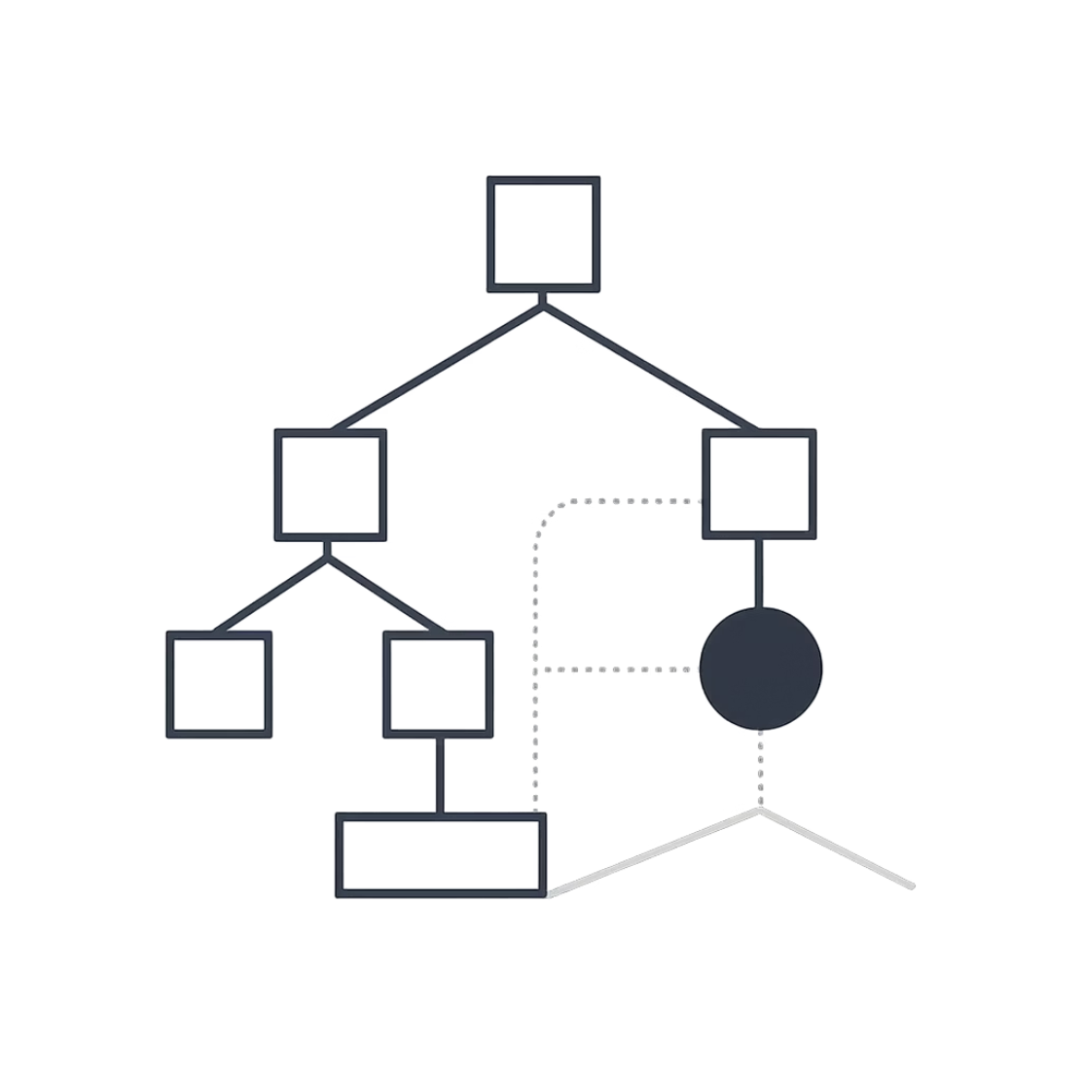
Model Architecture & Explanation
Feature Engineering Process
Raw flight data transformed into predictive features:
Time of day and day of week encoding
Route distance and historical delay rates
Airline performance metrics
Seasonal patterns and trends
Random Forest Algorithm
Ensemble of decision trees handles structured data efficiently, reduces overfitting, and provides feature importance analysis for model interpretability.

Slide 9

Results & Performance Analysis
85%
0.83
Accuracy Rate
F1 Score
High prediction accuracy achieved on test dataset
Balanced precision and recall performance
1.5s
Response Time
Average prediction generation time
The ML-based system successfully developed real-time predictions that balance accuracy with speed, providing actionable insights for airlines and passengers. Model achieves high F1 score, indicating balanced performance across delay and on-time predictions.

Slide 10
Conclusion & Future Work
Achievements
ML-based prediction system successfully developed and validated
Real-time predictions achieved with 1-2 second response time
System provides value for airlines, passengers, and operational planning
Future Enhancements
Integrate real-time weather data including storms, fog, and wind patterns
Incorporate air traffic congestion and airport capacity metrics
Develop mobile application for on-the-go delay predictions
References: Kaggle Flight Delay Dataset | Scikit-learn Documentation | FastAPI Documentation

