Slide 1







ModelFLOWs
APP
MODAL DECOMPOSITION
DEEP LEARNING
Pattern detection
Reconstruction
Prediction
Pattern detection
Reconstruction
Prediction
HOSVD
Data Repairing
HODMD
Autoencoders
Superresolution
Full DL
HODMD
Superresolution
Hybrid

Slide 2
ModelFLOWs
APP
MODAL DECOMPOSITION
DEEP LEARNING
Pattern detection
Reconstruction
Prediction
Pattern detection
Reconstruction
Prediction
Superresolution
HOSVD
Data Repairing
HODMD
Autoencoders
Superresolution
Full DL
HODMD
Superresolution
Hybrid

Slide 3
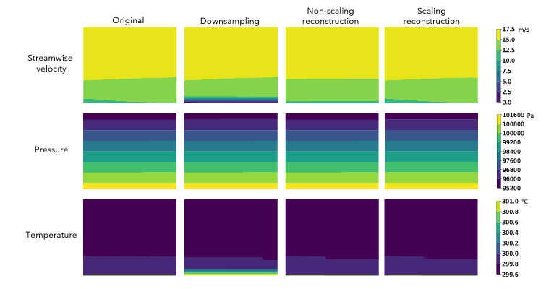
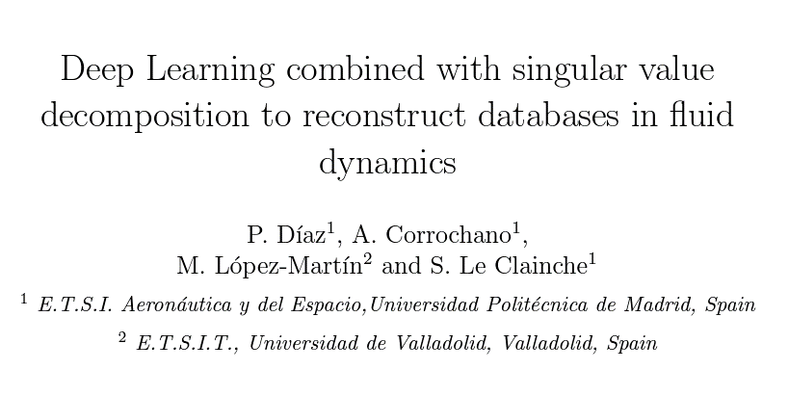
Motivation
Superresolution
https://doi.org/10.48550/arXiv.2305.08832
Reconstruction of fluid dynamics databases from few points.
For example, an Atmospheric Boundary Layer (ABL) database.

Slide 4
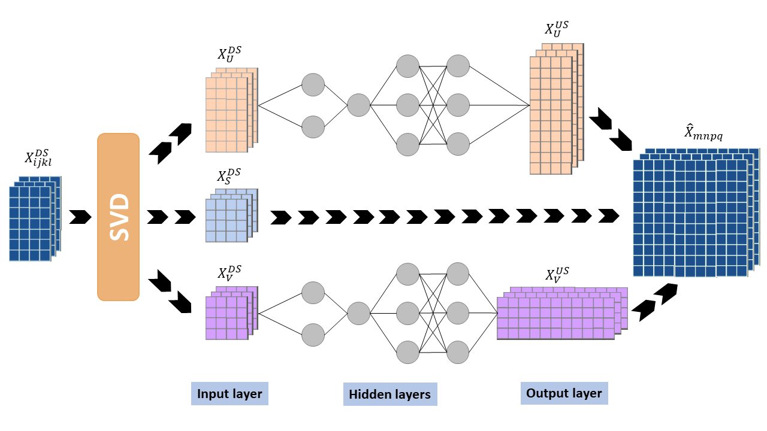
Methodology
Superresolution

Slide 5

Database & Data preparation
Superresolution
2D Flow past a cylinder at Re = 100
Spatial dimensions
y
Ly = 20
Snapshots Tensor = {$N_{v}, N_{x}, N_{y}, N_{t}$}
x
Variables
Temporal dimensions
x/d = -15
x/d = 45

Slide 6
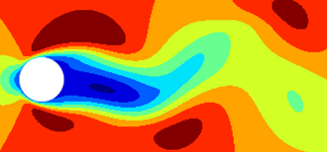

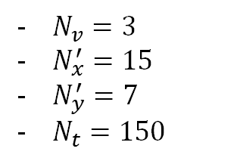

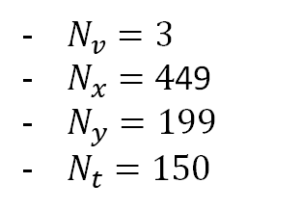

Database & Data preparation
Superresolution
$N_{v}=3$
$N_{x}=4$49
$N_{y}=199$
$N_{t}=150$
Snapshots Tensor = {$N_{v}, N_{x}, N_{y}, N_{t}$}
$N_{v}=3$
$N_{x}^{′}=15$
$N_{y}^{′}=7$
$N_{t}=150$
Downsampled Tensor = {$N_{v}, N_{x}, N_{y}, N_{t}$}

Slide 7
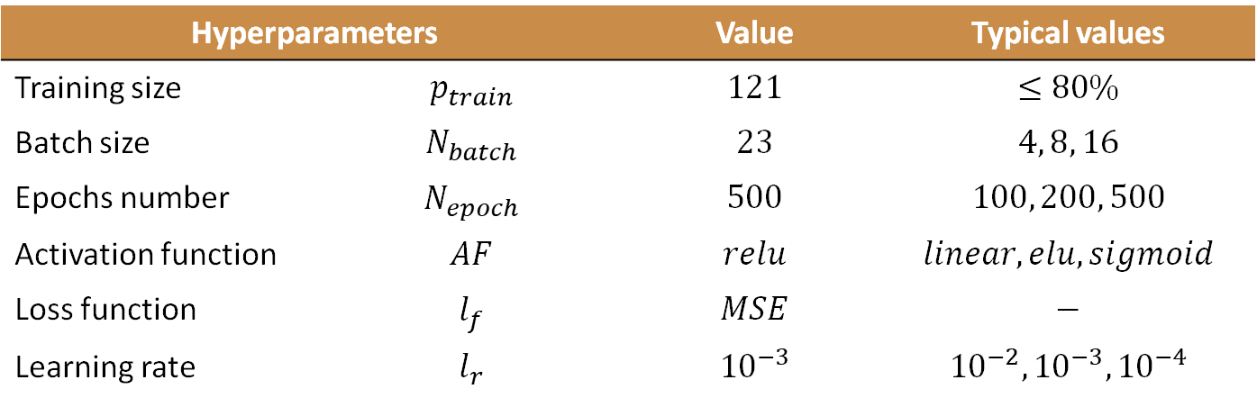
Calibration
Superresolution
Hyperparameters |  | Value | Typical values
Training size | $$p_{train}$$ | $$121$$ | $$≤80\%$$
Batch size | $$N_{batch}$$ | $$23$$ | $$4, 8, 16$$
Epochs number | $$N_{epoch}$$ | $$500$$ | $$100, 200, 500$$
Activation function | $$AF$$ | $$relu$$ | $$linear, elu, sigmoid$$
Loss function | $$l_{f}$$ | $$MSE$$ | $$−$$
Learning rate | $$l_{r}$$ | $${10}^{−3}$$ | $${10}^{−2}, {10}^{−3}, {10}^{−4}$$

Slide 8
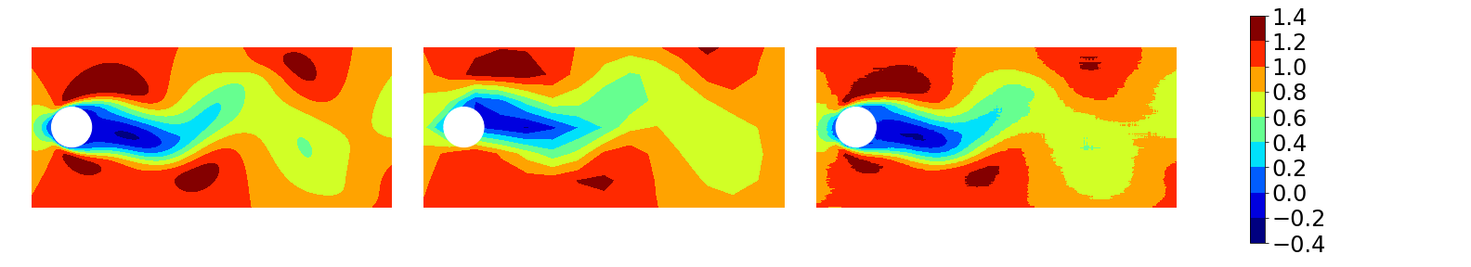
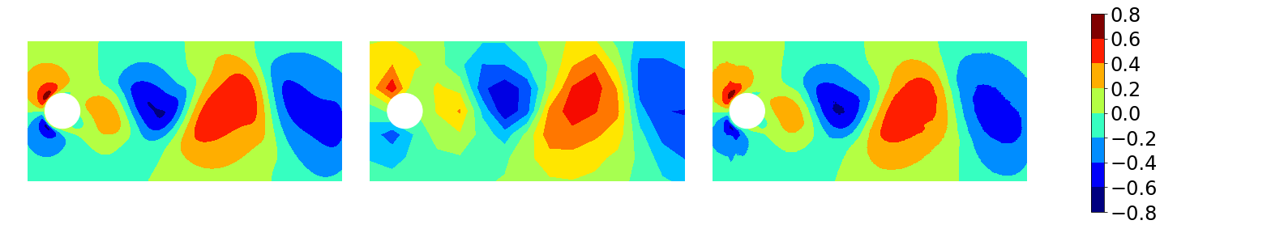
Results
Superresolution
Original Downsampling Reconstruction
Normal Streamwise

Slide 9

Thanks for watching! Visit us on: http://modelflows.es

