Slide 1







ModelFLOWs
APP
MODAL DECOMPOSITION
DEEP LEARNING
Pattern detection
Reconstruction
Prediction
Pattern detection
Reconstruction
Prediction
HOSVD
Data Repairing
HODMD
Autoencoders
Superresolution
Full DL
HODMD
Superresolution
Hybrid

Slide 2
ModelFLOWs
APP
MODAL DECOMPOSITION
DEEP LEARNING
Pattern detection
Reconstruction
Prediction
Pattern detection
Reconstruction
Prediction
HOSVD
Data Repairing
HODMD
Autoencoders
Superresolution
Full DL
HODMD
Superresolution
Hybrid

Slide 3
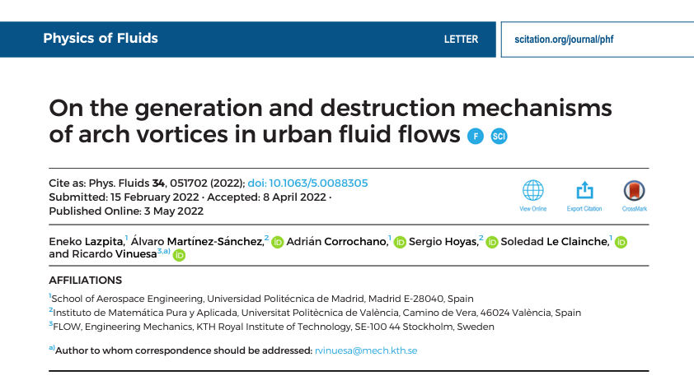
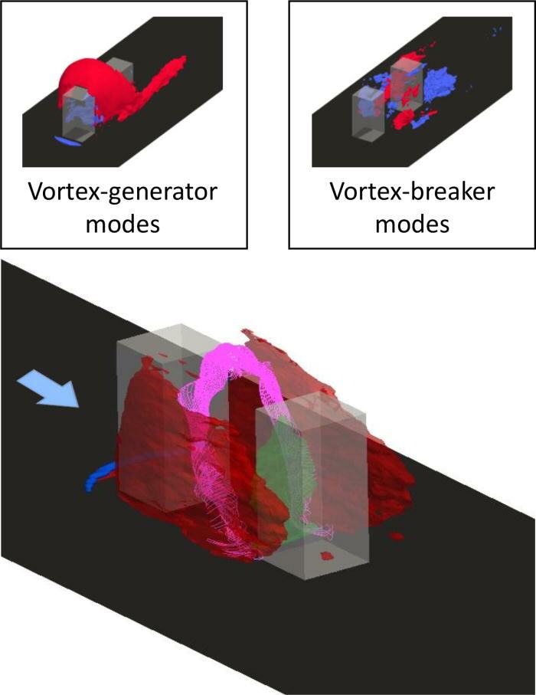
Motivation
HODMD
https://doi.org/10.1063/5.0088305
Pattern analysis in turbulent complex flows in urban environments.

Slide 4
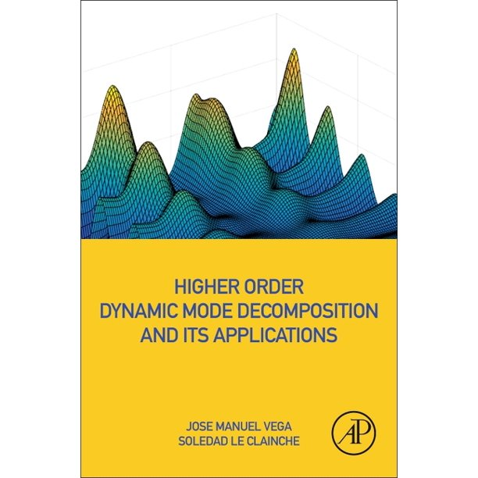
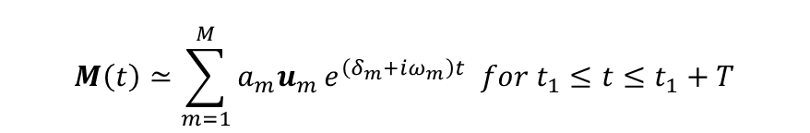
Methodology
HODMD
DMD modes
$$M\left(t\right)≃\sum_{m=1}^{M}{a_{m}u_{m}}e^{\left(δ_{m}+iω_{m}\right)t} for t_{1}≤t≤t_{1}+T$$
Vega, J. M., & Le Clainche, S. (2020). Higher order dynamic mode decomposition and its applications. Academic Press.
Amplitude
Amplitude
Amplitude
Frequency
Frequency
Growth-rate
Frequency
Growth-rate
Growth-rate

Slide 5
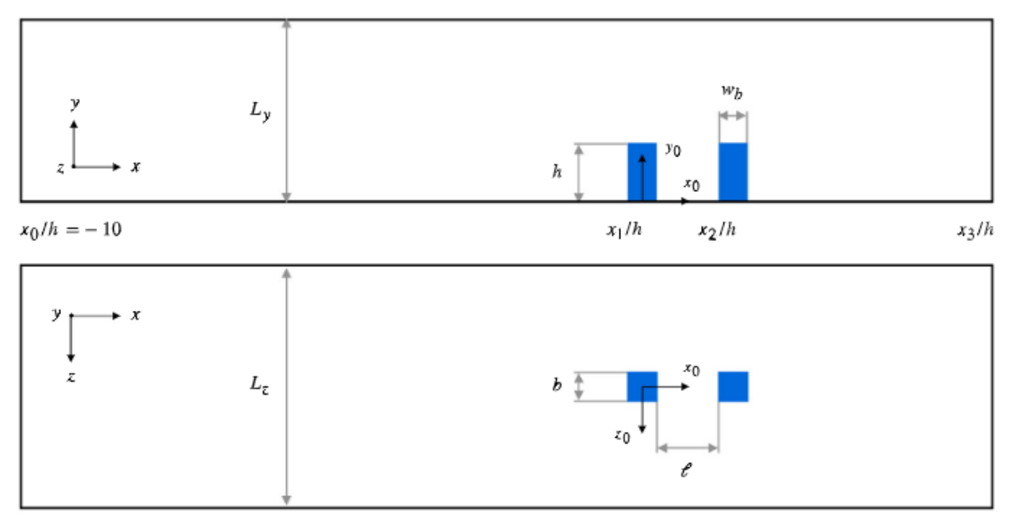

Database & Data preparation
HODMD
Spatial dimensions
Snapshots Tensor = {$N_{v}, N_{x}, N_{y}, N_{z}, N_{t}$}
Variables
Temporal dimensions

Slide 6
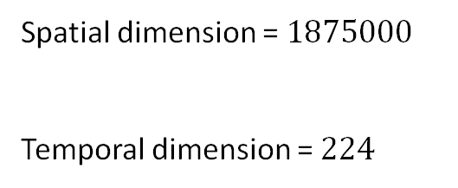

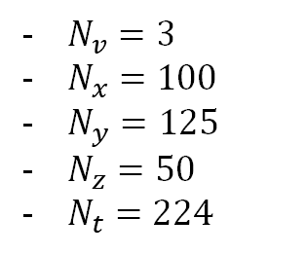
Database & Data preparation
HODMD
$N_{v}=3$
$N_{x}=100$
$N_{y}=125$
$N_{z}=50$
$N_{t}=224$
Spatial dimension = $1875000$
Temporal dimension = $224$
Snapshots Tensor = {$N_{v}, N_{x}, N_{y}, N_{z}, N_{t}$}

Slide 7
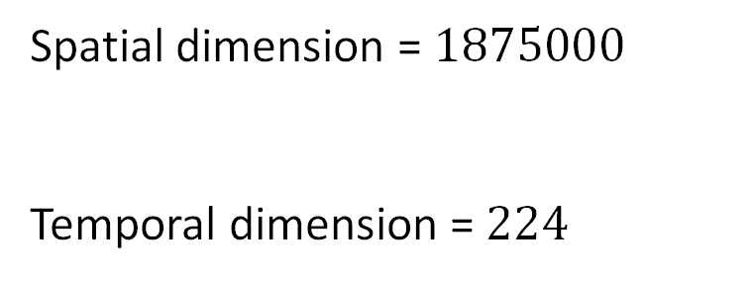
Calibration
HODMD
Tolerance SVD: How many singular values we retain. In turbulence, different scales.
Values: 1e-2, 1e-3, 1e-4
Spatial dimension = $1875000$
Temporal dimension = $224$
Tolerance DMD: What minimum amplitude is associated to the modes. Different scales.
Values: 1e-2, 1e-3, 1e-4
Number of windows: Needed for the HODMD windowing process ($\sim 10−50\%$ $N_{t}$).
Values: 10, 20, 50, 100

Slide 8
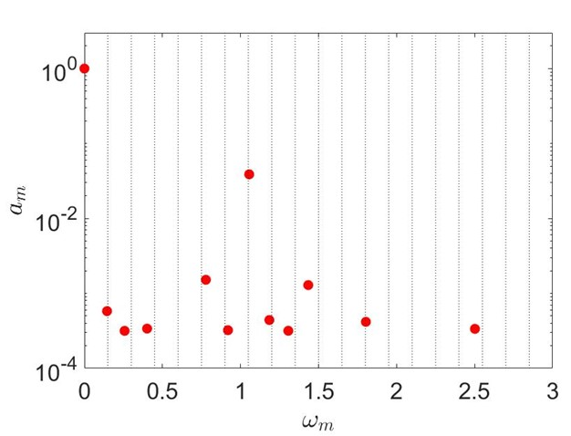
Calibration
HODMD
Tolerance SVD:
Values: 1e-3
Tolerance DMD:
Values: 1e-3
Window size:
Values: 50

Slide 9
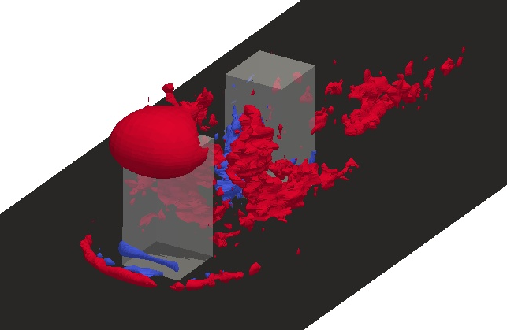
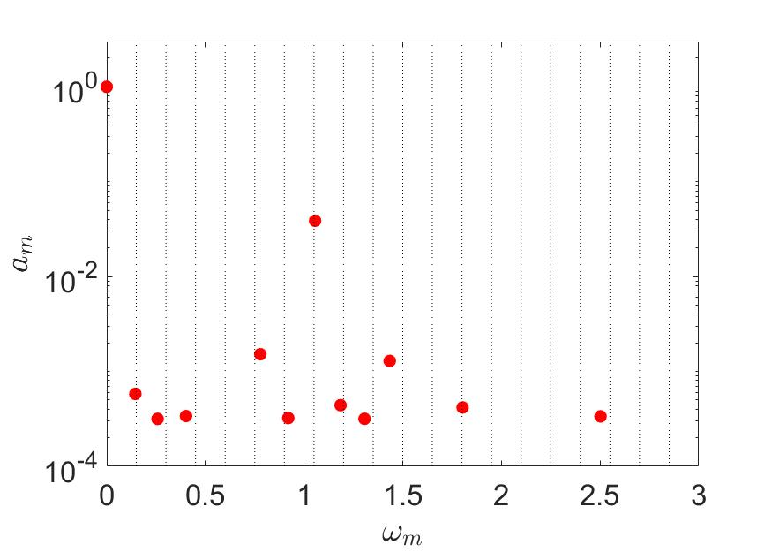
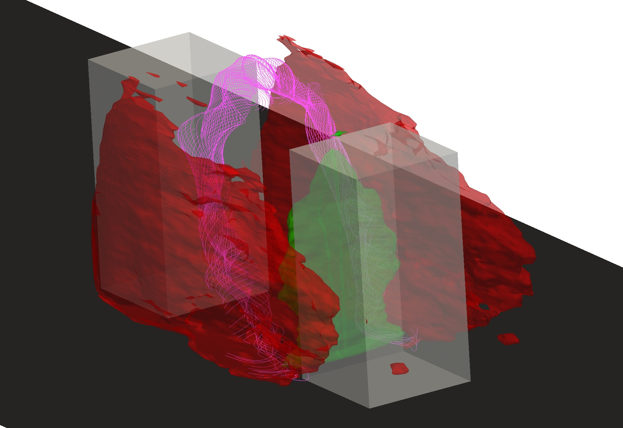
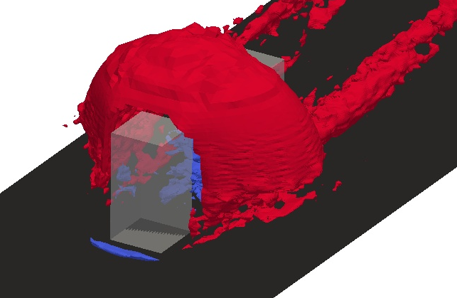
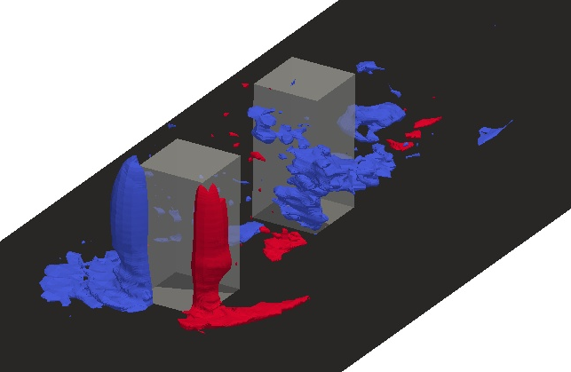





Results
HODMD
$$v_{y}$$
$$v_{x}$$
A mode
Generator modes
Click here for more information
$$v_{z}$$

Slide 10
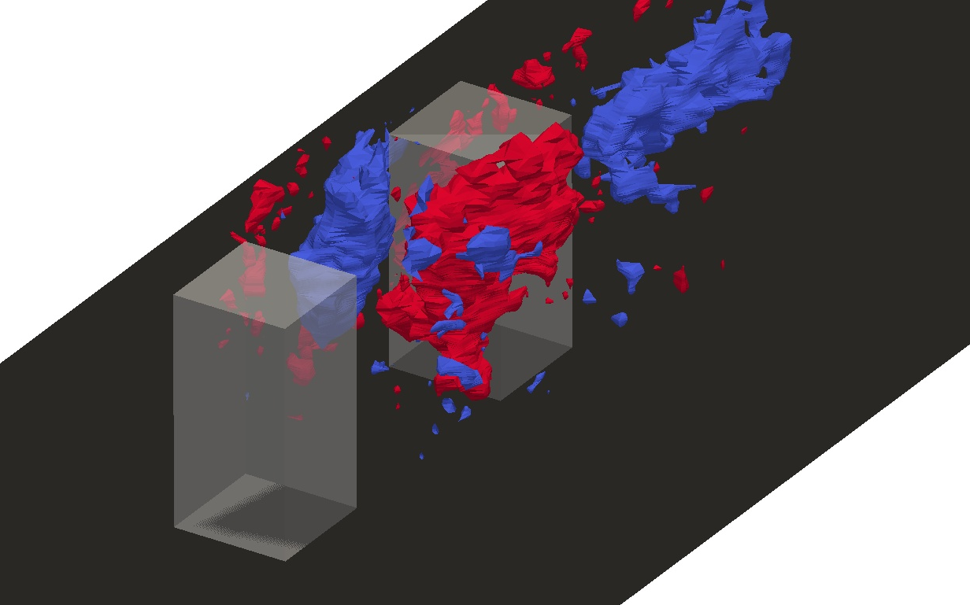
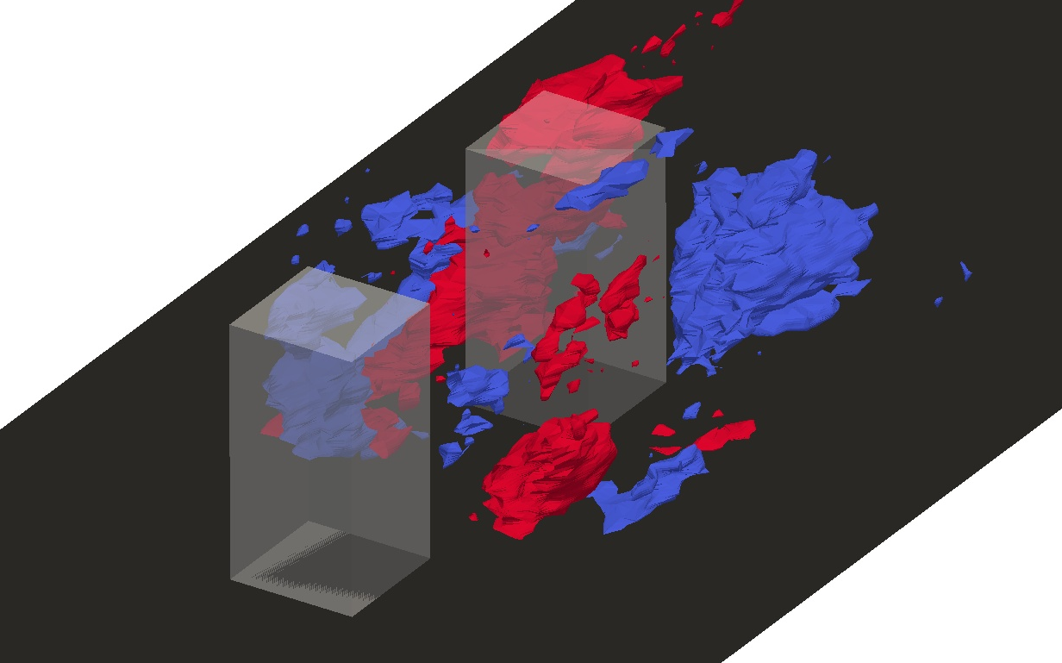
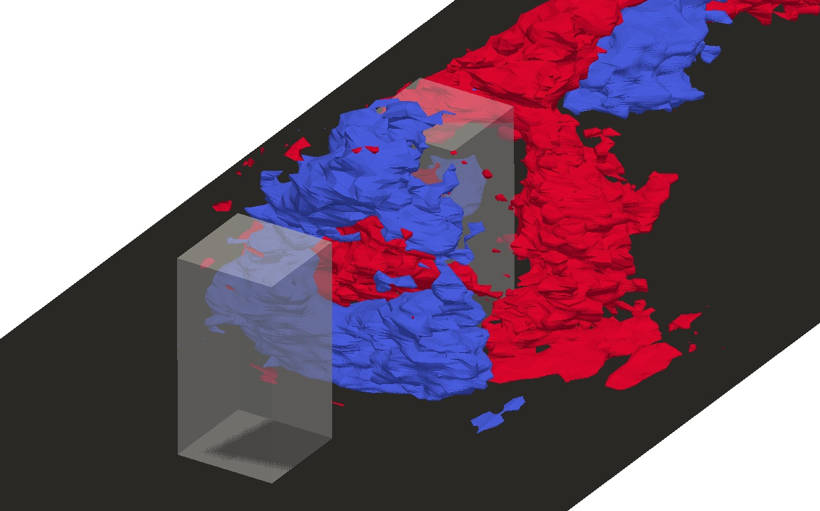
Results
HODMD
$$v_{y}$$
B mode
$$v_{x}$$
Breaker modes
Click here for more information
$$v_{z}$$

Slide 11

Thanks for watching! Visit us on: http://modelflows.es

