Slide 1







ModelFLOWs
APP
MODAL DECOMPOSITION
DEEP LEARNING
Pattern detection
Reconstruction
Prediction
Pattern detection
Reconstruction
Prediction
HOSVD
Data Repairing
HODMD
Autoencoders
Superresolution
Full DL
HODMD
Superresolution
Hybrid

Slide 2
ModelFLOWs
APP
MODAL DECOMPOSITION
DEEP LEARNING
Pattern detection
Reconstruction
Prediction
Pattern detection
Reconstruction
Prediction
HOSVD
Data Repairing
HODMD
Autoencoders
Superresolution
Full DL
HODMD
Superresolution
Hybrid

Slide 3
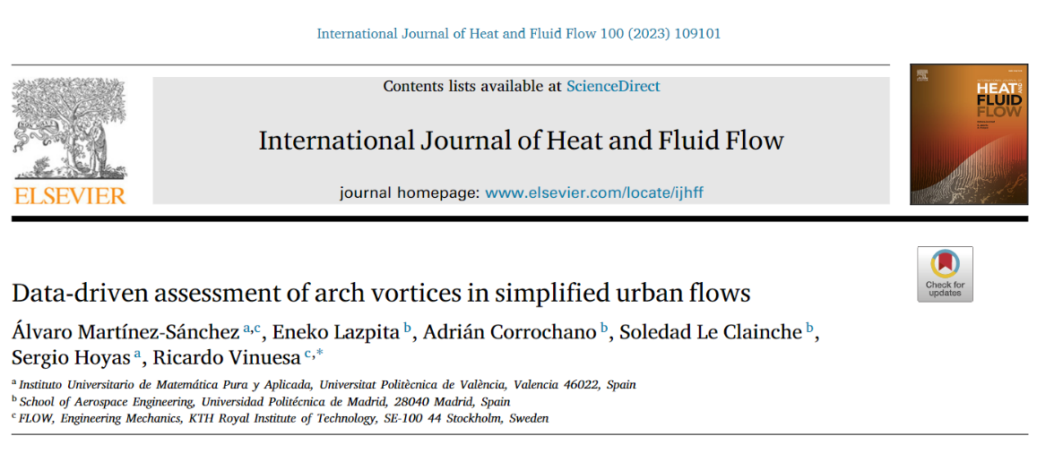
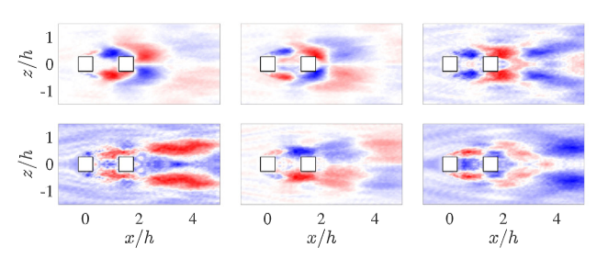
Motivation
HOSVD
https://doi.org/10.1016/j.ijheatfluidflow.2022.109101
Pattern analysis in turbulent complex flows in urban environments using proper orthogonal decomposition (POD).

Slide 4




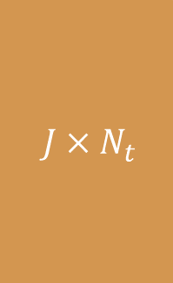
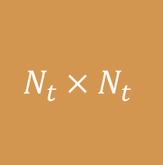

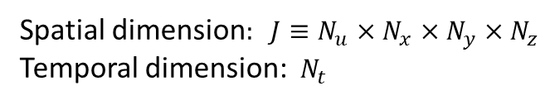



Methodology
HOSVD
$$M=UΣV^{T}$$
$$J×N_{t}$$
$$J×J$$
$$J×N_{t}$$
$$N_{t}×N_{t}$$
Spatial dimension$: J≡N_{u}×N_{x}×N_{y}×N_{z}$
Temporal dimension: $N_{t}$
$$=$$
$$M$$
$$U$$
$$Σ$$
$$V^{T}$$

Slide 5


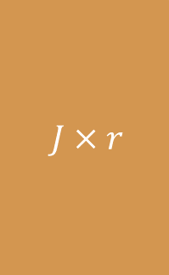


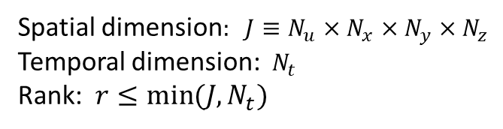

Methodology
HOSVD
$$M=UΣV^{T}$$
$$J×N_{t}$$
$$J×r$$
$$r×N_{t}$$
$$r×r$$
$$N_{t}×N_{t}$$
Spatial dimension$: J≡N_{u}×N_{x}×N_{y}×N_{z}$
Temporal dimension: $N_{t}$
Rank: $r≤min⁡(J,N_{t})$
$$=$$
$$M$$
$$U$$
$$Σ$$
$$V^{T}$$

Slide 6

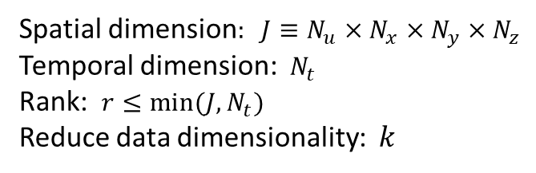






Methodology
HOSVD
$$M=UΣV^{T}$$
$$J×N_{t}$$
$$J×k$$
$$k×k$$
$$k×N_{t}$$
Spatial dimension$: J≡N_{u}×N_{x}×N_{y}×N_{z}$
Temporal dimension: $N_{t}$
Rank: $r≤min⁡(J,N_{t})$
Reduce data dimensionality: $k$
$$=$$
$$M$$
$$U$$
$$U$$
$$Σ$$
$$V^{T}$$
POD modes
Identify spatial patterns

Slide 7
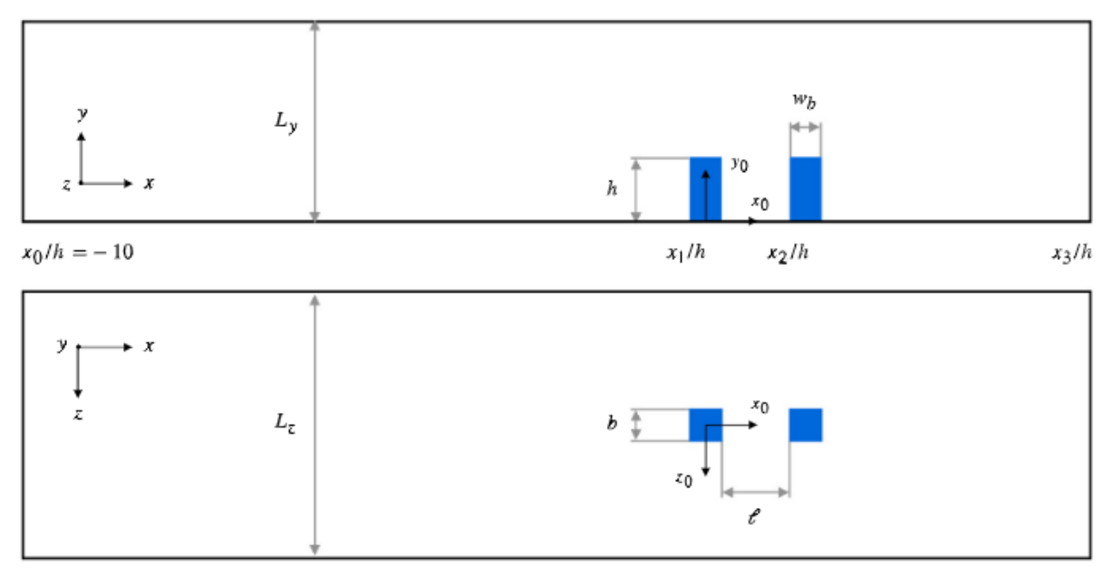

Database & Data preparation
HOSVD
Spatial dimensions
Snapshots Tensor = {$N_{v}, N_{x}, N_{y}, N_{z}, N_{t}$}
Variables
Temporal dimensions

Slide 8
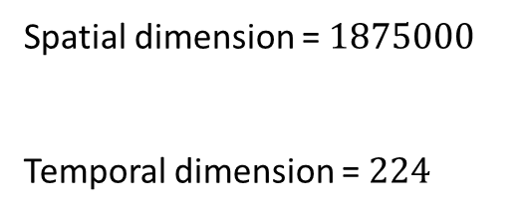

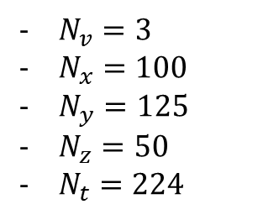
Database & Data preparation
HOSVD
$N_{v}=3$
$N_{x}=100$
$N_{y}=125$
$N_{z}=50$
$N_{t}=224$
Spatial dimension = $1875000$
Temporal dimension = $224$
Snapshots Tensor = {$N_{v}, N_{x}, N_{y}, N_{z}, N_{t}$}

Slide 9
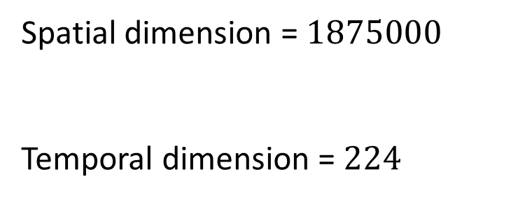
Calibration
HOSVD
Spatial dimension = $1875000$
Temporal dimension = $224$
Tolerance SVD: The energy amplitude where we cut the spectrum.
Values: 1e-2, 1e-3, 1e-4

Slide 10
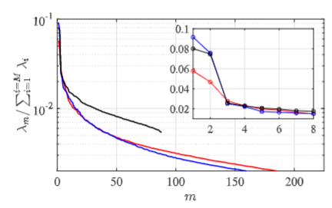
Calibration
HOSVD
Tolerance SVD:
Values: 1e-2, 1e-3, 1e-4
Mode energy decay spectrum

Slide 11
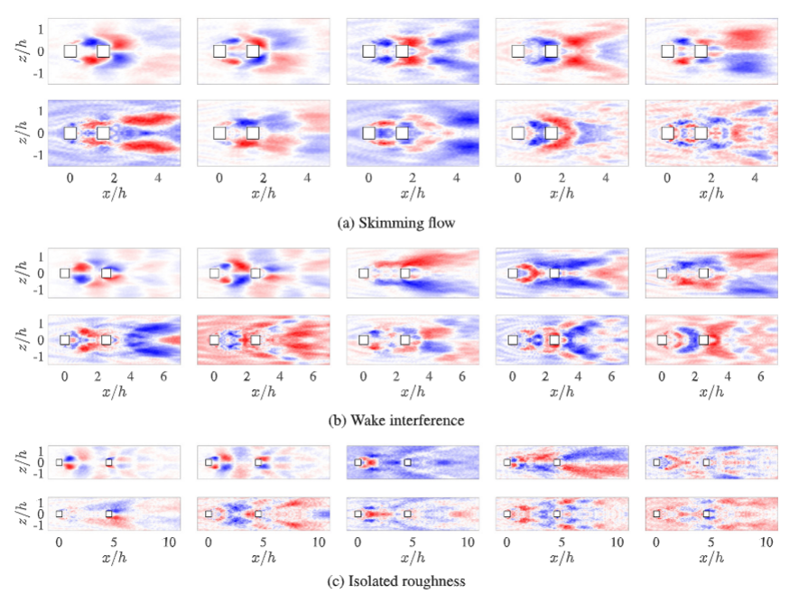


Results
HOSVD
Streamwise velocity patterns.
1st 10 most energetic modes.
3 different regimes
Symmetry.
Vortical structures.
Click here for more information

Slide 12
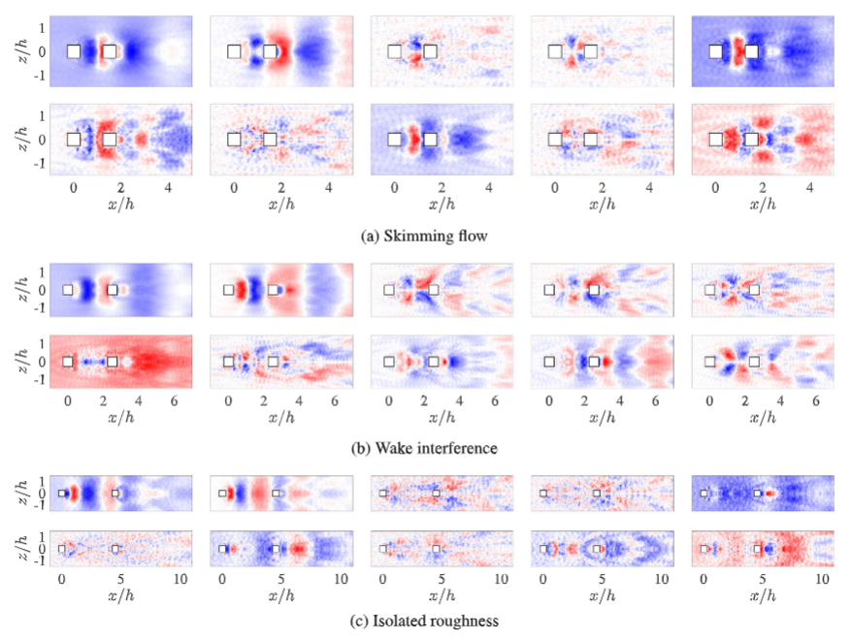
Results
HOSVD
Spanwise velocity patterns.
1st 10 most energetic modes.
3 different regimes
Symmetry.
Vortical structures.
Click here for more information

Slide 13

Thanks for watching! Visit us on: http://modelflows.es

