Slide 1







ModelFLOWs
APP
MODAL DECOMPOSITION
DEEP LEARNING
Pattern detection
Reconstruction
Prediction
Pattern detection
Reconstruction
Prediction
HOSVD
Data Repairing
HODMD
Autoencoders
Superresolution
Full DL
HODMD
Superresolution
Hybrid

Slide 2
ModelFLOWs
APP
MODAL DECOMPOSITION
DEEP LEARNING
Pattern detection
Reconstruction
Prediction
Pattern detection
Reconstruction
Prediction
HOSVD
Data Repairing
HODMD
Autoencoders
Superresolution
Full DL
HODMD
Superresolution
Hybrid

Slide 3
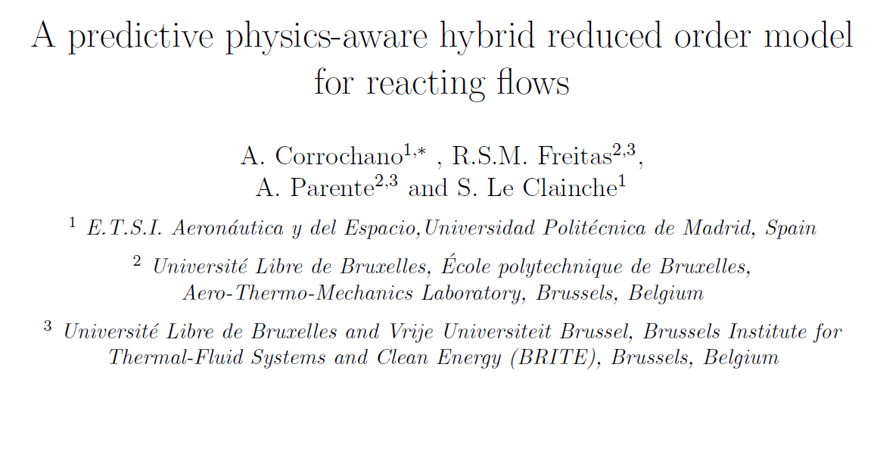
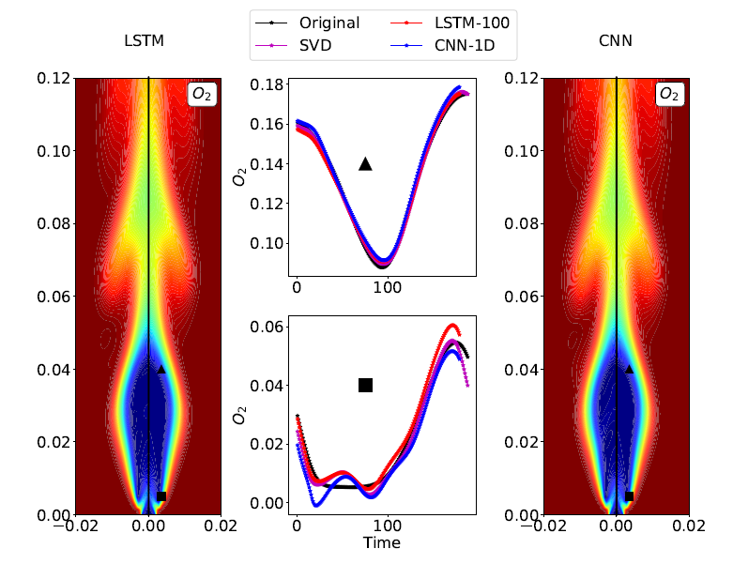
Motivation
Hybrid
A predictive physics-aware hybrid reduced order model for reacting flows
https://arxiv.org/abs/2212.12731
https://arxiv.org/abs/2301.09860

Slide 4
Motivation
Hybrid
A predictive physics-aware hybrid reduced order model for reacting flows
In this work we proposed two predictive models for reacting flows.
We combine dimensionality reduction techniques (SVD) with deep learning architectures, in contrast with other works based only on deep learning.
We also show the influence of the key hyperparameters on the model, as well as the ability of the model to predict a laminar flame under new conditions (transfer learning).
https://arxiv.org/abs/2301.09860

Slide 5
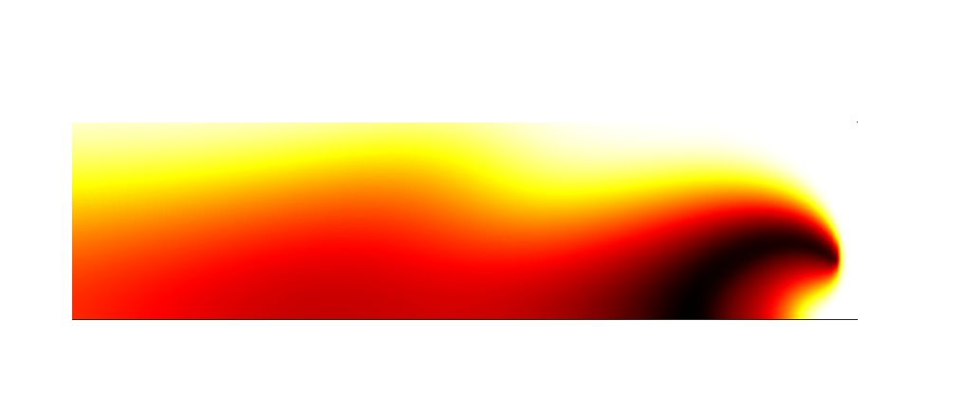


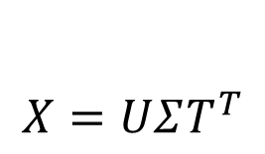

Methodology
Hybrid
INPUT
Step 1
Step 3
OUTPUT
Step 2
$$\hat{T}= ΣT^{T}$$
$$X=U{\hat{T}}^{∗}$$
…
SVD:
$$X=UΣT^{T}$$
RNN / CNN
$${\hat{T}}^{∗}$$
Original Database
Apply SVD
Predict the temporal coefficients
Predicted Database
Centering and scaling

Slide 6
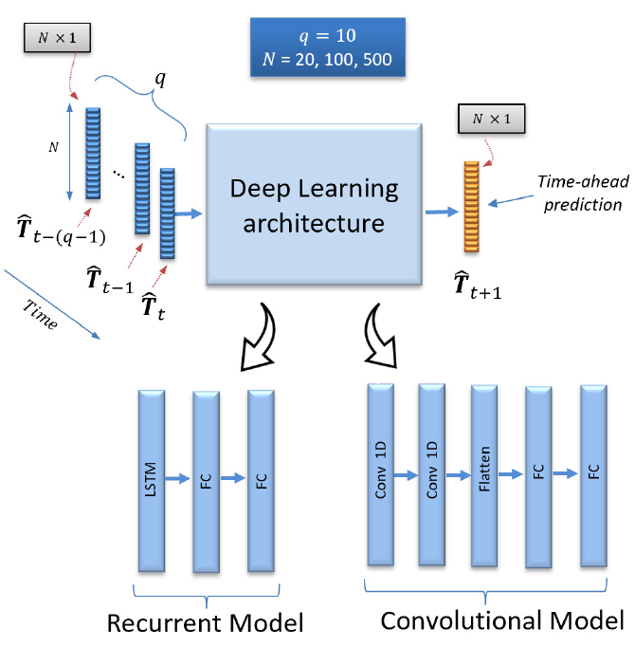
Methodology
Hybrid
RNN Model
CNN Model

Slide 7

Database & Data preparation
Hybrid
Axisymmetric, time varying, non-premixed laminar co-flow flame
Spatial dimensions
Snapshots Tensor = {$N_{v}, N_{z}, N_{r}, N_{t}$}
r
AIR
z
Variables
Temporal dimensions
FUEL
AXI-SYMMETRIC
(65% CH₄, 35% N₂)

Slide 8
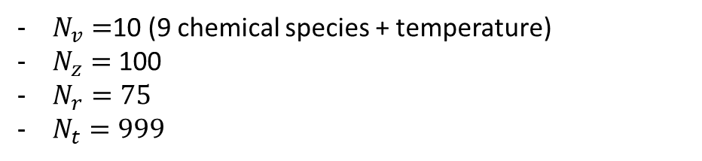

Database & Data preparation
Hybrid
$N_{v}=$10 (9 chemical species + temperature)
$N_{z}=$100
$N_{r}=75$
$N_{t}=999$
Snapshots Tensor = {$N_{v}, N_{z}, N_{r}, N_{t}$}
Training data set
Testing data set
65% Training snapshots
15% Validation snapshots
20% Testing snapshots

Slide 9
Calibration
Hybrid
Step 1
Step 1:
Scaling method: Auto scaling
Implemented: No scaling, Range, Pareto
Centering and scaling

Slide 10

Calibration
Hybrid
Step 1
Step 1:
Scaling method: Auto scaling
Implemented: No scaling, Range, Pareto
Step 2
Step 2:
Number of selected modes: 18
Scaling method: MaxPerMode
Implemented: No scaling, Range, Auto
SVD:
$$X=UΣT^{T}$$
Centering and scaling
Apply SVD

Slide 11


Calibration
Hybrid
Step 3
Step 3 (Hyperparameters):
$$\hat{T}= ΣT^{T}$$
Batch size: 12
Popular values: 5, 8, 16, 32, 64, and 128 samples.
Activation function for the hidden layer: relu
Popular values: linear, elu, tanh, sigmoid.
RNN / CNN
Activation function for the output layer: tanh
Popular values: linear, elu, tanh, sigmoid.
$${\hat{T}}^{∗}$$
Loss function: RRMSE+ sum of species = 1
Implemented values: mse, rrmse.
Predict the temporal coefficients
Batch size
Learning rate: 0.005
Popular values: 0.001, 0.01, 0.003.
…

Slide 12
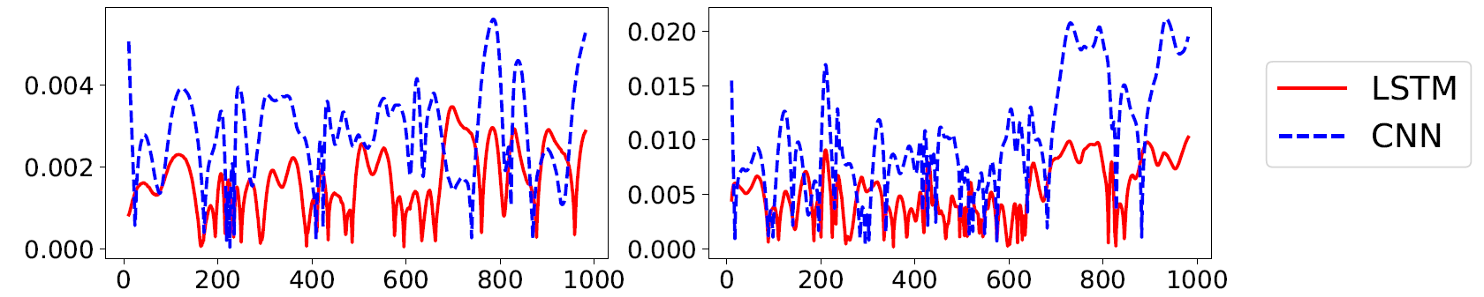
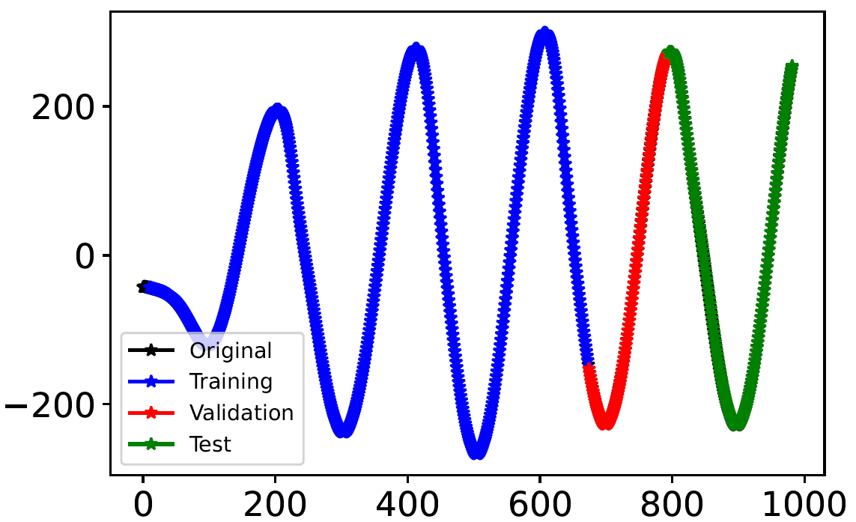
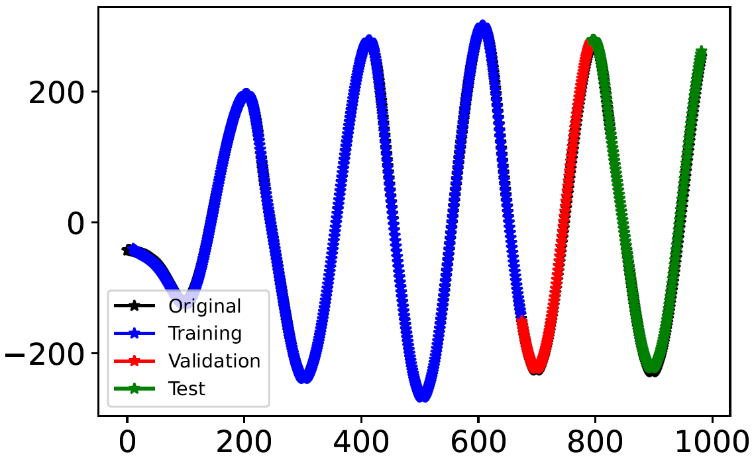
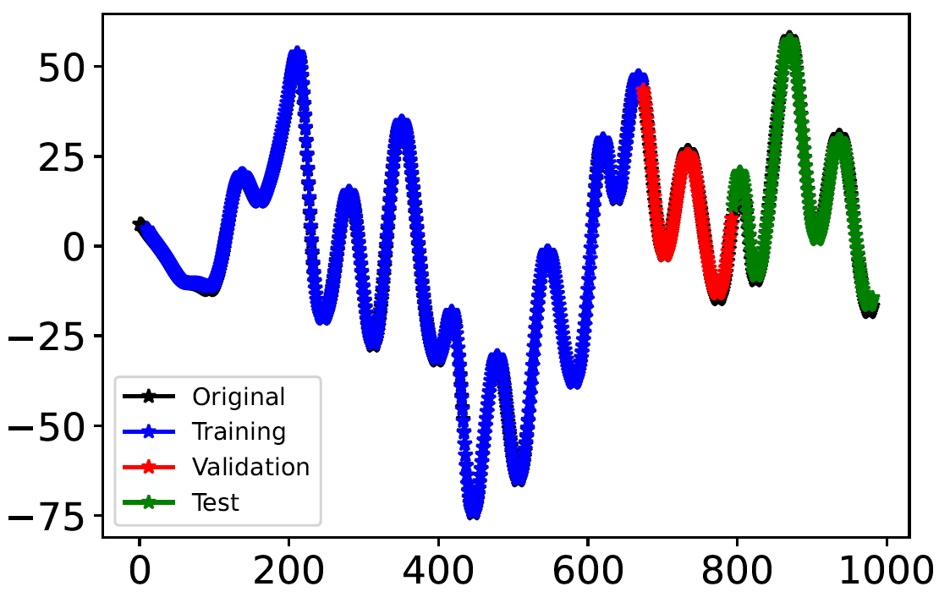
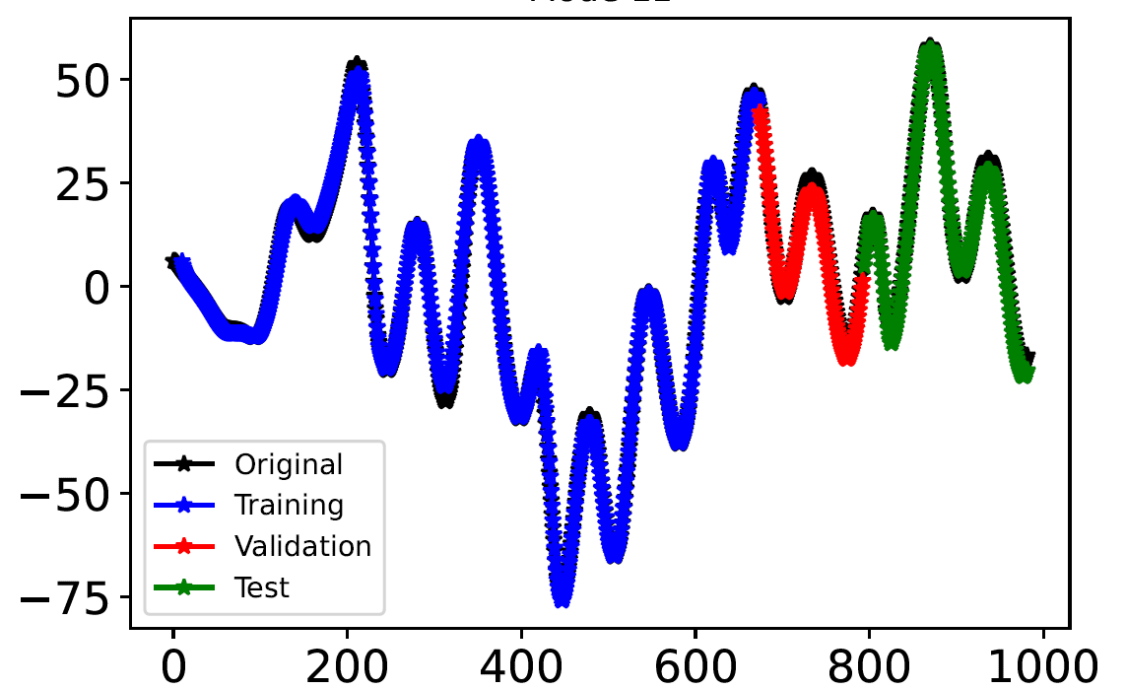
Results
Hybrid
RNN
CNN
Error

Slide 13
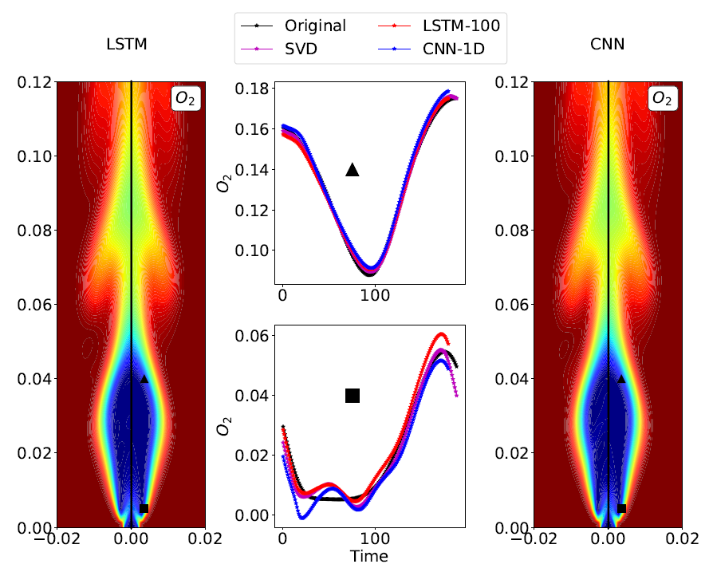
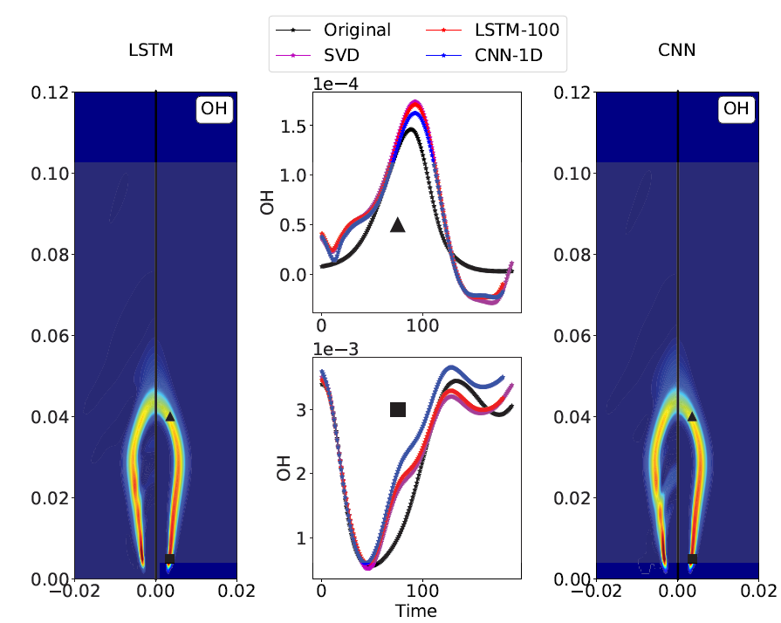
Results
Hybrid
Major species
Minor species
Click here for
more information

