Slide 1







ModelFLOWs
APP
MODAL DECOMPOSITION
DEEP LEARNING
Pattern detection
Reconstruction
Prediction
Pattern detection
Reconstruction
Prediction
HOSVD
Data Repairing
HODMD
Autoencoders
Superrresolution
Full DL
HODMD
Superresolution
Hybrid

Slide 2
ModelFLOWs
APP
MODAL DECOMPOSITION
DEEP LEARNING
Pattern detection
Reconstruction
Prediction
Pattern detection
Reconstruction
Prediction
HOSVD
Data Repairing
HODMD
Autoencoders
Superrresolution
Full DL
HODMD
Superresolution
Hybrid

Slide 3



Motivation
Superresolution
Many databases can come with a low resolution:
Low capacity of simulation.
Low quantity of sensors on an experiment.
Low resolution when zooming and analysing a certain area.
Aim: Enhance the resolution of a database.
Low resolution database

Slide 4
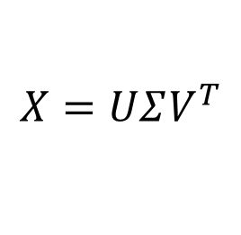
Methodology
Superresolution
INPUT
Step 1
Step 2
OUTPUT
SVD:
$$X=UΣV^{T}$$
Low resolution database
Apply
SVD
Interpolate modes
High resolution database

Slide 5

Database & Data preparation
Superresolution
2D Flow past a cylinder at Re = 100
Spatial dimensions
y
Ly = 20
Snapshots Tensor = {$N_{v}, N_{x}, N_{y}, N_{t}$}
x
Variables
Temporal dimensions
x/d = -15
x/d = 45

Slide 6
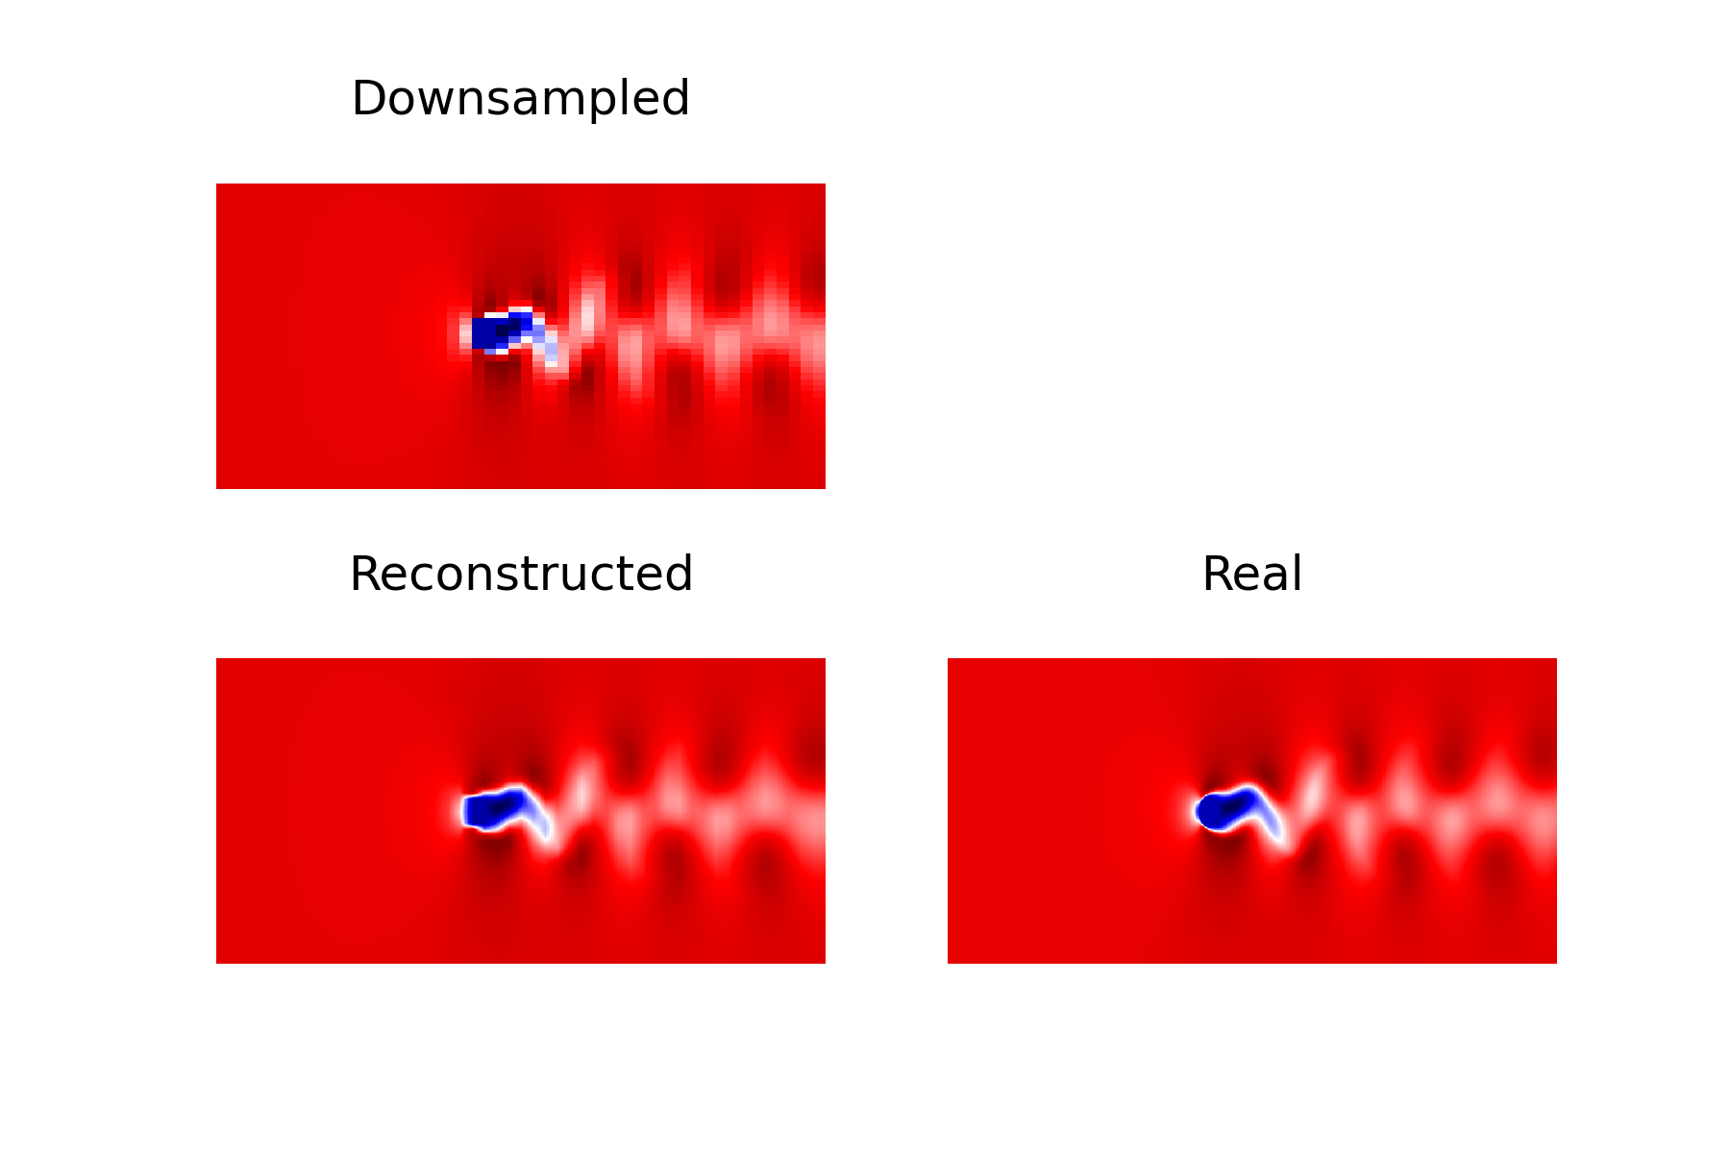

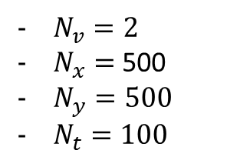
Database & Data preparation
Superresolution
$N_{v}=2$
$N_{x}=$500
$N_{y}=500$
$N_{t}=100$
Snapshots Tensor = {$N_{v}, N_{x}, N_{y}, N_{t}$}
Image = 500 x 500

Slide 7

Calibration
Superresolution
Enhancement parameter: The number of times the user wants to increase the resolution.
Value: 5x, 10x, 20x

Slide 8
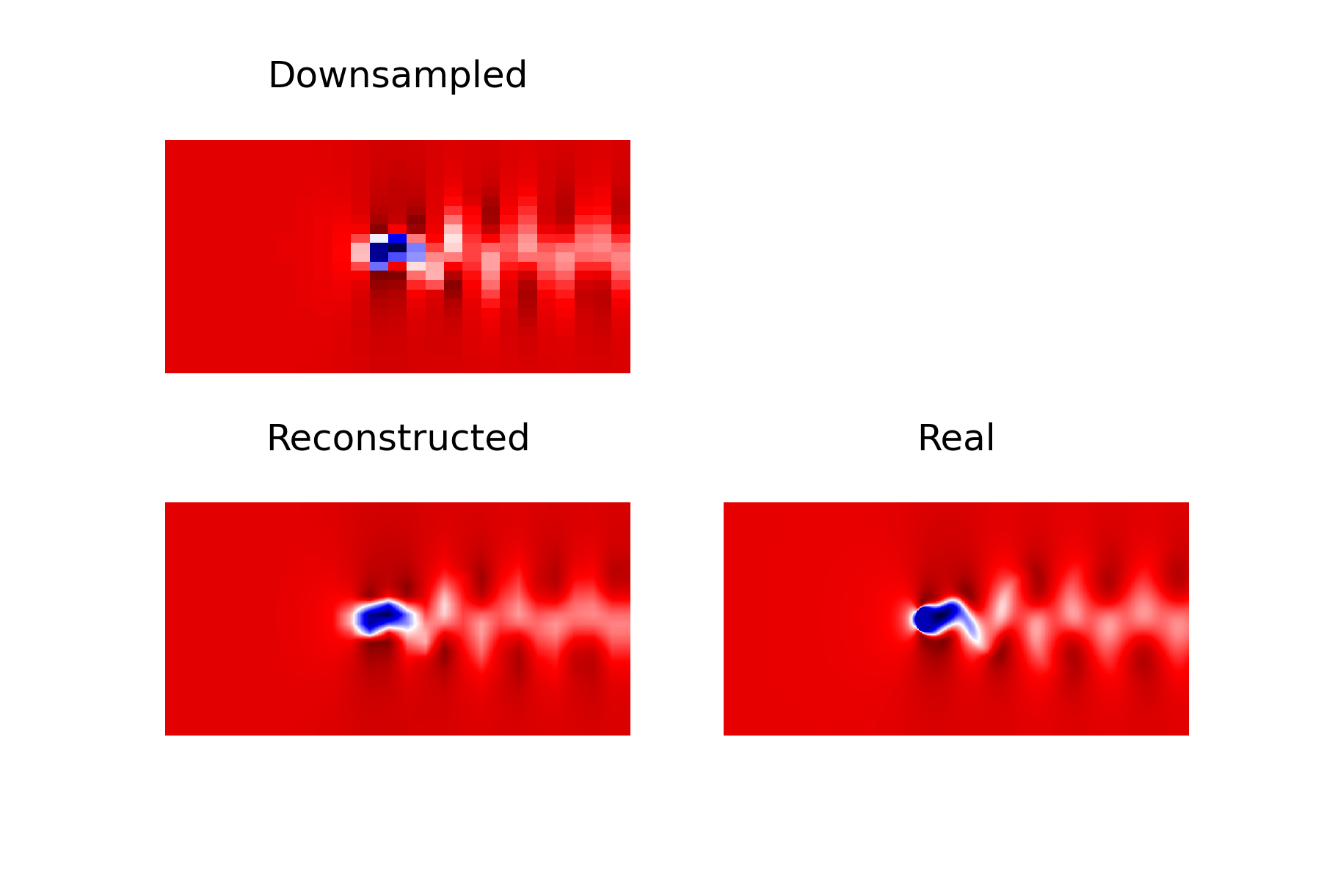
Results
Superresolution
10x
20x
RRMSE: 1.3%
RRMSE: 3.2%

