Slide 1
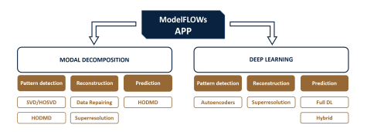

Installing and using ModelFLOWs-app
ModelFLOWs-app
Universidad Politécnica de Madrid

Slide 2
Open Source Software
ModelFLOWs
APP
MODAL DECOMPOSITION
DEEP LEARNING
Pattern detection
Reconstruction
Prediction
Pattern detection
Reconstruction
Prediction
HOSVD
Data Repairing
HODMD
Autoencoders
Superresolution
Full DL
HODMD
Superresolution
Hybrid
a)
Universidad Politécnica de Madrid

Slide 3
Download & Installation
How can I download ModelFLOWs-app?
ModelFLOWs-app is easy to download:
Head over to the ModelFLOWs-app GitHub repository (github.com/modelflows/ModelFLOWs-app)
Find the version that you would like to download (mains/desktop/web-browser demo)
Click on “main” and then the branch corresponding to the version you would like
Once in the desired branch, click on “code” and select “Download ZIP”
Done! You have downloaded ModelFLOWs-app
Universidad Politécnica de Madrid

Slide 4
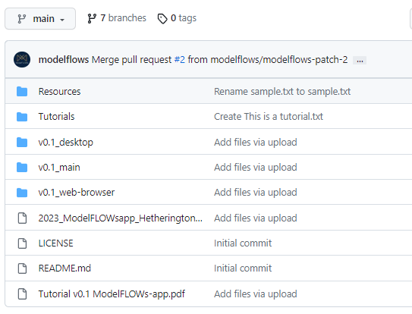
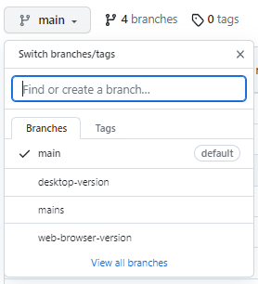
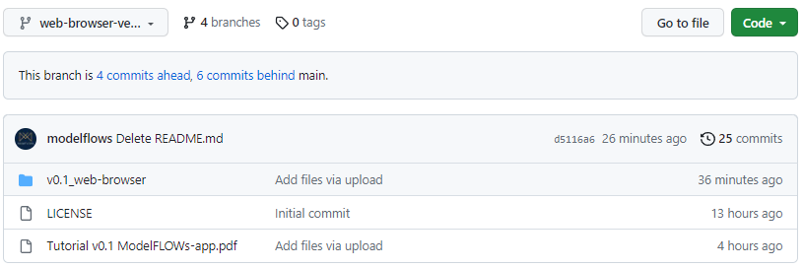
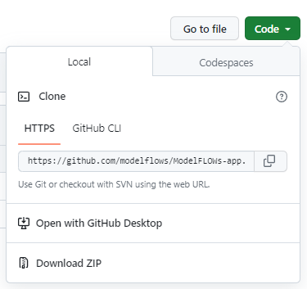
Download & Installation
How can I download ModelFLOWs-app?
1
3
2
4
Universidad Politécnica de Madrid

Slide 5
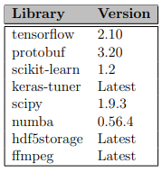

Download & Installation
How do I “Install” ModelFLOWs-app?
ModelFLOWs-app doesn’t require installation, but you may need to install some libraries to your environment.
This application has been developed using Python 3.9 and is compatible with all later versions.
The required libraries are: If you are going to use the web-version demo, you will also have to install:
Universidad Politécnica de Madrid

Slide 6
Download & Installation
How do I “Install” ModelFLOWs-app?
There are two options to install these libraries, both are done through the command prompt/line:
Option 1 (FAST): In command prompt, head to the ModelFLOWs-app directory (the folder that you have just downloaded) and run the following command:
This will read the Requirements.txt file, which is located inside the folder and contains a list of all the necessary libraries and corresponding versions, and install them automatically.
Option 2 (SLOW): Install each library manually (you don’t need to be inside the directory).
Universidad Politécnica de Madrid

Slide 7
Download & Installation
How do I open ModelFLOWs-app?
This is also done in the command prompt/line. Each version (web-browser/desktop) requires a different, but short and easy to remember command (inside the app directory):
For the web-browser demo: streamlit run ModelFLOWs_web.py
For the desktop version: python ModelFLOWs_app.py
Universidad Politécnica de Madrid

Slide 8
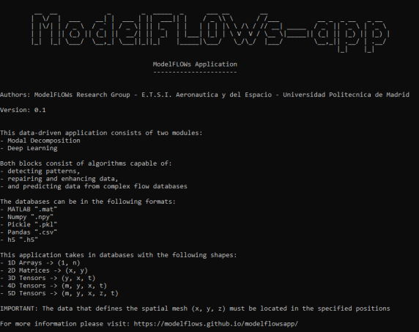
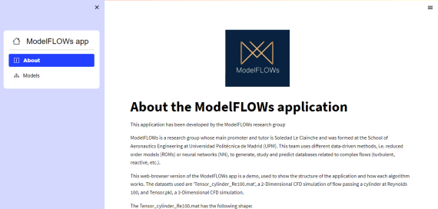
Download & Installation
Once the app is open…
Both versions of ModelFLOWs-app have very intuitive user-friendly menus, allowing you to easily navigate between the different options:
Universidad Politécnica de Madrid

Slide 9
Using ModelFLOWs-app
Differences between versions:
Desktop version | Web-browser version
Runs in command prompt/line | Runs in the web-browser (Chrome/Mozilla/Edge…)
User selects the database (.mat, .npy, .csv, .pkl, .h5) | Fixed databases
Flexible | Limited parameter configuration
This tutorial will focus on the web-browser version, since its has been created as a demo for unexperienced users.
Universidad Politécnica de Madrid

Slide 10
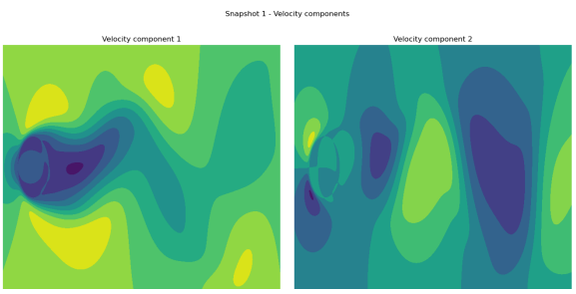
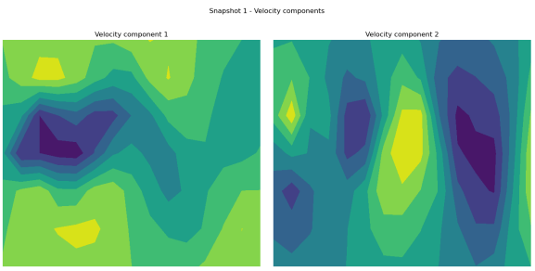
Using ModelFLOWs-app
Databases
The following databases are provided:
1.1) Tensor_cylinder_Re100.mat (used in most modules)
1.2) DS_30_Tensor_cylinder_Re100.mat
Universidad Politécnica de Madrid

Slide 11
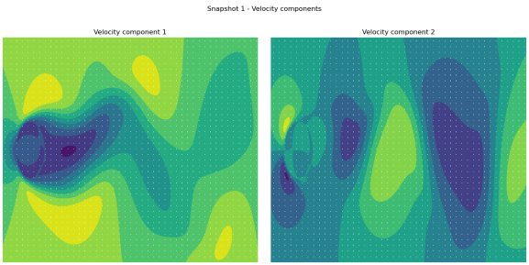
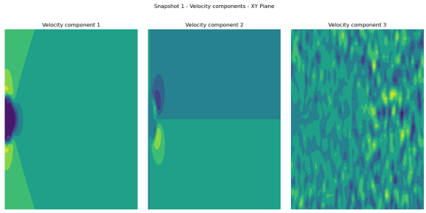
Using ModelFLOWs-app
1.3) Gappy_Tensor_cylinder_Re100.mat
2.1) Tensor.pkl
Universidad Politécnica de Madrid

Slide 12
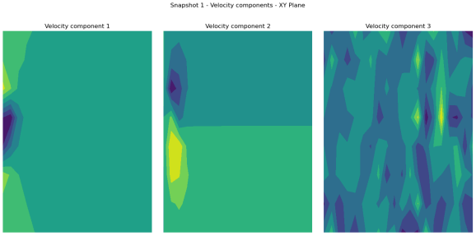
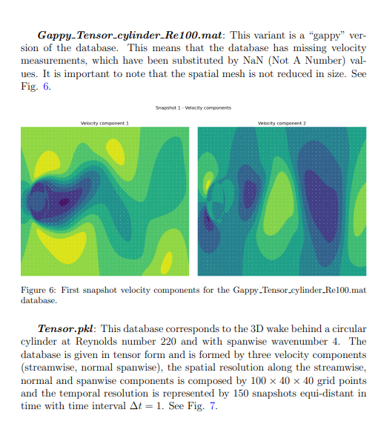
Using ModelFLOWs-app
2.2) DS_30_Tensor.pkl
Download the tutorial pdf for more info!
Universidad Politécnica de Madrid

Slide 13
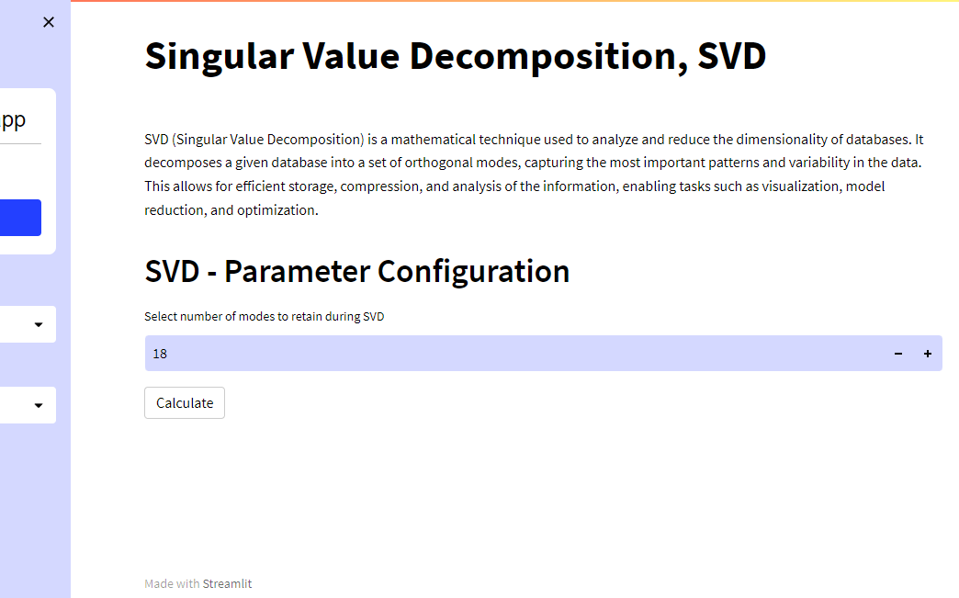
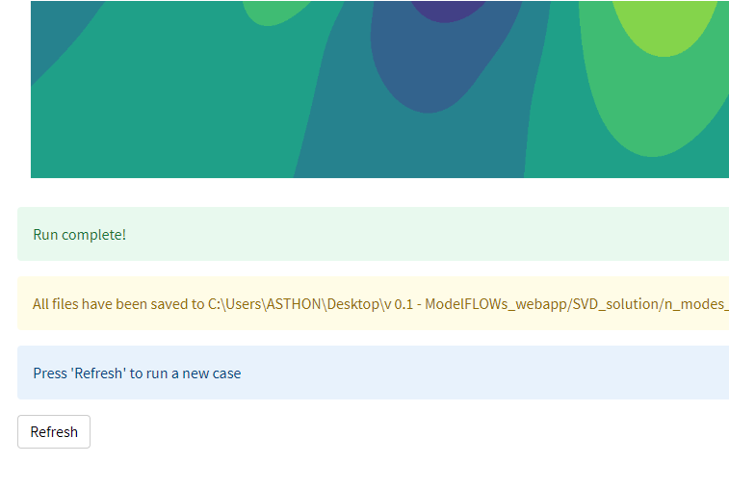
Using ModelFLOWs-app
How to run a case
How to run a new case
Universidad Politécnica de Madrid

Slide 14
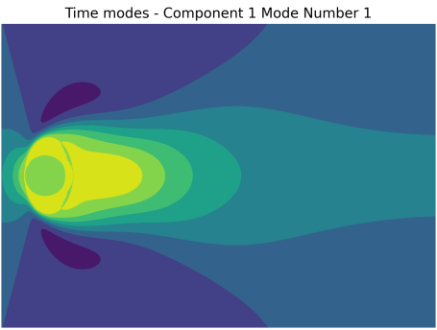
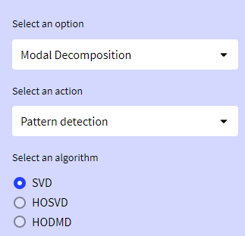

Using ModelFLOWs-app
Modal Decomposition – Pattern Detection
Singular Value Decomposition, SVD
SVD is a mathematical technique used to analyze and reduce the dimensionality of databases. It decomposes a given database into a set of orthogonal modes, capturing the most important patterns and variability in the data.
Universidad Politécnica de Madrid

Slide 15
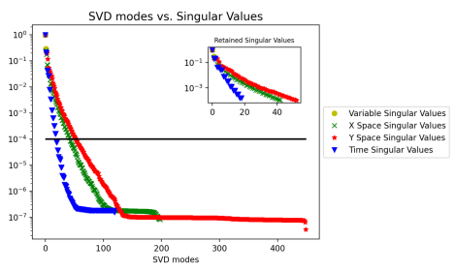
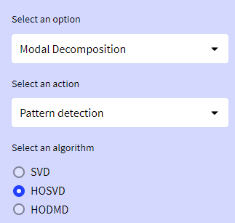

Using ModelFLOWs-app
Modal Decomposition – Pattern Detection
Higher-Order Singular Value Decomposition, HOSVD
In multilinear algebra, HOSVD of a tensor is a specific orthogonal Tucker decomposition. It may be regarded as one generalization of the matrix singular value decomposition.
Universidad Politécnica de Madrid

Slide 16
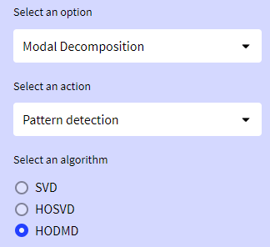
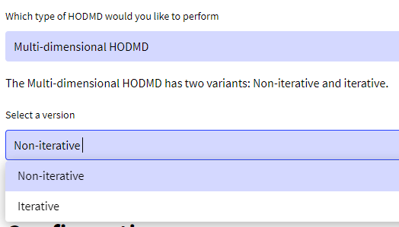
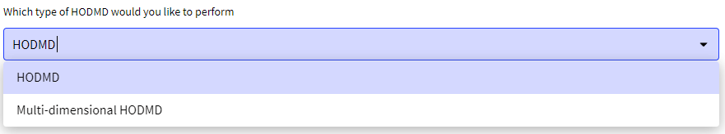
Using ModelFLOWs-app
Modal Decomposition – Pattern Detection
Higher-Order Dynamic Mode Decomposition, HODMD (I)
Two types: HODMD (for matrices, applies SVD) and Multi-dimensional HODMD (For tensors, applies HOSVD)
There are also two versions for Multi-dimensional HODMD: Non-iterative and iterative
Universidad Politécnica de Madrid

Slide 17
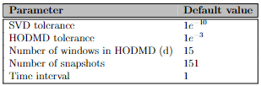
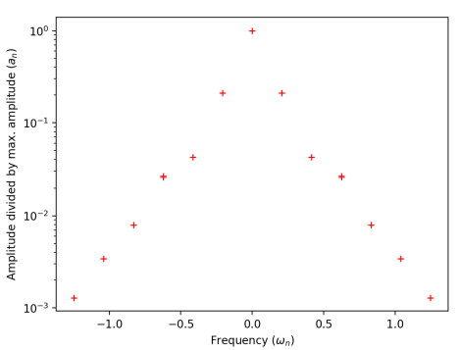
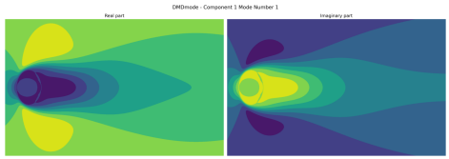
Using ModelFLOWs-app
Modal Decomposition – Pattern Detection
Higher-Order Dynamic Mode Decomposition, HODMD (II)
HODMD is a data-driven method generally used in fluid dynamics and in the analysis of complex non-linear dynamical systems modeling several complex industrial applications.
Universidad Politécnica de Madrid

Slide 18

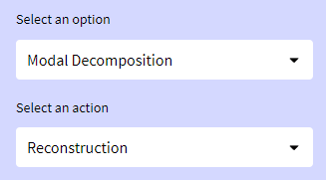
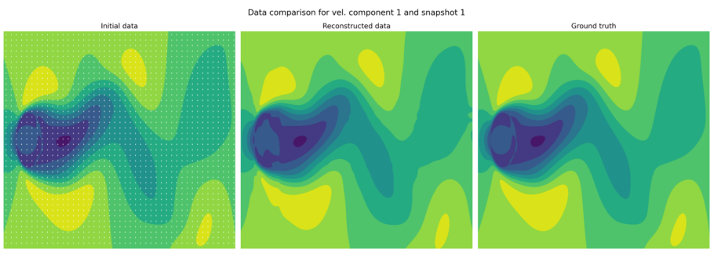

Using ModelFLOWs-app
Modal Decomposition – Data Reconstruction
Data Repairing
This module takes the Gappy_Tensor_cylinder_Re100.mat tensor, which has missing data, and fills in the gaps using different techniques (interpolation, mean value, zeros) and then HOSVD. The reconstructed data is then compared to Tensor_cylinder_Re100.mat, which is the ground truth.
Universidad Politécnica de Madrid

Slide 19
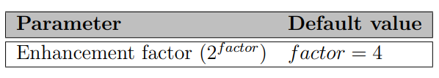
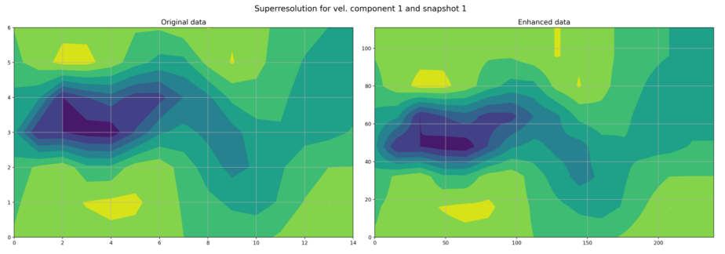

Using ModelFLOWs-app
Modal Decomposition – Data Reconstruction
Superresolution (Data Enhancement)
This module takes the DS_30_Tensor_cylinder_Re100.mat tensor, which is a low resolution database, and expands its spatial dimensions using HOSVD.
Universidad Politécnica de Madrid

Slide 20
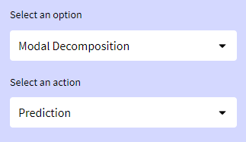
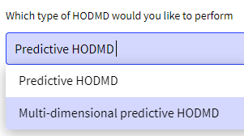
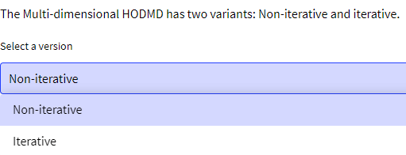
Using ModelFLOWs-app
Modal Decomposition – Prediction
(Multi-dimensional) Predictive Higher-Order Dynamic Mode Decomposition, (md)HODMD (I)
It is also possible to predict future snapshots using HODMD by reconstructing the original tensor setting the desired number of snapshots
Universidad Politécnica de Madrid

Slide 21
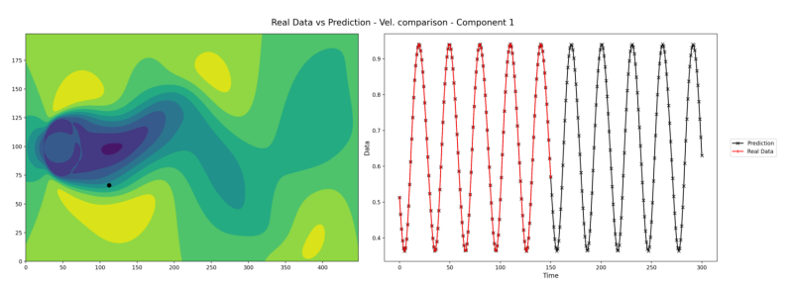
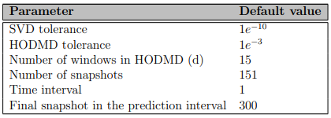
Using ModelFLOWs-app
Modal Decomposition – Prediction
(Multi-dimensional) Predictive Higher-Order Dynamic Mode Decomposition, (md)HODMD (II)
Universidad Politécnica de Madrid

Slide 22

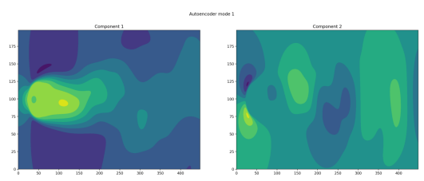
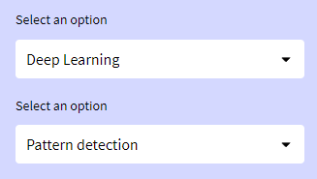
Using ModelFLOWs-app
Deep Learning - Pattern Detection
Autoencoders Neural Network
An autoencoder is an unsupervised learning technique for neural networks that learns efficient data representations (encoding) by training the network to ignore signal “noise.”
Universidad Politécnica de Madrid

Slide 23
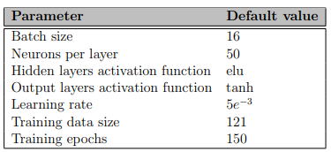
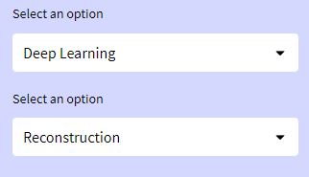
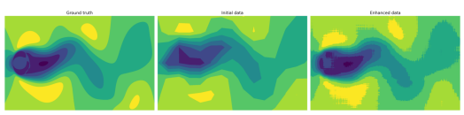
Using ModelFLOWs-app
Deep Learning – Data Reconstruction
Superresolution Neural Network
This model inputs 2D (Tensor_cylinder_Re100.mat) and 3D (Tensor.pkl) data. Precisely, the model inputs the downsampled and ground truth versions of each database, enhances the downsampled version’s resolution, and then compares it to the ground truth. This model is hybrid, since it combines SVD with DL.
Universidad Politécnica de Madrid

Slide 24
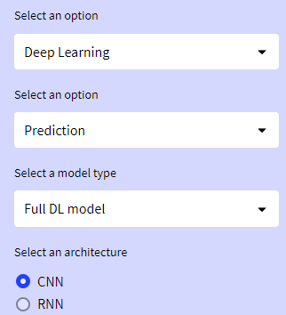
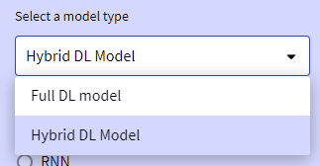
Using ModelFLOWs-app
Deep Learning – Prediction
Predictive Neural Networks
Two model types are available: full deep learning, and hybrid deep learning. This last one applies SVD on the training data during the data preprocessing stage. The used architectures are Convolutional Neural Network (CNN) architecture and Recurrent Neural Network (RNN).
Universidad Politécnica de Madrid

Slide 25
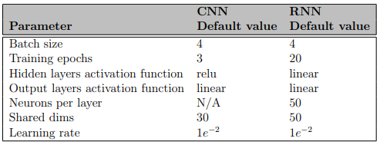
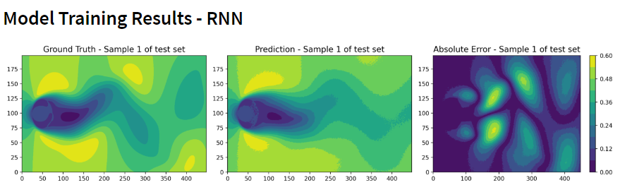
Using ModelFLOWs-app
Deep Learning – Prediction
Predictive Neural Networks – Full Deep Learning Model
Universidad Politécnica de Madrid

Slide 26
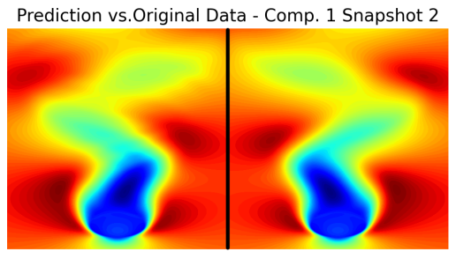
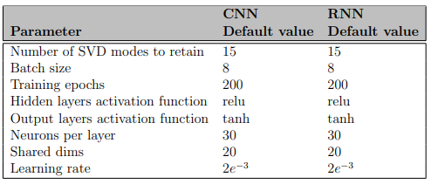
Using ModelFLOWs-app
Deep Learning – Prediction
Predictive Neural Networks – Hybrid Deep Learning Model
Two model types are available: full deep learning, and hybrid deep learning. This last one applies SVD on the training data during the data preprocessing stage. The used architectures are Convolutional Neural Network (CNN) architecture and Recurrent Neural Network (RNN.
Universidad Politécnica de Madrid

Slide 27



Thank you for your attention!
For any help or suggestions please contact us at:
modelflows.mf@gmail.com
Keep up to date with our work!
linkedin.com/in/company/modelflows/
github.com/modelflows
a)
Universidad Politécnica de Madrid

