Slide 1

COMPANY DATABASE MANAGEMENT SYSTEM
SUBMITTED BY:
sPARSH GAGNEJA
(rOLL NO. - 1706522)
VARUNPREET SINGH
(ROLL NO. - 1706535)

Slide 2
Introduction to the project
The company is organized into branches. Each branch has a name, unique
ID and an employee who manages the branch. We keep track of the branch
supplier by storing the records of the supplier name and the supply type.
A branch may have several branch suppliers.
Each branch handles a number of clients.
We store each employee’s ID number, address, salary, sex, and birthdate.
Each employee works for one branch but may work with several clients.
One employee manages one branch. We keep a track of the start time of
management for the employee for a branch.
We also keep track of the directed supervisor of each employee and the
supervisee associated with each employee.
An employee may work with a number of clients.
For each client, we keep track of their name, unique ID, relationship to the
employee.

Slide 3
Objectives
Describe basic file organization concepts and the problems of managing data resources in a traditional file environment
Describe how a database management system organizes information and compare the principal database models
Apply important database design principles
Evaluate new database trends
Identify the challenges posed by data resource management and management solutions

Slide 4
Problems with the Traditional File Environment
Data redundancy: The presence of duplicate data in multiple data files so that the same data are stored in more than one place or location.
Data inconsistency: The same attribute may have different values.
Program-data dependence: The coupling of data stored in files and the specific programs required to update and maintain those files such that changes in programs require changes to the data.
Lack of flexibility: A traditional file system can deliver routine scheduled reports after extensive programming efforts, but it cannot deliver ad-hoc reports or respond to unanticipated information requirements in a timely fashion.
Lack of data sharing and availability: Information cannot flow freely across different functional areas or different parts of the organization. Users find different values of the same piece of information in two different systems, and hence they may not use these systems because they cannot trust the accuracy of the data.

Slide 5
Database Management System (DBMS)
Software for creating and maintaining databases
Permits firms to rationally manage data for the entire firm
Acts as interface between application programs and physical data files
Separates logical and design views of data
Solves many problems of the traditional data file approach

Slide 6
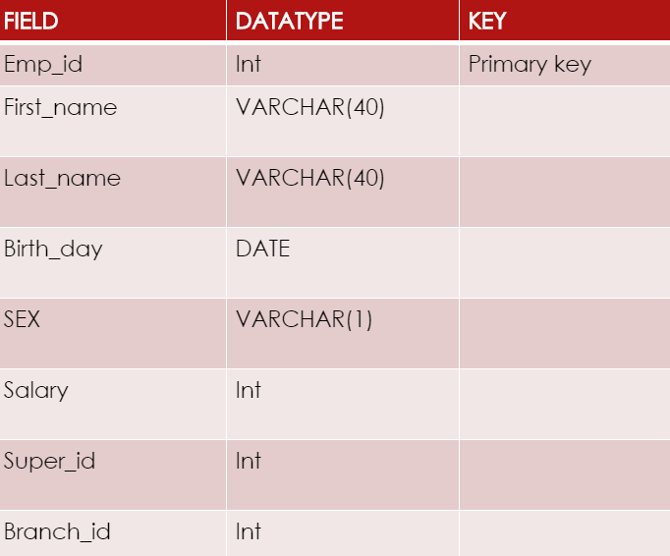
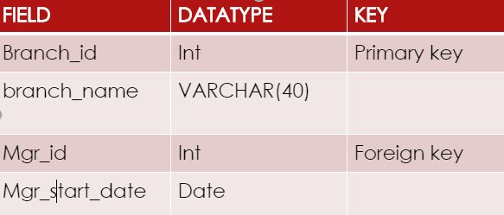
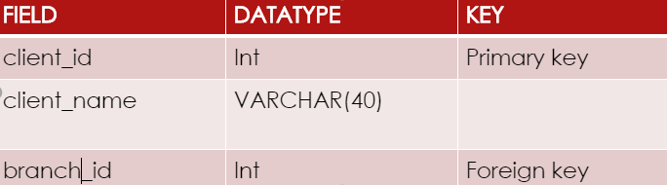
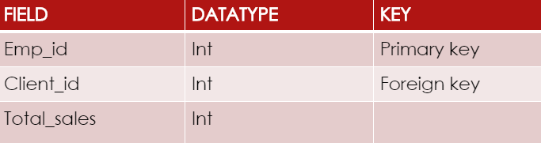
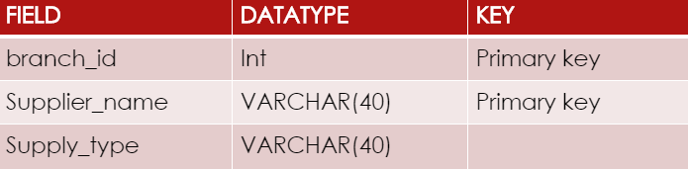
Entity description of the tables in the database

Slide 7
Entity-Relationship (ER) Model
Facts about ER Diagram Model:
ER model allows you to draw Database Design
It is an easy to use graphical tool for modeling data
Widely used in Database Design
It is a GUI representation of the logical structure of a Database
It helps you to identifies the entities which exist in a system and the relationships between those entities
Why use ER Diagrams?
ER diagrams are translatable into relational tables which allows you to build databases quickly
ER diagrams can be used by database designers as a blueprint for implementing data in specific software applications
ERD is allowed you to communicate with the logical structure of the database to users
Components of the ER Diagram
This model is based on three basic concepts:
Entities
Attributes
Relationships

Slide 8
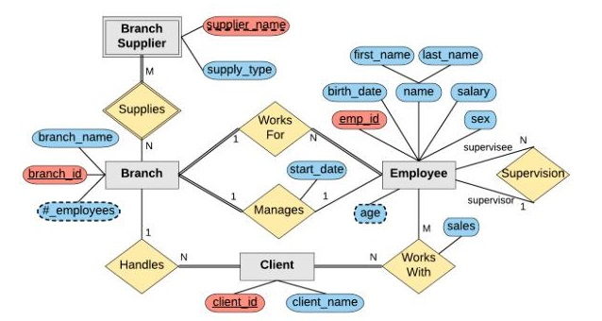
Company Database ER diagram

Slide 9
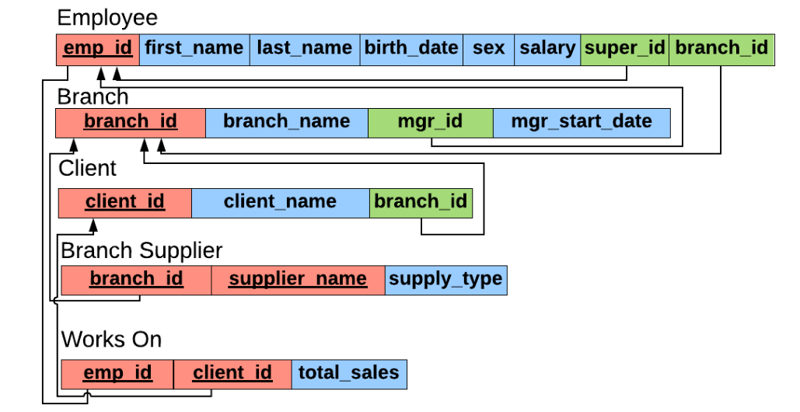
Company Database Schema

Slide 10

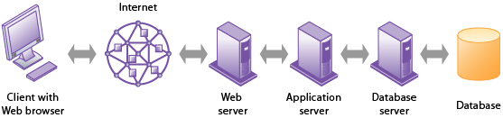



Linking Internal Databases to the Web

Slide 11
Management Challenges and Solution Guidelines
Management Challenges:
Organizational obstacles to a database environment : Need for cooperation in developing corporate-wide data administration.
Cost/benefit considerations: Bringing about significant change in the database environment of a firm can be very expensive and time consuming.
Solution Guidelines:
The critical elements for creating a database environment are:
Data-planning and modelling methodology
Data administration
Database technology and management
Users

