Slide 1
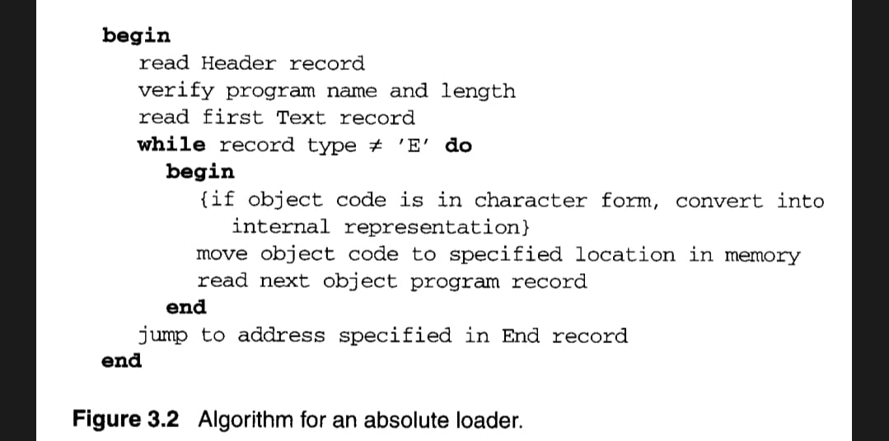
Pass 1:
begin
get PROGADDR from operating system
set CSSADDR to PROGADDR {for first control section}
while not end of input do
begin
read next input record
{Header record for control section }
set CSLTH to control section length
search ESTAB for control sectionA name
if found then
set error flag {duplicate external symbol}
else
enter control section name into ESTAB
with value CSADDR
While record type ≠ 'E' do
begin
read next input record
if record type = 'D' then
for each symbol in the record do
begin
search ESTAB for symbol name
if found then
set error flag {duplicate external symbol}
else
enter symbol into ESTAB with value
(CSADDR + indicated address)
end {for}
end { while ≠ 'E' }
add CSLTH to CSADDR
{starting address for next control section}
end {while not EOF}
End {Pass 1}
Pass 2:
begin
get CSSADDR from PROGADDR
set EXEADDR to PROGADDR
while not end of input do
begin
read next input record {Header record}
set CSLTH to control section length
While record type ≠’E’ do
begin
read next input record
if record type = ‘T’then
begin
{ if object code is in character form, convert
into internal representation }
move object code from record to location
{ CSADDR + specified address }
end {if ‘T’}
else if record type = ‘M’ then
begin
search ESTAB for modifying symbol name
begin
{ if object code is in character form, convert
into internal representation }
move object code from record to location
{ CSADDR + specified address }
end {if ‘T’}
else if record type = ‘M’ then
begin
search ESTAB for modifying symbol name
if found thenadd or subtract symbol value location
{CSADDR + specified address}
else
set error flag {undefined external symbol}
end { if ‘M’}
end {While ≠’E’}
if an address is specified {in End record} then
set EXECADDR to (CSADDR +specified address)
Add CSLTH to CSADDR
End {while not EOF}
Jump to location given by EXECADDR
End {Pass 2}
Relocation Loader Algorithm
Begin
Get PROGADDR from OS
While not end of input do
{read next record
while record type !='E' do
{read next input record
while record type =' T' do
{ move object code from record to location
ADDR+ specified address }
while record type = 'M'
add PROGADDR at the location PROGADOR +specified address }}
end

