Slide 1
Docker and Containerization

Slide 2
Software Version Problem

Slide 3
Exercise
Create HelloWorld.java in any directory:
public class HelloWorld {
public static void main(String[] args) {
System.out.println("Hello, World!");
}
}

Slide 4
Install OpenJDK 21
Download zip from https://jdk.java.net/21/
Extract in c:, so it should become C:\jdk-21.0.1
Open environment variables (Windows Start button->Search)
Under System variables
Set JAVA_HOME=C:\jdk-21.0.1
Delete old path entry for JDK and set it to C:\jdk-21.0.1\bin
Open a new command prompt
Compile HelloWorld.java: javac HelloWorld.java
Execute HelloWorld: java HelloWorld
Output should be Hello World!

Slide 5
Run using Old JDK
Revert back to old JDK (e.g. C:\Java\jdk1.8.0_311)
Again in environment variables->System variables
JAVA_HOME should be C:\Java\jdk1.8.0_311
Path for Java should be changed to C:\Java\jdk1.8.0_311\bin
Open a new command prompt
Rerun (do not recompile): java HelloWorld
Error!

Slide 6
Problem
Compiled Java code with a new version (Java 21)
Tried to execute it with an old version (Java 8)
What if
The developer has Java 21
Production server has Java 8
Code will fail on the prouction machine!

Slide 7
Software Deployment

Slide 8
Software Deployment
Software Deployment: Process of making a software application or update available for use in a specific environment
Involves installation, configuration, activation of software on IT systems
Aim: Make it ready for users or clients

Slide 9
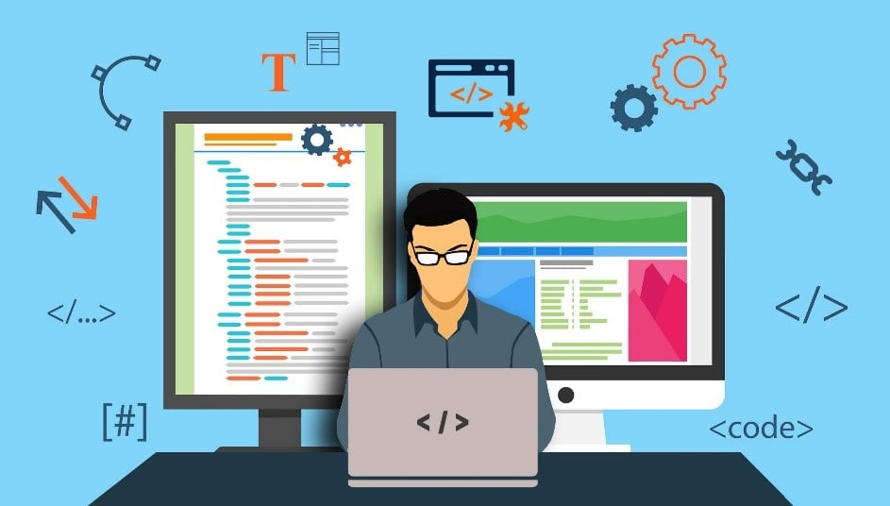
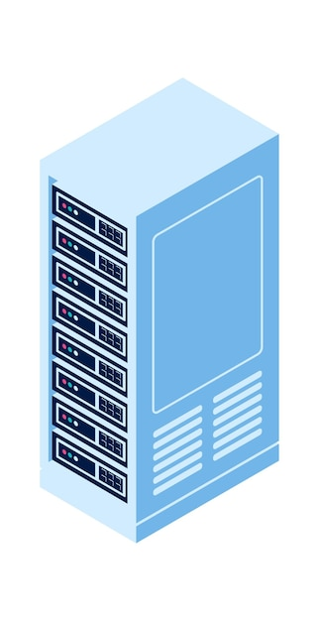
Traditional Software Deployment
Developers develop code on their machine, test it, and once it is error-free, are ready for deployment

Slide 10
Traditional Software Deployment
StudentApp.jar
StudentDB.sql
Developers upload/copy all the necessary files that are needed on the target server

Slide 11
Traditional Software Deployment
StudentApp.jar
StudentDB.sql
java -jar StudentApp.jar
Developers try running the software on the target server

Slide 12
Traditional Software Deployment
StudentApp.jar
StudentDB.sql
java -jar StudentApp.jar
Error – so the developer tries to check Java version on the server … Ooops – Java itself is not installed!

Slide 13
Traditional Software Deployment – Problem Summary
Target environment can be quite different
Result: Software works on the Developer machine, but does not work on the Test/Production machine
Developers are focused on their development environment

Slide 14
Varying Nature of Problems
Complete absence of software
Developer: Java, Production: No Java
Part-absence of software
Developer: Java + MySQL, Production: Java + Oracle
Version problems
Developer: Java 19 + MySQL 8, Production: Java 8 + MySQL 5
Library problems
Developer: Java 19 + MySQL 8 + Payment API, Production: Java 19 + MySQL 8
OS mismatches
Developer: HTML + CSS + JS on Windows, Production: HTML + CSS + JS on Linux

Slide 15
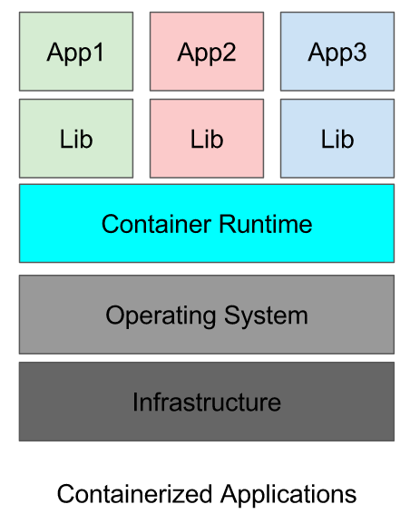
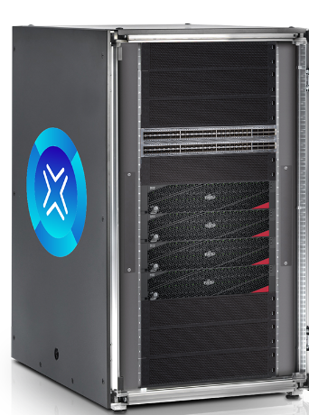
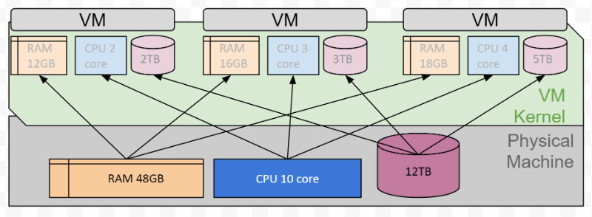
Solution: Evolution of Deployment
Deployment directly on the hardware
Deployment on a virtual machine
Containerized application

Slide 16
Quick Revision
Let us summarize …

Slide 17
Deployment Option 1: Traditional Deployment
Application
Libraries and Frameworks
Operating System
Hardware

Slide 18
Deployment Option 2: Virtualized Deployment
Virtual Machine
Virtual Machine
Virtual Machine
Application
Application
Application
Libraries and Frameworks
Libraries and Frameworks
Libraries and Frameworks
Operating System
Operating System
Operating System
Hypervisor
Operating System
Hardware

Slide 19
Deployment Option 3: Containerized Applications
Container
Container
Container
Application
Application
Application
Frameworks
Frameworks
Frameworks
Libraries
Libraries
Libraries
Docker
Operating System
Hardware

Slide 20
Deployment Option 4: Container Orchestration
Kubernetes
Container
Container
Container
Application
Application
Application
Frameworks
Frameworks
Frameworks
Libraries
Libraries
Libraries
Docker
Operating System
Hardware

Slide 21
Docker

Slide 22
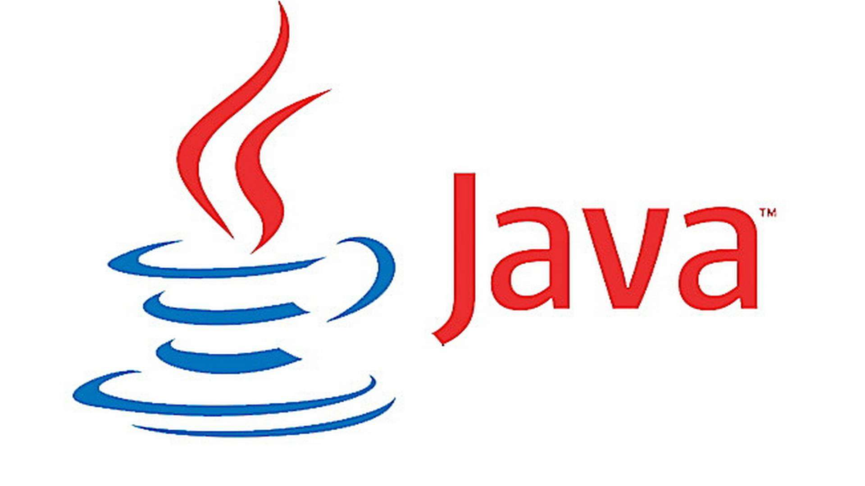
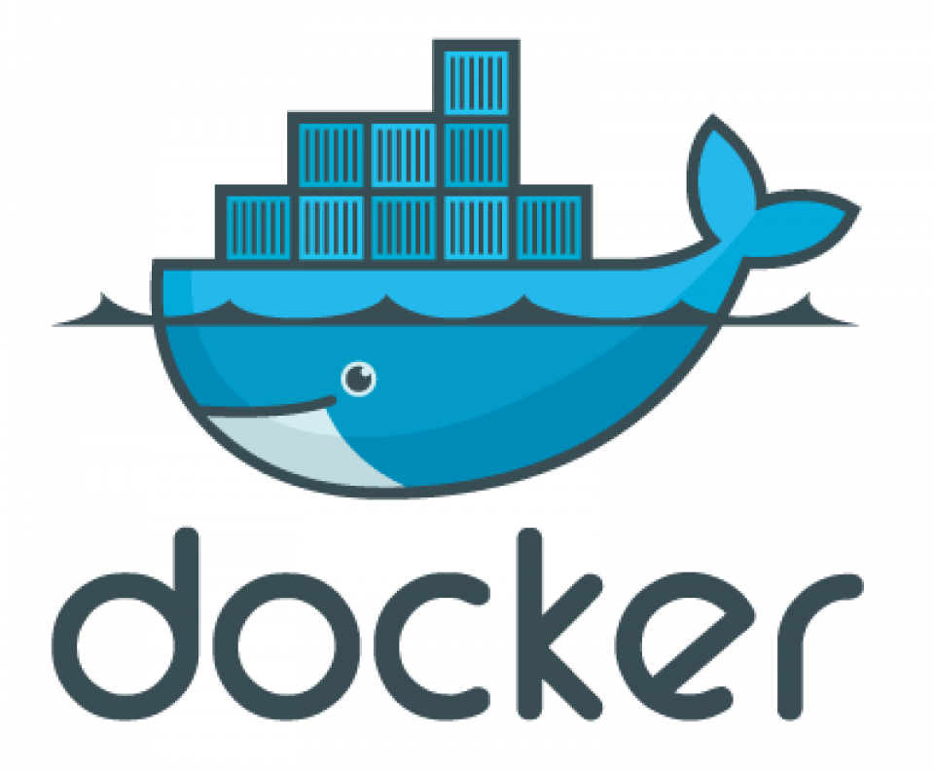

What is Docker?
Docker is a container technology
Why container? Because it contains everything needed to execute an application
Takes the virtualization concept to the next level
Example of Docker container
HelloWorld.class

Slide 23
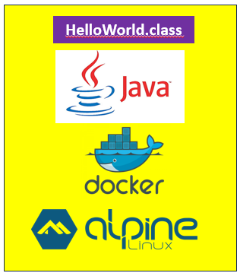
With and Without Container
Before Docker
After Docker
HelloWorld.class
May not work, if Java is not on the server, or the version is wrong

Slide 24

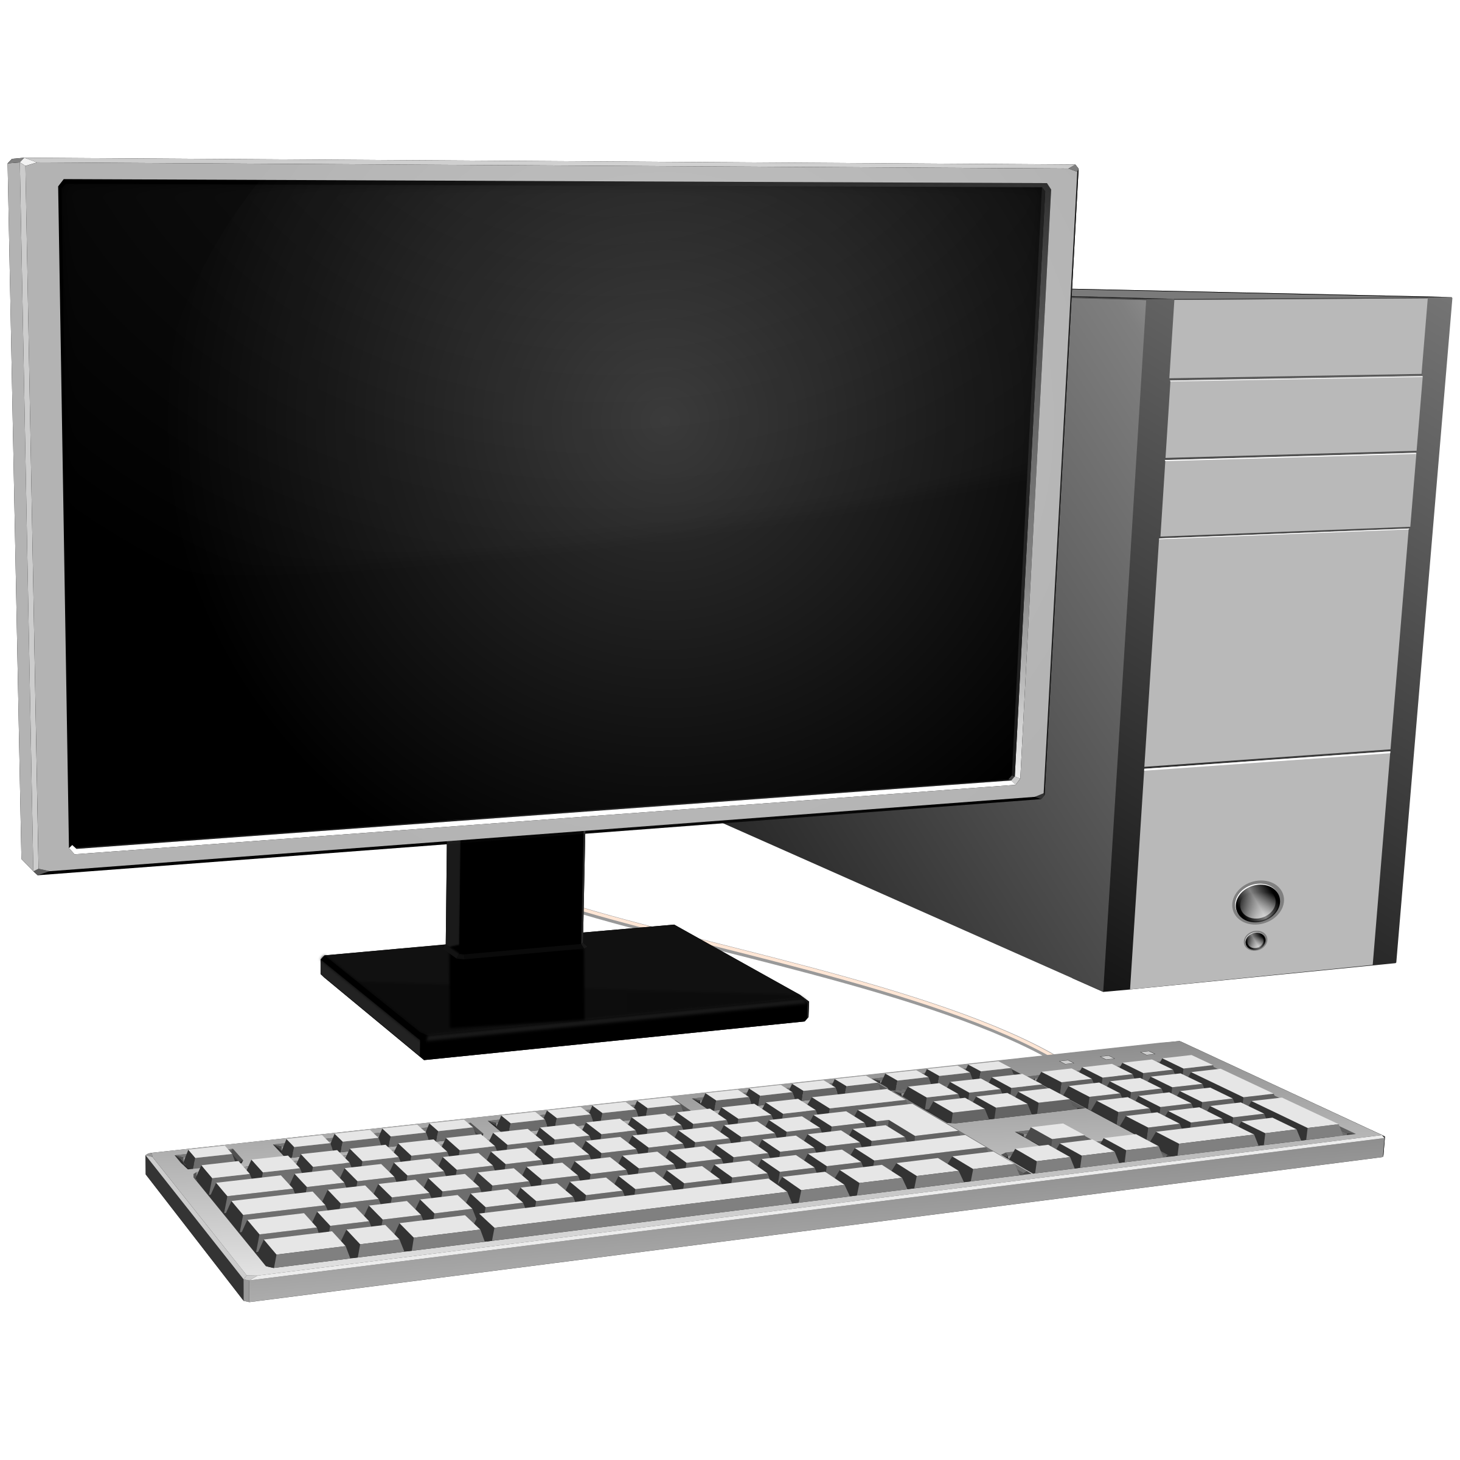
What Happens When We Install Docker?
Inside Docker
End result
VM Manager
Linux Kernel
VM Manager
Docker
Linux Kernel
Windows

Slide 25

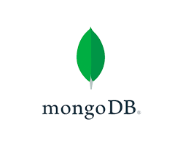

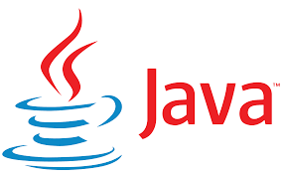


How to use Container Technology
Developers develop and test code (e.g. bank.war)
We do not give the WAR file to the customer now
We bundle all the dependencies of our WAR file with it: Java, MySQL, Tomcat, Spring Boot, MongoDB, …
How?

Slide 26
How to use Container Technology
Create a Docker Image (docker build command)
Docker Image
Take anywhere and run – it will always work and will always produce consistent output

Slide 27
How to use Container Technology
Execute the built Docker Image (docker run command)
Docker Image
Docker Container

Slide 28
What happens when we use docker run?
Docker looks for the specified image in the local cache, and if found, tries to run a container from it
If it cannot find the image locally, it automatically searches for it in the remote repository (Docker Hub)
If it finds it in the remote depository, it downloads it, creates a container using that image, and runs it

Slide 29
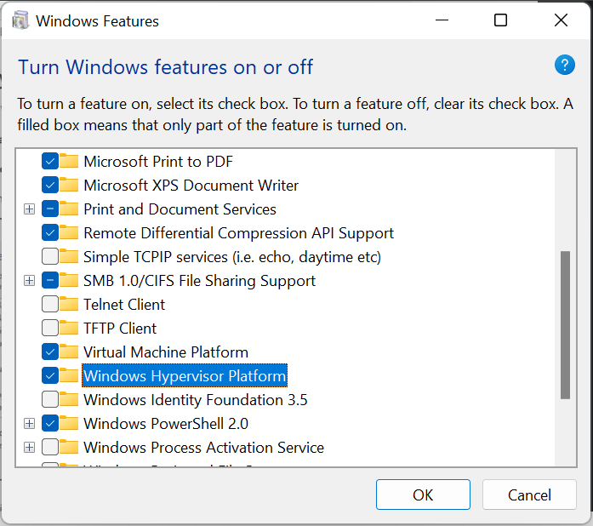
Docker Installation on Windows
Search for ‘Turn Windows Features on or off’
Then check the checkboxes, if required and restart

Slide 30
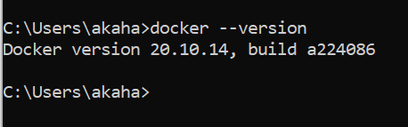
Docker Installation – 1
Install: https://docs.docker.com/desktop/windows/install/
(Docker Desktop is actually a hidden VM containing Linux)
If you get this error: ‘Docker WSL 2 installation is incomplete’
Download the package (Step 4 in the link): https://docs.microsoft.com/en-us/windows/wsl/install-manual#step-4---download-the-linux-kernel-update-package
Restart docker

Slide 31
Problems?
First enable WSL so you can run a command in Administrator PowerShell:
dism.exe /online /enable-feature /featurename:Microsoft-Windows-Subsystem-Linux /all /norestart
Update to the WSL2 by this command in PowerShell:
dism.exe /online /enable-feature /featurename:VirtualMachinePlatform /all /norestart
Also see this: https://www.c-sharpcorner.com/article/how-to-install-docker-desktop-and-troubleshoot-issues-in-windows-machine/

Slide 32
Docker Installation on Ubuntu 22.04/Above
How to find what is our current Linux distribution? cat /etc/os-release
How to find what is our current Linux release? uname -srm
Link: https://docs.docker.com/engine/install/ubuntu/#install-using-the-repository
Checking running status: sudo systemctl status docker
Enabling Docker: sudo systemctl enable docker
Starting Docker: sudo systemctl start docker

Slide 33
Container versus Virtual Machine
A container is just a process running on the host operating system
To understand, let us run a Tomcat container:
sudo docker container run -it --name tomcat -d --rm -p 9999:8080 tomcat:8.0
Verify that the container is running:
sudo docker container list
Now we can use docker top, which lists the processes that are running inside a container
sudo docker container top tomcat
We can see that the container has a PID, so it is just a process

Slide 34
A Note about the Syntax
Older syntax was: sudo docker run -it --name tomcat -d --rm -p 9999:8080 tomcat:8.0
Newer syntax is: sudo docker container run -it --name tomcat -d --rm -p 9999:8080 tomcat:8.0
Older syntax was: sudo docker stop tomcat
Newer syntax is: sudo docker container stop tomcat

Slide 35
‘Hello World’ in Docker

Slide 36
‘Hello World’ in Java using Docker
Create HelloWorld.java in C:\lectures\CDAC\Cloud\docker\hello-world-java\HelloWorld.java
public class HelloWorld {
public static void main(String[] args) {
System.out.println("Hello, World");
}
}
Compile: javac HelloWorld.java
Test: java HelloWorld

Slide 37
Create Dockerfile
C:\lectures\CDAC\Cloud\docker\hello-world-java\Dockerfile
# Use the official OpenJDK image as a parent image
FROM openjdk:latest
# Set the working directory to /app
WORKDIR /app
# Copy the current directory contents into the container at /app
COPY . /app
# Compile the Java code
RUN javac HelloWorld.java
# Run the program when the container starts
CMD ["java", "HelloWorld"]
These will be created/added because of the commands in Dockerfile
HelloWorld.class
app folder
We want JDK, but it comes with Oracle Linux User Space (not Kernel)
OpenJDK
Oracle Linux
Docker (VM with a Linux Kernel)
These two are already there
Our OS (Host)

Slide 38
End Result
These will be created/added because of the commands in Dockerfile
HelloWorld.class
.app folder
HelloWorld.class
Layer 4
We want JDK, but it comes with Oracle Linux User Space (not Kernel)
OpenJDK
.app folder
Layer 3
OpenJDK
Layer 2
Oracle Linux
Oracle Linux
Layer 1
Docker (VM with a Linux Kernel)
Resulting Docker Image
These two are already there
Our OS (Host)

Slide 39

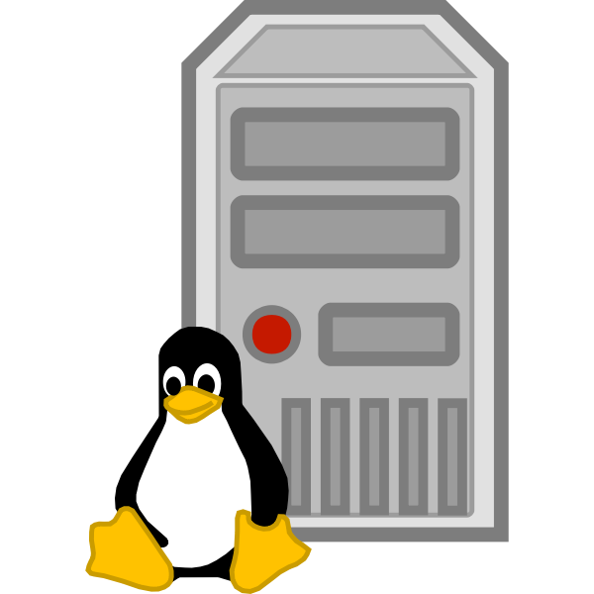
Using this Image Anywhere
HelloWorld.class
Layer 4
.app folder
Layer 3
OpenJDK
Layer 2
Oracle Linux User Space
Layer 1
Resulting Docker Image
Docker (VM with a Linux Kernel)
Docker (VM with a Linux Kernel)
Windows (Host)
Ubuntu Linux (Host)

Slide 40
What Happens Internally?
docker build -t java-hello-world .
java-hello-world.class
Docker Image
Linux User Part
VM Manager
Docker
VM Manager
Linux Kernel
Linux Kernel
Windows
Windows

Slide 41

What Happens Internally?
java-hello-world.class
Docker Image
docker run java-hello-world
Linux User Part
VM Manager
VM Manager
Docker
Docker
Linux Kernel
Linux Kernel
Windows
Windows

Slide 42
Important points to avoid confusion!
We will see other examples where we have RUN and CMD commands in a Dockerfile – they are different
RUN command is used as a step in building a Docker image. Example below:
RUN javac Main.java
This step will help us in compiling a Java program, which we next want to execute
Now we can use the CMD command:
CMD ["java", "Main"]
To execute the Dockerfile: docker run …
So, RUN is an intermediate command, and a Dockerfile can have multiple RUN commands
Also, RUN inside Dockerfile and docker run are different commands with different purposes
CMD is the command that finally runs the file that we want to execute when we use a docker run command

Slide 43
Build and Execute
# Build the Docker image
docker build -t java-hello-world .
# Run the Docker container
docker container run --name java-hello-world java-hello-world

Slide 44
Looking at the Container in Detail
sudo docker container top java-hello-world => PID information
sudo docker container inspect java-hello-world => Configuration
sudo docker container stats java-hello-world => Live performance data

Slide 45
Dockerfile Commands
FROM - specifies the base image for the Docker image.
RUN - executes a command in the Docker image during the build process.
COPY - copies files or directories from the host file system into the Docker image.
ADD - similar to COPY, but can also handle URLs and can extract tar files.
WORKDIR - sets the working directory for any RUN, CMD, ENTRYPOINT, COPY, or ADD commands that follow it.
ENV - sets environment variables in the Docker image.

Slide 46
Dockerfile Commands
EXPOSE - specifies the network ports that the container will listen on at runtime.
CMD - specifies the command to be run when the container starts.
ENTRYPOINT - specifies the command to be run when the container starts and cannot be overridden.
ARG - defines arguments that can be passed at build time.
LABEL - adds metadata to the image.
USER - sets the user ID and group ID to use when running the container.
VOLUME - specifies a mount point for a volume in the container.

Slide 47
‘Hello World’ in Python

Slide 48
Creating Python ‘Hello World’
Create a new directory
mkdir docker-hello-world-python
cd docker-hello-world-python
Create app.py inside that directory
print("Hello, World!")
In the same directory, create Dockerfile (Shown on the next slide)

Slide 49
Dockerfile
# Use an official Python runtime as a parent image
FROM python:3.9-slim-buster
# Set the working directory to /app
WORKDIR /app
# Copy the current directory contents into the container at /app
COPY . /app
# Run app.py when the container launches
CMD ["python", "app.py"]

Slide 50
Build and Execute
docker build -t docker-hello-world-python .
docker container run docker-hello-world-python

Slide 51
‘Hello World’ in Python with an Endless Loop

Slide 52
Create hello_world.py (C:\lectures\CDAC\Cloud\docker\hello-world-python)
from time import sleep
# the program will print hello world
# every 1 second forever
while True:
print("Hello", flush=True)
sleep(1)

Slide 53
Dockerfile
Create Dockerfile
# Use an official Python runtime as a parent image
FROM python:3.9-slim-buster
# Set the working directory to /app
WORKDIR /app
# Copy the current directory contents into the container at /app
COPY . /app
# Run app.py when the container launches
CMD ["python", "-u",“hello_world.py"]

Slide 54
Why From python: 3?
FROM python:3
This is your base image, the starting point.
In this case, it is the official image from the Python Software Foundation and has Python:3 installed.
That means we don’t have to install any framework; it’s already included with this base image.

Slide 55
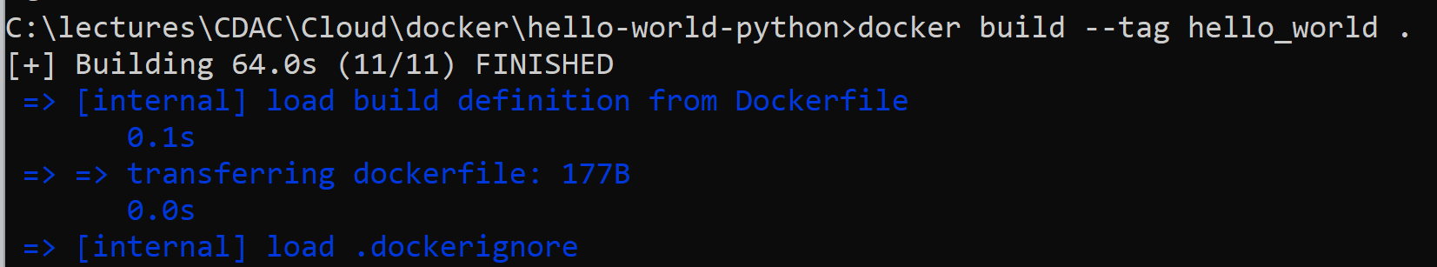
Running the Docker image
docker build -t hello_world .
Verify image creation: docker images

Slide 56
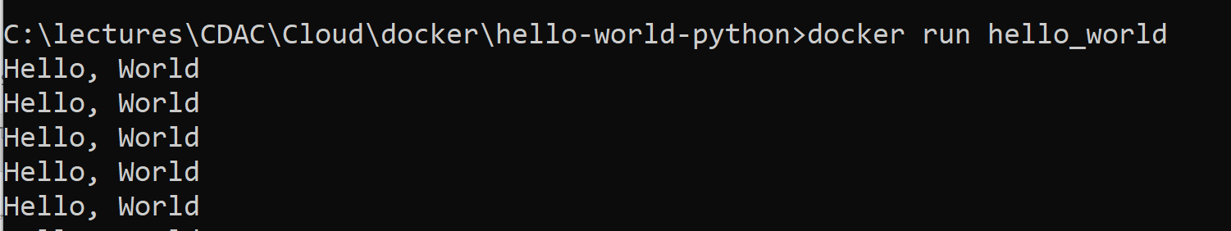
Running the Container
docker container run hello_world
Will get into an endless loop – How to break? See next slide

Slide 57
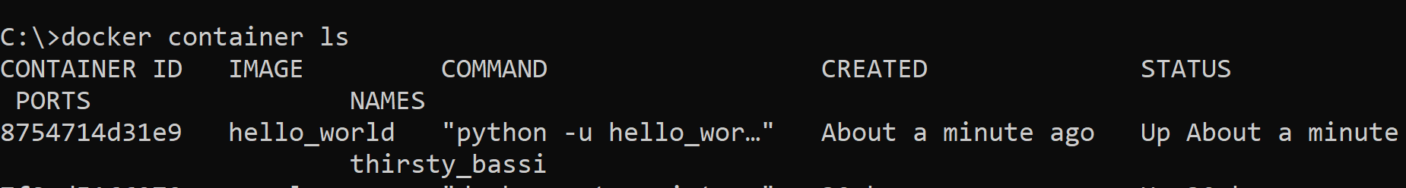
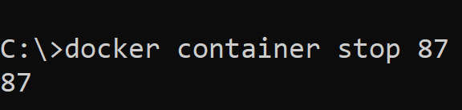
Breaking the endless loop
Open a second command prompt to know the id of the endlessly running container: docker container ls
Stop that container: docker container stop 87 (and then verify that the loop in the first command prompt has ended after this)

Slide 58
Common Docker Commands
docker build: Builds a Docker image from a Dockerfile.
Example: docker build -t my-image .
Docker container run: Runs a Docker container based on a Docker image.
Example: docker run my-image
docker container list: Lists running Docker containers.
Example: docker container list or docker ps

Slide 59
Common Docker Commands
docker container stop: Stops a running Docker container.
Example: docker stop container-name
docker container rm: Removes a Docker container.
Example: docker rm container-name
docker images: Lists Docker images.
Example: docker images

Slide 60
Common Docker Commands
docker rmi: Removes a Docker image.
Example: docker rmi image-name
docker container exec: Runs a command inside a running Docker container.
Example: docker exec -it container-name /bin/bash
docker pull: Pulls a Docker image from a registry.
Example: docker pull image-name
docker push: Pushes a Docker image to a registry.
Example: docker push image-name

Slide 61
Common Docker Commands
docker prune: Remove unused Docker resources, such as containers, images, networks, and volumes. When you run Docker containers and images, you might end up with a lot of unused resources that take up disk space on your system. Running docker prune can help you clean up these unused resources and free up disk space.
Note that when you use docker prune, you are permanently removing unused Docker resources from your system. Be sure to use this command with caution and only when you are sure that you no longer need the resources you are removing.

Slide 62
Common Docker Commands
docker system prune: This command removes all unused resources, including stopped containers, dangling images, and unused networks and volumes.
docker container prune: This command removes all stopped containers.
docker image prune: This command removes all dangling images. Dangling images are images that have no associated container.
docker network prune: This command removes all unused networks.
docker volume prune: This command removes all unused volumes.

Slide 63
Docker publish

Slide 64
Running nginx
Run nginx container: docker run nginx
By default, nginx runs on port 80, so try accessing localhost:80 in the browser – nothing will come up
Solution: Use the publish option
docker run -p 7777:80 nginx
Now access localhost:7777

Slide 65
‘Hello World’ in Python Flask

Slide 66
hello_flask.py (C:\lectures\CDAC\Cloud\docker\hello-world-python-flask)
from flask import Flask
app = Flask(__name__)
@app.route('/')
def hello():
return "Hello, World!"
if __name__ == '__main__':
app.run(debug=True, host='0.0.0.0')

Slide 67
Dockerfile
# Use an official Python runtime as a parent image
FROM python:3.9-slim-buster
# Set the working directory to /app
WORKDIR /app
# Copy the current directory contents into the container at /app
COPY . /app
# Install any needed packages specified in requirements.txt
RUN pip install --trusted-host pypi.python.org -r requirements.txt
# Expose port 5000 for the Flask app
EXPOSE 5000
# Run app.py when the container launches
CMD ["python", "app.py"]

Slide 68
requirements.txt
flask

Slide 69
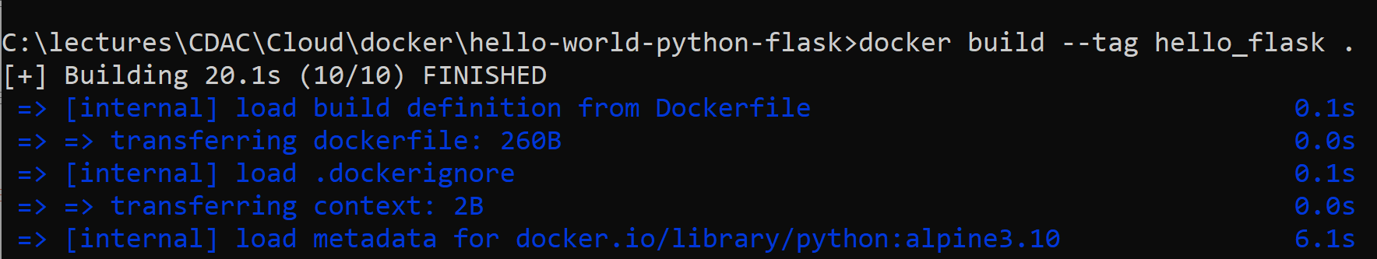
Build image
docker build -t hello_flask .

Slide 70
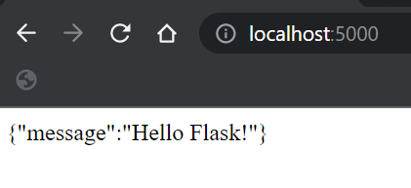
Execute
Container port = Port on a virtual IP on a private network inside the container
Host port = Our actual machine’s port
p = Publish
docker container run -d -p 5000:5000 hello_flask
Syntax: docker container run -d -p host port: container port <image name>

Slide 71
Java Application with User Input

Slide 72
Create PrimeNumber.java (C:\lectures\CDAC\Cloud\docker\javainputdocker)
import java.util.Scanner;
public class PrimeNumber {
public static void main(String[] args) {
Scanner sc = new Scanner(System.in);
System.out.println("Prime number check ... Please enter a number: ");
int num = sc.nextInt();
boolean isPrime = true;
for(int i = 2; i < num/2; i++) {
if(num % i == 0) {
isPrime = false;
break;
}
}
if(isPrime)
System.out.println(num + " is a prime number");
else
System.out.println(num + " is not a prime number");
sc.close();
}
}

Slide 73
Dockerfile (C:\lectures\CDAC\Cloud\docker\javainputdocker)
FROM openjdk:12-alpine
COPY . /usr/src/myjavaapp
WORKDIR /usr/src/myjavaapp
RUN javac PrimeNumber.java
CMD ["java", "PrimeNumber"]

Slide 74
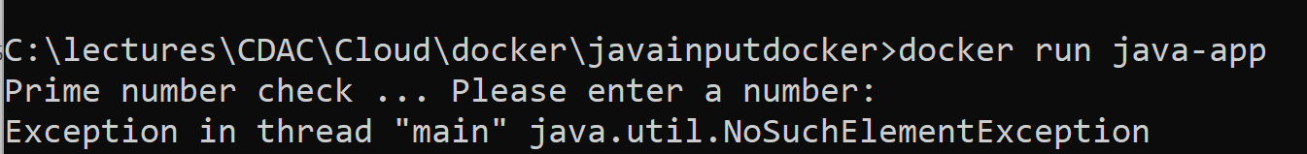
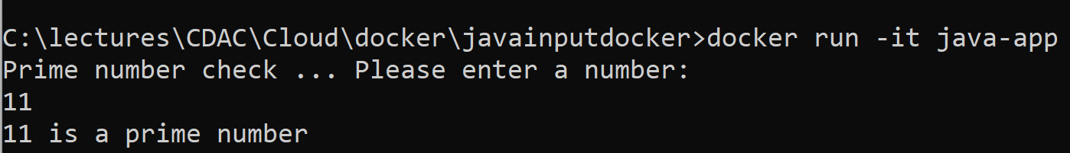
Build image and run
docker build -t java-app .
docker container run java-app
To resolve: docker container run -it java-app

Slide 75
Interactive Terminal
The -it option is made up of two things: interactive and terminal
It allows us to open a terminal inside the container, almost like SSHing inside it
We can run any allowed commands inside the container now
Example: Launch an Ubuntu container and then install Curl
sudo docker container run -it --name ubuntu ubuntu
apt-get update
apt-get install -y curl
curl google.com
exit

Slide 76
Interactive Terminal
After we exit, the container stops
If we run the container again, it will have curl
However, if we create a new container from the Ubuntu image, it will not have curl or anything that we had installed in the previous container
How to start the existing container again? The syntax is slightly different:
docker container start -ai ubuntu
Meaning: Attach interactive

Slide 77
Interactive Terminal
The distributions of Ubuntu and similar software are minimal inside a container
When we install an ISO image on a Virtual Machine, the distributions are full-fledged, meaning their size is quite large
They also contain everything that is supposed to be a part of the distribution
Containers only contain what is absolutely necessary

Slide 78
Difference between -it and exec -it
docker container run -it: Create and start a new container and immediately attach a new terminal to it to run commands
docker container run exec -it: When an existing container is already running and we want to run commands inside it, we use this option
Syntax: docker exec -it my_container_name_or_id /bin/bash
This means, run an existing container and run the bash program inside it to open its shell prompt

Slide 79
Running Tomcat using an Interactive Terminal

Slide 80
Steps
Pull the latest tomcat image:
docker image pull tomcat:8.0
docker run command with –it option to start the container:
docker container run -it --rm --name tomcat-container -p 8080:8080 tomcat:8.0 /bin/bash
Connect to the interactive terminal
docker container exec -it tomcat-container /bin/bash
Run any command, e.g. start tomcat
cd /usr/local/tomcat/bin
./catalina.sh run
Try accessing it on localhost:8080

Slide 81
Assignment
Run the following three containers: mysql, httpd (Apache) and ngnix
Run all of them in the detached mode (-d) and name them using --name respectively as db, webserver, and proxy
mysql should listen on 3306:3306, httpd on 8888:80, and ngnix on 9999:80,
When running mysql, use the --env option (or -e) to pass a parameter MYSQL_RANDOM_ROOT_PASSWORD=yes
Use docker container logs on mysql to find this random password
Clean up all the containers using docker container stop and docker container rm (Both the commands can accept multiple container names or ids)
Use docker container list to ensure everything is correct before and after the assignment

Slide 82
Solution
sudo docker container run -d -p 3306:3306 --name db -e MYSQL_RANDOM_ROOT_PASSWORD=yes mysql
sudo docker logs db
sudo docker container run -d -p 8888:80 --name webserver httpd
sudo docker container run -d -p 9999:80 --name proxy nginx
docker list (New command)
docker ps (Old command)
curl localhost:8888
sudo docker container stop db, webserver, proxy
sudo docker container rm db, webserver, proxy
sudo docker container list –a (To see all the containers, running or not)

Slide 83
Pushing a Local Image to Docker Hub

Slide 84
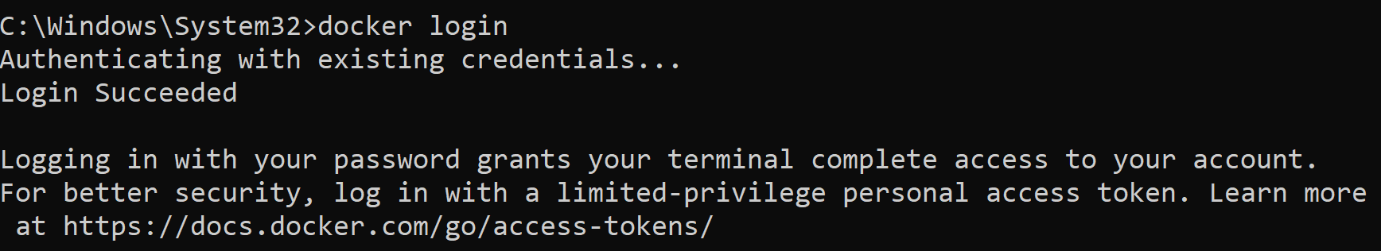
Login to Docker Repository
docker login

Slide 85
Build a New Image (Or Use an Existing One, if Already Built)
docker build -t java-hello-world .
Check the image id: docker image list
Copy the image id (e.g. a531573d8d6b)

Slide 86
Tag and Push the Image
Your DockerHub user id
docker tag a531573d8d6b newdelthis/java-hello-world:latest
docker push newdelthis/java-hello-world:latest
Local image id
Name to be given on Docker Hub
Image tag

Slide 87
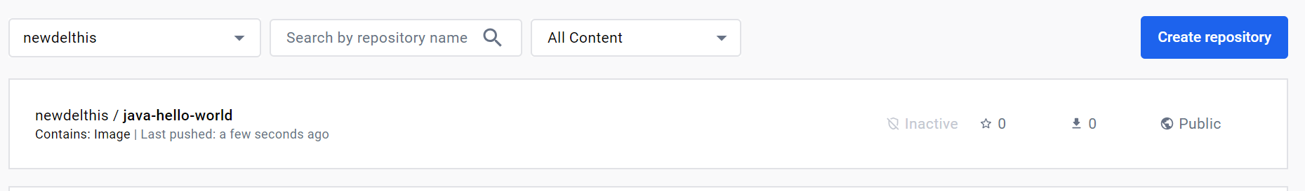
Verify on the Docker Hub Site

Slide 88
Assignment
1. Modify the Python Flask application to display two lines of output:
Hello from DITISS
Welcome to Docker
2. Test the application locally.
3. Create a Docker image and upload it on DockerHub with tag 0.1.
4. Modify the application to add a third line of ouput:
Hello from DITISS
Welcome to Docker
We are trying image tagging.
5. Test the application locally.
6. Create a Docker image and upload it on DockerHub with tag 0.2.
7. Ask someone to pull and run version 0.1 and 0.2 separately. Confirm that they see different outputs (2 lines for version 0.1 and 3 lines for version 0.2).

Slide 89
Docker export and import Commands

Slide 90
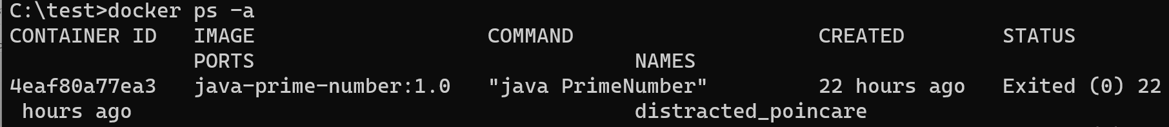
Exporting a Docker Container
First get the name of the container using docker container list -a
To export: docker export distracted_poincare > export_demo.gz
You can open this file to see its contents

Slide 91
Importing a Docker Container on the Target Machine
docker import export_demo.gz

Slide 92
Docker Networking

Slide 93
Docker Networking Hands-on
First prune everything: docker system prune (We also have docker container prune and docker image prune)
Create two BusyBox containers and try to perform communication between them
BusyBox: Tiny open source software that packages many common UNIX utilities into one executable binary
docker run -it busybox
Open a second terminal and repeat:
docker run -it busybox

Slide 94
Docker Networking Hands-on
Verify their IP addresss (Run in both separately):
hostname -i
Verify hostnames
hostname
Try pinging using hostname (Copy one and try in the other, e.g.)
ping de329e6f1e41
Result: Bad address
Try using IP address:
ping 172.17.0.4

Slide 95
Docker Networking Hands-on
Open a new terminal and type docker container list
Inspect one of the containers: docker inspect de329e6f1e41
We will see the container’s IP address
Repeat command for both the containers and see what is the default gateway – It should be the same (e.g. 172.17.0.1)
Also note a field called Aliases – It will be null
So, the random names that we saw are not really the container host names (Then what are they? See next slide)
Are we not able to ping each other using host names because of this?
We will now try to change it

Slide 96
Docker Networking Hands-on
Exit from both the containers
Try this: docker container run --help
We will see an option called hostname, which allows us to set the default container hostname
Note: --name is the external name of the container and --hostname is the internal hostname of the container, hence we were not able to ping using their external names – they are not visible inside the container
Restart both containers:
docker run -it --name busybox1 --hostname busybox-one busybox
docker run -it --name busybox2 --hostname busybox-two busybox

Slide 97
Docker Networking Hands-on
Verify IP addresses and hostnames of both the containers using the hostname and hostname -i commands
Repeat earlier pings using IP addresses and the host names
Result: We can still ping using only IP addresses, not the host names
Did we make an error? Verify the host names:
docker container list
docker inspect <container id> or <container name>
The alias is still null!
Result: By default, containers cannot communicate with each other using their host names or names

Slide 98
Docker Networking Hands-on
Docker creates a network for all the containers by default called Bridge network
Again inspect the container and scroll up – we should see bridge network details
Solution: Create a custom bridge network and then containers inside that custom bridge network
Leave the two busybox containers running
First see help: docker network --help
Now try docker network ls
We will see three networks: bridge, host, and none

Slide 99
Docker Networking Hands-on
Let us inspect bridge network:
docker network inspect <bridge network id>
Scroll up to the subnet part
We will see it as 172.17.0.0/16 – This is the default gateway address
That is how we got IP addresses such as 172.17.0.2, 3, etc for busybox containers
We will also see that there are two containers in this bridge network
See their IP and MAC addresses – MAC addresses are generated randomly

Slide 100
Docker Networking Hands-on
To create a new custom bridge network: docker network create custom
(Name can be anything other than custom)
docker network ls
docker network inspect custom
Check its name, id, creation date/time, subnet, gateway
It is a completely different subnet
If we create containers inside it, they will be able to communicate with each other, but not with the containers in the default brige network
The gateway address for this (e.g. 172.18.0.1) is assigned to Docker host, and it is connected to both: default bridge and custom networks; and also to the Internet
So, all the hosts inside this subnet will be able to communicate with the Internet via this default gateway

Slide 101
Docker Networking Hands-on
Stop both the busybox containers and recreate them in the new custom bridge network
First docker container prune to clean up all containers
docker container run -it --network custom busybox
Check ip: hostname -i and check hostname: hostname
Also inspect both the container and the network:
docker container inspect <>
docker network inspect custom
Repeat for a second busybox container

Slide 102
Docker Networking Hands-on
Try pinging with IP addresses first
Then try pinging with their host names
Both should be successful
Conclusion: Containers in the same custom network can communicate with each other using IP addresses or host names
Now repeat, but instead of host names, try container names
Result: Failure
Solution: Use custom names for the containers

Slide 103
Docker Networking Hands-on
Try pinging with IP addresses first
Then try pinging with their host names
Both should be successful
Conclusion: Containers in the same custom network can communicate with each other using IP addresses or host names
Now repeat, but instead of host names, try container names
Result: Failure
Problem: Since container host names are randomly generated, how ca we use them practically?
Solution: Use custom names for the containers

Slide 104
Docker Networking Hands-on
Stop both the containers
Now give custom names to both while restarting:
docker container run -it --network custom --name busybox1 busybox
docker container run -it --network custom --name busybox2 busybox
Now try pinging using their custom names, e.g. ping busybox2
Success!
Stop both containers and restart, e.g. docker start -it busybox1 and docker start -it busybox1
Recheck connectivity
Conclusion: Containers in the same custom network can communicate with each other using custom container names

Slide 105
PHP and MySQL using Docker Network
docker network create mysql
docker network inspect mysql
## Set MySQL root password to my_password
docker run --network mysql -e MYSQL_ROOT_PASSWORD=my_password --name mysql -d mysql
docker container list
## PMA_HOST environment variable = What is our MySQL server?
docker run --network mysql -p 8080:80 -e PMA_HOST=mysql -d phpmyadmin/phpmyadmin

Slide 106
PHP and MySQL
Open browser
localhost:8080
ID: root
Password: my_password
Click on MySQL to see if we can connect to MySQL

Slide 107
Assignment
Create a Tomcat container and a MySQL container
Demonstrate a connection from Tomcat to MySQL
Note: You will have to install MySQL client in the Tomcat container and try connecting to MySQL server from there
Create a database, a table, and add 1 row:
CREATE DATABASE devops;
USE devops;
CREATE TABLE student_tbl (prn integer, name char(30));
INSERT INTO student_tbl VALUES (1, “My name”);
SELECT * FROM student_tbl;

Slide 108
Docker Networking Example
Create a new bridge network
docker network create my-network
Start a MySQL container and connect it to the my-network network
docker container run --name mysql-container --network my-network -e MYSQL_ROOT_PASSWORD=pass -d mysql:latest
Start Tomcat and connect it to the my-network network
docker container run --name tomcat-container --network my-network -p 7777:8080 -d tomcat:8

Slide 109
Docker Networking Example
Connect to the Tomcat container and verify that it can access MySQL
docker exec -it tomcat-container /bin/bash
apt-get update
apt-get install -y mysql-client
mysql -h mysql-container -uroot -ppass
Create a database, a table, and add 1 row:
CREATE DATABASE devops;
USE devops;
CREATE TABLE student_tbl (prn integer, name char(30));
INSERT INTO student_tbl VALUES (1, “My name”);
SELECT * FROM student_tbl;

Slide 110
Stopping and Restarting Containers
Stop MySQL container
Start it again using this command:
docker container run --name mysql-container --network my-network -e MYSQL_ROOT_PASSWORD=pass -d mysql:latest
It will give error
We must use the following command:
docker container start -ai mysql-container
Now again go to tomcat container and run the same SELECT statement to see if data still exists
It does
Conclusion: Stopping and restarting a container does not cause it to lose its state

Slide 111
Removing Containers
Stop and remove MySQL container
Start it again using this command:
docker container run --name mysql-container --network my-network -e MYSQL_ROOT_PASSWORD=pass -d mysql:latest
Now again go to tomcat container and run the same USE/SELECT statements to see if database/data still exists
It does not
Conclusion: Removing a container causes it to lose its state and all the information
Hence, containers are immutable.

Slide 112
Persisting Data

Slide 113
Container Characteristics
Problem: Containers are immutable and ephemeral
Solution: Use Docker volumes or Bind mounts – We will cover volumes

Slide 114
Modifying Index/Home Page of nginx
First test basic nginx home page:
docker run -p 8081:80 nginx
Browser: localhost:8081
Verify, stop, remove container

Slide 115
Modifying Index/Home Page of nginx
Create
Linux: /users/xyz/desktop/containers/nginx/index.html
Windows: c:\delthis\index.html
<h1>Welcome to Our Custom Home Page</h1>
Linux: docker run -p 8081:80 -v /users/xyz/desktop/containers/nginx:/usr/share/nginx/html nginx
Windows: docker run -p 8081:80 -v "c:/delthis:/usr/share/nginx/html" nginx
localhost:8081

Slide 116
Persisting Data using Docker Volumes
Run a MySQL container
docker run --name mysql -d -p 3306:3306 -e MYSQL_ROOT_PASSWORD=change-me -v mysql:/var/lib/mysql mysql:8
Open an interactive terminal in MySQL container
docker exec -it mysql mysql -p
(Give the password as change-me)
On the MySQL prompt:
create database yuhaspro;
use yuhaspro;
create table test (test char(20));
quit

Slide 117
Persisting Data using Docker Volumes
Stop and remove the container
docker stop mysql
docker rm <container id>
Once again start the container using the same command and repeat the process to open interactive terminal, use cdac, show tables
It should show the test table
If we want to see logs at any time, docker logs mysql

Slide 118
Docker Compose

Slide 119
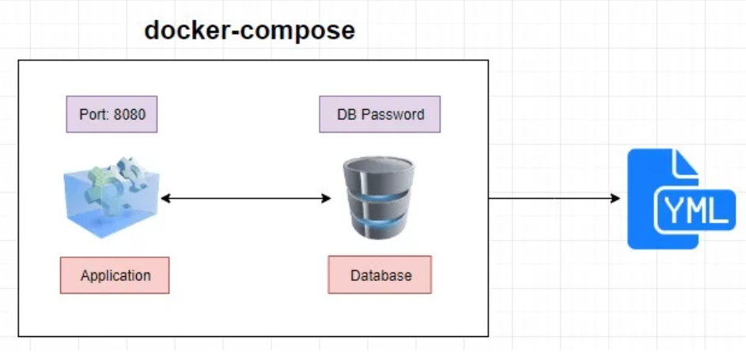
What is Docker Compose?
Docker Compose is a Docker tool used to define and run multi-container applications
Uses a YAML file to configure everything related to the application

Slide 120
Steps for using Docker Compose
Create Dockerfile for defining application environment while building the Docker image
Define services for the application in docker-compose.yaml file
Run docker-compose up to start, docker-compose down to start

Slide 121
Installation
Verify if already installed: Run docker-compose in terminal
Docker Compose is automatically installed with Docker Desktop
Linux: Install Docker Compose plug-in (https://docs.docker.com/compose/install/linux/)

Slide 122
Using Docker Compose
docker-compose build
This command builds images in the docker-compose.yml file.
The job of the build command is to get the images ready to create containers.
So if a service is using a prebuilt image, it will skip this service.
docker-compose images
This command will list the images you have built using the current docker-compose file.
docker-compose stop
This command stops the running containers of specified services.
docker-compose run
This is similar to the docker run command. It will create containers from images built for the services mentioned in the compose file.
docker-compose up
This command does the work of the docker-compose build and docker-compose run commands. It builds the images if they are not located locally and starts the containers. If images are already built, it will fork the container directly.
docker-compose ps
This command list all the containers in the current docker-compose file. They can then either be running or stopped.
docker-compose down
This command is similar to the docker system prune command. However, in Compose, it stops all the services and cleans up the containers, networks, and images.

Slide 123
C:\lectures\CDAC\Cloud\docker\docker_compose_tomcat.yaml
version: '3'
services:
tomcat8:
image: tomcat:8
container_name: my-tomcat8-container
ports:
- "8080:8080"

Slide 124
Executing using Docker Compose
C:\lectures\CDAC\Cloud\docker>docker-compose -f docker_compose_tomcat.yaml up
To remove container and other resources:
C:\lectures\CDAC\Cloud\docker>docker-compose -f docker_compose_tomcat.yaml down

Slide 125
Java “Hello World” using Docker Compose
Directory: C:\lectures\CDAC\Cloud\docker\docker-compose-java-hello-world

Slide 126
HelloWorld.java
public class HelloWorld {
public static void main(String[] args) {
System.out.println("Hello, World!");
}
}

Slide 127
Dockerfile
FROM openjdk:latest
WORKDIR /app
COPY . /app
RUN javac HelloWorld.java
CMD ["java", "HelloWorld"]

Slide 128
docker-compose.yaml
version: '3'
services:
app:
build:
context: .
dockerfile: Dockerfile
# Other configurations specific to your desktop application

Slide 129
Test
docker-compose up
docker-compose down

Slide 130
C:\lectures\CDAC\Cloud\docker\docker_compose_tomcat_terminal.yaml
version: '3'
services:
tomcat8:
image: tomcat:8
container_name: my-tomcat8-container
ports:
- "8080:8080"
volumes:
- ./webapp:/usr/local/tomcat/webapps
stdin_open: true
tty: true

Slide 131
C:\lectures\CDAC\Cloud\docker\docker_compose_mysql.yaml
version: '3'
services:
mysql:
image: mysql:8.0
container_name: my-mysql-container
environment:
MYSQL_ROOT_PASSWORD: YourRootPassword123
ports:
- "3306:3306"
volumes:
- ./mysql_data:/var/lib/mysql
command: --default-authentication-plugin=mysql_native_password
stdin_open: true
tty: true

Slide 132
C:\lectures\CDAC\Cloud\docker\docker_compose_tomcat_mysql.yaml
version: '3.8'
services:
# Tomcat Service
tomcat:
image: tomcat:9.0
container_name: my-tomcat-app
ports:
- "8080:8080"
volumes:
- ./webapp:/usr/local/tomcat/webapps
depends_on:
- mysql
# MySQL Service
mysql:
image: mysql:8.0
container_name: my-mysql-db
environment:
MYSQL_ROOT_PASSWORD: YourRootPassword123
MYSQL_DATABASE: your_database_name
MYSQL_USER: your_username
MYSQL_PASSWORD: YourUserPassword123
ports:
- "3306:3306"

Slide 133
Python Flask and Docker Using Docker Compose (YAML)

Slide 134
Create a New Application from Scratch
Create a directory flask-docker-app
C:\code>mkdir flask-docker-composer-app
Go to the above directory
C:\code>cd flask-docker-composer-app

Slide 135
main.py (c:\code\flask-docker-composer-app)
from flask import Flask
app = Flask(__name__)
@app.route('/')
def hello_world():
return 'Hello World'
if __name__ == '__main__':
app.run(host="0.0.0.0", debug=True)

Slide 136
docker-compose.yml
version: "3.8"
services:
app:
build: .
command: python main.py
ports:
- "5000:5000"
volumes:
- .:/python-flask

Slide 137
Dockerfile
FROM python:3.9.1
ADD . /python-flask
WORKDIR /python-flask
RUN pip install -r requirements.txt

Slide 138
requirements.txt
Flask

Slide 139
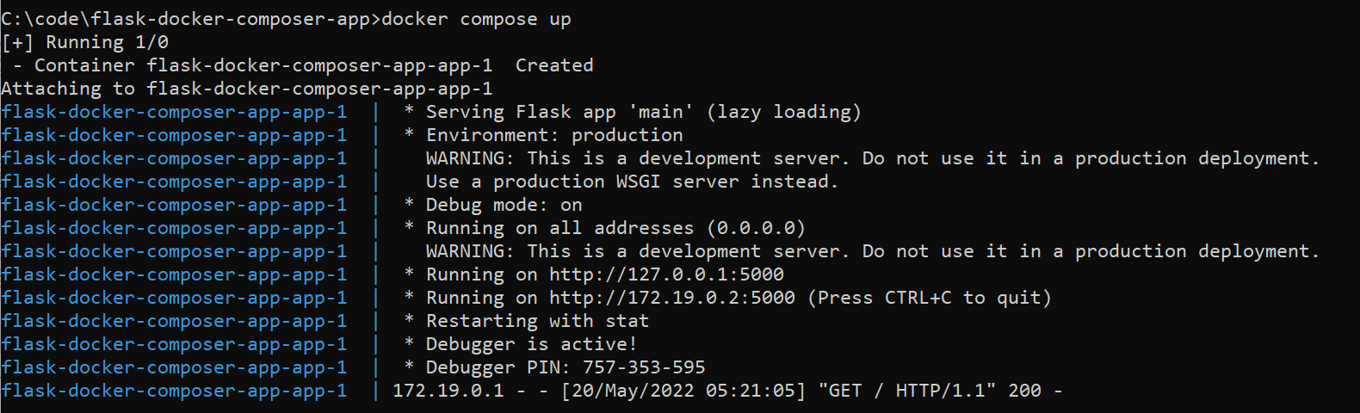
Compose and Run
C:\code\flask-docker-composer-app>docker compose up

Slide 140
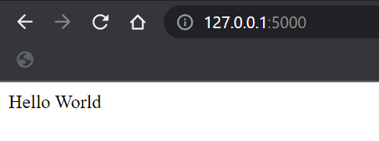
Test

Slide 141
Tomcat-MySQL using Docker Compose

Slide 142
Tomcat-MySQL using Docker Compose
Create a directory for your project (e.g. C:\lectures\CDAC\Cloud\docker\tomcat-mysql-docker-compose)
Make sure it has your .war file (rps.war)
Create Dockerfile (See next slide)

Slide 143
Dockerfile
FROM tomcat:latest
COPY ./rps.war /usr/local/tomcat/webapps/
RUN apt-get update && apt-get install -y mysql-client
ADD https://dev.mysql.com/get/Downloads/Connector-J/mysql-connector-java-8.0.27.tar.gz /tmp/
RUN tar xzf /tmp/mysql-connector-java-8.0.27.tar.gz -C /tmp/ && \
cp /tmp/mysql-connector-java-8.0.27/mysql-connector-java-8.0.27.jar /usr/local/tomcat/lib/
COPY ./context.xml /usr/local/tomcat/conf/

Slide 144
Build and Run
docker-compose up --build
Try localhost:8080/rps in the browser

