Slide 1

24-783 Lecture Note 03.5

Slide 2
Numerical Optimization
What’s Numerical Optimization?
Cost Function
Examples:
Finite-element mesh optimization.
Finding the best controller parameters.
Topology optimization.
Pattern matching.
Neural network training is also an optimization.
Types of Optimization Algorithms
Sequential Quadratic Programming (SQP)
Setting up solsqp
Sample problems

Slide 3
What’s Numerical Optimization?
Finding a set of parameters that maximizes or minimizes a cost function.
Typically formulated as a minimization problem. (If you need to maximize, just multiply -1!)
Want to minimize the cost or the energy consumption by finding the optimal set of parameters.

Slide 4
Example
Flying an airplane from airport A to airport B.
Objective: Minimize time to get to the destination.
Parameters are:
Waypoints: What's the best route that takes the most advantage of the wind?
Altitude: Airplanes tends to be slow to climb up, but there may be better wind higher up.

Slide 5
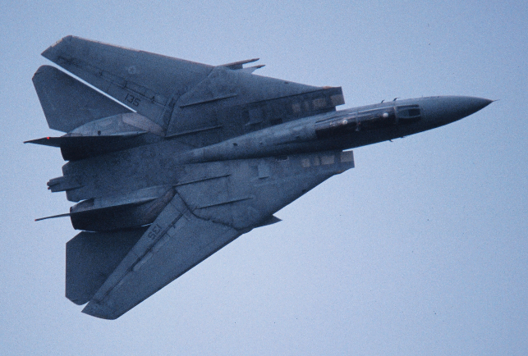



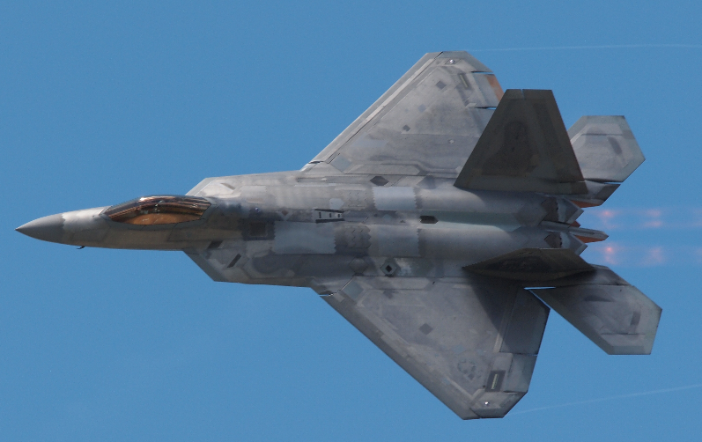
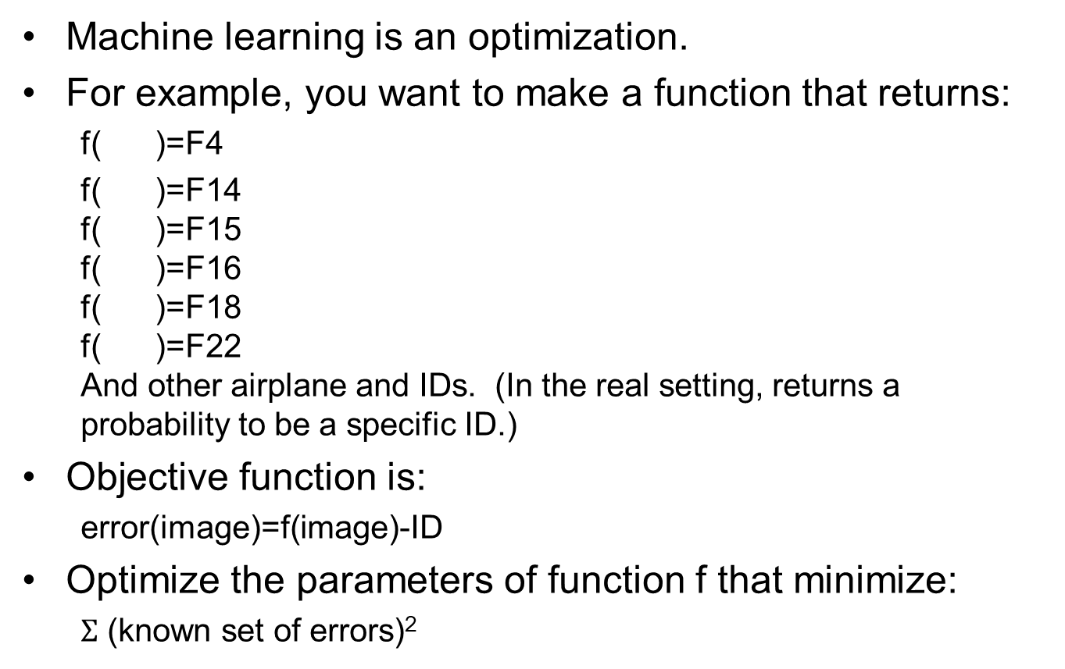
Example
Machine learning is an optimization.
For example, you want to make a function that returns:
f( )=F4
f( )=F14 f( )=F15 f( )=F16 f( )=F18 f( )=F22 And other airplane and IDs. (In the real setting, returns a probability to be a specific ID.)
Objective function is:
error(image)=f(image)-ID
Optimize the parameters of function f that minimize:
$Σ$ (known set of errors)²

Slide 6
Why Optimization?
When the problem cannot be analytically nor algorithmically solved.
When you have multiple objectives that all cannot be satisfied simultaneously.

Slide 7
Cost Function (aka Objective Function)
The function that we want to minimize.
Can be anything as long as you can numerically calculate.
Ideally convex (no local minimum).

Slide 8
Local Minima
In practice, the objective function does not that well-behave.
Only exhaustive search can guarantee the global minimum.
Making a reasonable initial guess is important
Local minima
Global minimum

Slide 9
Types of Optimization Algorithms
Gradient based vs. Non-gradient based.
Gradient based examples:
Gradient descend
Newton’s method
SQP
Non-gradient based examples:
Exhaustive search
Simulated annealing
Genetic algorithm
Iterative vs. Non-Iterative
Non-Iterative: e.g. least square fitting.
Constrained vs. Unconstrained
Constrained: e.g. minimize x²+y² that satisfies y-mx-b=0
Unconstrained: e.g. minimize x²+y²

Slide 10
Sequential Quadratic Programming (SQP)
Iterative
Non-linear
Gradient-based
Constrained (Can use it for unconstrained optimization by giving zero constraints.)
What if we do not know the gradient? - The optimizer numerically calculates the gradient.

Slide 11
Setting Up SOLNP
SOLNP: Open-Source SQP Library
CD to your 24783 directory and run the following commands: git clone https://github.com/KristerSJakobsson/solnp cd solnp/library git clone https://github.com/davisking/dlib
In CMakeLists.txt, add add_subdirectory(../../solnp solnp) include_directories(../../solnp/src)
The relative path (../..) should be changed depending on where solnp is installed relative to your CMakeLists.txt

Slide 12
Toy Example
Minimize y=(x-3)²+(y-2)²+1
#include "solnp.hpp"
#include <iostream>
// Return value is a 1x1 matrix.
// Input parameter is Nx1 matrix, where N is the number of parameters.
dlib::matrix<double, 1, 1> objective_function(const dlib::matrix<double, 2, 1> &m)
{
double x=m(0);
double y=m(1);
dlib::matrix<double,1,1> res;
res(0)=(x-3.0)*(x-3.0)+(y-2.0)*(y-2.0)+1.0;
return res;
}
int main(void)
{
// 2 parameters
// 3 values for each parameter, initial value, minimum, maximum
dlib::matrix<double, 2, 3> parameter_data;
// Weird syntax that destroys the beauty of C++, but that's what they like.
parameter_data=
0, -10.0,10.0,
0, -10.0,10.0;
cppsolnp::SolveResult calculate = cppsolnp::solnp(objective_function, parameter_data);
double x=calculate.optimum(0);
double y=calculate.optimum(1);
double minimum=calculate.solve_value;
std::cout << x << " " << y << " " << minimum << "\n";
return 0;
}

Slide 13
SOLNP Objective Function
Return Value is 1x1 matrix
2 parameters
// Return value is a 1x1 matrix.
// Input parameter is Nx1 matrix, where N is the number of parameters.
dlib::matrix<double, 1, 1> objective_function(const dlib::matrix<double, 2, 1> &m)
{
double x=m(0);
double y=m(1);
dlib::matrix<double,1,1> res;
res(0)=(x-3.0)*(x-3.0)+(y-2.0)*(y-2.0)+1.0;
return res;
}
Two parameters
Given by the optimizer
Objective Function

Slide 14
SOLNP Initial Condition
2 parameters, initial guess, minimum, maximum of the search space
int main(void)
{
// 2 parameters
// 3 values for each parameter, initial value, minimum, maximum
dlib::matrix<double, 2, 3> parameter_data;
// Weird syntax that destroys the beauty of C++, but that's what they like.
parameter_data=
0, -10.0,10.0,
0, -10.0,10.0;
cppsolnp::SolveResult calculate = cppsolnp::solnp(objective_function, parameter_data);
double x=calculate.optimum(0);
double y=calculate.optimum(1);
double minimum=calculate.solve_value;
std::cout << x << " " << y << " " << minimum << "\n";
return 0;
}
2 sets of initial guess, minimum and maximum of the search range
Run the optimizer
Get what optimizer found.

Slide 15
Toy Example with Lambda, just for your reference
Minimize y=(x-3)²+(y-2)²+1
#include "solnp.hpp"
#include <iostream>
int main(void)
{
// 2 parameters
// 3 values for each parameter, initial value, minimum, maximum
dlib::matrix<double, 2, 3> parameter_data;
// Weird syntax that destroys the beauty of C++, but that's what they like.
parameter_data=
0, -10.0,10.0,
0, -10.0,10.0;
auto objective_function=[&](const dlib::matrix<double, 7, 1> &m)->dlib::matrix<double, 1, 1>
{
double x=m(0);
double y=m(1);
dlib::matrix<double,1,1> res;
res(0)=(x-3.0)*(x-3.0)+(y-2.0)*(y-2.0)+1.0;
return res;
};
cppsolnp::SolveResult calculate = cppsolnp::solnp(objective_function, parameter_data);
double x=calculate.optimum(0);
double y=calculate.optimum(1);
double minimum=calculate.solve_value;
std::cout << x << " " << y << " " << minimum << "\n";
return 0;
}
Don't worry about lambda at this time. We will cover it later in the semester.

Slide 16
Toy Example
Linear Regression
We know that it can be analytically solved, which is more efficient.
Just as an example, it can be formulated as a numerical-optimization problem.

Slide 17
Not-So-Toy Example
Fitting a Bezier Curve
The user draws a stroke, and then the program finds Bezier control points.
What is the reasonable cost function?
What is the reasonable initial guess?

Slide 18
Very Easy Way to Remember Bezier Calculation
Cubic Bezier: p=B(c₁,c₂,c₃,c₄,t) where c_{i} is a control point, and t is the parameter.
Step 1: Interpolate between c₁,c₂ and c₂,c₃ and c₃,c₄ to obtain b₁,b₂,b₃ .
Step 2: Interpolate between b₁,b₂ and b₂,b₃ and to obtain a₂,a₃ .
Step 3: Interpolate between b₂,b₃ to obtain p.
c₂
t : 1-t
c₃
b₂
a₂
b₂
t : 1-t
t : 1-t
t : 1-t
b₃
t : 1-t
t : 1-t
a₂
a₁
p
b₁
a₁
b₃
c₁
b₁
c₄
Step 1
Step 2
Step 3

