Slide 1




Atliq Hardwares
Consumer
Goods
Ad-hoc
Insights
Presented by Sparsh Anand
Created by Sparsh Anand

Slide 2
Background/Context
Getting familiar with Atliq’s Business
Their Markets and Product lines
–
AGENDA
Getting familiar with the input data
Ad-hoc requests along with the queried
results, visualizations and Insights
Created by Sparsh Anand

Slide 3
Our Company
Atliq Hardwares (imaginary company) - One of the leading computer hardware producers in India.
Background
The management noticed that they do not get enough insights to make quick and smart data-informed decisions.
BACKGROUND / CONTEXT
Problem
There are 10 ad-hoc requests for which the company needs insights.
Approach
Run a SQL query to answer these requests. Convert it into visualizations and present the Insights to the top- level management.
Created by Sparsh Anand

Slide 4
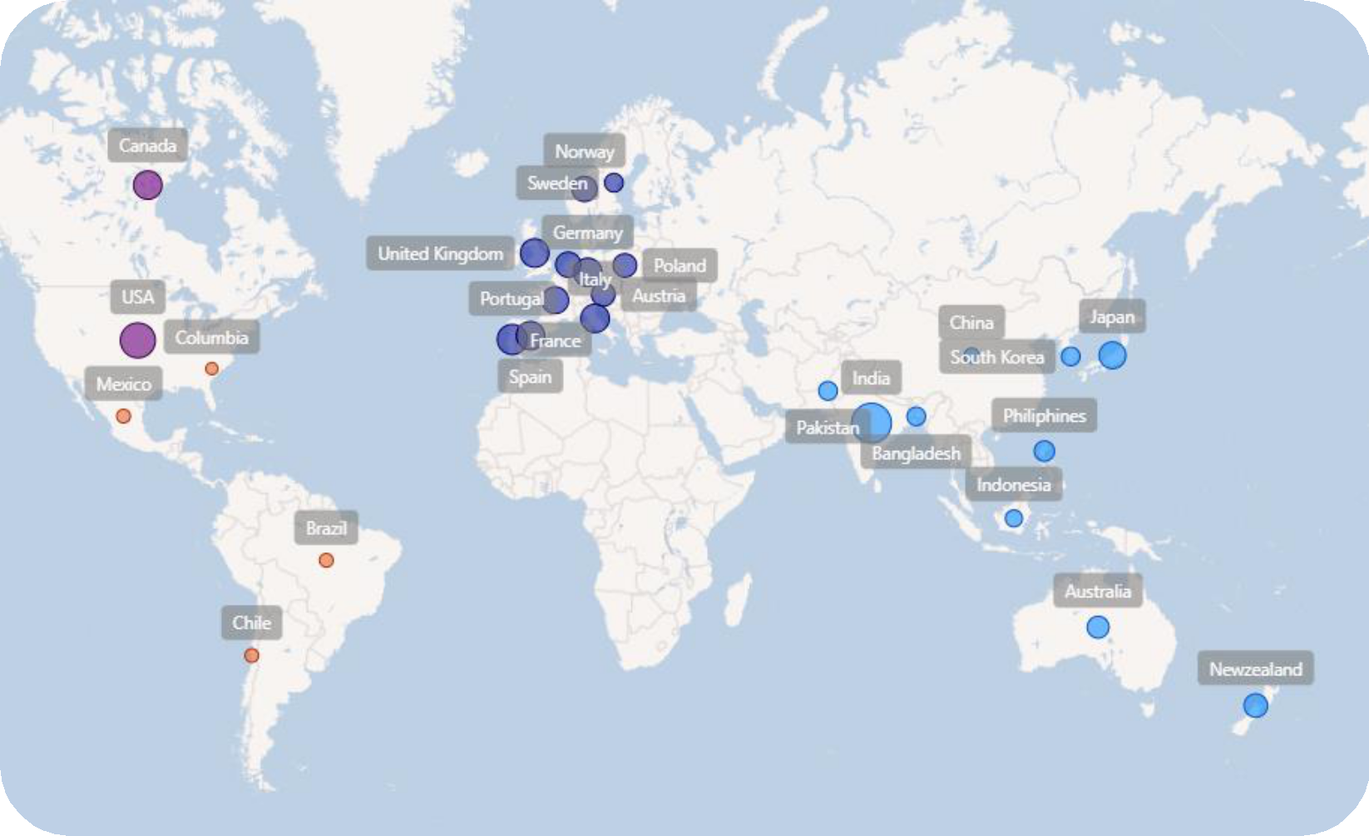

Getting
familiar
with
Atliq’s
Business
–Their
Markets
and
Product
lines
Atliq’s
Markets
Created by Sparsh Anand

Slide 5

































Atliq’s
Product
lines
PC
P&A
N&S
Desktop
Notebook
Peripherals
Accessories
Networking
Storage
Business laptop
Gaming laptop
Graphic card
Batteries
Wi Fi
Extender
External SSD
Personal laptop
Business laptop
Internal HDD
Keyboard
USB Flash
drives
Personal laptop
MotherBoard
Mouse
Processors
Created by Sparsh Anand

Slide 6

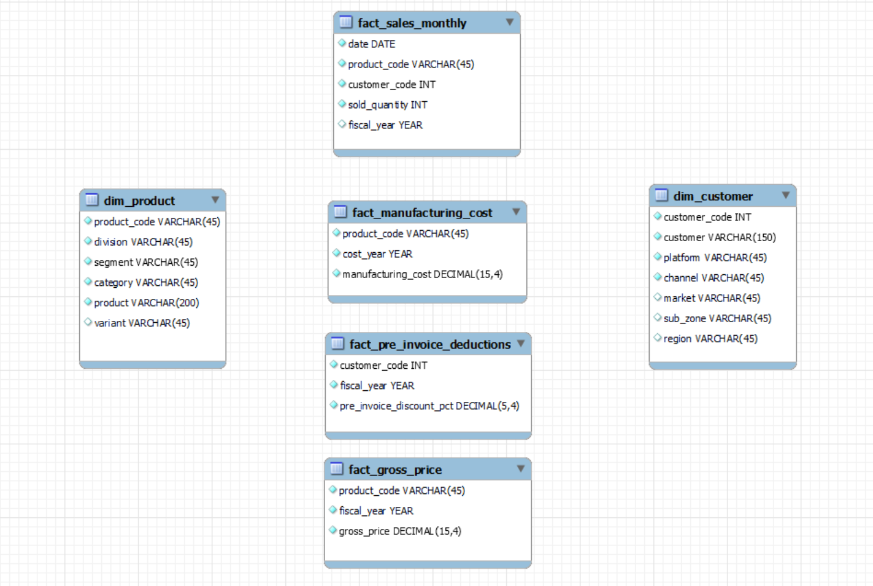
Getting
familiar
with
the
input
data
• Input data consists of
sales data for FY 2020 and
FY 2021, along with
different other dimension
tables like customer details,
product details, etc.
Created by Sparsh Anand

Slide 7
Ad-hoc
requests,
queried results,
Insights and
visualization
Created by Sparsh Anand

Slide 8
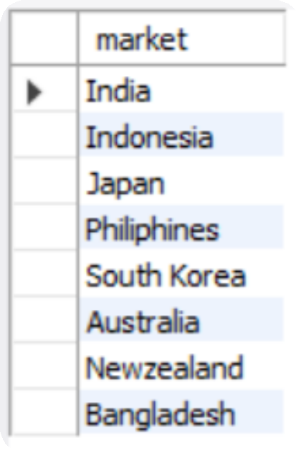

REQUEST 1:
Provide the list of markets in
which customer "Atliq
Exclusive" operates its
business in the APAC region.
OUTPUT
Created by Sparsh Anand

Slide 9
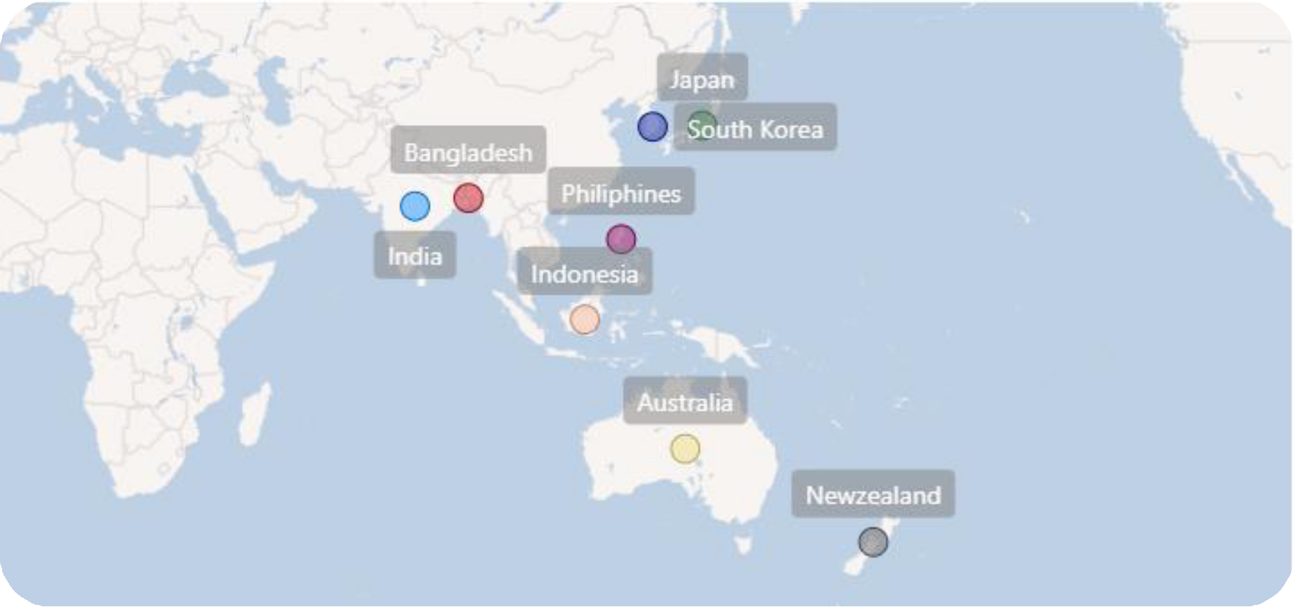
Insights
In the APAC region, our Exclusive store has established its presence in 8 major markets.
Created by Sparsh Anand

Slide 10
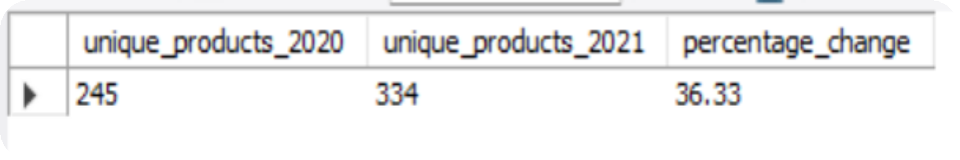

REQUEST 2:
What is the percentage of
unique product increase in
2021 vs. 2020? The final output
contains these fields:
unique_products_2020
unique_products_2021
percentage_chg
OUTPUT
Created by Sparsh Anand

Slide 11
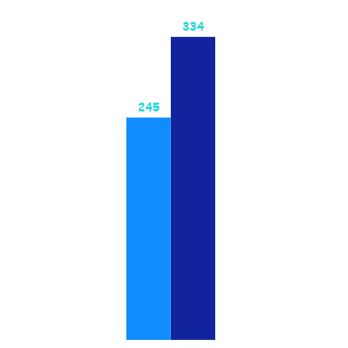
Insights
36.33
% increase
It’s a good sign that we are continuously innovating and
introducing new products to the market. In FY 2020, we
had a total of 245 products, but in FY 2021, our count
increased by 36% to 334 products.
Product_count-2020
Product_count-2021
2020
2021
Count of Products
Created by Sparsh Anand

Slide 12
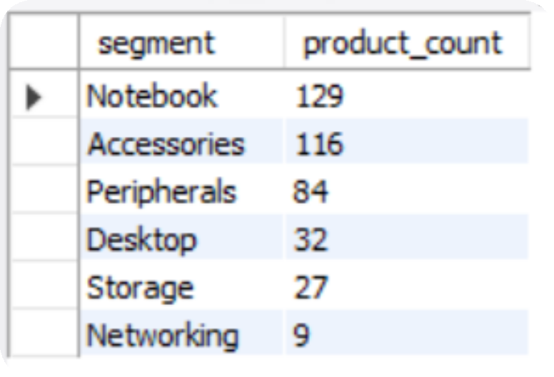

REQUEST 3:
Provide a report with all the
unique product counts for each
segment and sort them in
descending order of product
counts. The final output
contains 2 fields:
Segment
product_count
OUTPUT
Created by Sparsh Anand

Slide 13
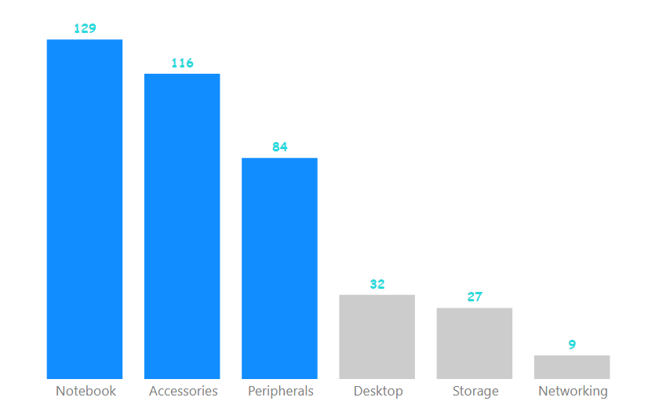
Insights
We provide a wide range of products under the segments Notebook, Peripherals,
and Accessories, with an average of 110 products in each segment. However we still
need to diversify our production in the Desktop, Networking, and Storage segments,
where there are just an average of only 23 products per segment.
Average: 109.6
Average: 22.6
How many products are there
in each segments?
Created by Sparsh Anand

Slide 14
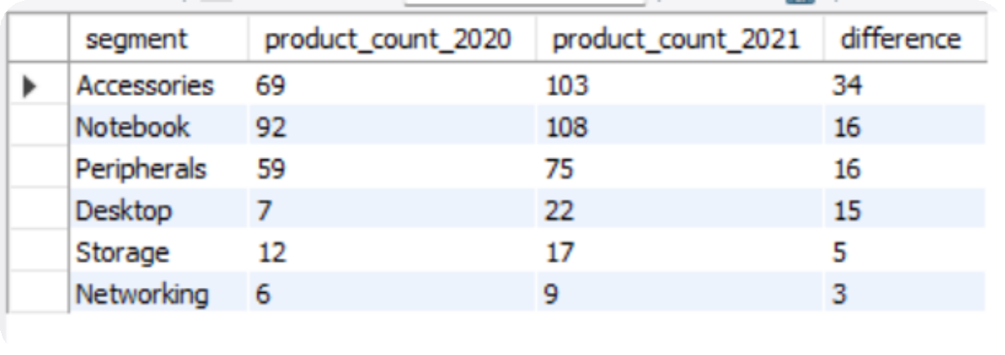

REQUEST 4:
Follow-up: Which segment had the
most increase in unique products in
2021 vs 2020? The final output
contains these fields:
OUTPUT
segment
product_count_2020
product_count_2021
difference
Created by Sparsh Anand

Slide 15

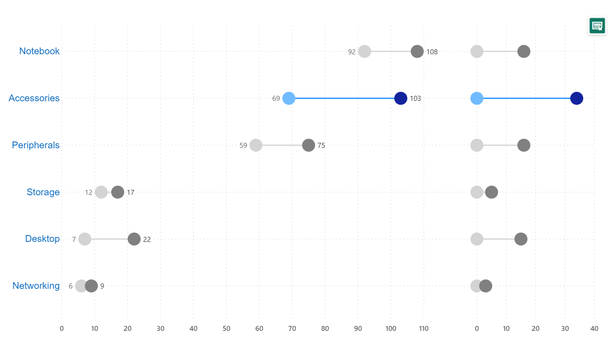
Insights
In 2021, we were mainly focusing on diversifying our accessories segment.
We introduced 34 new products to the market in accessories.
34
Product_count-2020
Product_count-2021
Comparison of Product count in 2020 vs 2021 for each of the segments
Which segment had
the most
increasere?ated by Sparsh Anand

Slide 16
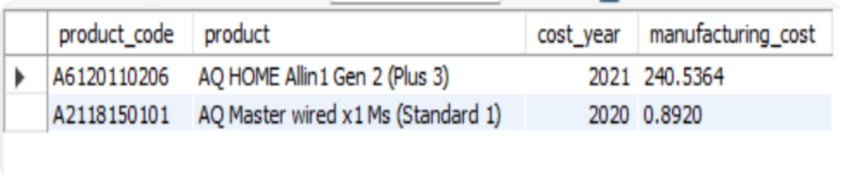

REQUEST 5:
Get the products that have the highest and lowest manufacturing costs. The final
OUTPUT
output should contain
fields:
these
product_code
product
manufacturing_cost
Created by Sparsh Anand

Slide 17


Insights
Which of our products has
the highest manufacturing cost?
Which of our products has
the lowest manufacturing cost?
240.54$
0.89$
AQ HOME Allin1 Gen 2 (Plus 3)
Personal Desktop
AQ Master wired x1 Ms (Standard 1)
Mouse
Created by Sparsh Anand

Slide 18
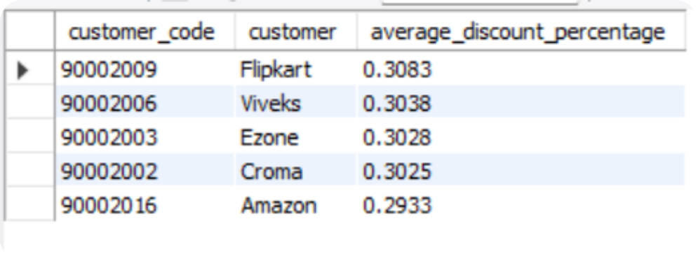

REQUEST 6:
Generate a report which contains
the top 5 customers who received
an average high pre_invoice
discount_pct for the fiscal year
2021 and in the Indian market. The
final output contains these fields:
customer_code customer
average_discount_percentage
OUTPUT
Created by Sparsh Anand

Slide 19
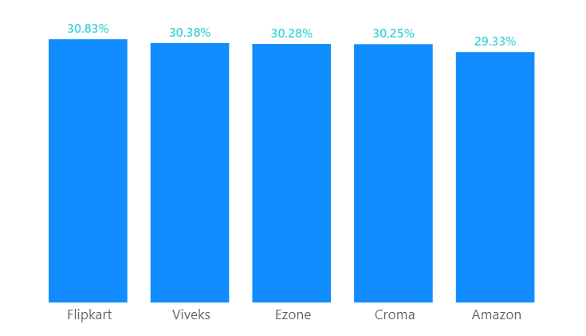
Insigh
ts
In 2021, we offered nearly equal pre-invoice discount
percentages to each of our top 5 customers, given that Flipkart
is the most discounted customer in the Indian market, which
equals 30.83%.
Who are the top 5 customers for whom we offered the most
pre-invoice discount percentage in 2021 and in the Indian
market?
Created by Sparsh Anand

Slide 20
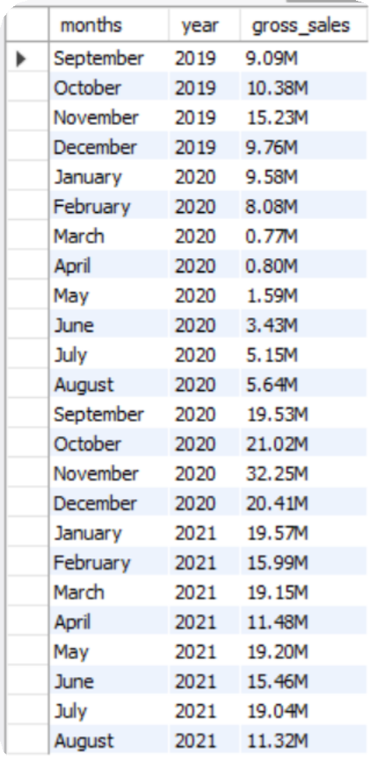

OUTPUT
REQUEST 7:
Get the complete report of the
Gross sales amount for the
customer “Atliq Exclusive” for
each month. This analysis helps
to get an idea of low and high-
performing months and take
strategic decisions. The final
report contains these columns:
Month
Year
Gross sales Amount
Created by Sparsh Anand

Slide 21
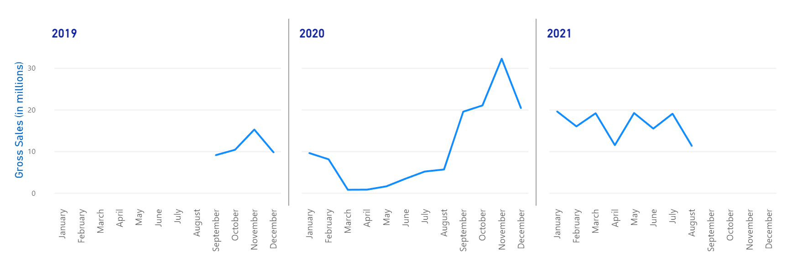
For Atliq Exclusive, November 2020 marked the highest sales, and March 2020 marked the
lowest gross sales. It’s very evident that the lower sales between March and August are
because of COVID-19. However, it’s a very good sign that the sales increased quickly after
August and reached the highest level since the last two years in November.
Insigh
ts
Atliq Exclusive Sales Trend
32.25M
0.77M
FY 2020
In FY 2020, we have a total
sales of 79.50M
FY 2021
In FY 2021, we have a total
sales of 224.42M
Altogether we have a
total sales of 303.92M
Created by Sparsh Anand

Slide 22
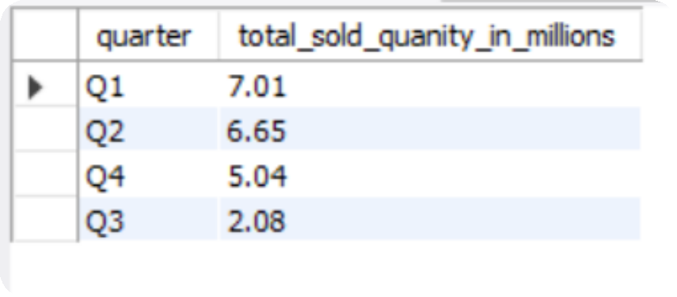

REQUEST 8:
In which quarter of 2020, got the
maximum total_sold_quantity?
OUTPUT
The final output contains
fields sorted by the
total_sold_quantity:
these
Quarter
total_sold_quantity
Created by Sparsh Anand

Slide 23
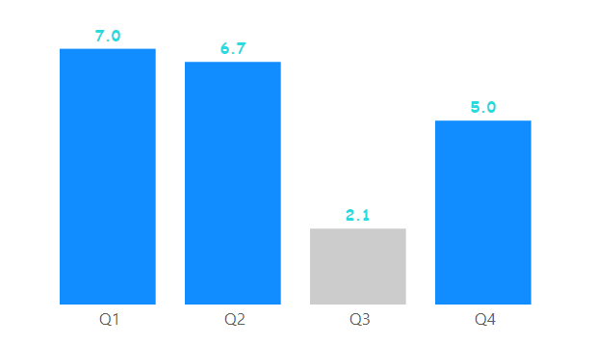
How many quantities were sold during the quarters of FY 2020?
Insigh
ts
Quarter 1 has the maximum
total sold quantity
In millions
This again complements the previous insight. That is the effect of COVID-19 on our sales. The sold quantity decreased
to 2.1 million in quarter 3 of FY 2020, which was actually March, April, and May when COVID-19 was at its peak.
But we started recovering very early despite the continuance of the pandemic. This early recovery during quarter 4 is
probably because of the increased need for hardware like desktops and notebooks as majority of the students began
or continued to do their coursework online during this time, and there was a huge demand for computer accessories
during this period.
Created by Sparsh Anand

Slide 24
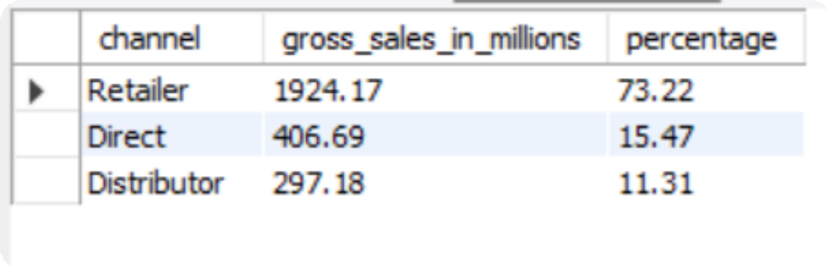

REQUEST 9:
Which channel helped to
bring more gross sales in the
fiscal year 2021 and the
percentage of contribution?
The final output contains
these fields:
OUTPUT
channel
gross_sales_mln
percentage
Created by Sparsh Anand

Slide 25
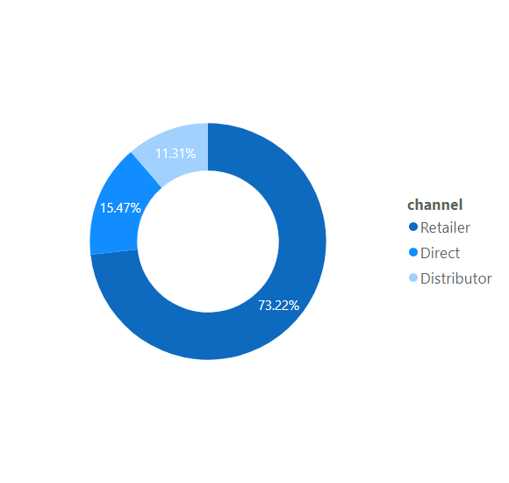
Insigh
ts
The majority of our sales took place via retailers, which is
75% of the total sales. Only a very small percentage of our
sales happened through direct and distributor channels.
In FY 2021, How are our sales distributed among the
different channels through which we sell our products?
Created by Sparsh Anand

Slide 26
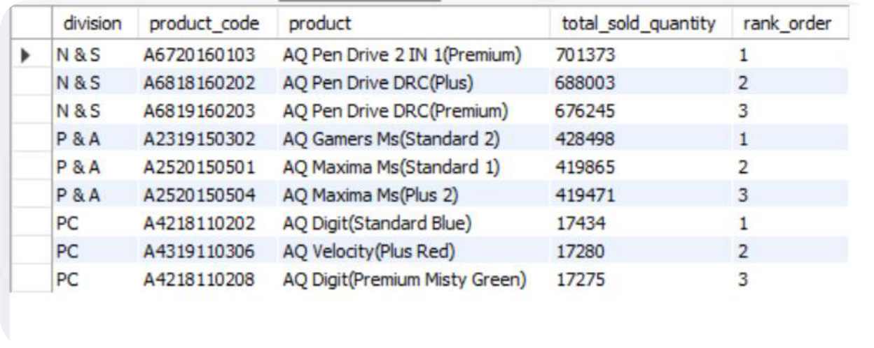

REQUEST 10:
Get the Top 3 products in each
division that have a high
total_sold_quantity in the
OUTPUT
fiscal_year 2021? The final output
contains these fields:
division
product_code
Product
total_sold_quantity
rank_order
Created by Sparsh Anand

Slide 27
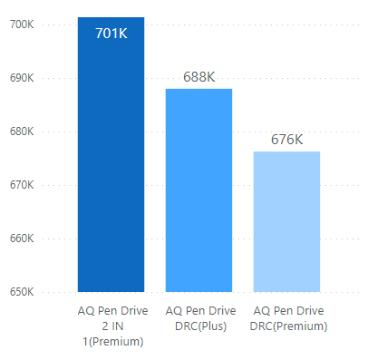
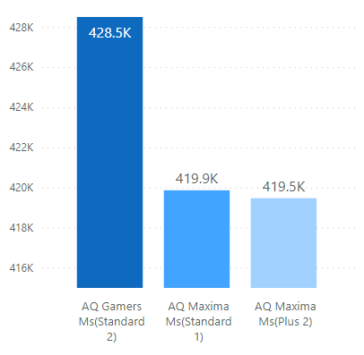
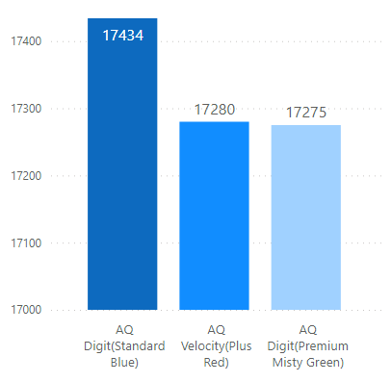
Insigh
ts
The top 3 selling products in N&S were pen drives, which were around 7 lakh in quantity.
The top 3 selling products in
P&A were mouse, which were
around 4 lakh in quantity.
The top 3 selling products in PC
were personal laptops, which were
around 17000 in quantity.
N&S
P&A
PC
Sold quantities
Which are the top 3 selling products in each of Atliq’s product lines in FY 2021?
Created by Sparsh Anand

Slide 28
END
THANK YOU
Created by Sparsh Anand

