Slide 1
The statistics of pairwise alignment
BMI/CS 576
www.biostat.wisc.edu/bmi576/
Irene Ong
irene.ong@wisc.edu
Fall 2017

Slide 2
Issues in scoring pairwise alignments
How do we determine the substitution and gap scores for alignment?
How do we determine whether the score of the best alignment is indicative of truly related sequences?
These issues are related and addressed via statistical models

Slide 3
Circular logic in alignment and scoring
How do we know what is the right distance without a good alignment?
How do we construct a good alignment without knowing what substitutions were made previously?

Slide 4
Probabilistic Model of Alignments
We’ll focus on protein alignments without gaps
given an alignment, we can consider two possibilities
R: the sequences are related by evolution
U: the sequences are unrelated
How can we distinguish these possibilities?
How is this view related to amino-acid substitution matrices?

Slide 5
Model for Unrelated Sequences
We’ll assume that each position in the alignment is sampled randomly from some distribution of amino acids
We’ll assume that amino acids at each position are independent of each other
let be the probability of amino acid a
the probability of an n-character alignment of x and y is given by

Slide 6
Model for Related Sequences
We’ll assume that each pair of aligned amino acids evolved from a common ancestor
We’ll assume each pair is independent of the other pairs
let be the probability that evolution gave rise to amino acid a in one sequence and b in another sequence
the probability of an alignment of x and y is given by

Slide 7
Probabilistic Model of Alignments
How can we decide which possibility (U or R) is more likely?
one principled way is to consider the relative likelihood of the two possibilities
taking the log, we get
This is the log-odds ratio (or log likelihood ratio)

Slide 8
Probabilistic Model of Alignments
If we let the substitution matrix score for the pair a, b be:
Then the score of an ungapped alignment is the log likelihood ratio:

Slide 9
Substitution Matrices
two popular sets of matrices for protein sequences
PAM matrices [Dayhoff et al., 1978]
BLOSUM matrices [Henikoff & Henikoff, 1992]
both try to capture the the relative substitutability of amino acid pairs in the context of evolution

Slide 10
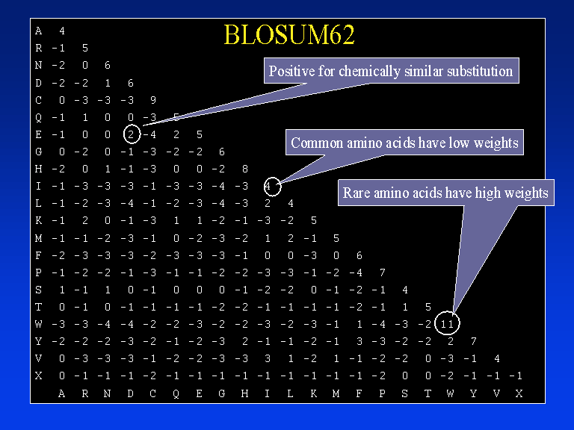
Blosum 62 Matrix

Slide 11
Substitution Matrices
the substitution matrix score for the pair a, b is given by:
but how do we get values for (probability of a and b given that they are derived from a common ancestor)?
it depends on how long ago sequences diverged
diverged recently:
diverged long ago:

Slide 12
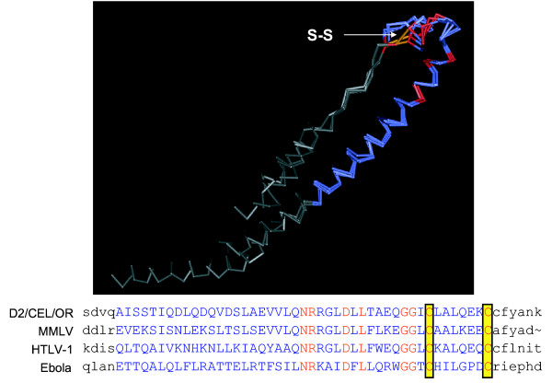
Substitution Matrices
key idea: trusted alignments of related sequences provide information about biologically permissible mutations
protein structure similarity provides the gold standard for which alignments are trusted

Slide 13
BLOSUM Matrices
[Henikoff & Henikoff, PNAS 1992]
probabilities estimated from “blocks” of sequence fragments that represent structurally conserved regions in proteins
transition frequencies observed directly by counting pairs of characters between clusters in the blocks. Sequences within blocks are clustered at various levels:
45% identical (BLOSUM-45)
50% identical (BLOSUM-50)
62% identical (BLOSUM-62)
etc.

Slide 14
BLOSUM Matrices
given: a set of sequences in a block
fill in matrix A with number of observed substitutions (we won’t worry about details of some normalization that happens here)
a paired with b

Slide 15
Assessing significance of the alignment score
There are two ways to do this
Bayesian approach
Classical approach

Slide 16
Bayesian approach
Compute probability of Related model using Bayes rule
Requires prior probability of R and U

Slide 17
Classical approach
Determine how likely it is that such an alignment score would result from chance.
3 ways to calculate chance; look at alignment scores for
real but non-homologous sequences
real sequences shuffled to preserve compositional properties
sequences generated randomly based upon a DNA/protein sequence model

Slide 18
Scores from Random Alignments
suppose we assume
sequence lengths m and n
a particular substitution matrix and amino-acid frequencies
and we consider generating random sequences of lengths m and n and finding the best alignment of these sequences
this will give us a distribution over alignment scores for random pairs of sequences

Slide 19
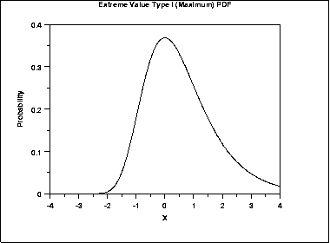
Statistics of Alignment Scores: The Extreme Value Distribution
in particular, we get an extreme value distribution

Slide 20
Distribution of Scores
the expected number of alignments, E, with score at least S is given by:
S is a given score threshold
m and n are the lengths of the sequences under consideration
K and are constants that can be calculated from
the substitution matrix
the frequencies of the individual amino acids

Slide 21
Statistics of Alignment Scores
to generalize this to searching a database, have n represent the summed length of the sequences in the DB (adjusting for edge effects)
the NCBI BLAST server does just this
theory for gapped alignments not as well developed
computational experiments suggest this analysis holds for gapped alignments (but K and must be estimated from data)

Slide 22
Scoring Matrices
Differences between PAM and BLOSUM
PAM based on predictions of mutations when proteins diverged from common ancestor – explicit evolutionary model
BLOSUM based on common regions (BLOCKS) in protein families
BLOSUM is better designed to find conserved domains
Much larger data set was used than for PAM
BLOSUM matrices with small percentage correspond to PAM with large evolutionary distances
BLOSUM64 ~ PAM120

Slide 23
Are these proteins homologs?
SEQ 1:RVVNLVPS--FWVLDATYKNYAINYNCDVTYKLY
| | | | | | | | |
SEQ 2:QFFPLMPPAPYWILATDYENLPLVYSCTTFFWLF
NO (score = 69)
SEQ 1: RVVNLVPS--FWVLDATYKNYAINYNCDVTYKLY
| | | ||||||||| | | |
SEQ 2: QFFPLMPPAPYWILDATYKNYALVYSCTTFFWLF
MAYBE (score = 104)
SEQ 1: RVVNLVPS--FWVLDATYKNYAINYNCDVTYKLY
||| | || | ||||||||| | |||||||
SEQ 2: RVVPLMPSAPYWILDATYKNYALVYSCDVTYKLF
YES (score = 153)
Slides courtesy of William Noble

Slide 24
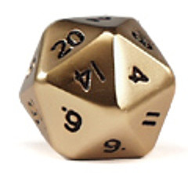
An empirical histogram
Roll a 20-sided die 1000 times.
Keep a tally of the number of times each value is observed.
Slides courtesy of William Noble

Slide 25
A table of results
1 | 2 | 3 | 4 | 5 | 6 | 7 | 8 | 9 | 10 | 11 | 12 | 13 | 14 | 15 | 16 | 17 | 18 | 19 | 20
41 | 52 | 67 | 45 | 34 | 55 | 53 | 71 | 60 | 50 | 41 | 43 | 54 | 56 | 50 | 46 | 48 | 35 | 61 | 38
Slides courtesy of William Noble

Slide 26
A table of results
1 | 2 | 3 | 4 | 5 | 6 | 7 | 8 | 9 | 10 | 11 | 12 | 13 | 14 | 15 | 16 | 17 | 18 | 19 | 20
41 | 52 | 67 | 45 | 34 | 55 | 53 | 71 | 60 | 50 | 41 | 43 | 54 | 56 | 50 | 46 | 48 | 35 | 61 | 38
A histogram plots the number of times or the frequency with which each value of a given variable (e.g., the die value) is observed.
Slides courtesy of William Noble

Slide 27
After 21,000 rolls
As the number of observations increases, the histogram becomes smoother.
Slides courtesy of William Noble

Slide 28
Frequency histogram = distribution
Divide through by the total number of observations to get frequencies.
The resulting histogram is called a distribution.
The sum of the bars in the distribution is 1.
This particular distribution is “uniform.”
Slides courtesy of William Noble

Slide 29
Distribution from two dice
There is only one way to get a score of 2.
How many ways can you get a 7 from two six-sided dice?
This distribution is approximately normal (Gaussian).
Slides courtesy of William Noble

Slide 30
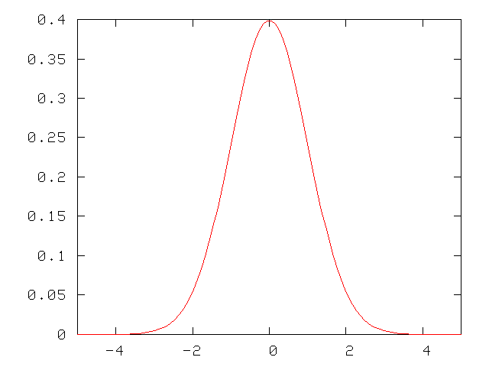
Normal distribution
This is probably the most common distribution in science.
The area under a continuous distribution curve is 1.
Slides courtesy of William Noble

Slide 31
The null hypothesis
We are interested in characterizing the distribution of scores from sequence comparison algorithms.
We would like to measure how surprising a given score is, assuming that the two sequences are not related.
The assumption is called the null hypothesis.
The purpose of most statistical tests is to determine whether the observed results provide a reason to reject the hypothesis that the results are merely a product of chance factors.
Slides courtesy of William Noble

Slide 32
Sequence similarity score distribution
?
Frequency
Sequence comparison score
Search a randomly generated database of DNA sequences using a randomly generated DNA query.
What will be the form of the resulting distribution of pairwise sequence comparison scores?
Slides courtesy of William Noble

Slide 33
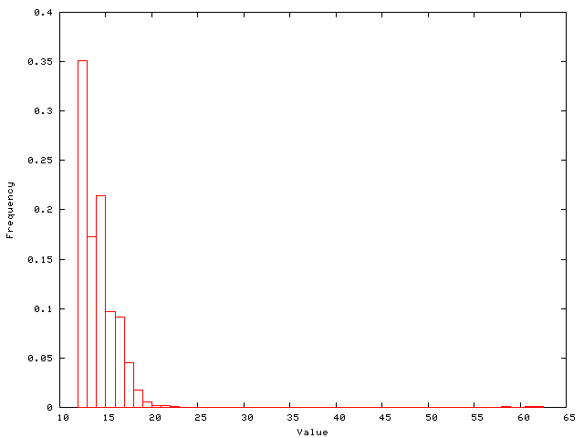
Empirical score distribution
The picture shows a distribution of scores from a real database search using BLAST.
This distribution contains scores from non-homologous and homologous pairs.
Frequency
Score
High scores from homology
Slides courtesy of William Noble

Slide 34
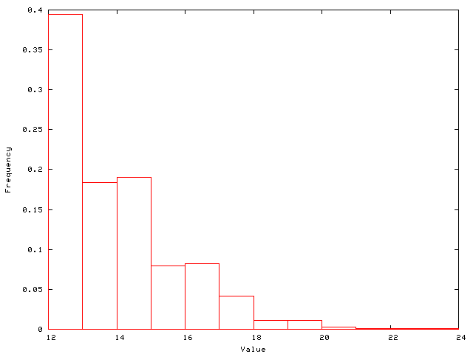
Empirical null score distribution
This distribution is similar to the previous one, but generated using a randomized sequence database.
Slides courtesy of William Noble

Slide 35
Computing a p-value
The probability of observing a score >X is the area under the curve to the right of X.
This probability is called a p-value.
p-value = Pr(data|null)
Out of 1685 scores, 28 receive a score of 20 or better. Thus, the p-value associated with a score of 20 is approximately 28/1685 = 0.0166.
Slides courtesy of William Noble

Slide 36
Problems with empirical distributions
We are interested in very small probabilities.
These are computed from the tail of the distribution.
Estimating a distribution with accurate tails is computationally very expensive.
Slides courtesy of William Noble

Slide 37
A solution
Solution: Characterize the form of the distribution mathematically.
Fit the parameters of the distribution empirically, or compute them analytically.
Use the resulting distribution to compute accurate p-values.
Slides courtesy of William Noble

Slide 38
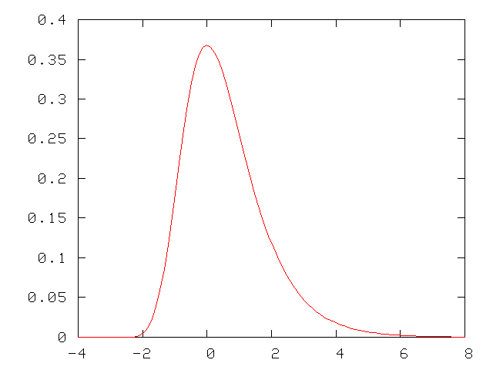
Extreme value distribution
This distribution is characterized by a larger tail on the right.
Slides courtesy of William Noble

Slide 39
Computing a p-value
The probability of observing a score >4 is the area under the curve to the right of 4.
This probability is called a p-value.
p-value = Pr(data|null)
Slides courtesy of William Noble

Slide 40
Extreme value distribution
Compute this value for x=4.
Slides courtesy of William Noble

Slide 41
Computing a p-value
Calculator keys: 4, +/-, inv, ln, +/-, inv, ln, +/-, +, 1, =
Solution: 0.018149
Slides courtesy of William Noble

Slide 42
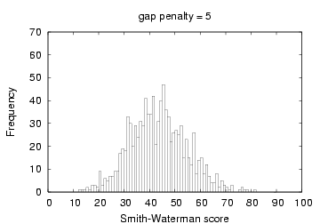
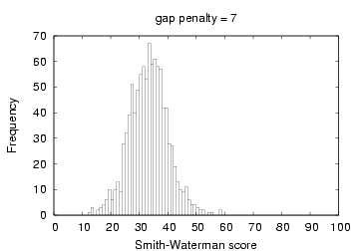
Scaling the EVD
An extreme value distribution derived from, e.g., the Smith-Waterman algorithm will have a characteristic mode μ and scale parameter λ.
These parameters depend upon the size of the query, the size of the target database, the substitution matrix and the gap penalties.
Slides courtesy of William Noble

Slide 43
An example
You run the Smith-Waterman algorithm and get a score of 45. You then run Smith-Waterman with the same query but using a shuffled version of the database, and you fit an extreme value distribution to the resulting empirical distribution. The parameters of the EVD are μ = 25 and λ = 0.693. What is the p-value associated with 45?
Slides courtesy of William Noble

Slide 44
An example
You run BLAST and get a score of 45. You then run BLAST on a shuffled version of the database, and fit an extreme value distribution to the resulting empirical distribution. The parameters of the EVD are μ = 25 and λ = 0.693. What is the p-value associated with 45?
Slides courtesy of William Noble

Slide 45
What p-value is significant?
The most common thresholds are 0.01 and 0.05.
A threshold of 0.05 means you are 95% sure that the result is significant.
Is 95% enough? It depends upon the cost associated with making a mistake.
Examples of costs:
Doing expensive wet lab validation.
Making clinical treatment decisions.
Misleading the scientific community.
Most sequence analysis uses more stringent thresholds because the p-values are not very accurate.
Slides courtesy of William Noble

Slide 46
Multiple testing
Say that you perform a statistical test with a 0.05 threshold, but you repeat the test on twenty different observations.
Assume that all of the observations are explainable by the null hypothesis.
What is the chance that at least one of the observations will receive a p-value less than 0.05?
Slides courtesy of William Noble

Slide 47
Multiple testing
Say that you perform a statistical test with a 0.05 threshold, but you repeat the test on twenty different observations. Assuming that all of the observations are explainable by the null hypothesis, what is the chance that at least one of the observations will receive a p-value less than 0.05?
Pr(making a mistake) = 0.05
Pr(not making a mistake) = 0.95
Pr(not making any mistake) = 0.95²⁰ = 0.358
Pr(making at least one mistake) = 1 - 0.358 = 0.642
There is a 64.2% chance of making at least one mistake.
Slides courtesy of William Noble

Slide 48
Bonferroni correction
Assume that individual tests are independent.
Divide the desired p-value threshold by the number of tests performed.
For the previous example, 0.05 / 20 = 0.0025.
Pr(making a mistake) = 0.0025
Pr(not making a mistake) = 0.9975
Pr(not making any mistake) = 0.9975²⁰ = 0.9512
Pr(making at least one mistake) = 1 - 0.9512 = 0.0488
Slides courtesy of William Noble

Slide 49
Database searching
Say that you search the non-redundant protein database at NCBI, containing roughly one million sequences. What p-value threshold should you use?
Slides courtesy of William Noble

Slide 50
Database searching
Say that you search the non-redundant protein database at NCBI, containing roughly one million sequences. What p-value threshold should you use?
Say that you want to use a conservative p-value of 0.001.
Recall that you would observe such a p-value by chance approximately every 1000 times in a random database.
A Bonferroni correction would suggest using a p-value threshold of 0.001 / 1,000,000 = 0.000000001 = 10⁻⁹.
Slides courtesy of William Noble

Slide 51
E-values
A p-value is the probability of making a mistake.
The E-value is the expected number of times that the given score would appear in a random database of the given size.
One simple way to compute the E-value is to multiply the p-value times the size of the database.
Thus, for a p-value of 0.001 and a database of 1,000,000 sequences, the corresponding E-value is 0.001 × 1,000,000 = 1,000.
BLAST actually calculates E-values in a more complex way.
Slides courtesy of William Noble

Slide 52
Summary
A distribution plots the frequency of a given type of observation.
The area under the distribution is 1.
Most statistical tests compare observed data to the expected result according to the null hypothesis.
Sequence similarity scores follow an extreme value distribution, which is characterized by a larger tail.
The p-value associated with a score is the area under the curve to the right of that score.
Selecting a significance threshold requires evaluating the cost of making a mistake.
Bonferroni correction: Divide the desired p-value threshold by the number of statistical tests performed.
The E-value is the expected number of times that the given score would appear in a random database of the given size.
Slides courtesy of William Noble

