Slide 1
Sequence Assembly
Fall 2016
BMI/CS 576
www.biostat.wisc.edu/bmi576/
Irene Ong
Irene.ong@wisc.edu

Slide 2
Directed multigraph
Directed multigraph G(V, E) consists of
set of vertices, V and
multiset of directed edges, E
Otherwise, same as directed graph
Repeated edges
De Bruijn graph is a directed multigraph

Slide 3
de Bruijn k-mer examples
de Bruijn₂( TAATGCCATGGGATGTT)=
AT
TT
T
A
AA
TA
TG
GA
CA
G
C
GG
GG
GC
CC
de Bruijn₄( TAATGCCATGGGATGTT)=
GGAT
GAT
GGA
GATG
GGGA
TGGG
ATGG
TGG
GGG
TAAT
AATG
TAA
ATGT
TGT
TGTT
GTT
AAT
ATG
ATGC
TGCC
CATA
TGC
GCC
GCCA
CCAC
CAT
CCA

Slide 4
de Bruijn example
de Bruijn₅( TAATGCCATGGGATGTT)=
TAATG
AATGC
ATGCC
TGCCA
GCCAT
CCATG
TAAT
AATG
ATGC
TGCC
GCCA
CCAT
CATG
CATGG
ATGTT
GATGT
GGATG
GGGAT
TGGGA
ATGGG
TGTT
ATGT
GATG
GGAT
GGGA
TGGG
ATGG
GGA
GGG

Slide 5
Sequencing by Hybridization (SBH)
SBH array has probes for all possible k-mers
For a given DNA sample, array tells us whether each k-mer is PRESENT or ABSENT in the sample
The set of all k-mers present in a string s is called its spectrum (a.k.a. composition)
Example:
s = ACTGATGCAT
spectrum(s, 3) = {ACT, ATG, CAT, CTG, GAT, GCA, TGA, TGC}

Slide 6
Example DNA Array
 | AA | AC | AG | AT | CA | CC | CG | CT | GA | GC | GG | GT | TA | TC | TG | TT
AA
AC |  |  |  |  |  |  |  |  |  |  |  |  |  |  | X
AG
AT |  |  |  |  |  |  |  |  |  | X
CA
CC
CG
CT |  |  |  |  |  |  |  |  | X
GA |  |  |  |  |  |  |  |  |  |  |  |  |  |  | X
GC |  |  |  | X
GG
GT
TA
TC
TG |  |  |  | X | X
TT
Sample:
ACTGATGCAT
Spectrum (k=4):
{ACTG, ATGC,
CTGA,GATG,
GCAT,TGAT,
TGCA}

Slide 7
SBH Problem
Given: A set S of k-mers
Do: Find a string s, such that spectrum(s,k) = S
{ACT, ATG, CAT, CTG, GAT, GCA, TGA, TGC}
?

Slide 8
SBH as Eulerian path
Could use Hamiltonian path approach, but not useful due to NP-completeness
Instead, use Eulerian path approach
Eulerian path: A path through a graph that traverses every edge exactly once
Construct graph with all (k-1)-mers as vertices
For each k-mer in spectrum, add edge from vertex representing first k-1 characters to vertex representing last k-1 characters

Slide 9
Properties of Eulerian graphs
It will be easier to consider Eulerian cycles: Eulerian paths that form a cycle
Graphs that have an Eulerian cycle are simply called Eulerian
Theorem: A connected directed graph is Eulerian if and only if each of its vertices are balanced
A vertex v is balanced if indegree(v) = outdegree(v)
There is a polynomial-time algorithm for finding Eulerian cycles!

Slide 10
Eulerian cycle algorithm
Convert graph into Eulerian (if not one) by adding an edge to make all nodes balanced, then recursively find cycles while not Eulerian
Start at any vertex v, traverse unused edges until returning to v
While the cycle is not Eulerian
Pick a vertex w along the cycle for which there are untraversed outgoing edges
Traverse unused edges until ending up back at w
Join two cycles into one cycle

Slide 11
Joining cycles
v
v
v
w

Slide 12
Eulerian Path -> Eulerian Cycle
If a graph has an Eulerian Path starting at s and ending at t then
All vertices must be balanced, except for s and t which may have |indegree(v) – outdegree(v)| = 1
If s and t are not balanced, add an edge between them to balance
Graph now has an Eulerian cycle which can be converted to an Eulerian path by removal of the added edge

Slide 13
SBH graph example
{ACT, ATG, CAT, CTG, GAT, GCA, TGA, TGC}
AA
AC
AG
AT
CA
CC
CG
CT
GA
GC
GG
GT
TA
TC
TG
TT

Slide 14
de Bruijn graphs
Assume perfect sequencing where each length-k substring is sequenced exactly once with no errors
With perfect sequencing, this procedure always yields an Eulerian graph. Why?
Node is semi-balanced if indegree differs from outdegree by 1
Node for k-1-mer from left end is semi-balanced with one more outgoing edge than incoming *
Node for k-1-mer at right end is semi-balanced with one more incoming than outgoing *
Other nodes are balanced since # times k-1-mer occurs as a left k-1-mer = # times it occurs as a right k-1-mer
* Unless genome is circular

Slide 15
SBH difficulties
In practice, sequencing by hybridization is hard
Arrays are often inaccurate -> incorrect spectra
False positives/negatives
Need long probes to deal with repetitive sequence
But the number of probes needed is exponential in the length of the probes!
There is a limit to the number of probes per array (currently between 1-10 million probes / array)

Slide 16
Outline
What Is Genome Sequencing?
Exploding Newspapers
The String Reconstruction Problem
String Reconstruction as a Hamiltonian Path Problem
String Reconstruction as an Eulerian Path Problem
Similar Problems with Different Fates
De Bruijn Graphs
Euler’s Theorem
Assembling Read-Pairs
De Bruijn Graphs Face Harsh Realities of Assembly

Slide 17
Some Unrealistic Assumptions
Perfect coverage of genome by reads (every k-mer from the genome is represented by a read)
Reads are error-free.
Multiplicities of k-mers are known
Distances between reads within read-pairs are exact.

Slide 18
Some Unrealistic Assumptions
Imperfect coverage of genome by reads (every k-mer from the genome is represented by a read)
Reads are error-prone.
Multiplicities of k-mers are unknown.
Distances between reads within read-pairs are inexact.

Slide 19
Coverage
Coverage is defined as the number of reads to which the k-mer belongs.
In typical assembly projects, average coverage is ~ 30 – 50
Same edge might appear in dozens of copies; we can use edge weights instead
Weight = # times k-mer occurs
Using weights, there’s one weighted edge for each distinct k-mer

Slide 20
Average Coverage
Average # reads covering a genome position
CTAGGCCCTCAATTTTT
CTCTAGGCCCTCAATTTTT
GGCTCTAGGCCCTCATTTTTT
CTCGGCTCTAGCCCCTCATTTT
TATCTCGACTCTAGGCCCTCA
TATCTCGACTCTAGGCC 177 nucleotides
TCTATATCTCGGCTCTAGG
GGCGTCTATATCTCG
GGCGTCGATATCT
GGCGTCTATATCT
GGCGTCTATATCTCGGCTCTAGGCCCTCATTTTTT 35 nucleotides
Average coverage = 177 / 35 ≈ 7x

Slide 21
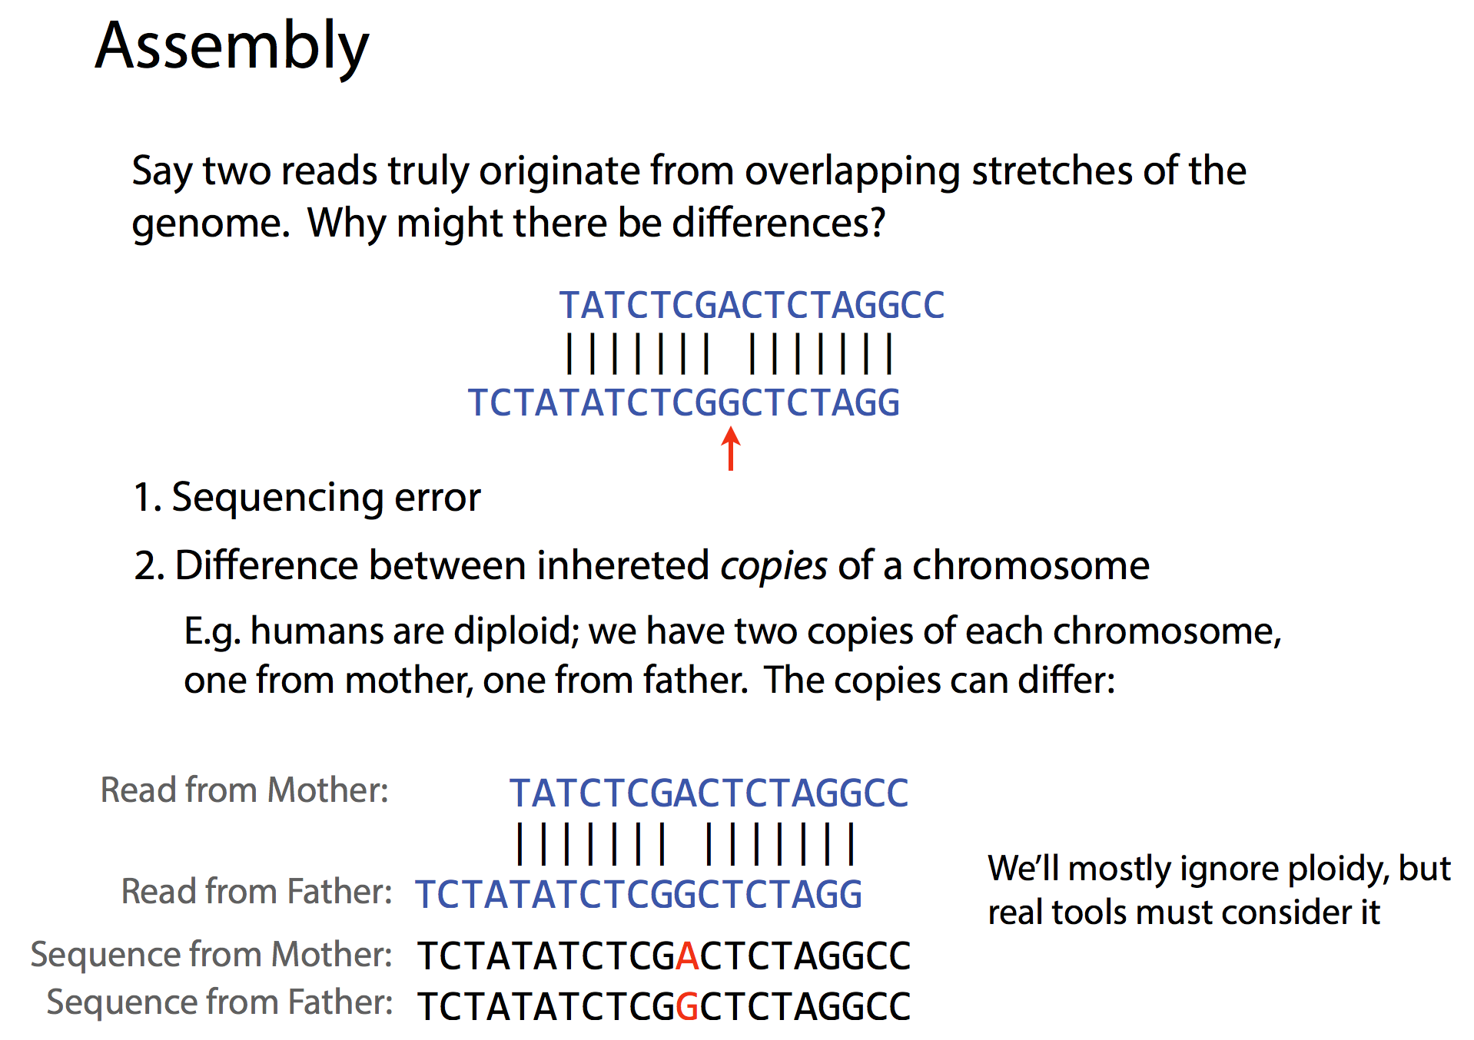

Slide 22
1st Unrealistic Assumption: Perfect Coverage
atgccgtatggacaacgact
atgccgtatg
gccgtatgga
gtatggacaa
gacaacgact
250-nucleotide reads generated by Illumina technology capture only a small fraction of 250-mers from the genome, thus violating the key assumption of the de Bruijn graphs.

Slide 23
Breaking Reads into Shorter k-mers
atgccgtatggacaacgact atgccgtatggacaacgact
atgccgtatg atgcc
gccgtatgga tgccg
gtatggacaa gccgt
gacaacgact ccgta
cgtat
gtatg
tatgg
atgga
tggac
ggaca
gacaa
acaac
caacg
aacga
acgac
cgact

Slide 24
2nd Unrealistic Assumption: Error-free Reads
atgccgtatggacaacgact atgccgtatggacaacgact
atgccgtatg atgcc
gccgtatgga tgccg
gtatggacaa gccgt
gacaacgact ccgta
cgtaCggaca cgtat
gtatg
tatgg
atgga
tggac
ggaca
gacaa
acaac
caacg
aacga
acgac
cgact
cgtaC
gtaCg
taCgg
aCgga
Cggac
Erroneous read (change of t to C)

Slide 25
De Bruijn Graph of ATGGCGTGCAATG… Constructed from Error-Free Reads
.
ATGCC
TGCCG
GCCGT
CCGTA
CGTAT
GTATG
TATGG
ATGGA
TGGAC
GGACA
ATGC
TGCC
GCCG
CCGT
CGTA
GTAT
TATG
ATGG
TGGA
GGAC
GACA

Slide 26
Errors in Reads Lead to Bubbles in the De Bruijn Graph
.
ATGCC
TGCCG
GCCGT
CCGTA
CGTAT
GTATG
TATGG
ATGGA
TGGAC
GGACA
ATGC
TGCC
GCCG
CCGT
CGTA
GTAT
TATG
ATGG
TGGA
GGAC
GACA
GCCGC
Bubble!
CATG
CCGC
CGCA
GCAT
CATG
CCGCA
CGCAT
GCATG

Slide 27
Bubble Explosion…Where Are the Correct Edges of the de Bruijn Graph?

Slide 28
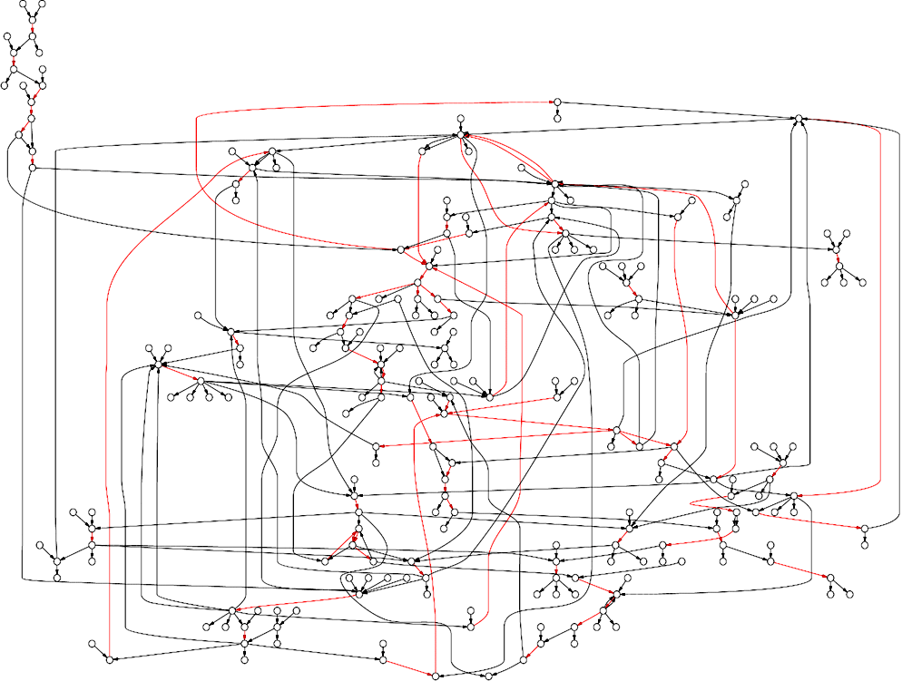
De Bruin Graph of N. meningitidis Genome AFTER Removing Bubbles
Red edges represent repeats

Slide 29
K-mer spectrum approach with read data (de Bruijn approach)
Generate spectrum from set of all k-mers contained within reads
Choose k to be small enough such that the majority of the genome’s k-mers will be found within the reads
Particularly useful for short-read data, such as that produced by Illumina
Made popular by methods such as Euler and Velvet

Slide 30
Difficulties with de Bruijn approach
Not all k-mers may be contained within the reads even if reads completely cover the genome
DNA repeats result in k-mers that are present in multiple copies across the genome
Reads often have sequencing errors!

Slide 31
Fragment assembly challenges
Read errors
Complicates computing read overlaps
Repeats
Roughly half of the human genome is composed of repetitive elements
Repetitive elements can be long (1000s of bp)
Human genome
1 million Alu repeats (~300 bp)
200,000 LINE repeats (~1000 bp)

Slide 32
Overlap-Layout-Consensus
Most common assembler strategy for long reads
Overlap: Find all significant overlaps between reads, allowing for errors
Layout: Determine path through overlapping reads representing assembled sequence
Consensus: Correct for errors in reads using layout

Slide 34
Consensus
GTATCGTAGCTGACTGCGCTGC
Layout
ATCGTCTCGTAGCTGACTGCGCTGC
ATCGTATCGAATCGTAG
TGACTGCGCTGCATCGTATCGTATC
Consensus
TGACTGCGCTGCATCGTATCGTATCGTAGCTGACTGCGCTGC

Slide 35
Whole Genome Sequencing
Two main strategies:
Clone-by-clone mapping
Fragment genome into large pieces, insert into BACs (Bacterial Artificial Chromosomes)
Choose tiling set of BACs: overlapping set that covers entire genome
Shotgun sequence the BACs
Whole-genome shotgun
Shotgun sequence the entire genome at once

Slide 36
Assembly in practice
Assembly methods used in practice are complex
But generally follow one of the two approaches
Reads as vertices
Reads as edges (or paths of edges)
Assemblies do not typically give whole chromosomes
Instead gives a set of “contigs”
contig: contiguous piece of sequence from overlapping reads
contigs can be ordered into scaffolds with extra information (e.g., paired end reads)

Slide 37
Cloning and Paired-end reads
DNA fragment
…
transform bacteria with vector and grow
Insert fragment into
vector
Sequence ends of insert using flanking primers
vector

Slide 38
Paired-end read advantages
Scaffolding: layout of adjacent, but not overlapping, contigs
Gap filling:
contig
scaffold
paired-end reads
gap

Slide 39
Sequence assembly summary
Two general algorithmic strategies
Overlap graph hamiltonian paths
Eulerian paths in k-mer graphs
Biggest challenge
Repeats!
Large genomes have a lot of repetitive sequence
Sequencing strategies
Clone-by-clone: break the problem into smaller pieces which have fewer repeats
Whole-genome shotgun: use paired-end reads to assemble around and inside repeats

