Slide 1
The statistics of pairwise alignment
BMI/CS 576
www.biostat.wisc.edu/bmi576/
Irene Ong
irene.ong@wisc.edu
Fall 2017

Slide 2
Issues in scoring pairwise alignments
How do we determine the substitution and gap scores for alignment?
How do we determine whether the score of the best alignment is indicative of truly related sequences?
These issues are related and addressed via statistical models

Slide 3
Circular logic in alignment and scoring
How do we know what is the right distance without a good alignment?
How do we construct a good alignment without knowing what substitutions were made previously?

Slide 4
Probabilistic Model of Alignments
We’ll focus on protein alignments without gaps
given an alignment, we can consider two possibilities
R: the sequences are related by evolution
U: the sequences are unrelated
How can we distinguish these possibilities?
How is this view related to amino-acid substitution matrices?

Slide 5
Model for Unrelated Sequences
We’ll assume that each position in the alignment is sampled randomly from some distribution of amino acids
We’ll assume that amino acids at each position are independent of each other
let be the probability of amino acid a
the probability of an n-character alignment of x and y is given by

Slide 6
Model for Related Sequences
We’ll assume that each pair of aligned amino acids evolved from a common ancestor
We’ll assume each pair is independent of the other pairs
let be the probability that evolution gave rise to amino acid a in one sequence and b in another sequence
the probability of an alignment of x and y is given by

Slide 7
Probabilistic Model of Alignments
How can we decide which possibility (U or R) is more likely?
one principled way is to consider the relative likelihood of the two possibilities
taking the log, we get
This is the log-odds ratio (or log likelihood ratio)

Slide 8
Probabilistic Model of Alignments
If we let the substitution matrix score for the pair a, b be:
Then the score of an ungapped alignment is the log likelihood ratio:

Slide 9
Substitution Matrices
two popular sets of matrices for protein sequences
PAM matrices [Dayhoff et al., 1978]
BLOSUM matrices [Henikoff & Henikoff, 1992]
both try to capture the the relative substitutability of amino acid pairs in the context of evolution

Slide 10
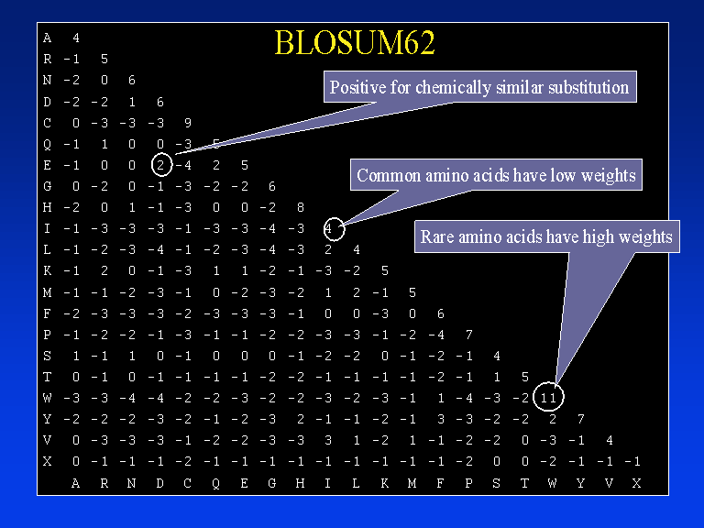
Blosum 62 Matrix

Slide 11
Substitution Matrices
the substitution matrix score for the pair a, b is given by:
but how do we get values for (probability of a and b given that they are derived from a common ancestor)?
it depends on how long ago sequences diverged
diverged recently:
diverged long ago:

Slide 12
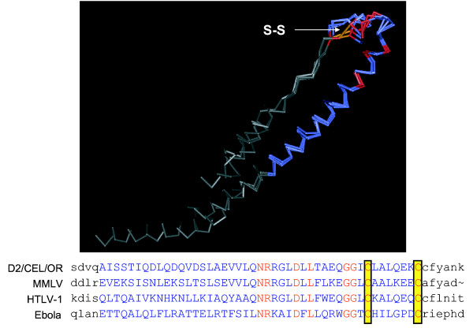
Substitution Matrices
key idea: trusted alignments of related sequences provide information about biologically permissible mutations
protein structure similarity provides the gold standard for which alignments are trusted

Slide 13
BLOSUM Matrices
[Henikoff & Henikoff, PNAS 1992]
probabilities estimated from “blocks” of sequence fragments that represent structurally conserved regions in proteins
transition frequencies observed directly by counting pairs of characters between clusters in the blocks. Sequences within blocks are clustered at various levels:
45% identical (BLOSUM-45)
50% identical (BLOSUM-50)
62% identical (BLOSUM-62)
etc.

Slide 14
BLOSUM Matrices
given: a set of sequences in a block
fill in matrix A with number of observed substitutions (we won’t worry about details of some normalization that happens here)
a paired with b

Slide 15
Assessing significance of the alignment score
There are two ways to do this
Bayesian approach
Classical approach

Slide 16
Bayesian approach
Compute probability of Related model using Bayes rule
Requires prior probability of R and U

Slide 17
Classical approach
Determine how likely it is that such an alignment score would result from chance.
3 ways to calculate chance; look at alignment scores for
real but non-homologous sequences
real sequences shuffled to preserve compositional properties
sequences generated randomly based upon a DNA/protein sequence model

Slide 18
Scores from Random Alignments
suppose we assume
sequence lengths m and n
a particular substitution matrix and amino-acid frequencies
and we consider generating random sequences of lengths m and n and finding the best alignment of these sequences
this will give us a distribution over alignment scores for random pairs of sequences

Slide 19
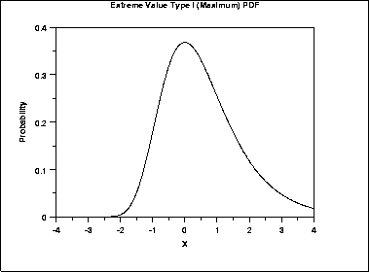
Statistics of Alignment Scores: The Extreme Value Distribution
in particular, we get an extreme value distribution

Slide 20
Distribution of Scores
the expected number of alignments, E, with score at least S is given by:
S is a given score threshold
m and n are the lengths of the sequences under consideration
K and are constants that can be calculated from
the substitution matrix
the frequencies of the individual amino acids

Slide 21
Statistics of Alignment Scores
to generalize this to searching a database, have n represent the summed length of the sequences in the DB (adjusting for edge effects)
the NCBI BLAST server does just this
theory for gapped alignments not as well developed
computational experiments suggest this analysis holds for gapped alignments (but K and must be estimated from data)

Slide 22
Scoring Matrices
Differences between PAM and BLOSUM
PAM based on predictions of mutations when proteins diverged from common ancestor – explicit evolutionary model
BLOSUM based on common regions (BLOCKS) in protein families
BLOSUM is better designed to find conserved domains
Much larger data set was used than for PAM
BLOSUM matrices with small percentage correspond to PAM with large evolutionary distances
BLOSUM64 ~ PAM120

