Slide 1
Intro to Probability for Discrete Variables
BMI/CS 576
www.biostat.wisc.edu/bmi576/
Irene Ong
irene.ong@wisc.edu
Fall 2017

Slide 2
Definition of Probability
frequentist interpretation: the probability of an event from a random experiment is proportion of the time events of the same kind will occur in the long run, when the experiment is repeated
examples
the probability my flight to Chicago will be on time
the probability this ticket will win the lottery
the probability it will rain tomorrow
always a number in the interval [0,1]
0 means “never occurs”
1 means “always occurs”

Slide 3
Sample Spaces
sample space: a set of possible outcomes for some event
examples
flight to Chicago: {on time, late}
lottery:{ticket 1 wins, ticket 2 wins,…,ticket n wins}
weather tomorrow:
{rain, not rain} or
{sun, rain, snow} or
{sun, clouds, rain, snow, sleet} or…

Slide 4
Random Variables
random variable: a function that maps the outcome of an experiment to a label (often a numerical value)
example
X represents the outcome of my flight to Chicago
we write the probability of my flight being on time as Pr(X = on-time)
or when it's clear which variable we’re referring to, we may use the shorthand Pr(on-time)

Slide 5
Notation
UPPERCASE letters and Capitalized words denote random variables
lowercase letters and uncapitalized words denote values
we'll denote a particular value for a variable as follows
we'll also use the shorthand form
for Boolean random variables, we’ll use the shorthand

Slide 6
Probability Distributions
if X is a random variable, the function given by Pr(X = x) for each x is the probability distribution of X
requirements:
0.3
0.2
0.1
sun
clouds
rain
snow
sleet

Slide 7
Joint Distributions
joint probability distribution: the function given by Pr(X = x, Y = y)
read “X equals x and Y equals y”
example
x, y | Pr(X = x, Y = y)
sun, on-time | 0.20
rain, on-time | 0.20
snow, on-time | 0.05
sun, late | 0.10
rain, late | 0.30
snow, late | 0.15
probability that it's sunny
and my flight is on time

Slide 8
Marginal Distributions
the marginal distribution of X is defined by
“the distribution of X ignoring other variables”
this definition generalizes to more than two variables, e.g.

Slide 9
Marginal Distribution Example
joint distribution
marginal distribution for X
x, y | Pr(X = x, Y = y)
sun, on-time | 0.20
rain, on-time | 0.20
snow, on-time | 0.05
sun, late | 0.10
rain, late | 0.30
snow, late | 0.15
x | Pr(X = x)
sun | 0.3
rain | 0.5
snow | 0.2

Slide 10
Conditional Distributions
the conditional distribution of X given Y is defined as:
“the distribution of X given that we know Y ”

Slide 11
Conditional Distribution Example
conditional distribution for X
given Y=on-time
joint distribution
x, y | Pr(X = x, Y = y)
sun, on-time | 0.20
rain, on-time | 0.20
snow, on-time | 0.05
sun, late | 0.10
rain, late | 0.30
snow, late | 0.15
x | Pr(X = x|Y=on-time)
sun | 0.20/0.45 = 0.444
rain | 0.20/0.45 = 0.444
snow | 0.05/0.45 = 0.111

Slide 12
Independence
two random variables, X and Y, are independent if and only if

Slide 13
Independence Example #1
joint distribution
marginal distributions
x, y | Pr(X = x, Y = y)
sun, on-time | 0.20
rain, on-time | 0.20
snow, on-time | 0.05
sun, late | 0.10
rain, late | 0.30
snow, late | 0.15
x | Pr(X = x)
sun | 0.3
rain | 0.5
snow | 0.2
y | Pr(Y = y)
on-time | 0.45
late | 0.55
Are X and Y independent here?
NO.

Slide 14
Independence Example #2
joint distribution
marginal distributions
x, y | Pr(X = x, Y = y)
sun, fly-United | 0.27
rain, fly-United | 0.45
snow, fly-United | 0.18
sun, fly-Delta | 0.03
rain, fly-Delta | 0.05
snow, fly-Delta | 0.02
x | Pr(X = x)
sun | 0.3
rain | 0.5
snow | 0.2
y | Pr(Y = y)
fly-United | 0.9
fly-Delta | 0.1
Are X and Y independent here?
YES.

Slide 15
Conditional Independence
two random variables X and Y are conditionally independent given Z if and only if
“once you know the value of Z, knowing Y doesn't tell you anything about X ”
alternatively

Slide 16
Conditional Independence Example
Flu | Fever | Vomit | Pr
true | true | true | 0.04
true | true | false | 0.04
true | false | true | 0.01
true | false | false | 0.01
false | true | true | 0.009
false | true | false | 0.081
false | false | true | 0.081
false | false | false | 0.729
Fever and Vomit are not independent:
Fever and Vomit are conditionally independent given Flu:

Slide 17
Chain Rule of Probability
For two variables:
For three variables
etc.
to see that this is true, note that

Slide 18
Bayes Theorem
this theorem is extremely useful
there are many cases when it is hard to estimate Pr(x | y) directly, but it's not too hard to estimate Pr(y | x) and Pr(x)

Slide 19
Bayes Theorem Example
MDs usually aren't good at estimating Pr(Disorder | Symptom)
they're usually better at estimating Pr(Symptom | Disorder)
if we can estimate Pr(Fever | Flu) and Pr(Flu) we can use Bayes' Theorem to get diagnosis

Slide 20
Expected Values
the expected value of a random variable that takes on numerical values is defined as:
this is the same thing as the mean
we can also talk about the expected value of a function of a random variable (which is also a random variable)

Slide 21
Expected Value Examples
Suppose each lottery ticket costs $1 and the winning ticket pays out $100. The probability that a particular ticket is the winning ticket is 0.001.

Slide 22
Linearity of Expectation
An extremely useful aspect of expected values is the following identity
This holds even if X and Y are not independent!

Slide 23
Expected values of indicator random variables
It is common to use indicator random variables
The expected value of such a variable is simply

Slide 24
The Geometric Distribution
distribution over the number of trials before the first failure (with same probability of success p in each)
e.g. the probability of x heads before the first tail

Slide 25
The Binomial Distribution
distribution over the number of successes in a fixed number n of independent trials (with same probability of success p in each)
e.g. the probability of x heads in n coin flips

Slide 26
The Multinomial Distribution
k possible outcomes on each trial
probability p_{i} for outcome x_{i} in each trial
distribution over the number of occurrences x_{i} for each outcome in a fixed number n of independent trials
For example, with k = 6 (e.g., a six-sided die) and n = 30:

Slide 27
Continuous random variables
When our outcome is a continuous number we need a continuous random variable
Examples: Weight, Height
We specify a density function for random variable X as
Probabilities are specified over an interval to derive probability values
Probability of taking on a single value is 0.

Slide 28
Continuous random variables contd
To define a probability distribution for a continuous variable, we need to integrate f(x)

Slide 29
Examples of continuous distributions
Gaussian distribution
Exponential distribution
Extreme Value distribution

Slide 30
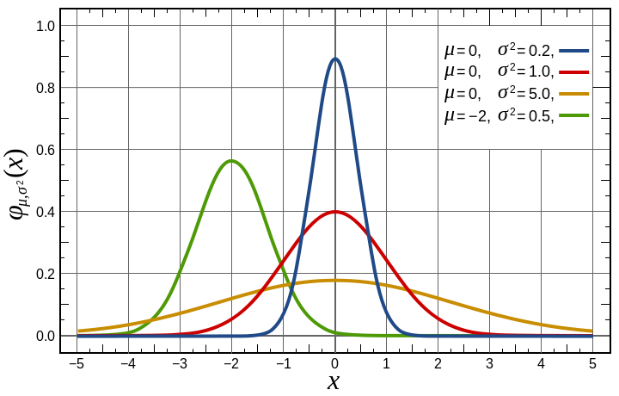
Gaussian distribution
Gaussian distribution

