Slide 1
Pairwise Sequence Alignment
BMI/CS 576
www.biostat.wisc.edu/bmi576
Irene Ong
irene.ong@wisc.edu
Fall 2017

Slide 2
Overview
What does it mean to align sequences?
How do we cast sequence alignment as a computational problem?
What algorithms exist for solving this computational problem?

Slide 3
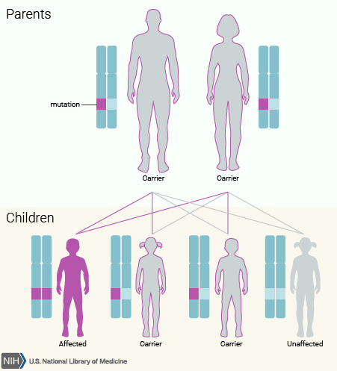
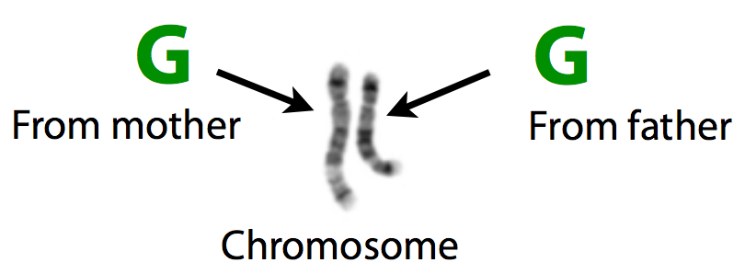
Genotype and Phenotype
Genotype is all the inherited information
Phenotype is something we observe: eye color
Mother
ACCTCTATTCA
ACGTCTGTCCA
Father
A
G
A and G are alleles, the
variable site is in a gene
A
G
AA
AG
AG
GG

Slide 4
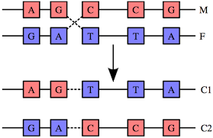
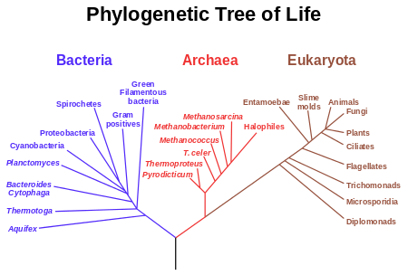
Evolution: select these genotypes
Organisms reproduce, offspring inherit genotype
Random mutation changes genotype and recombination shuffles chunks of genotypes in new combination
Natural selection favors phenotypes that reproduce more
Over time, produces diversity of life on earth. Incredibly, all organisms share a common ancestor
http://en.wikipedia.org/wiki/Genetic_recombination
http://en.wikipedia.org/wiki/Evolutionary_tree
Slide courtesy of Ben Langmead

Slide 5
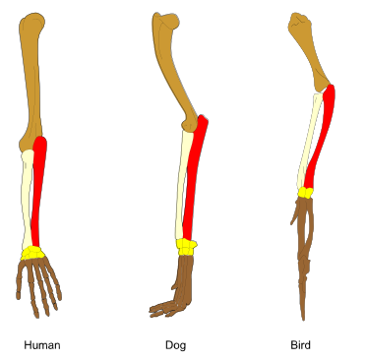
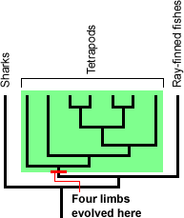
The Role of Homology
character: some feature of an organism (could be molecular, structural, behavioral, etc.)
homology: the relationship of two characters that have descended from a common ancestor
http://en.wikipedia.org/wiki/Homology_(biology)
http://evolution.berkeley.edu/evolibrary/article/evo_09

Slide 6
The Role of Homology
homologous characters tend to be similar due to their common ancestry and evolutionary pressures
thus we often infer homology from similarity
similarly we can sometimes infer structure/function from sequence similarity

Slide 7
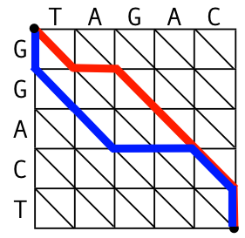

What is sequence alignment?
Pattern matching
...CATCGATGACTATCCG...
ATGACTGT
suffix trees, locality-sensitive hashing,...
.
.
.
CATGCATGCTGCGTAC
CATGGTTGCTCACAAGTAC
CATGCCTGCTGCGTAA
TACGTGCCTGACCTGCGTAC
CATGCCGAATGCTG
.
.
.
Database searching
CATGCTTGCTGGCGTAAA
BLAST
Optimization problem
Needleman-Wunsch, Smith-Waterman,...
Statistical problem
Pair HMMs, TKF, Karlin-Altschul statistic...

Slide 8
DNA sequence edits
Substitutions: ACGA AGGA
Insertions: ACGA ACCGGAGA
Deletions: ACGGAGA AGA
Transpositions: ACGGAGA AAGCGGA
Inversions: ACGGAGA ACTCCGA

Slide 9
Alignment scales
For proteins and short DNA sequences (gene scale) we will generally only consider
Substitutions: cause mismatches in alignments
Insertions/Deletions: cause gaps in alignments
For long DNA sequences (genome scale) we will consider additional events
Transposition
Inversion
In this course we will focus on the case of short sequences

Slide 10
What is a pairwise alignment?
We will focus on evolutionary alignment
matching of homologous positions in two sequences
positions with no homologous pair are matched with a space ‘-’
A group of consecutive spaces is a gap
CA--GATTCGAAT
CGCCGATT---AT
gap

Slide 11
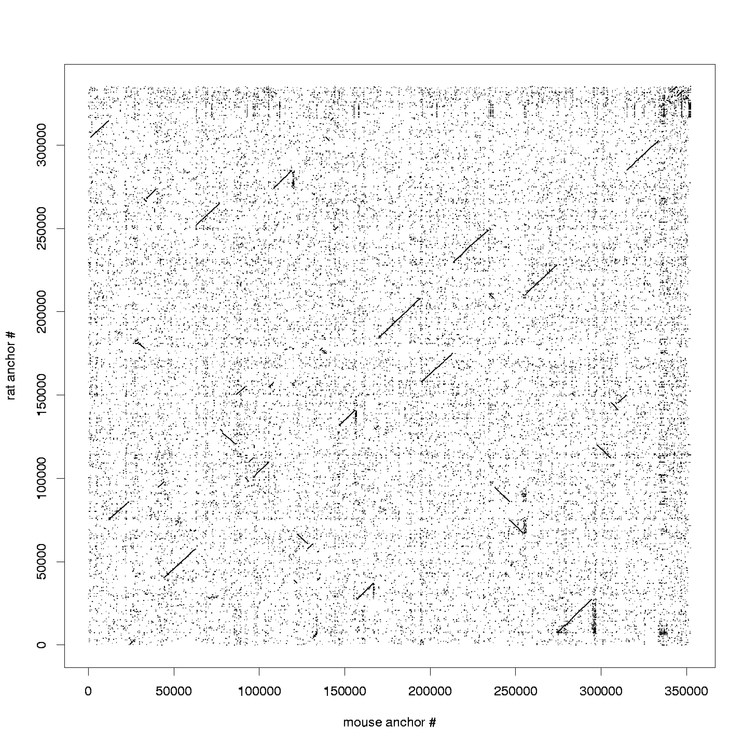
Dot plots
Not technically an “alignment”
But gives picture of correspondence between pairs of sequences
Dot represents similarity between segments of the two sequences

Slide 12
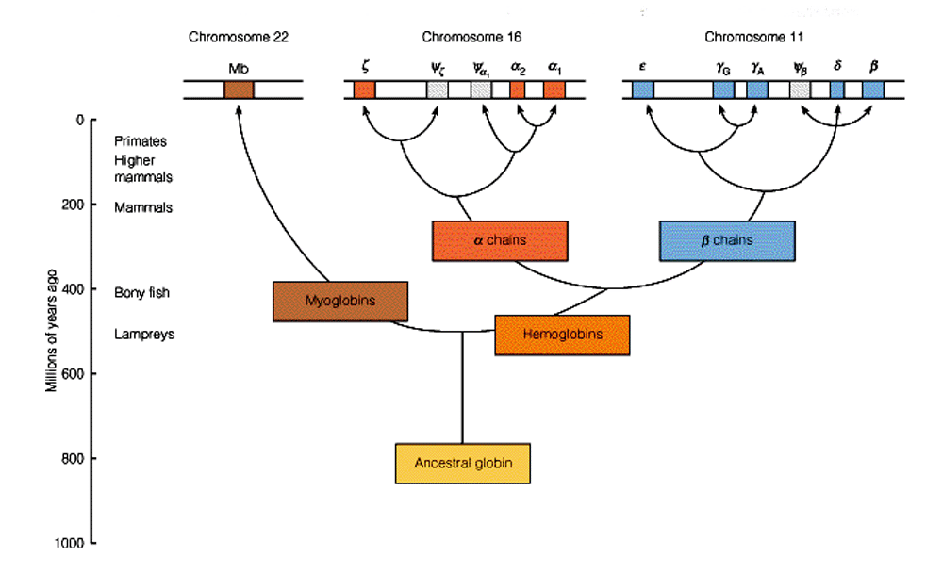
Homology Example: Evolution of the Globins

Slide 13
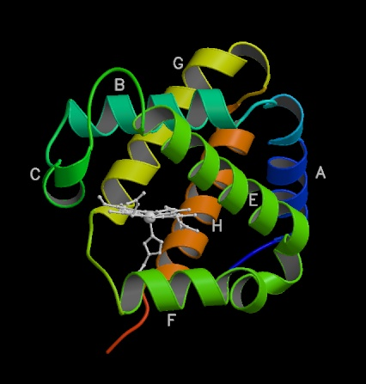
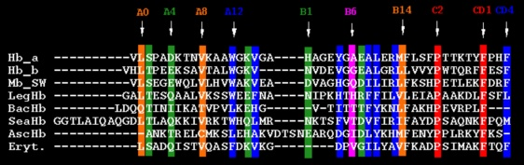
Example Alignment: Globins
figure at right shows prototypical structure of globins
figure below shows part of alignment for 8 globins (-’s indicate gaps)

Slide 14
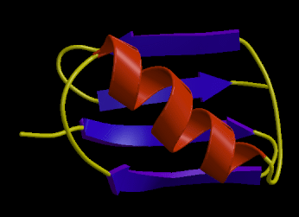
Insertions/Deletions and Protein Structure
Why is it that two “similar” sequences may have large insertions/deletions?
some insertions and deletions may not significantly affect the structure of a protein
loop structures: insertions/deletions
here not so significant

Slide 15
Issues in Sequence Alignment
the sequences we’re comparing probably differ in length
there may be only a relatively small region in the sequences that matches
we want to allow partial matches (i.e. some amino acid pairs are more substitutable than others)
variable length regions may have been inserted/deleted from the common ancestral sequence

Slide 16
Two main classes of pairwise alignment
Global: All positions are aligned
Local: A (contiguous) subset of positions are aligned
CA--GAGTCGAAT
CGCCGA-TC-A--
..GAGTC....
....GA-TC.

Slide 17
Pairwise Alignment: Task Definition
Given
a pair of sequences (DNA or protein)
a method for scoring a candidate alignment
Do
find an alignment for which the score is maximized

Slide 18
The Alignment Task
A T G T T A T A
A T C G T C C
Alignment Task (maximizing the number of points):
Remove the 1st symbol from each sequence
1 point if the symbols match, 0 points if they don’t match
Remove the 1st symbol from one of the sequences
0 points
Slides courtesy of Compeau and Pevzner

Slide 19
The Alignment Task
A T G T T A T A
A T C G T C C
+1
Slides courtesy of Compeau and Pevzner

Slide 20
The Alignment Task
A T G T T A T A
A T C G T C C
+1+1
Slides courtesy of Compeau and Pevzner

Slide 21
The Alignment Task
A T - G T T A T A
A T C G T C C
+1+1
Slides courtesy of Compeau and Pevzner

Slide 22
The Alignment Task
A T - G T T A T A
A T C G T C C
+1+1 +1
Slides courtesy of Compeau and Pevzner

Slide 23
The Alignment Task
A T - G T T A T A
A T C G T C C
+1+1 +1+1
Slides courtesy of Compeau and Pevzner

Slide 24
The Alignment Task
A T - G T T A T A
A T C G T - C C
+1+1 +1+1
Slides courtesy of Compeau and Pevzner

Slide 25
The Alignment Task
A T - G T T A T A
A T C G T - C C
+1+1 +1+1
Slides courtesy of Compeau and Pevzner

Slide 26
The Alignment Task
A T - G T T A T A
A T C G T - C - C
+1+1 +1+1
Slides courtesy of Compeau and Pevzner

Slide 27
The Alignment Task
A T - G T T A T A
A T C G T - C - C
+1+1 +1+1 =4
Slides courtesy of Compeau and Pevzner

Slide 28
What Is the Sequence Alignment?
matches insertions deletions mismatches
A T - G T T A T A
A T C G T - C - C
+1+1 +1+1 =4
Alignment of two sequences is a two-row matrix:
1st row: symbols of the 1st sequence (in order) interspersed by “-”
2nd row: symbols of the 2nd sequence (in order) interspersed by “-”
Slides courtesy of Compeau and Pevzner

Slide 29
Longest Common Subsequence
A T - G T T A T A
A T C G T - C - C
Matches in alignment of two sequences (ATGT) form their
Common Subsequence
Longest Common Subsequence Problem: Find a longest common subsequence of two strings.
Input: Two strings.
Output: A longest common subsequence of these strings.
Slides courtesy of Compeau and Pevzner

Slide 30
Scoring An Alignment: What Is Needed?
substitution matrix
S(a,b) indicates score of aligning character a with character b
gap penalty function
w(k) indicates cost of a gap of length k

Slide 31
Linear Gap Penalty Function
different gap penalty functions require somewhat different algorithms
the simplest case is when a linear gap function is used
where s is a constant and w(k) is cost of gap of length k
we'll start by considering this case

Slide 32
Scoring an Alignment
the score of an alignment is the sum of the scores for pairs of aligned characters plus the scores for gaps
example: given the following alignment
VAHV---D--DMPNALSALSDLHAHKL
AIQLQVTGVVVTDATLKNLGSVHVSKG
we would score it by
S(V,A) + S(A,I) + S(H,Q) + S(V,L) + 3s + S(D,G) + 2s …

Slide 33
The Space of Global Alignments
some possible global alignments for ELV and VIS
ELV
VIS
-ELV
VIS-
--ELV
VIS--
ELV-
-VIS
E-LV
VIS-
ELV--
--VIS
EL-V
-VIS

Slide 34
Number of Possible Alignments
given sequences of length m and n
assume we don’t count as distinct and
we can have as few as 0 and as many as min{m, n} aligned pairs
therefore the number of possible alignments is given by
C-
-G
-C
G-

Slide 35
Number of Possible Alignments
there are
possible global alignments for 2 sequences of length n
e.g. two sequences of length 100 have possible alignments
but we can use dynamic programming to find an optimal alignment efficiently

Slide 36
Dynamic Programming
Algorithmic technique for optimization problems that have two properties:
Optimal substructure: Optimal solution can be computed from optimal solutions to subproblems
Overlapping subproblems: Subproblems overlap such that the total number of distinct subproblems to be solved is relatively small

Slide 37

Dynamic Programming
Break problem into overlapping subproblems
use memoization: remember solutions to subproblems that we have already seen
3
5
7
1
8
2
4
6

Slide 38
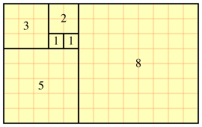
Fibonacci example
1,1,2,3,5,8,13,21,...
fib(n) = fib(n - 2) + fib(n - 1)
Could implement as a simple recursive function
However, complexity of simple recursive function is exponential in n

Slide 39
Fibonacci execution stack
fib(6)
fib(5)
fib(4)
fib(4)
fib(3)
fib(3)
fib(2)
fib(3)
fib(2)
fib(2)
fib(1)
fib(2)
fib(1)
fib(1)
fib(1)
fib(2)
fib(1)
fib(1)
fib(1)
fib(1)
fib(1)
fib(1)
fib(1)
fib(1)
fib(1)

Slide 40
Fibonacci dynamic programming
Two approaches
Memoization: Store results from previous calls of function in a table (top down approach)
Solve subproblems from smallest to largest, storing results in table (bottom up approach)
Both require evaluating all (n-1) subproblems only once: O(n)

Slide 41
Dynamic Programming Graphs
Dynamic programming algorithms can be represented by a directed acyclic graph
Each subproblem is a vertex
Direct dependencies between subproblems are edges
1
2
3
4
5
6
graph for fib(6)

Slide 42
Fibonacci DP
Memoization (top-down approach)
Solve subproblems from smallest to largest (bottom-up approach)
fib_dict = {}
def fib(n):
if n is fib_dict:
return fib_dict[n]
else:
fib_dict[n] = n if n < 3 else fib(n-2) + fib(n-1)
return fib_dict[n]
def fib(n):
a = [1,1,1] // a[0]=a[1]=a[2]=1
for i in range (3,n):
a[i] = a [i-2] + a[i-1]
return a[n]

Slide 43
Why “Dynamic Programming”?
Coined by Richard Bellman in 1950 while working at RAND
Government officials were overseeing RAND, disliked research and mathematics
“programming”: planning, decision making (optimization)
“dynamic”: multistage, time varying
“It was something not even a Congressman could object to. So I used it as an umbrella for my activities”

Slide 44
Pairwise Alignment Via Dynamic Programming
first algorithm by Needleman & Wunsch, Journal of Molecular Biology, 1970
dynamic programming algorithm: determine best alignment of two sequences by determining best alignment of all prefixes of the sequences

Slide 45
Dynamic Programming Idea
consider last step in computing alignment of AAAC with AGC
three possible options; in each we’ll choose a different pairing for end of alignment, and add this to the best alignment of previous characters
AAA
C
AAAC
-
AG
C
AG
C
AAA
C
consider best
alignment of
these prefixes
score of
aligning
this pair
+
AGC
-

Slide 46
DP Algorithm for Global Alignment with Linear Gap Penalty
Subproblem: F(i,j) = score of best alignment of the length i prefix of x and the length j prefix of y.
Match x_{i} with y_{j}
Insertion in x
Insertion in y

Slide 47
Dynamic Programming Implementation
given an n-character sequence x, and an m-character sequence y
construct an (n+1) × (m+1) matrix F
F ( i, j ) = score of the best alignment of
x[1…i ] with y[1…j ]
A
G
C
A
A
A
score of best alignment of
AAA to AG
C

Slide 48
Initializing Matrix: Global Alignment with Linear Gap Penalty
A
G
C
0
s
2s
3s
s = gap penalty
k = length of gap
Initialize matrix:
F(0,0) = 0
F(i,0) = sk
F(0,j) = sk
A
s
A
2s
A
3s
C
4s

Slide 49
DP Algorithm Sketch: Global Alignment
initialize first row and column of matrix
fill in rest of matrix from top to bottom, left to right
for each F ( i, j ), save pointer(s) to cell(s) that resulted in best score
F (m, n) holds the optimal alignment score; trace pointers back from F (m, n) to F (0, 0) to recover alignment

Slide 50
Global Alignment Example
suppose we choose the following scoring scheme:
+1
-1
s (penalty for aligning with a space) = -2

Slide 51
Global Alignment Example
A
G
C
0
-2
-4
-6
A
one optimal alignment
-2
1
-1
-3
A
x:
A
A
A
C
y:
A
G
-
C
-4
-1
0
-2
A
but there are three optimal alignments here (can you find them?)
-6
-3
-2
-1
C
-8
-5
-4
-1

Slide 52
DP Comments
works for either DNA or protein sequences, although the substitution matrices used differ
finds an optimal alignment
the exact algorithm (and computational complexity) depends on gap penalty function (we’ll come back to this issue)

Slide 53
Equally Optimal Alignments
many optimal alignments may exist for a given pair of sequences
can use preference ordering over paths when doing traceback
highroad
1
lowroad
3
2
2
3
1
highroad and lowroad alignments show the two most different optimal alignments

Slide 54
Highroad & Lowroad Alignments
A
G
C
highroad alignment
0
-2
-4
-6
A
x:
A
A
A
C
y:
A
G
-
C
-2
1
-1
-3
A
-4
-1
0
-2
lowroad alignment
A
x:
A
A
A
C
-6
-3
-2
-1
y:
-
A
G
C
C
-8
-5
-4
-1

Slide 55
Dynamic Programming Analysis
recall, there are
possible global alignments for 2 sequences of length n
but the DP approach finds an optimal alignment efficiently

Slide 56
Computational Complexity
initialization: O(m), O(n) where sequence lengths are m, n
filling in rest of matrix: O(mn)
traceback: O(m + n)
hence, if sequences have nearly same length, the computational complexity is

Slide 57
Local Alignment
so far we have discussed global alignment, where we are looking for the best matching between sequences from one end to the other
often, we will only want a local alignment, the best match between contiguous subsequences (substrings) of x and y

Slide 58
Local Alignment Motivation
useful for comparing protein sequences that share a common motif (conserved pattern) or domain (independently folded unit) but differ elsewhere
useful for comparing DNA sequences that share a similar motif but differ elsewhere
useful for comparing protein sequences against genomic DNA sequences (long stretches of uncharacterized sequence)
more sensitive when comparing highly diverged sequences

Slide 59
Local Alignment DP Algorithm
original formulation: Smith & Waterman, Journal of Molecular Biology, 1981
interpretation of array values is somewhat different
F (i, j) = score of the best alignment of a suffix of x[1…i ] and a suffix of y[1…j ]

Slide 60
Local Alignment DP Algorithm
the recurrence relation is slightly different than for global algorithm

Slide 61
Local Alignment DP Algorithm
initialization: first row and first column initialized with 0’s
traceback:
find maximum value of F(i, j); can be anywhere in matrix
stop when we get to a cell with value 0

Slide 62
Local Alignment Example
A
A
G
A
0
0
0
0
0
T
0
0
0
0
0
T
0
0
0
0
0
A
0
1
1
0
1
A
0
1
2
0
1
G
0
0
0
3
1
Match: +1
Mismatch: -1
Space: -2
x:
A
A
G
y:
A
A
G

Slide 63
More On Gap Penalty Functions
a gap of length k is more probable than k gaps of length 1
a gap may be due to a single mutational event that inserted/deleted a stretch of characters
separated gaps are probably due to distinct mutational events
a linear gap penalty function treats these cases the same
it is more common to use gap penalty functions involving two terms
a penalty g associated with opening a gap
a smaller penalty s for extending the gap

Slide 64
Gap Penalty Functions
linear
affine

Slide 65
Dynamic Programming for the Affine Gap Penalty Case
to do in time, need 3 matrices instead of 1
best score given that x[i] is
aligned to y[j]
best score given that x[i] is
aligned to a gap
best score given that y[j] is
aligned to a gap

Slide 66
Why Three Matrices Are Needed
consider aligning the sequences WFP and FW using g = -4, s = -1 and the following values from the BLOSUM-62 substitution matrix:
S(F, W) = 1 S(W, W) = 11
S(F, F) = 6 S(W, P) = -4
S(F, P) = -4
the matrix shows the highest-scoring partial alignment for each pair of prefixes
W
F
P
0
-5
-6
-7
F
-5
1
1
-4
-WFP
FW--
W
optimal alignment
-6
6
2
0
WF
FW
best alignment of these prefixes;
to get optimal alignment,
need to also consider
-WF WF-
FW- -FW

Slide 67
Relationship of three states for affine gap alignment
s
I_{x}
(+1,+0)
s(x_{i,}y_{j})
g
M
(+1,+1)
g
s(x_{i,}y_{j})
I_{y}
(+0,+1)
s(x_{i,}y_{j})
s

Slide 68
Global Alignment DP for the Affine Gap Penalty Case
Match x_{i} with y_{j}
Insertion in x
Insertion in y
Open gap in x
Extend gap in x
Open gap in y
Extend gap in y

Slide 69
Global Alignment DP for the Affine Gap Penalty Case
initialization
traceback
start at largest of
stop at any of
note that pointers may traverse all three matrices

Slide 70
Global Alignment Example (Affine Gap Penalty)
Match: +1
Mismatch: -1
g = -3, s = -1
A
C
A
C
T
M : 0
-∞
-∞
-∞
-∞
-∞
I_{x} : -3
-∞
-∞
-∞
-∞
-∞
I_{y} : -3
-4
-5
-6
-7
-8
A
-∞
1
-5
-4
-7
-8
-4
-∞
-∞
-∞
-∞
-∞
-∞
-∞
-3
-4
-5
-6
A
-∞
-3
0
-2
-5
-6
-5
-3
-9
-8
-11
-12
-∞
-∞
-7
-4
-5
-6
T
-∞
-6
-4
-1
-3
-4
-6
-4
-4
-6
-9
-10
-∞
-∞
-10
-8
-5
-6

Slide 71
Global Alignment Example (Continued)
A
C
A
C
T
M : 0
-∞
-∞
-∞
-∞
-∞
I_{x} : -3
-∞
-∞
-∞
-∞
-∞
I_{y} : -3
-4
-5
-6
-7
-8
A
-∞
1
-5
-4
-7
-8
-4
-∞
-∞
-∞
-∞
-∞
A
-∞
-∞
-3
-4
-5
-6
-∞
-3
0
-2
-5
-6
-5
-3
-9
-8
-11
-12
-∞
-∞
-7
-4
-5
-6
T
-∞
-6
-4
-1
-3
-4
-6
-4
-4
-6
-9
-10
-∞
-∞
-10
-8
-5
-6
ACACT
AA--T
ACACT
A--AT
ACACT
--AAT
three optimal alignments:

Slide 72
Local Alignment DP for the Affine Gap Penalty Case

Slide 73
Local Alignment DP for the Affine Gap Penalty Case
initialization
traceback
start at largest
stop at

Slide 74
Gap Penalty Functions
linear:
affine:
concave: a function for which the following holds for all k, l, m ≥ 0
e.g.

Slide 75
Concave Gap Penalty Functions
8
7
6
5
4
3
2
1
0
1
2
3
4
5
6
7
8
9
10

Slide 76
Computational Complexity and Gap Penalty Functions
linear: w(k) = sk
affine: w(k) = g + sk, where s<g
concave: ΔW(k) ≥ ΔW(k+1) for all k ≥ 1, where ΔW(k) = W(k+1) - W(k)
general:
∗ assuming two sequences of length n

Slide 77
Alignment (Global) with General Gap Penalty Function
consider every previous
element in the row
consider every previous
element in the column

