Slide 1
Merck Challenge - Final Review
Mayank Shah, Sparsh Jain

Slide 2
Libraries Used
Numpy , pandas, matplotlib
from keras.utils import to_categorical
from keras.datasets import mnist
from keras.layers import Conv2D, MaxPooling2D, Dense, Flatten, Dropout, MaxPool2D
from keras.models import Model, Sequential
from keras.optimizers import Adam
from keras.callbacks import TensorBoard
from sklearn.metrics import accuracy_score

Slide 3
Interpretability libraries:
from tf_keras_vis.saliency import Saliency
from tf_keras_vis.utils import normalize
from tf_keras_vis.gradcam import Gradcam
from tf_keras_vis.gradcam_plus_plus import GradcamPlusPlus
from tf_keras_vis.scorecam import Scorecam
Link to tf-keras-vis documentation: https://keisen.github.io/tf-keras-vis-docs/

Slide 4

Preprocessing
We have 60K training data and 10K testing data of MNIST.
Converted every images to size 28 x 28 x 1. We kept channel 1 for every images as we are considering it to be in grayscale format.
Normalized every pixel value in the images for better predictions.
Converted target variables into categorical data.
Used one-hot encoding to convert the numerical classes to categorical data
Splitted training dataset to 4:1 ratio for training and validation dataset.

Slide 5
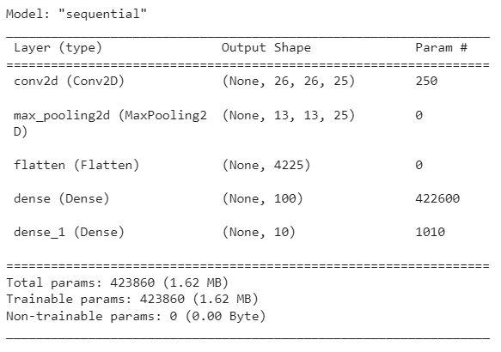
CNN Model
Epochs = 10
Optimizer = Adam
Loss = Categorical Cross Entropy
Batch size = 128

Slide 6
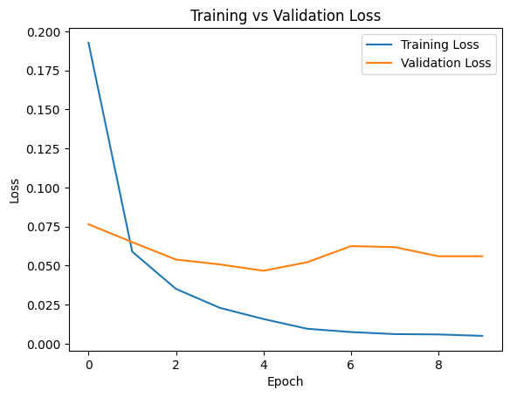
CNN Model
Training loss = 0.0051
Validation loss = 0.056
Validation accuracy = 0.985
Testing accuracy = 0.955

Slide 7
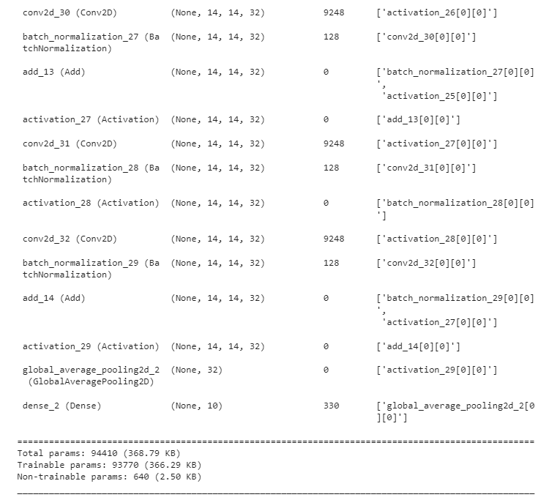
ResNet Model
Epochs = 10
Optimizer = Adam
Loss = Categorical Cross Entropy
Batch size = 128

Slide 8
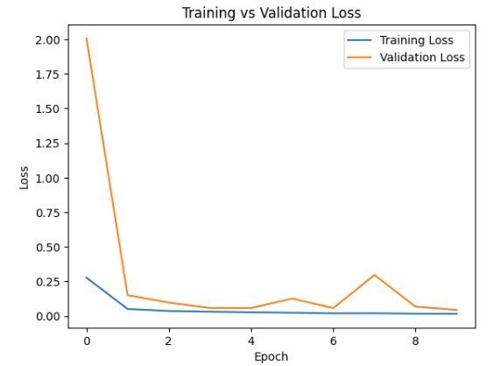
ResNet Model
Training loss : 0.0172
Validation loss : 0.0802
Validation accuracy : 0.9743
Testing Accuracy : 0.9871

Slide 9
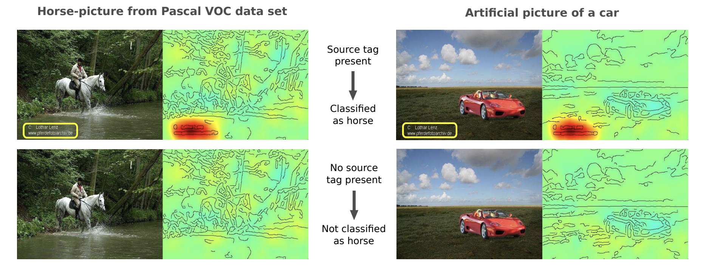
Why is interpretability so important?
a CNN learns to classify an image as a “horse” based on the presence of a lower left-hand corner source tag present in one-fifth of the horse images in the data set.
If this “horse source tag” is placed on an image of a car, then the network classifiers the image as “horse.”

Slide 10
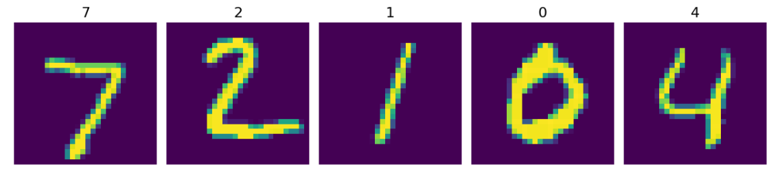
Original data points
First 5 correct model predictions which will be used to study the interpretability of the model

Slide 11
Important Functions/Modifications
First modification is to replace the softmax activation function in the last layer of the model to linear activation function.
This is done because softmax obstructs the generation of attention images/feature activation maps which is then taken care by the linear activation function.
The score which is generated after making these changes is used for creating heatmaps or saliency map.

Slide 12
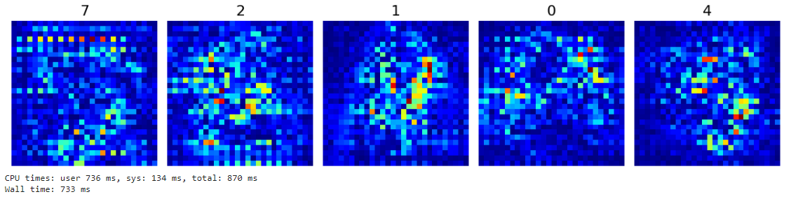
Saliency
We generate a saliency map that appears the regions of ​​the input image that contributes the most to the output value
A saliency map highlights the most relevant parts of an input, such as an image, for a machine learning model's prediction

Slide 13
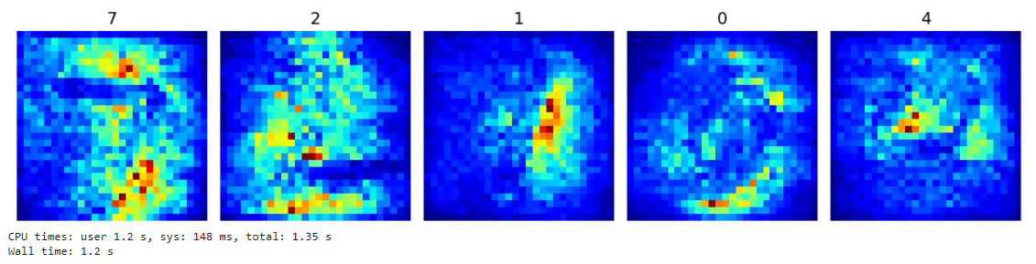
SmoothGrad
Saliency also known as Vanilla Saliency generates very noisy maps
SmoothGrad is a method that reduce the noise in saliency map by adding noise to input image
It calculates the gradient in a similar fashion as in saliency but it smoothens the high variations between pixels by penalizing them.

Slide 14
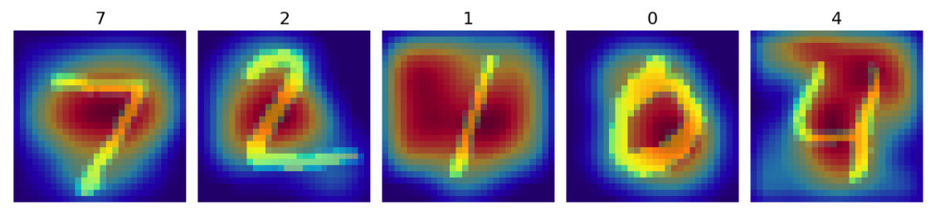
GradCAM
Just like Saliency, GradCAM is another way of visualizing attention over input
It works by using the gradients of a target class score with respect to the final convolutional layer to produce a heatmap highlighting important regions in an image for the model's prediction
GradCAM is useful method for intuitively knowing where the attention is focused within CNN, providing valuable insights for important regions contributing to network’s decision making process.

Slide 15
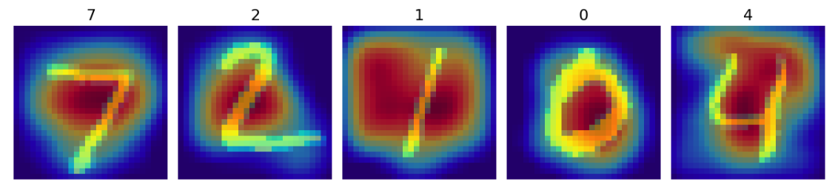
GradCAM++
GradCAM++ enhances GradCAM by incorporating the second-order gradients to better localize important regions in an image for a model's prediction.
It also includes normalization of the refined gradients to maintain consistent localization maps.

Slide 16
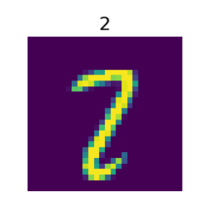
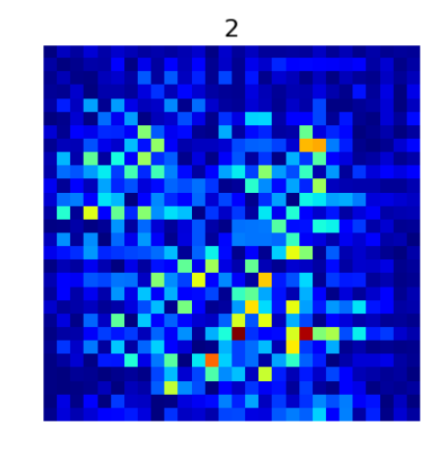
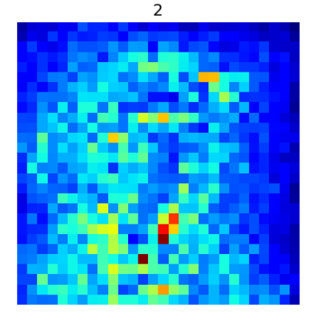
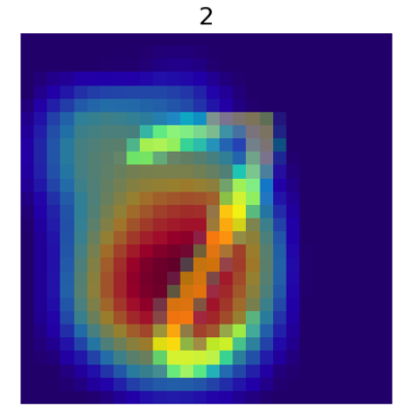
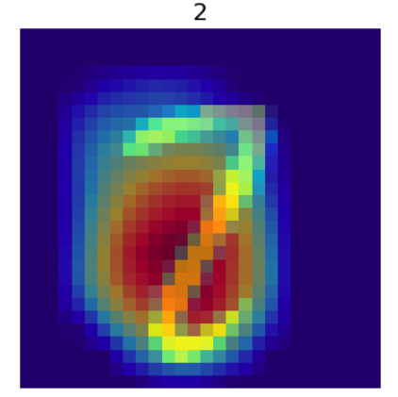
Wrong Predictions
Correct Label : 2
Predicted class: 7
ORIGINAL IMAGE
Saliency Map
Smooth Grading
GRAD CAM
GRAD CAM ++

Slide 17
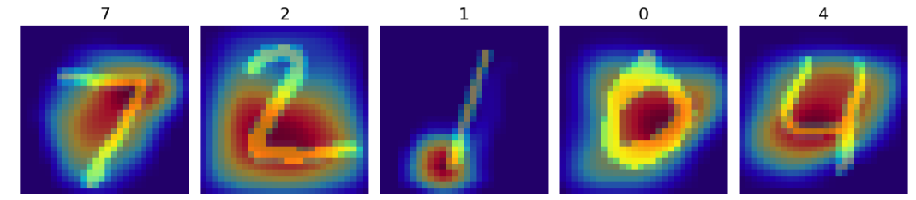
ScoreCAM
The characteristic of this method is that it’s the gradient-free method unlike GradCAM, GradCAM++ or Saliency.
It gets rid of the dependence on gradients by obtaining the weight of each activation map through its forward passing score on target class

Slide 18
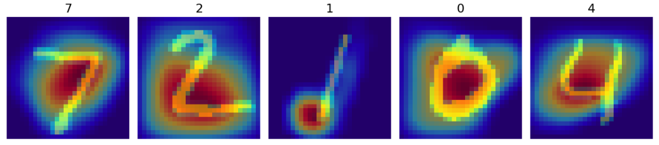
Faster ScoreCAM
ScoreCAM is a great method, however, it takes a bit more time to process it than other cam methods.
Faster-Score-CAM adds the processing of “use only channels with large variances as mask images” to Score-CAM.

Slide 19
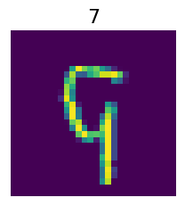
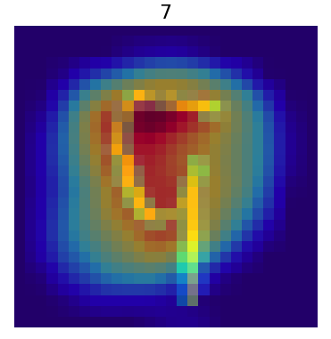
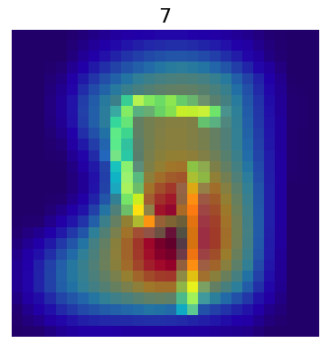
Wrong Predictions
Correct Label : 9
Predicted class: 7
ORIGINAL IMAGE
ScoreCAM
Faster ScoreCAM

Slide 20
Evaluation
For evaluation purposes, we have used IoU
IOU stands for Intersection over Union and is used to calculate the overlap between the prediction and the ground truth area
For this problem, we have considered the non-zero pixels in the image as the ground truth area
For this, we applied ReLU to the original image with a threshold of 0.4, converting image into binary

Slide 21
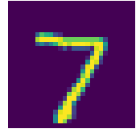
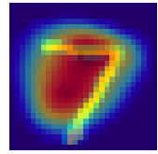
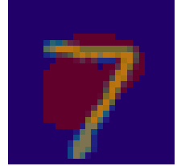
Next, for the heatmap image, we only considered the red channel as it indicates what the model actually used for prediction
We then converted all these pixels to 255 (with a threshold of 150) and multiplied element wise with the converted binary image to get the common region.
Later it was divided by the union of both red region and GTB.
Finally, we averaged the IoU score for the test set
Image with heatmap
Extracting red channel
Original Image

Slide 22
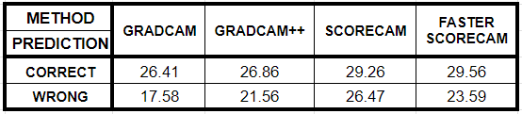
Results
Higher IoU scores for correct predictions suggest that, these visualization methods capture relevant information when the model predicts correctly.
Similarly, lower IoU scores for wrong predictions shows that these methods struggle to find relevant information when the model makes errors.

Slide 23
Conclusion
We implemented gradient-based and gradient-free visualization algorithms on our model and assessed our results and got a fair understanding of the interpretability of machine learning models
We can further generalize the evaluation metrics for multichannel images to have more comprehensive understanding of our model's performance across different types of data and help us refine our
interpretability assessments.

