Slide 1
Seminaris d’empresa 2017
Arnau Prat-Pérez
January 2016
Joan Guisado-Gámez

Slide 2
Sparksee
Sparksee = Graph Database developed by *Sparsity.
Definition
IS a high-performance and out-of-core graph database management system
FOR large scale labeled and attributed multigraphs
BASED ON vertical partitioning and collections of objects identifiers stored as bitmaps.

Slide 3
Let’s start
Let’s start!
— All exercises are within a Netbeans project.
Download it from Sparsity Technologies git
https://github.com/SparsityTechnologies/sparksee-handson
— Open the IDE and the project.
— Required data sets are stored into the “data” directory.
— Required libraries are stored into the “libs” directory.
— All exercises have a main method to be executed.
— All exercises are self-explained

Slide 4
Java API
Java API
— We are using Sparksee Java for the Training Session
— Java library is a public API
— Private native dynamic library is automatically loaded
— System requirements:
JVM: 5.0 or newer
Operative system: Windows, MacOSX, Linux (32 and 64 bits)
— Javadoc available at the same downloaded package /libs/sparskeejava-javadoc.jar

Slide 5
Installation
Installation
— Open your Netbeans Project.
— Make sure Sparksee library is correctly already linked at
Properties -> Libraries -> Compile
— Make sure Sparksee Javadoc is correctly already linked
— Otherwise, You should be able to see the sparkseejava.jar, select it and click on the Edit button.
— In the new window where it says Javadoc: write the path to the sparkseejava-javadoc.jar (available at /libs) or click Browse and select it.

Slide 6
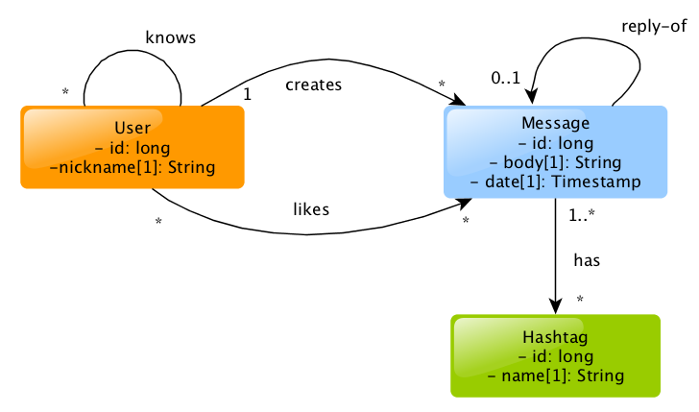
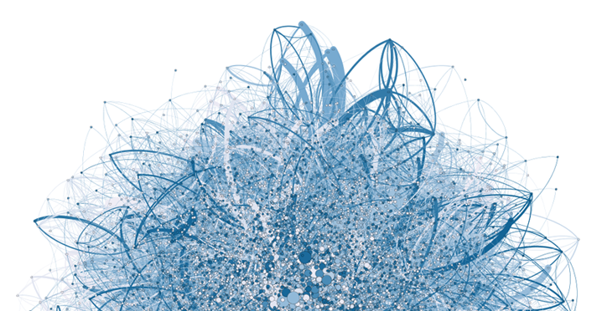
Twitter data model
Social Network data model

Slide 7

Sparksee Graph Example
1009
id:25 name: #soccer
 | Type name | Type id (int)
 | user | 10
 | message | 11
 | hashtag | 12
 | knows | 100
 | creates | 101
 | likes | 102
 | has | 103
 | user.id | 201
 | user.nick | 202
 | hashtah.id | 203
 | hashtag.name | 204
1008
1003
1004
1001
id:25 nick: Bob
1009
id:26 nick: Alice
1007
1002
1005
Operation | Result
findType(“user”) | int: 10
select(10) | Objects: {1001L,1002L}
neighbors(1012L,103,IN) | Objects: {1005L,1006L}
getAttribute(1001L,202) | Value: v
v.getString() | String: “Bob”
getAttribute(1011L,201) | ERROR
v.getString() | String: “Bob”
1006
1013
1010
1011
1012
id:255 name: #messi

Slide 8
WALK-THROUGH

Slide 9
Exercise 1
Exercice 1
Calculate Page Rank
It’s the PageRank of User A
It’s the damping factor
Number of users that i follows
For each follower of A

Slide 10
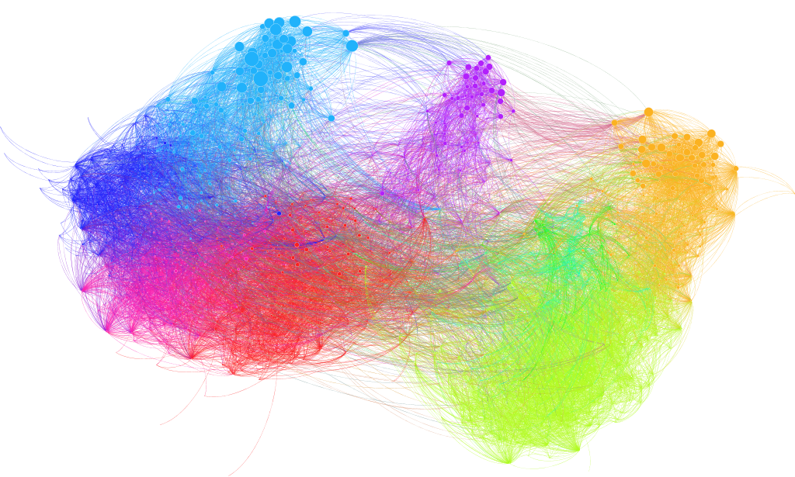
Exercise 2
Exercise 2
Finding communities by means of Label Propagation

Slide 11
Exercise 1
API Methods Used:
Manage Sparksee
create(String filename) → Database
close()
Manage Databases
newSession() → Session
close()
Manage Sessions
getGraph() → Graph
close()
Manage Graph – Create Schema
Create Types
newNodeType(String name) → int
newEdgeType(String name,
Boolean directed,
Boolean neighbros) → int
Create Attributes
newAttribute(int TypeID,
String name,
DataType type,
AttributeKind kind) → int
Manage Graph – Populate Database
New Objects
newNode(int nodeType) → long
newEdge(int edgeType,
long nodeId_1,
long nodeId_2) → long
Set attributes
setAttribute(long nodeId,
int attributeType,
Value v)
Manage Value
setString(String value)
setBoolean(Boolean value)
setInteger(Integer value)
setDouble(Double value)
setTimestamp(Timestamp value)
setLong(Long value)

Slide 12
Exercici 2
API Methods Used:
Manage Sparksee
open(String filename,
Boolean readOnly) → Database
close()
Manage Graph – Data
dumpData(String fileName)
export (String fileName,
ExportType type,
ExportManager export)
Export Manager
prepare(Graph graph)
getGraph(EdgeExport graphExport) → Boolean
getNodeType(int nodeType,
EdgeExport nodeExport) → Boolean
getEdgeType(int edgeType,
EdgeExport edgeExport) → Boolean
getNode(long nodeID,
EdgeExport nodeExport) → Boolean
getEdge(long edgeID,
EdgeExport edgeExport) → Boolean
enableType(int type) → Boolean
release()

Slide 13
API Methods used
Manage Graph – Access Data
select(int type) → Objects
select(int attributeType
Condition condition
Value value) → Objects
degree(long nodeId,
int edgeType,
EdgesDirection direction) → long
getValues(int attributeType) → Values
Values
Iterator(Order order) → ValuesIterator
close()

Slide 14

API Methods used
Manage Graph – Access Data
findType(String typeName) → int
findAttribute(int type,
String name) → int
findObject(int attributeType,
Value value) → long
neighbors(long nodeId,
int edgeType,
EdgesDirection dir) → Objects
getAttribute(long objectId,
int attributeId,
Value outValue)
intersection(Objects objectd) → int
Shortest Path
SinglePairShortestPathBFS(Session session,
long nodeId_1,
long nodeId_2)→ShortestPath
SinglePairShortestPathBFS(Session session,
long nodeId_1,
long nodeId_2)→ShortestPath
addEdgeType(int edgeType,
EdgesDirection direction)
addNodeType(int nodeType)
run ()
getCost() → double
Manage Objects
iterator() → ObjectesIterator
close()
Manage ObjectsIterator
hasNext()→Boolean
next() → long
close()

Slide 15




Thanks, Q&A
Thanks!
*Sparsity
Arnau Prat
arnau@sparsity-technologies.com
Joan Guisado
joan@sparsity-technologies.com
Sparsity-Technologies
@sparsitytech
Sparsity Technologies
Sparsity Technologies

