Slide 1
SAKHI

Slide 2

Team Members
19BAI1073- RITHEESHA PRIYA KOVUR 19BCE1083- N A PRASANNA VENKATESH
19BCE1263- RIYA RANI 19BCE1290- SABRINA MARSHAL
19BCE1327- KARTIKEY GAUTAM 19BCE1459- MEGHNA MANOJ NAIR
19BCE1564- S V S AKHIL RAMAN 19BCE1644- CHARU ANANT RAJPUT
19BCE1698- SAM METHUSELAH 19BCE1759- SABARI GIRISH S
19MIS1013- YAGANTI MOUNIKA SAI 19MIS1047- GENKUNTLA PRANITHA

Slide 3

Introduction
It is unsafe for women out there even though the law has become stricter in dealing with such felonies. What we, as a team, our trying to do is to make a product which will help the authorities ascertain the location of the victim and maybe stop the crime from happening or from getting worse. The motive is to let the people know how bad the security of women in the country is and to possibly help better this situation with our product.
Our product will be small in size, easy to carry and alerts the listed emergency contacts on the click of a button. Therefore, all the emergency contacts get an SMS of your location and thus it’s easy to reach the location on time. This will help alert the authorities and action will be taken before it is too late. The materials being used to create this device our cheap and thus it will be affordable.
Our device will automatically send an SMS, when triggered, which will be including the location(latitude and longitude) to the listed emergency contacts. The emergency contacts are provided by the user. Thus we will be able to alert the authorities before things could get worse

Slide 4

Outcome of the project
Regardless of the financial status, everyone will be able to buy this product and thus the user need not worry about their safety while travelling alone or through isolated areas. The authorities will be notified of the crime taking place and the location of the crime and therefore they will be able to take action quickly. The product is simple to use since it uses a knob mechanism and this also reduces the chance of accidental triggers which happens in case of smartphones. Hence, with this product, we will be able to ensure safety and security for women. The outcome of this project is also being able to raise awareness and bring attention to the safety issue women face everyday. It is also to bring to attention certain things which happen on a daily basis to women but have been normalized and thus are not spoken of.

Slide 5
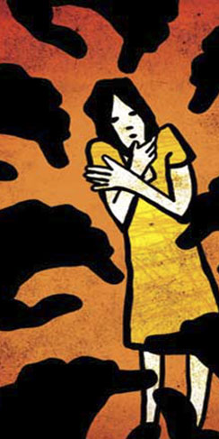
BACKGROUND OF THE BUSINESS
India ranks amongst the top 10 un-safest countries for women in the world.
Every 2 minutes, a crime against a woman takes place in the country while a rape takes place in every 15 minutes.
In certain states of the country, molestation of girls (especially underage girls) is so prominent that girls have started to believe that it is an extremely normal thing to do and hence don’t even try to report such cases.
It has become very difficult for the working class women to step out of the house without worrying about their safety and they have to be extra cautious near dark and isolated areas which thus leads them to take the long route to their work place or home. Also it becomes very difficult for the women who leave their place of work late at night. Thus we decided to work for the betterment of security for women in our country and to make people aware of the situation we are facing. This is what led us to make this product.

Slide 6

CUSTOMER’S PROFILE
The product will be majorly targeting the working class women from both rural and urban areas.
They are the ones who have to face a lot of problems due to the rise in women related crimes. It becomes really difficult for the women who have to work late and have to leave their work place at night. In case of rural areas, women mostly live far away from their workplaces and have to travel great distances to reach their place of work. There are a lot of isolated places in rural areas and this puts them at risk.
Other than the working class women, this product will also be helpful to teenagers in the urban areas. Late night parties and hanging out with friends during teenage have resulted in many unforeseen heinous crimes and our product will help the victims to avoid such situations.
Our product is available for everyone, however it will be major help to the working class women and the teenagers.

Slide 7
MARKETING AND SALES TEAM-
19BCE1083-N A PRASANNA VENKATESH
19BCE1759-SABARI GIRISH S
19BCE1327 KARTIKEY GAUTAM
19BCE1290 SABRINA MARSHAL
TECHNICAL TEAM-
MANAGEMENT AND OUTREACH-
19BCE1263 RIYA RANI
19BAI1073 RITHEESHA PRIYA KOVUR
19BCE1564 S V S AKHIL RAMAN
19BCE1698 SAM METHUSELAH
19BCE1459 MEGHNA MANOJ NAIR
19BCE1644 CHARU ANANT RAJPUT
19MIS1013 YAGANTI MOUNIKA SAI
19MIS1047 GENKUNTLA PRANITHA

Slide 8

Marketing
WHY US?-
Although in urban areas everyone owns a smartphone, in rural areas not everyone owns a smartphone and even if someone has a smartphone, he/she may not know how to operate the device other than calling and various necessary features. However our device is really easy to use
Taking out a smartphone to use an app is not possible in many situations and also apps like these may get triggered just lying inside your handbags and wallets. However, our device has a knob mechanism and will not get triggered unless intentional.
COMPETITION-
Apps like bSafe,Shake2Safety,Eyewatch SOS etc. which can be downloaded on your smartphones
The built in features in smartphones to send and SOS signal when triggered.
OBJECTIVE-
Our main objective is the security of women. We will begin with spreading awareness regarding the seriousness of the situation and market our product in rural areas in the beginning. When our market grows we will move to urban areas as well.

Slide 9
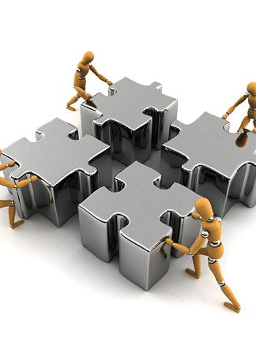
Execution
Marketing and Sales
Technology
Financing plan and Milestones

Slide 10
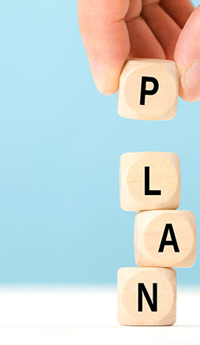
Marketing Plan
Proper marketing plan is required to reach out to our target audience and to spread awareness of the issue we intend to tackle.
Engaging With Our Customers Rather Than Just Selling
Social media is one of the best and easiest ways to engage with our target audience. It presents an opportunity for indirect marketing which is very effective.
Sharing or retweeting posts, commenting, getting involved in conversations helps show our interest in solving the issue and makes customers interested in our company.
Customers will notice us and, eventually, they will begin to trust our brand. Having a page in instagram and interacting with customers through surveys help interacting with customers and let us know what they actually want. Side by side it strengthens the bond with the customers. This strategy is mainly to be used in urban areas where social media is more prevalent.

Slide 11
Marketing Plan
Creating a Niche and Build Credibility-
In order to spread awareness of the issues, and to build our market in rural areas, we will organize awareness campaigns and will visit rural areas in person and educate the people about the ongoing situation and how are product will help them contact security. We will then be sharing our experiences through blogs, podcasts, webinars and YouTube videos. This will help us connect with our audience in the cities. Videos reach more audience, take less time to create, and are easy to understand.

Slide 12

Sales plan
After building a market, it is necessary to pitch our sale-
Free Samples And Giveaways
When introducing a new business, it can be hard to reach your target audience and engage them. However, no one can say no to free things. Therefore, giving away some of our products can be a good way to engage as the recipients will talk and spread the word about the product. The giveaways also bring unbiased product reviews, and we can get to know genuine pros and cons of our product. Free giveaways will be done during the awareness campaigns we will be doing in rural areas. It's also good to thank and reward your reviewers with little things that make them happy. It could be a small goodie bag or a discount coupon for our product. Such a gesture will make them feel good about our company and our product, and will prompt them to market the product through word of mouth.

Slide 13
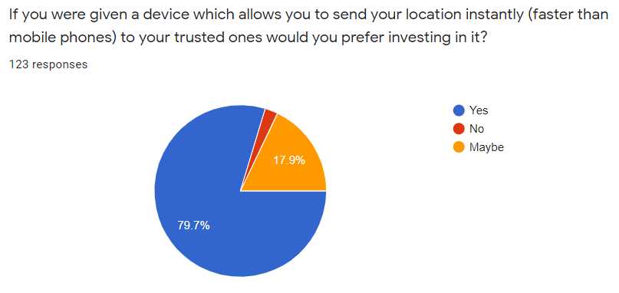
We also conducted a survey to understand what the audience thinks of our product and whether they will be interested in buying our product. We collected responses from 123 people and used the data to plot pie charts. Here are the results-

Slide 14
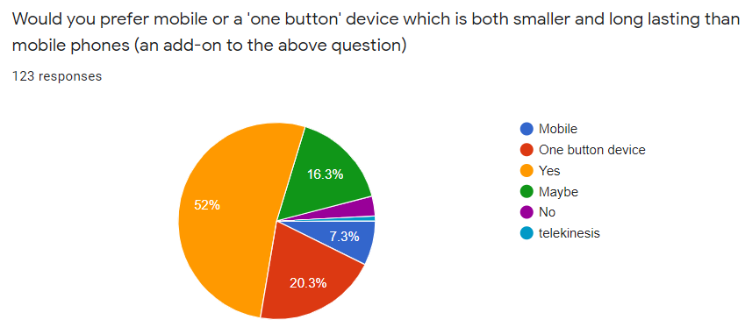

Slide 15
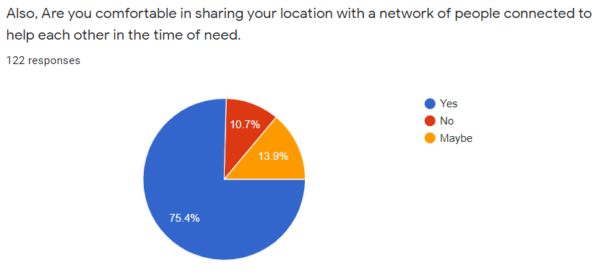

Slide 16
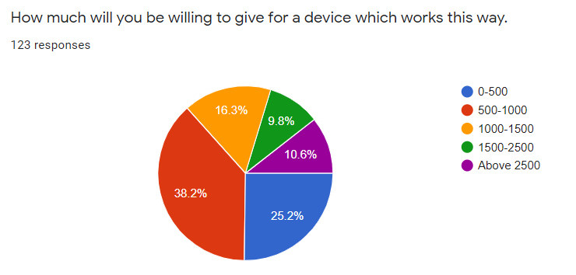
Like this we will be conducting surveys and through our marketing plan we will engage with our customers to come up with a price which will be suitable for our audience.

Slide 17

Technology
Devices used:
GSM plus GPS service
One button/ Knob design__ reduces the chance of false alarm
Separate device__ provide efficiency and reduce latency
Main components:
Arduino pro mini
Sim 800I
Ublox neo 6m
Raspberry pi 3 (for connection with server)

Slide 18

Key features of Product
Values __ location sent follows pattern
Coordinates of the person
Location
Date/Time
Button Design:
Knob is first pressed connects server via Arduino
Rotating knob halfway __ sends data
Knob after full rotation_ Real time Location

Slide 19
Under the hood
The device as a prototype uses Arduino pro mini, sim 800l, Ublox neo 6m as main components.
The button/knob when pressed signals Arduino which then sends location (lat/long) to the server.
Rotating the knob halfway sends accurate data continuously with gaps of 1 mins. and a full turn signifies Real Time Location.
The server after further evaluation and computing sends the values to nearby people's mobile phone as an alert high priority notification and it communicates the nearby police station automatically.
Message is then sent to the family members of the person and further steps comes into action
The device has Arduino pro mini as a micro controller which is continuously refreshed with data from G.P.S and G.S.M for accuracy and sends it whenever needed , the whole process works under a loop.
The server for the prototype is a raspberry pi 3 for now which does all the nearby calculations using web services.

Slide 20
Prototype SMS which will be sent
TO THE SERVER VIA DEVICE: *COORDINATES OF THE PERSON AS GIVEN BY GPS TRACKER* *LOCATION OF NEAREST COMMUNICATION TOWER AS PROVIDED BY SIM MODULE
*DATE/TIME GIVEN BY GPS TRACKER*
TO THE APPLICATION VIA SERVER : HELP!, A PERSON NEARBY NEEDS YOUR HELP
*COORDINATES OF THE PERSON * *LINKS PROVIDING LAT/LONG IN THE GOOGLE MAPS APPLICATION FOR EASE OF ACCESS * *DATE/TIME OF SENT MESSAGE*

Slide 21

Financing plan and milestones
Initially, our team will be investing on our own for the project.
We will be contacting NGOs which work on women security, like Guria India, ActionAid India, Majlis Manch, Sayodhya Home, Shikshan Ane Samaj Kalyan Kendra, International Foundation for Crime Prevention and Victim Care (PCVC)etc.
We will be explaining the potential of our product to such NGOs and will be helping them forward their message as well. This way, we will be able to gather a huge audience.
We will ask the NGOs to fund us so that more products can be manufactured and giveaways will be possible.
We will participate in awareness campaigns of the NGOs and our own, to further our product to the masses and we will also blog and upload videos to our YouTube channel to create more awareness and to further increase our audience.

Slide 22
Financing plan and milestones
We would first like to create an audience and after that we will be executing our sales plan.
We will further create an application for our product to make it more fool proof and tap a new market.
Once we are at a niche, we will be using a percentage of the money we are getting, to fund the NGOs and promote their cause.

Slide 23
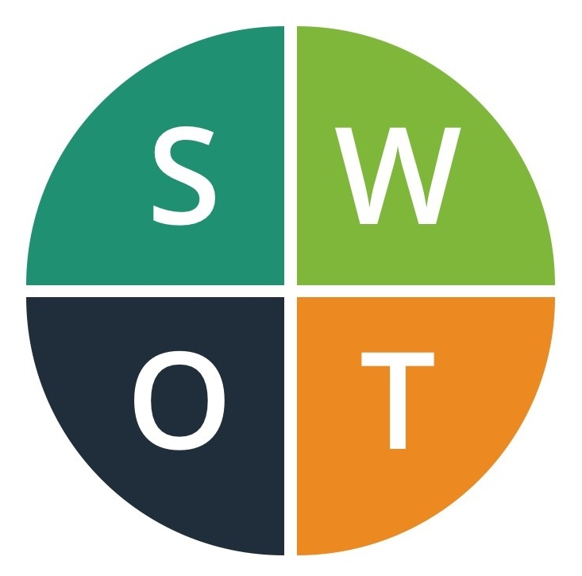
SWOT ANALYSIS
Strengths:
It becomes really difficult to access our smartphones in situations like assault, harassment, kidnappings etc. assuming we have it in the first place. Not everyone can afford a smartphone and hence this further decreases our chances of alerting someone.
This is where our device will come in handy. The materials being used to create this device our cheap and thus it will be affordable.
When a user twists the knob on our device, it will automatically send an SMS which will be including our location(latitude and longitude) to the listed emergency contacts. The emergency contacts are provided by the user.
Thus we will be able to alert the authorities before things could get worse.
It has a knob mechanism and thus reduces chances of false alarms.
Weaknesses:
It becomes difficult to send the SMS and notify the emergency contacts in areas with bad network reception.

Slide 24
SWOT ANALYSIS
Opportunity:
What we are trying to do is to promote a secure environment for women and to raise awareness regarding women safety. We will be approaching various NGOs focusing on women security, for funding and will be participating in the activities held by these NGOs to help promote their own causes. Other than that, this product can be used by all but our prime focus is security of women since they are more unsafe as compared to men. We will be making blogs and vlogs of the awareness campaigns we participate in to engage with our audience on social medias.
Active participation will ensure a strong and big base and will also ensure that our main purpose is served.
Threats:
Apps like bSafe, Shake2Safety, Eyewatch SOS etc. which can be downloaded on your smartphones.
The built in features in smartphones to send and SOS signal when triggered.

Slide 25


