Slide 1
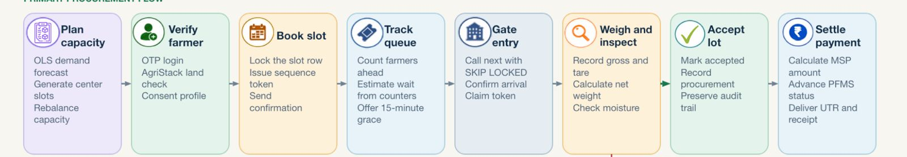
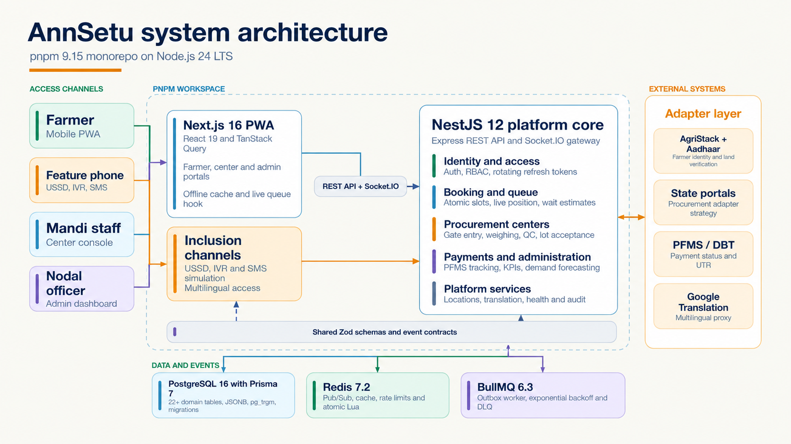
AnnSetu
TECHNICAL APPROACH
1. TECHNOLOGY STACK
2. SYSTEM FLOW | REGISTERED FARMER
3. IMPLEMENTATION METHODOLOGY
UI
Web experience
Next.js, React
TanStack Query
1
FARMER ACCESS
Login or assisted booking
Choose center and slot
Track by account, mobile or token
View queue, lot and payment
API
API and realtime
NestJS, REST
Socket.IO
ASSISTED PATH Center books by phone Track with mobile or token Cash settlement
SYSTEM ARCHITECTURE
DB
Data and jobs
2
CENTER OPERATIONS
PostgreSQL, Prisma
Redis, BullMQ
Plan slots and assist bookings
Call next, gate entry, weigh and inspect
Accept or reject the lot
DBT for registered, cash for assisted
Security
Identity demo
adapter
SEC
Next.js PWA
NestJS platform core
JWT, RBAC, Argon2
Zod, audit controls
React and TanStack Query
Inclusive access
PFMS payment
mock
IO
3
ADMIN AND GOVERNANCE
PWA, SMS, USSD
IVR and TTS simulation
Translation
fallback
Manage centers, MSP and commodities
Forecast demand and rebalance capacity
Review KPIs, audits and failed jobs
Handle consent withdrawal and erasure
CI
Delivery
pnpm monorepo
Docker Compose, CI
PostgreSQL + Prisma
Redis
BullMQ
Government and communication integrations use adapter-ready simulations in the SIH demo
Notes:
The system flow image represents the registered-farmer path. The added assisted path reflects the current code: center staff create the booking by phone, the farmer tracks by mobile or token without an account, and settlement is cash only because verified bank details were not collected.
The architecture image is embedded from the user-supplied PNG. Version labels are visually masked. Identity, PFMS and translation labels are qualified as demo adapters or fallbacks rather than live government integrations.
Evidence: docs/pitch_deck/FEATURE_VALIDATION_CURRENT_CODEBASE.md; apps/api/src/modules/booking/booking.controller.ts; apps/api/src/modules/queue/queue.service.ts; apps/api/src/modules/payments/payment-policy.ts; apps/web/src/screens/PublicBookingTracking.tsx; apps/web/src/screens/CenterDashboard.tsx.
Image sources: /Users/shubham/Downloads/AnnSetu System Architecture Flowchart.png; /Users/shubham/Downloads/WhatsApp Image 2026-09-15 at 13.29.58.jpeg.

