Slide 1
RDBMS
MySQL, PostgreSQL and SQL SERVER,

Slide 2
DBMS
Database Management System (DBMS) is a software that is used to define, create and maintain a database and provides controlled access to the data. Relational Database Management System (RDBMS) is an advanced version of a DBMS.

Slide 3
RDBMS
A relational database management system (RDBMS) is a collection of programs and capabilities that enable IT teams and others to create, update, administer and otherwise interact with a relational database.
RDBMS store data in the form of tables, with most commercial relational database management systems using Structured Query Language (SQL) to access the database. However, since SQL was invented after the initial development of the relational model, it is not necessary for RDBMS use.
The RDBMS is the most popular database system among organizations across the world. It provides a dependable method of storing and retrieving large amounts of data while offering a combination of system performance and ease of implementation.

Slide 4
DBMS vs RDBMS :
Number of allowed users. While a DBMS can only accept one user at a time, an RDBMS can operate with multiple users.
Hardware and software requirements. A DBMS needs less software and hardware than an RDBMS.
Amount of data. RDBMS can handle any amount of data, from small to large, while a DBMS can only manage small amounts.
Distributed databases. While an RDBMS offers complete support for distributed databases, a DBMS will not provide support.
Support of database normalization. An RDBMS can be normalized, but a DBMS cannot.

Slide 5
MySQL
MySQL est un système de gestion de bases de données relationnelles SQL open source développé et supporté par Oracle.
Une base de données n’est qu’une collection structurée de données qui est organisée pour en faciliter l’utilisation et la récupération. Pour un site WordPress, ces « données » sont des choses comme le texte de vos articles de blog, des informations pour tous les utilisateurs enregistrés sur votre site, des données chargées automatiquement, des configurations de paramètres importants, etc.
MySQL n’est qu’un système populaire qui peut stocker et gérer ces données pour vous, et c’est une solution de base de données particulièrement populaire pour les sites WordPress.

Slide 6
PostgreSQL
PostgreSQL is an advanced, enterprise-class, and open-source relational database system. PostgreSQL supports both SQL (relational) and JSON (non-relational) querying.
PostgreSQL is a highly stable database backed by more than 20 years of development by the open-source community.

Slide 7
MySQL vs PostgreSQL
PostgreSQL is an Object Relational Database Management System (ORDBMS) whereas MySQL is a community driven DBMS system.
PostgreSQL support modern applications feature like JSON, XML etc. while MySQL only supports JSON.
PostgreSQL performance well when executing complex queries whereas MySQL performs well in OLAP & OLTP systems.
PostgreSQL is complete ACID compliant while MySQL is only ACID compliant when used with InnoDB and NDB.
PostgreSQL supports Materialized Views whereas MySQL doesn’t supports Materialized Views.

Slide 8
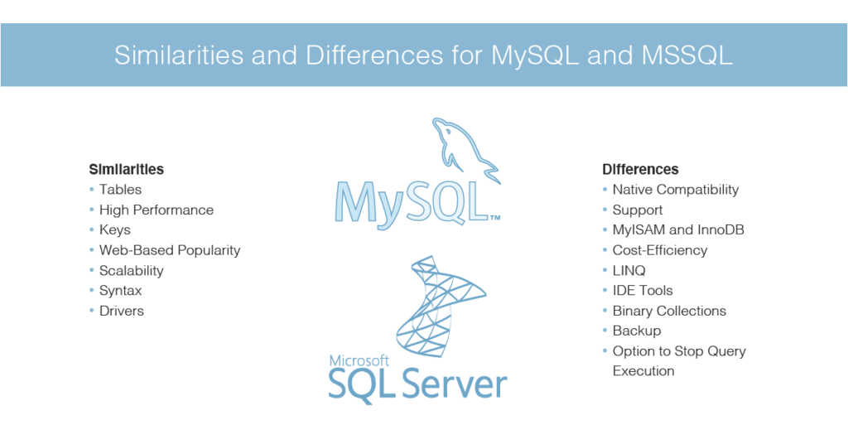
MySQL vs SQL SERVER

Slide 9
PostgreSQL vs MSSQL
PostgreSQL is an advanced object-relational database management system that uses Structured Query Language (SQL) in addition to its own procedural language, PL/pgSQL. PostgreSQL is easy-to-use with a full stack of RDBMS database features and capabilities for handling data. It can be easily installed on Linux environments.
SQL Server is a Relational Database Management System (RDBM) developed and operated by Microsoft. It uses a variant of Structured Query Language (SQL) called T-SQL (for Transact-SQL). It can run on Linux operating systems with Kubernetes support or on Windows. Users describe it as easy to use and reliable, with strong .NET compatibility.

