Slide 1
STOCK MARKET PREDICTION
by: Sumit Pathania

Slide 2
CONTENTS :
Overview
Why Python ?
Scikit-learn
My model
Future Scope

Slide 3
OVERVIEW:
In this project I have taken the 5 years all stocks dataset and isolated the top 100 data points of a single stock named AAL.
In order to predict the closing value of the stock I then figured out the co-relation between the opening and closing price of the stock.
Then I trained my model after splitting the training and test set into 75% and 25% respectively.
After training the model I tested it to find out its accuracy and also figured out the probability of error.

Slide 4
Why python:
Simple and Consistent: Python offers concise and readable code. While complex algorithms and versatile workflows stand behind machine learning and AI, Python’s simplicity allows developers to write reliable systems.
Libraries and Frameworks: To reduce development time, programmers turn to a number of Python frameworks and libraries. A software library is pre-written code that developers use to solve common programming tasks.
Platform Independence: Platform independence refers to a programming language or framework allowing developers to implement things on one machine and use them on another machine without any (or with only minimal) changes.

Slide 5
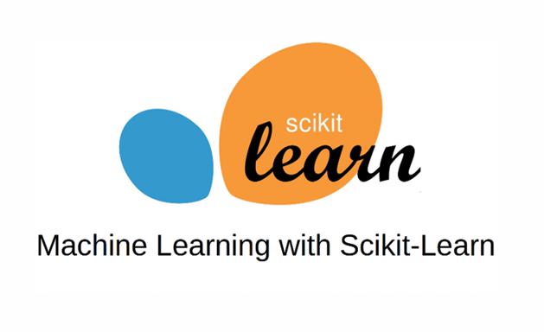
Scikit Learn:
Scikit-learn is a free software machine learning library for the Python programing Language.
It features various classification, regression and clustering algorithms including support-vector machines, random forests, gradient boosting, and is designed to interoperate with the Python numerical and scientific libraries NumPy and SciPy.
Scikit-learn is largely written in Python, and uses NumPy extensively for
high-performance linear algebra and array operations.

Slide 6
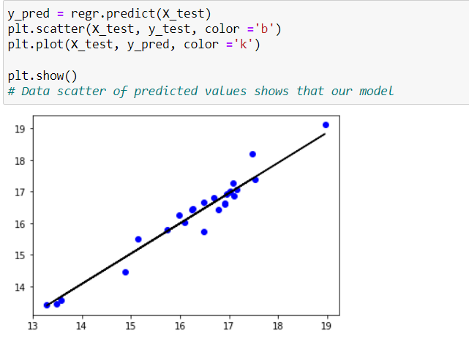
My Prediction model:
My prediction model uses scikit-learn library to implement linear
regression on opening and closing values of the stock and figure out
the relations between them.
After training the model, I tested it on the dataset and plotted a
graph with tested values to see how close were the values to the
actual values.

Slide 7
Future Scope:
The linear regression model is good, however it does not predict values with respect to time. For predicting stocks value accurately with taking in the time factor we need to use the keras library.
Keras is a high-level neural network library that wraps an API similar to scikit-learn around the Theano or TensorFlow backend.
With the help of Keras library we can Build a LSTM (long short-term memory) model.
Long Short-Term Memory (LSTM) networks are a type of recurrent neural network capable of learning order dependence in sequence prediction problems.

Slide 8


