Slide 1




Process-Guided Interpretable Machine Learning for Ecosystem Dynamics: Modeling Bio-geo-chemical Fluxes with Kolmogorov-Arnold Networks
Zhangyu Wang^{1,2}, Yanghui Kang³
¹ School of Computing and Information Science, University of Maine, Orono, ME, United States
² Center for Research on Sustainable Forests, University of Maine, Orono, ME, United States.
³ Department of Biological Systems Engineering, Virginia Tech, Blacksburg, VA, United States
Notes:
I am excited to talk about our work on incorporating CO2 fertilization effects in the global upscaling of eddy covariance photosynthesis measurements

Slide 2
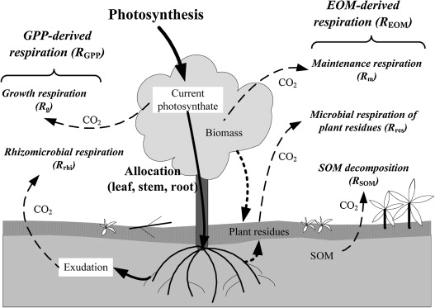
Modeling Ecosystem Respiration
Ecosystem Respiration (RECO) is the total release of CO₂ from an ecosystem, combining autotrophic respiration (plants) and heterotrophic respiration (microbes decomposing organic matter).

Slide 3
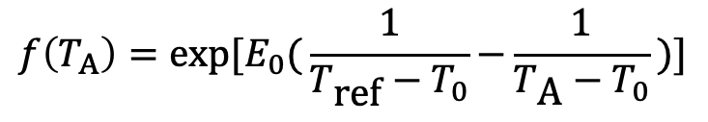


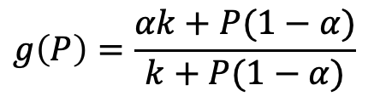
Process Model for Ecosystem Modelling
Migliavacca et al, 2011
Environmental variables
Temperature (proxied by air temperature T_{A})
Soil water availability (proxied by precipitation P and VPD)
Vegetation and productivity (proxied by GPP)
$$R_{\text{ECO}}=R_{\text{ref}} × f(T_{\text{A}}) × g(P)$$
$$R_{\text{ref}}=a_{0}+a_{1}× \text{SOC}\text{ + }a_{2}× \text{GPP}$$
$$f\left(T_{A}\right)=\text{exp}[E_{0}\text{(}\frac{1}{T_{\text{ref}}−T_{0}}\text{−}\frac{1}{T_{\text{A}}−T_{0}}\text{)]}$$
$$g\left(P\right)=\frac{αk+P(1−α)}{k+P(1−α)}$$

Slide 4
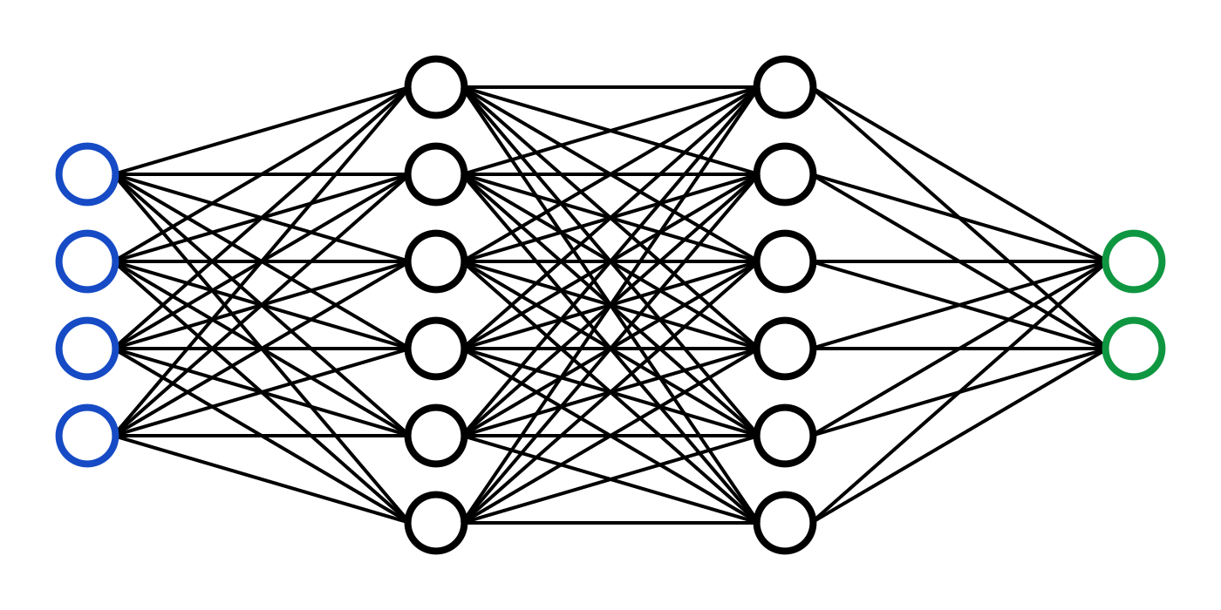



Neuro-Symbolic Approach
Symbolic
Neuro-Symbolic
$$R_{\text{ECO}}=R_{\text{ref}}(GPP) × f(T_{\text{A}}) × g(P)$$
$$R_{\text{ECO}}=R_{\text{ref}}(GPP) × f(T_{\text{A}}) × NN(P)$$
$$R_{\text{ref}}(GPP)=a_{0}+a_{1}× \text{SOC}\text{ + }a_{2}× \text{GPP}$$
$$f\left(T_{A}\right)=\text{exp}[E_{0}\text{(}\frac{1}{T_{\text{ref}}−T_{0}}\text{−}\frac{1}{T_{\text{A}}−T_{0}}\text{)]}$$
$$g\left(P\right)=\frac{αk+P(1−α)}{k+P(1−α)}$$
Neural Network

Slide 5
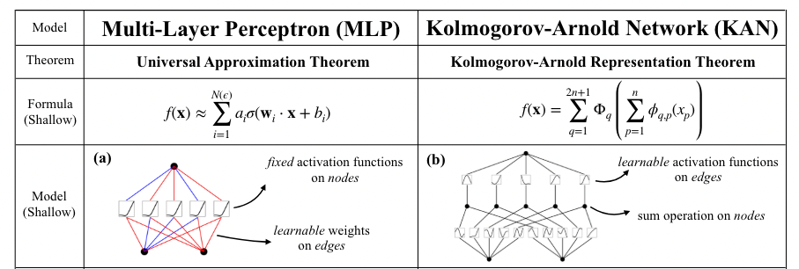
A Tale of Two Network Architectures

Slide 6
Kolmogorov-Arnold Network (KAN)
Multi-Layer Perceptron (MLP)
Dense variable interactions
Hard to analyze variable activations
Non-interpretable weights
Kolmogorov-Arnold Network (KAN)
Sparse variable interactions
Easy to visualize variable activations
Interpretable formulae (network topologies correspond to symbols)

Slide 7
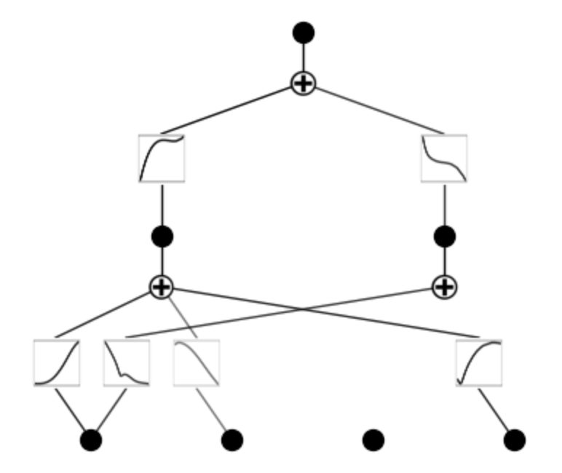
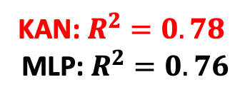

Experimental Results
$$\log{(\text{RECO}\text{)}}$$
Domain knowledge assistance
KAN: $R^{2}=0.78$
MLP: $R^{2}=0.76$
Dataset - Harvard Forest
Deciduous boradleaf forest
AmeriFlux code: US-xHA
Variables
TA: half-hourly air temperature
VPD: vapor pressure deficit
P: half-hourly precipitation
GPP: Gross Primary Productivity
Response
RECO: Ecosystem Respiration
Physically valid
response of GPP
TA
VPD
P
GPP
Automatic variable selection

Slide 8

Future Work: ECO-KAN
$$\log{(\text{RECO}\text{)}}$$
Eco-Native KAN
KAN is originally designed for physics
Expert-constructed pool of activation functions -- Not all activation functions are physically valid
Expert-constructed pool of network topologies – Not all variable interactions are physically valid
ECO-KAN: KAN for Ecosystem Dynamics Modelling
TA
VPD
P
GPP

Slide 9



Acknowledgment
Thank you!
zhangyu.wang@maine.edu
https://github.com/Spatial-Info-Telligence-Lab/KAN-EC
Collaborators: Yanghui Kang
Special Thanks: Aaron Weiskittel

