Slide 1


WESkit
GA4GH-compliant workflow execution
Sven Twardziok
Online training

Slide 2
Contents
Introduction to GA4GH-WES specification
Introduction to WESkit
Demo: deploying WESkit
Exercise: using WESkit
WESkit use cases
Summary

Slide 3
GA4GH - WES

Slide 4
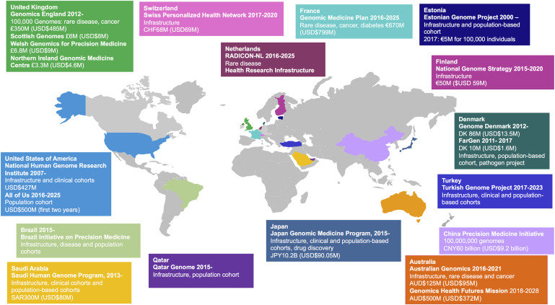
Workflows & Cloud Genomics in healthcare
Expected 60 millions of human genomes sequenced within global healthcare systems by 2025 - this will transform whole healthcare systems¹
National sequencing initiatives²
Challenges²:
Technical: infrastructure and bioinformatics capacity
Research: data integration and interpretation
Social: public acceptability, and ethical and legislative issues
¹ Genomics in healthcare: GA4GH looks to 2022 (2017) | bioRxiv.,
² Integrating Genomics into Healthcare: A Global Responsibility (2019) | AJHG

Slide 5





Genomics data in healthcare Features
Big: hundreds of gigabytes per patient
Sensitive: genetic data is specifically protected by GDPR
Structured: linked with many metadata such as clinical data
Decentralized: located in sequencing facilities, (university) hospitals, private laboratories
Genomics data
Metadata

Slide 6



Sharing human genomics data Use cases
1.) Compare single patients to other patients
2.) Study populations
3.) Analyze virtual cohorts

Slide 7
Science Cloud
Sending analysis workflows to data
Requirements for standardization
Organize a decentralized cloud infrastructure including a decentralized user access management.
Send and process workflows in the cloud.
Provide access to data and data discovery.
Define good data/workflow management.

Slide 8
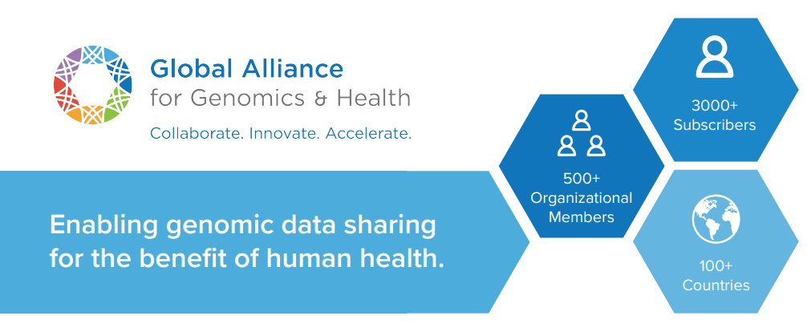
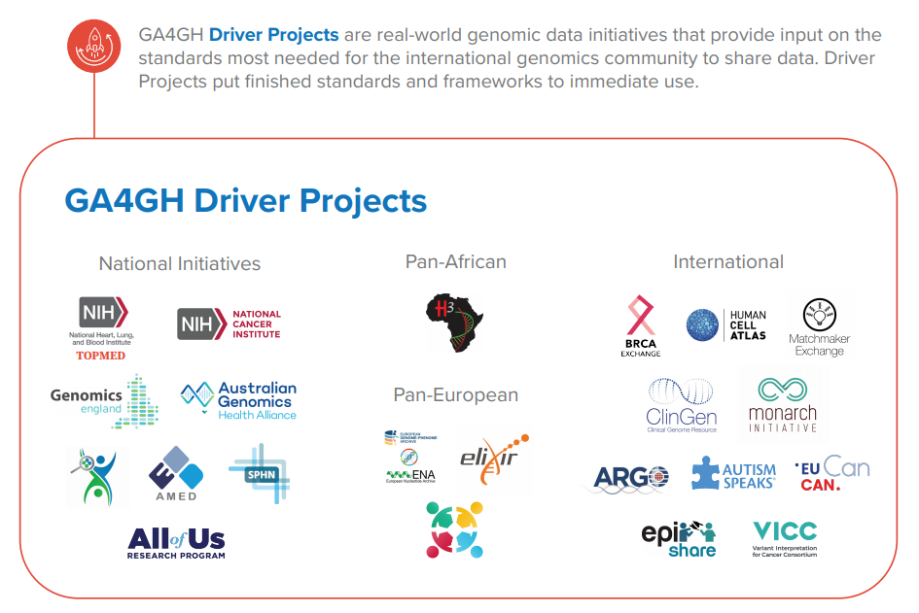
Global Alliance for Genomics & Health (GA4GH)
Mission
The Global Alliance for Genomics and Health aims to accelerate progress in genomic research and human health by cultivating a common framework of standards and harmonized approaches for effective and responsible genomic and health-related data sharing.
https://www.ga4gh.org/wp-content/uploads/GA4GH-onepager-v6.pdf

Slide 9
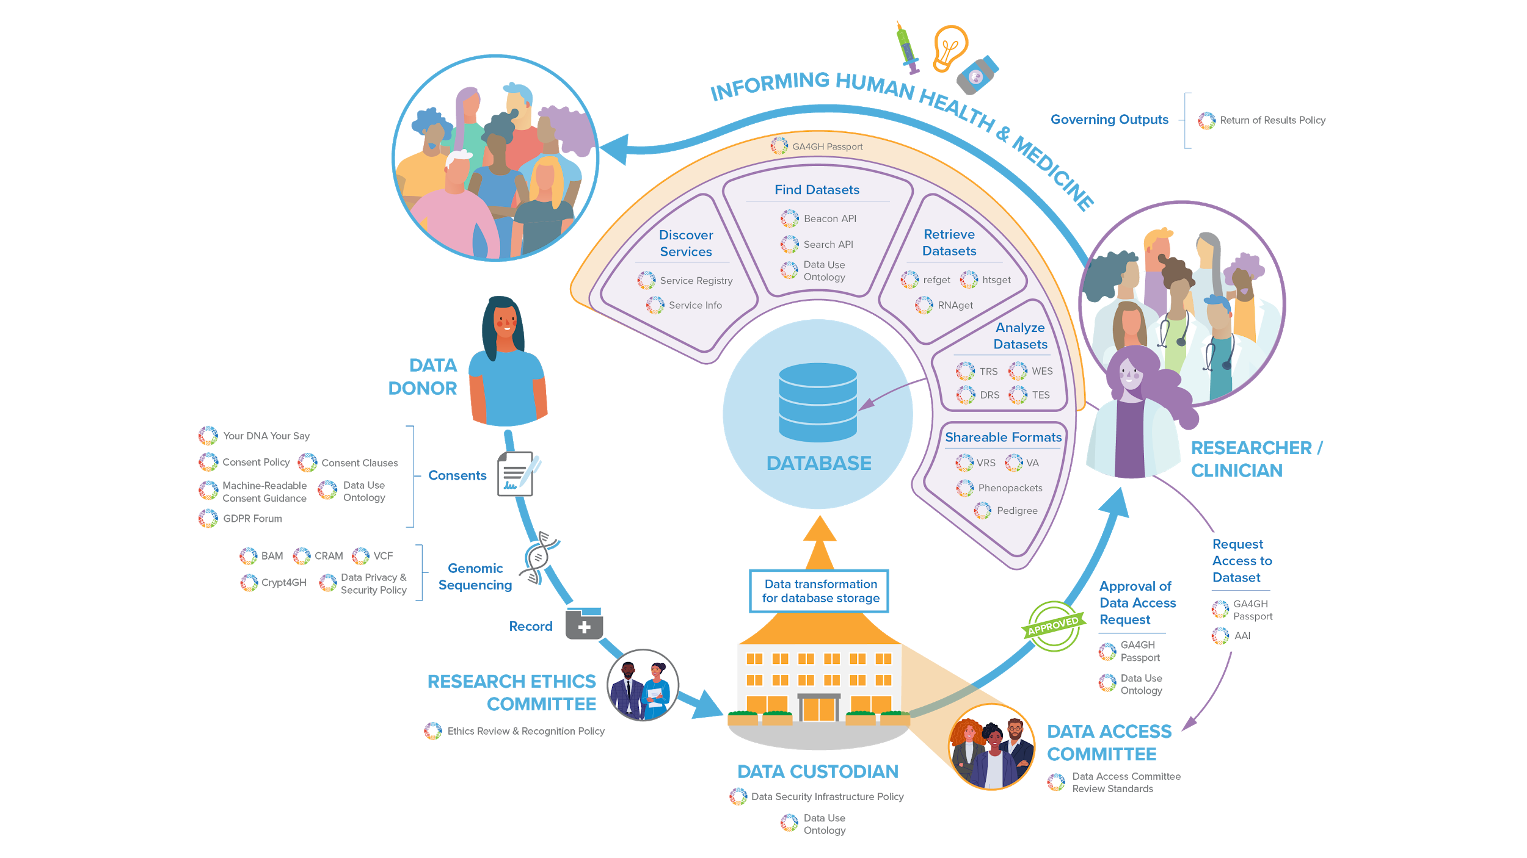
GA4GH 8th Plenary Meeting
Notes:
EWAN
Come back first thing tomorrow to hear the GA4GH staff providing a deep dive into this story

Slide 10
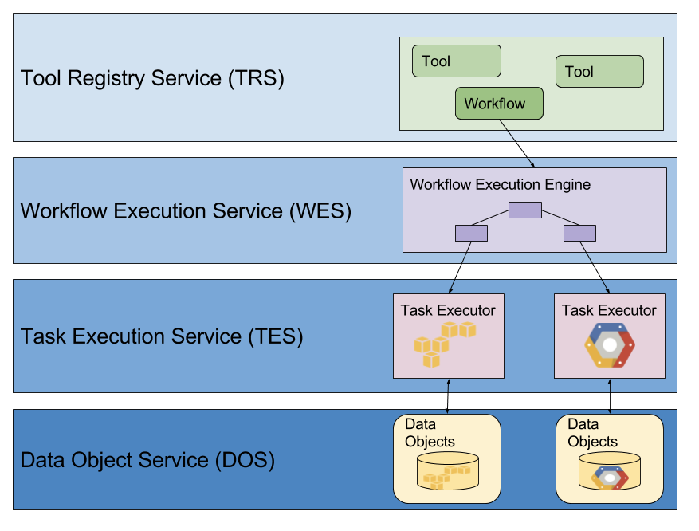
Cloud Work Stream APIs
Sharing Tools and Workflows
Executing Workflows
Executing Individual Tasks
Accessing Data
Data Repository Service (DRS)
GA4GH 8th Plenary Meeting - Cloud work stream

Slide 11


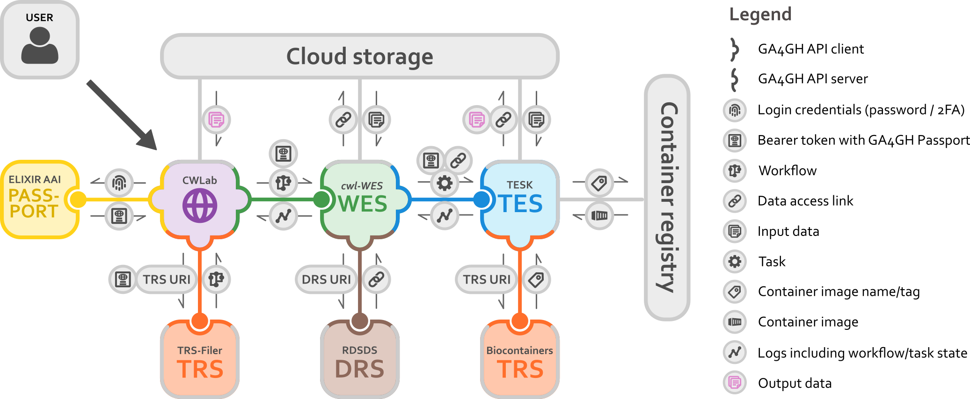
ELIXIR Cloud & AAI Integration of services
2020-09-30 ELIXIR Cloud & AAI @ 8th GA4GH Plenary

Slide 12
GA4GH Workflow Execution Service (WES)
Endpoints
Method | Path | Description
GET | /service-info | Get information about Workflow Execution Service.
GET | /runs | List the workflow runs.
POST | /runs | Run a workflow.
GET | /runs/{run_id} | Get detailed info about a workflow run.
GET | /runs/{run_id}/status | Get quick status info about a workflow run.
POST | /runs/{run_id}/cancel | Cancel a running workflow.
https://github.com/ga4gh/workflow-execution-service-schemas/

Slide 13



Workflow Execution Service (WES)
POST /run
requests.post(
url = WES_SERVER + "/ga4gh/wes/v1/runs",
header = {"Authorization" : "Bearer " + ACCESS_TOKEN},
data = {
"workflow_params": CONFIG_JSON,
"workflow_type": "Snakemake",
"workflow_type_version": "5",
"workflow_url": "/workflows/wf1/Snakefile"
}
}
)
{"run_id": "id_123"}
WES
Workflow Execution Service

Slide 14
Workflow Execution Service (WES)
GET /runs/{run_id}
requests.get(url = WES_SERVER + "/ga4gh/wes/v1/runs/id_123")
{
"run_id": "id_123",
"request": {...},
"state": "COMPLETE",
"run_log":{
"name": "my_workflow",
"cmd": "snakemake …",
"start_time": "2021-01-12T12:00:00Z",
"end_time": "2021-01-12T12:05:00Z",
"stdout": "/PATH/TO/STDOUT"
"stderr": "/PATH/TO/STDERR",
"exit_code": 0
},
"task_logs": [...],
"outputs": {...}
}
WES
Workflow Execution Service

Slide 15
WESkit

Slide 16



GA4GH WES implementation
https://gitlab.com/one-touch-pipeline/weskit
Features
GA4GH WES implementation supporting Snakemake and Nextflow
Developed for stability and high data throughput at BIH and DKFZ
HPC and cloud deployment supported
OAuth2.0 support
Developed in cooperation with ELIXIR compute platform

Slide 17

GA4GH WES implementation
https://gitlab.com/one-touch-pipeline/weskit
Redis
Celery Worker
Batch Processing System
GA4GH WES
WESkit
FLASK app
MongoDB
Containerized deployment

Slide 18
Demonstration

Slide 19

Demo: deploying WESkit
WESkit platform
Protected data
Workflow
WES
Results
https://gitlab.com/one-touch-pipeline/weskit/documentation

Slide 20
Exercise

Slide 21

Task: send workflow to cloud
https://gitlab.com/twardzso/weskit-elixir-workflow-workshop-2021
1.) Login to Theia VM and prepare project
Protected data
2.) Request auth token
Keycloak
Snakemake Workflow*
Theia VM
Results
WES
3.) Send to cloud platform
*https://snakemake.readthedocs.io/en/stable/tutorial/tutorial.html

Slide 22
WESkit use-cases

Slide 23








WESkit Cloud Use Case
Workflow repository
Protected data
User Client
TRS
Workflow A
TRS
Input data
Parameter
ELIXIR-AAI
GA4GH WES
S3
Output data
Run
Computing
Sharable data
Project 08 @ ELIXIR Biohackathon 2021

Slide 24







WESkit Automation Use Case
https://gitlab.com/one-touch-pipeline
OTP
WESkit provides
Standardized workflow execution
Stability, logging, security
Sequencing Facility
Sequences
Alignments
Variants

Slide 25
Summary
GA4GH-WES: specification for sending workflows to execution environment
WESkit: implementation of GA4GH-WES for Snakemake and Nextflow
Cloud use case: build platform to provide access to sensitive data
Automation use case: provide standardized interface for repetitive execution of workflows

Slide 26

Thank you
Charité - BIH
Roland Eils
Andreas Kling
Valentin Schneider-Lunitz
Florian Kärcher
Harald Wagener
Jürgen Eils
Martin Braun
Matthias Bieg
Naveed Ishaque
Philipp Strubel
HD-Hub
Chris Lawerenz
Elisabeth Bürger
Ivo Buchhalter
Kersten Breuer
Pavlo Lutsik
Philip Kensche
ELIXIR Cloud & AAI
Alexander Kanitz
Alvaro Gonzalez
Ania Niewielska
Jonathan Tedds
Justin Clark-Casey
Kostis Zagganas
Lukas Hehtmanek
Marius Diekmann
Questions:
sven.twardziok@bih-charite.de
www.bihealth.org

Slide 27
Questions?

