Slide 1



Introduction to the Common Workflow Language
Michael R. Crusoe @biocrusoe CWL Project Leader #CommonWL https://orcid.org/0000-0002-2961-9670
All slide text is licensed CC-BY-4.0

Slide 2
Background
Computational workflows are routinely used for large scale analyses in many fields
Replication, validation, and extension of scientific results are crucial for scientific progress
Many workflows systems exist but few of the systems have
adoption, active user community, and sustained development support
the ability to painlessly port or extend their workflows to another system or platform
Needed a multi-lingual workflow description standard between systems and for cross-vendor portability
Notes:
Multi-lingual: supports workflow steps (tools) in any programming language

Slide 3


The CWL Project is a boutique SDO, part of Software Freedom Conservancy
The CWL project supports open consensus-based standards for command line data analysis workflows and tools. Specifically, the project supports the
pre-standards process by providing a neutral place of convening to discuss, propose and test ideas about command-line tool based workflow standards and related topics.
standardization process by stewarding the development and delivery of standards in accordance with the Open Stand principles.
post-standards life cycle by (1) promoting the released standards, (2) developing and maintaining related training and tools, and by (3) tracking deficits and other post-standardization feedback.

Slide 4


What is Common Workflow Language (CWL)?
Open standard for describing analysis workflows and tools
Started as a grassroots effort by developers at BOSC codefest in 2014
Community based standards effort, not a specific software package
Defined with a schema, specification and test suite
Reference implementation (cwltool) along with academic and commercial production implementations
Portable and scalable across a variety of software and deployment environments
Supports the use of containers (e.g. Docker, Singularity)
Designed to meet the needs of data-intensive science to improve the FAIRness of their workflows
CWL now used in Bioinformatics, Medical Imaging, Astronomy, High Energy Physics, Machine Learning, ... GeoSpatial?

Slide 5
CWL: Two Standards in One
CWL Command Line Tool Description standard: how to run a single tool; what inputs are required and allowed, what outputs are made and how to get them.
CWL Workflow Description standard: connecting these CommandLineTools along with sub-Workflows into a workflow graph
Can use just the CommandLineTool CWL standard or the full combination of both.

Slide 6
















CWL Enables Execution Portability
Local execution on Linux, macOS, and MS Windows
via the CWL reference implementation (cwltool) and Docker/uDocker/Singularity/podman/...
Authors of CWL tool and workflow descriptions
Backends supported by various F/OSS CWL implementations
Notes:
Icons from https://github.com/opencontainers/artwork

Slide 7
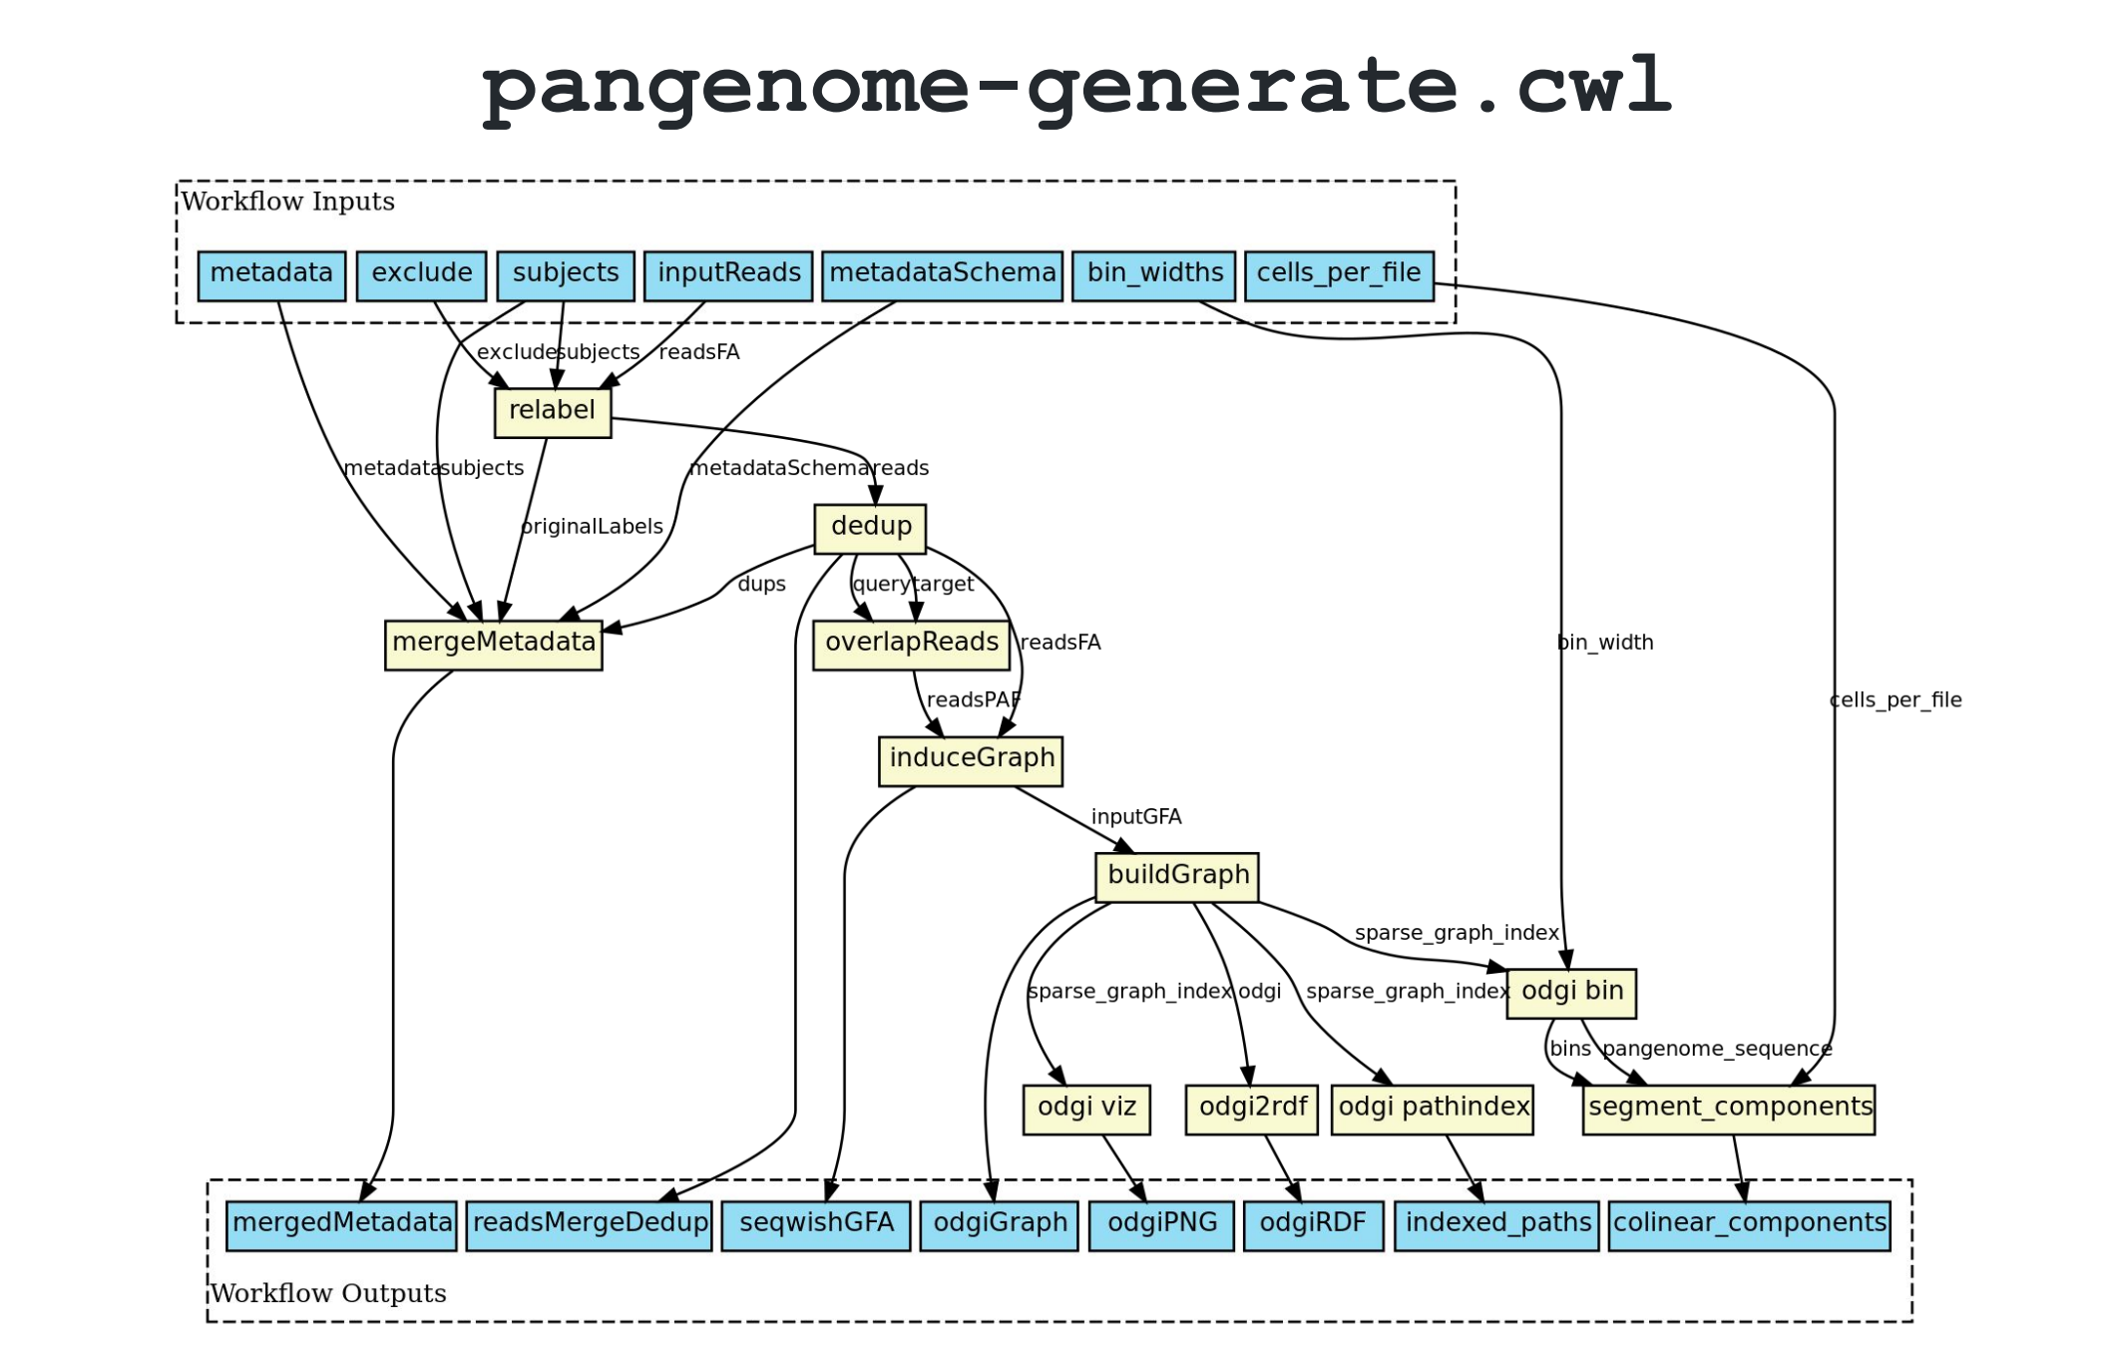
CWL Technical Details
CWL file contains a tool or workflow description
Human readable
Written in YAML or JSON
Many optional fields to increase readability and reusability (i.e. “doc”, “label”, “SoftwarePackage”, “format”)
Input/outputs are explicitly stated
Designed to be modular and easy to reuse components
CWL Workflows are graphs made up of CWL tool descriptions
Designed for high-throughput (grid and cloud) computing
Distribute steps over many compute nodes
Data movement handled by the CWL-aware workflow engine
Encourages well-marked vendor/user extensions
Supporting progress without hurting portability

Slide 8
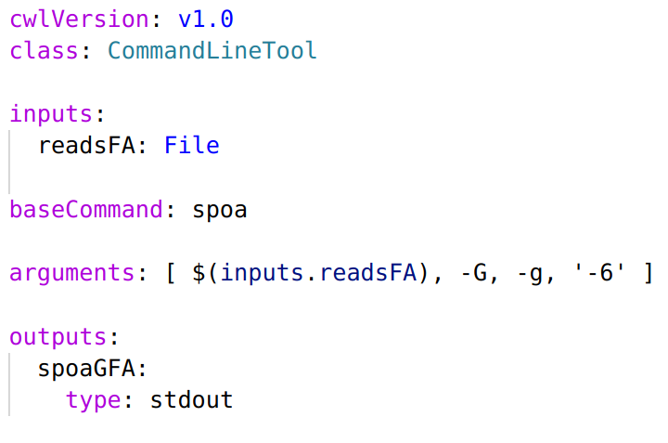
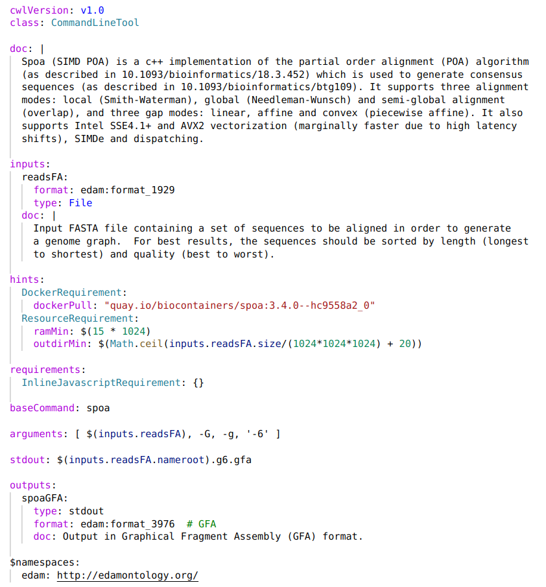
CWL Encourages Progressive Enhancement
Community Maintained File Format Identifier
Dynamic Resource Requirements
Both describe the same tool.
The 2nd description is more helpful.
Notes:
Can start with a compact minimal description
Add more flexibility, and helpful bits: default values, contextual documentation, tool metadata, resource hints

Slide 9
CWL Data Model
The basic unit is a command line tool.
CWL Types: strings, numbers, file/directories, or records that combine these; or arrays of any of these types. Union and optional types too.
Files can have a further specialization via the “format” field: a URI that identifies the file type iana:application/geo+json edam:format_3016
CWL does not dictate the source of these format identifiers, each community of users should define their own.

Slide 10
CWL Technical Details cont.
Workflow graph can be exported as linked-data (RDF/JSON-LD)
Supports provenance exporting using existing standards and ontologies: W3C Prov, IETF BagIt, wfdesc, wfprov
CWL’s object model enables a variety of infrastructure-specific optimizations
Cost and/or data-location aware scheduling
(User overridable) caching of results
Streaming in-/out- of object stores; or between steps
Hundreds of conformance tests are used to ensure portability independent of vendor
Workflow validation catches many sneaky syntax errors before runtime

Slide 11
Data locality with CWL
Input and output files are modeled in CWL as rich object with identifier (URI/IRI) and other metadata.
Platforms that understand CWL can use these identifiers to send compute to near the location of data.
In combination with the resource matchmaking this can conversely result in data being sent to specialized compute resources as configured by the operator (or machine learning)

Slide 12
Proposed enhancement to CWL data model
input value restrictions / validations · Issue #764
Refinements to the existing CWL types have been proposed, but need implementation before they can be voted on.
string: Regular expressions, string sets int/long: Integer intervals, integer sequences, integer sets float/double: (Real) intervals, integer intervals, real sets
Goal is to catch validation errors sooner, produce more helpful (G)UIs, and prevent execution of workflows/tools that doomed to fail

Slide 13
How to extend CWL for your own needs?
CWL 💓 community/vendor extensions!
Do let the CWL community know how your needs aren’t being met.
Experiment with alternative syntax via additional Requirements. Fork the CWL reference runner (cwltool) or another CWL implementation to implement your ideas.
Make sure that your extensions are namespaced, so that other systems can still read your CWL documents.
Let the CWL community know about your progress as you go.
If it makes sense, make a formal proposal for possible inclusion in a future version of the CWL standards!

Slide 14
CWL v1.2 released 2020-08-10!
3 new features: workflow level conditionals, abstract operations, absolute paths for container inputs
20 cleanups and clarifications of corner cases in the specifications
Forward compatibility via the `cwl-upgrader` script or the reference CWL runner
Available today in the CWL reference runner (cwltool), Arvados, and toil-cwl-runner. Support in additional commercial providers is forthcoming.

Slide 15
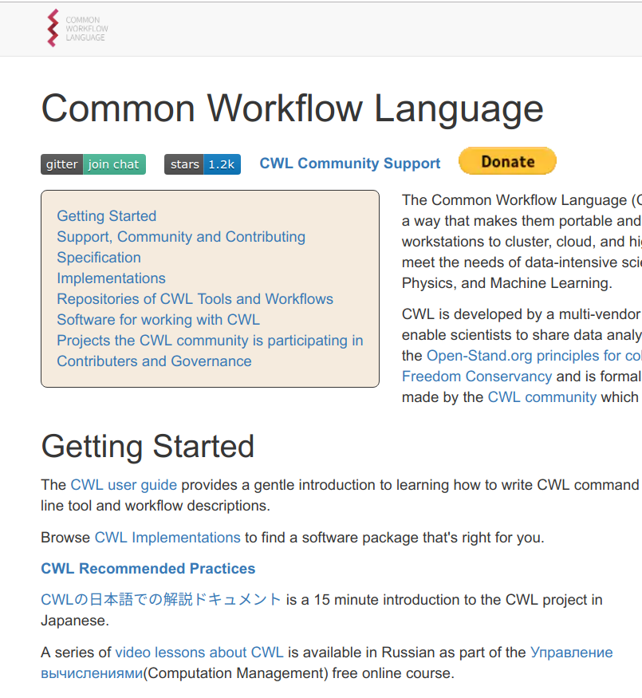
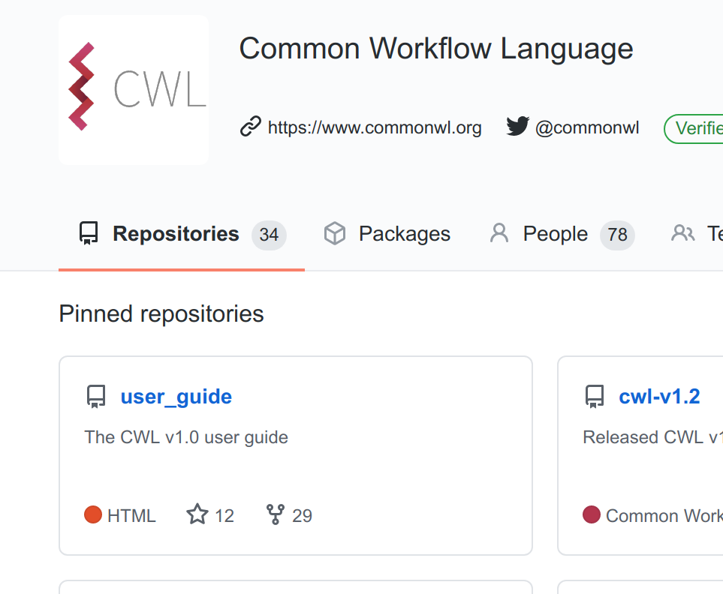

Participating in the CWL Community
https://www.commonwl.org/
Getting Started
User guide: https://www.commonwl.org/user_guide/
Support, Community and Contributing
Forum: https://cwl.discourse.group/
Chat: https://gitter.im/common-workflow-language/home
GitHub: https://github.com/common-workflow-language/
Social Media: @commonwl & #CommonWL
Weekly video chat

Slide 16



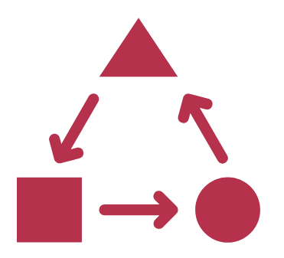



Common Workflow Language
Is a vendor neutral open standard
Is a community-first project
Designed with an open and transparent governance
Improves interoperability and portability
Increases reusability and reproducibility
Enables parallelization and scale
Is supported by an ecosystem of tools, libraries, and editor plugins
Notes:
https://github.com/common-workflow-language/common-workflow-language/wiki/Notable-CWL-mentions,-adoption,-and-users

Slide 17
Thank you!
Questions?
https://www.commonwl.org

Slide 18
Backup slides..

Slide 19
Linked Data & CWL
Hyperlinks are common currency
Bring your own RDF ontologies for metadata
Supports SPARQL to query
Example: can use the EDAM ontology to specify file formats and reason about them: “FASTQ Sanger” encoding is a type of FASTQ file

Slide 20
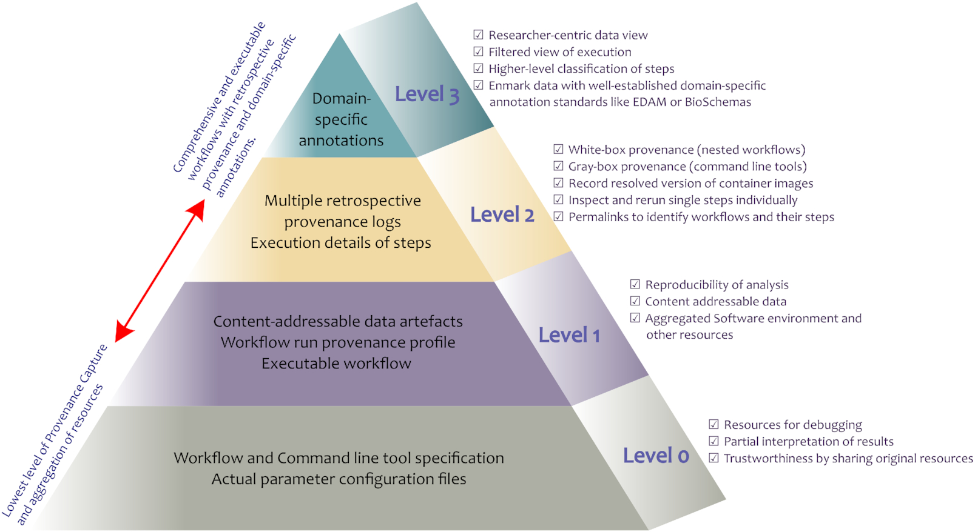
Figure 2: Levels of provenance and resource sharing and their applications.
Notes:
Figure 2: Levels of provenance and resource sharing and their applications.
Unless provided in the caption above, the following copyright applies to the content of this slide: © The Author(s) 2019. Published by Oxford University Press.This is an Open Access article distributed under the terms of the Creative Commons Attribution License (http://creativecommons.org/licenses/by/4.0/), which permits unrestricted reuse, distribution, and reproduction in any medium, provided the original work is properly cited.

Slide 21
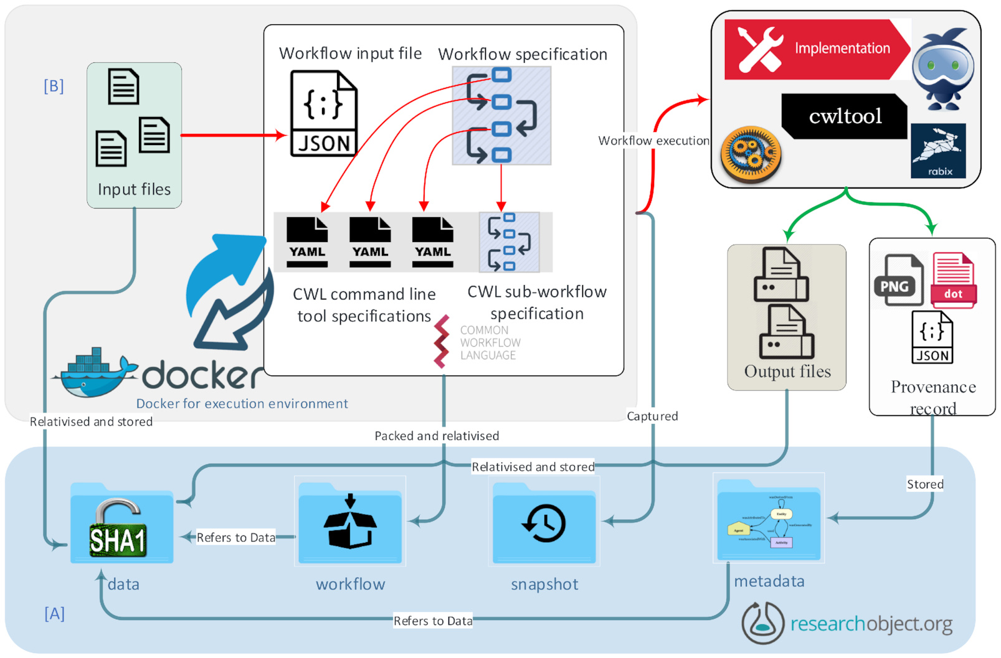

Notes:
Figure 5: Schematic representation of the aggregation and links between the components of a given workflow enactment. Layers of execution are separated for clarity. The workflow specification and command line tool specifications are described using CWL. Each individual command line tool specification can optionally interact with Docker to satisfy software dependencies. [A] The RO layer shows the structure of the RO including its content and interactions with different components in the RO and [B] the CWL layer.
Unless provided in the caption above, the following copyright applies to the content of this slide: © The Author(s) 2019. Published by Oxford University Press.This is an Open Access article distributed under the terms of the Creative Commons Attribution License (http://creativecommons.org/licenses/by/4.0/), which permits unrestricted reuse, distribution, and reproduction in any medium, provided the original work is properly cited.

Slide 22
Timeline
2014 Bioinformatics Open Source Conference CodeFest: 4 software engineers & a whiteboard
2015: CWL “draft-2” version, commercial vendor (SBG) releases product in December.
2016: CWL v1.0 released
2017: CWL v1.0.1 and v1.0.2 released. Now 4 public implementations
2018: IBM released their CWL implementation for LSF.
2019: CWL v1.1 released
2020: CWL v1.2 released with workflow conditionals, work on CWL v1.2.1 and beyond commences

