Slide 1
ELIXIR Workflow Workshop Mon 29th Nov – Wed 1st Dec 2021 Naveed Ishaque Digital Health Centre, Berlin Institute of Health @ Charite

Slide 2

















Acknowledgements
Daniel Wibberg, de.NBI/ELIXIR-DE
Helena Schnitzer, de.NBI/ELIXIR-DE
Sina Barysch, de.NBI/EMBL
Franziska Müller, BIH at Charité
CWL
Michael R. Crusoe, VU Amsterdam, Netherlands
Fotis E. Psomopoulos, CERTH, Greece
workflUX - The Workflow User eXperience
Pavlo Lutsik, DKFZ, Germany
Mei-Ju Chen, DKFZ, Germany
Clarissa Feuerstein, DKFZ, Germany
WESkit
Sven Twardziok, BIH at Charité, Germany
Snakemake
Johannes Köster, UDE, Germany
OpenEBench
Salvador Capella-Gutierrez, BSC, Spain
Laura Portell, BSC, Spain
Asier Gonzalez, BSC, Spain
Jose Maria Fernandez, BSC, Spain
Laura Rodriguez-Navas, BSC, Spain
Nextflow
Paolo Di Tommaso, Seqera Labs, Spain
Evan Floden, Seqera Labs, Spain
Luca Cozzuto, CRG, Spain
nf-core
Gisela Gabernet, Uni Tübingen, Germany
Friederike Hanssen, Uni Tübingen, Germany

Slide 3
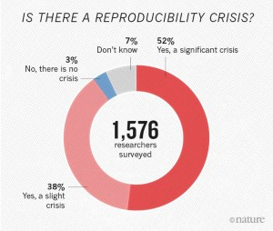
Reproducibility in bioinformatics research
Reproducibility is a cornerstone of good scientific practice
Reproducibility in bioinformatics:
documentation
data
code
We are in the midst of a reproducibility crisis:
“… more than half have failed to reproduce their own experiments”
https://doi.org/10.1038/533452a

Slide 4





Reproducibility in bioinformatics research
Reproducibility is a cornerstone of good scientific practice
Reproducibility in bioinformatics:
documentation
data
code
We are in the midst of a reproducibility crisis:
“… more than half have failed to reproduce their own experiments”
… but there is light at the end of the tunnel!
https://doi.org/10.1038/533452a

Slide 5
The workshop: preparation and engagement
Be prepared! https://elixir-workflow-workshop.github.io/2021/preparation.html
The workshop will be recorded
Virtual social event via Gather.Town on Tuesday evening 18:00… open to all!
Two levels of participation
30 participants via Zoom, who can interact with trainers
Many more participants via Twitch: https://www.twitch.tv/elixir_workshops/
Slido: https://app.sli.do/event/pl9n9alm/live/questions?w=9qyxd
All participants can ask questions at slido.com with #446128

Slide 6
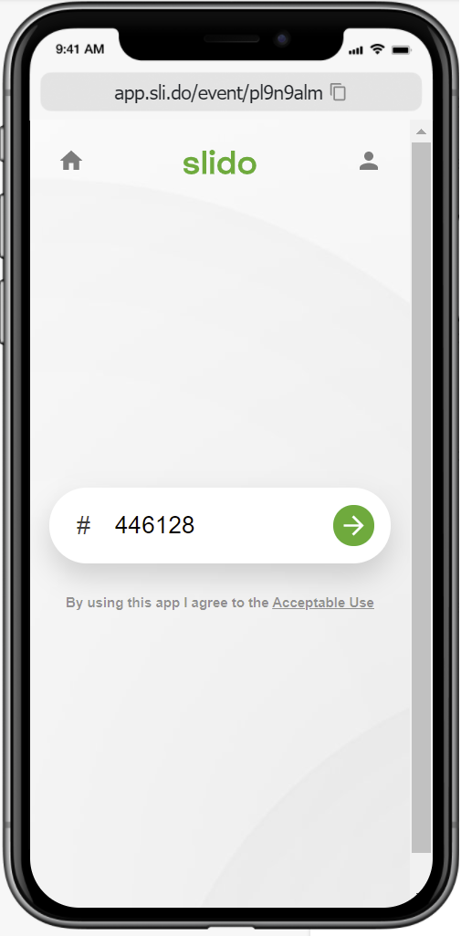
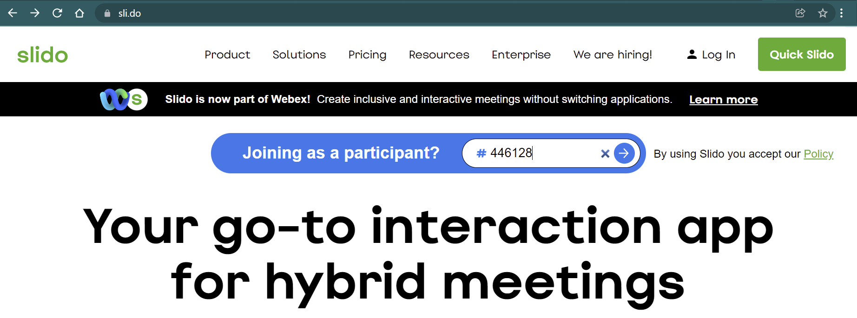
Let’s try out slido!
Head over to https://www.sli.do/ and enter “#446128”

Slide 7
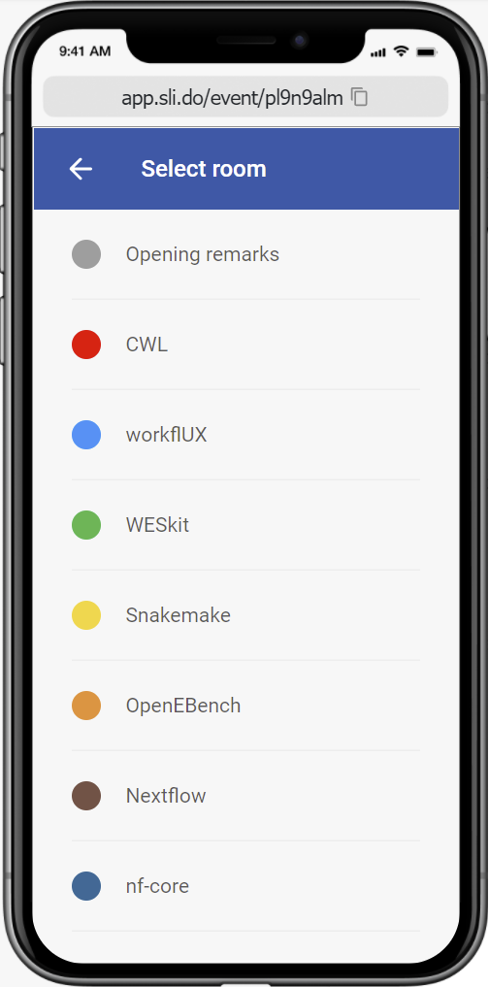
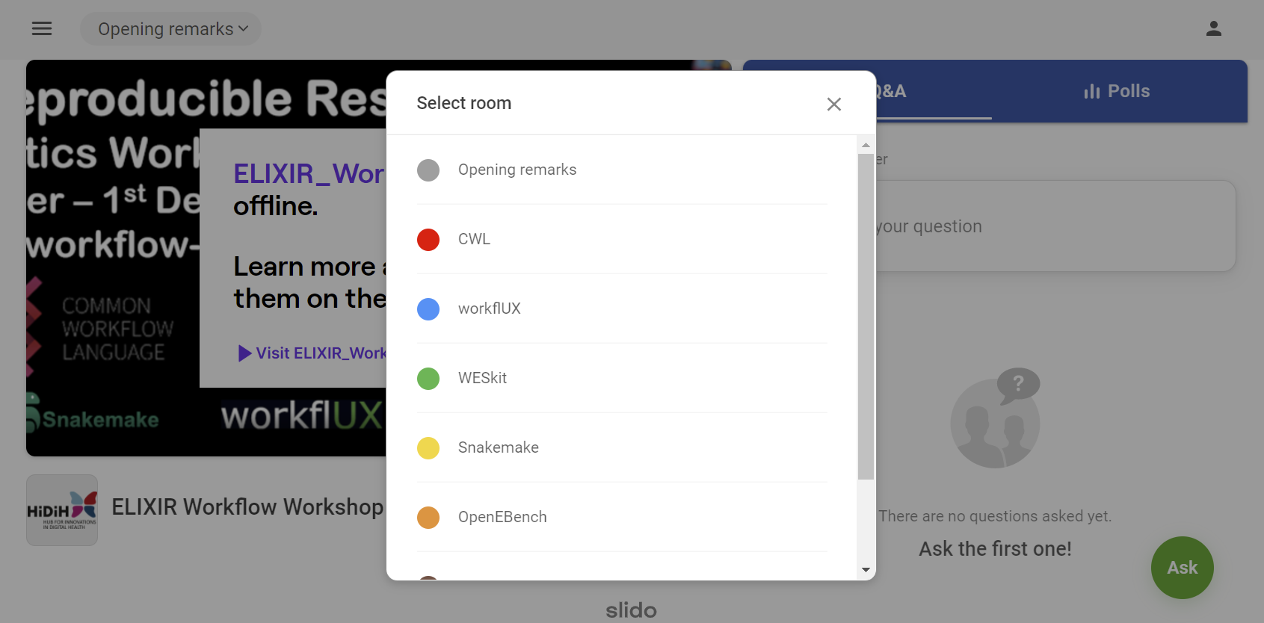
Let’s try out slido!
Head over to https://www.sli.do/ and enter “#446128”
Select the “Opening remarks” room

Slide 8
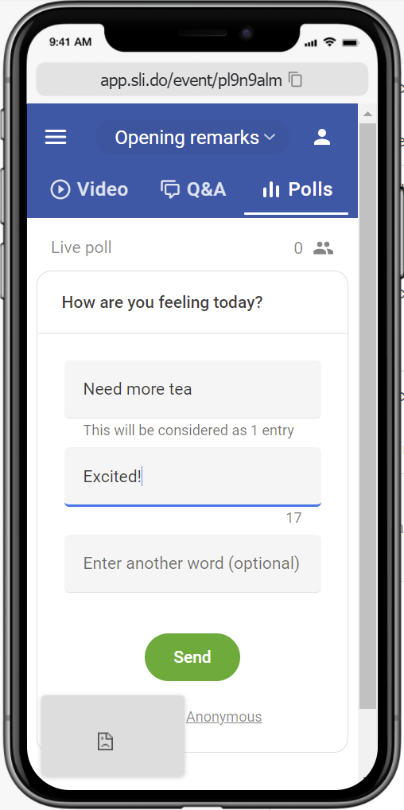
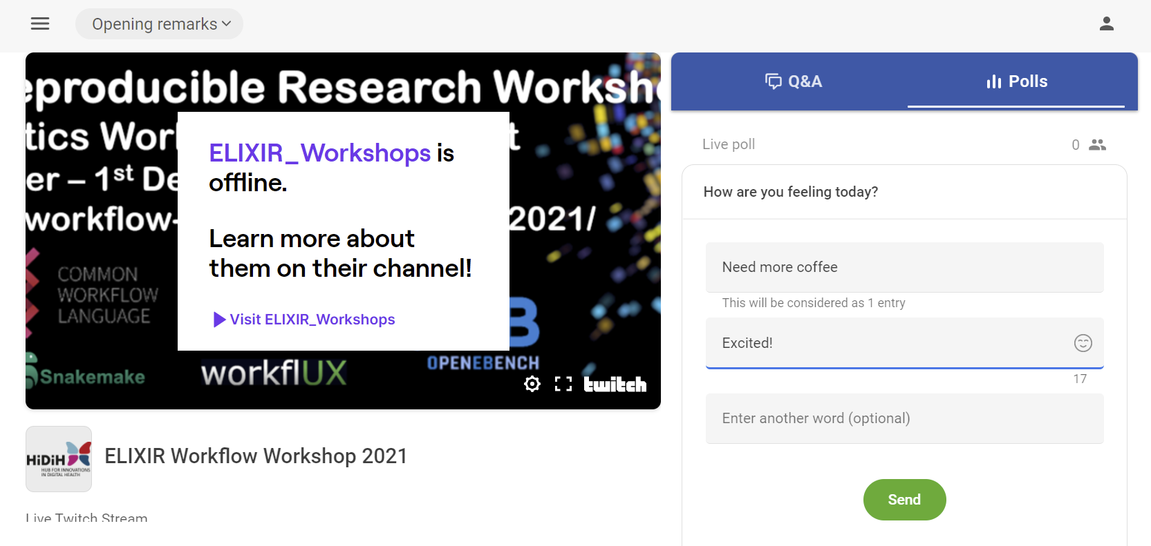
Let’s try out slido!
Head over to https://www.sli.do/ and enter “#446128”
Select the “Opening remarks” room
Click on “Polls” and let me know how you are feeling today

Slide 9


How are you feeling today?
ⓘ Start presenting to display the poll results on this slide.

Slide 10

How would you describe your employment?
ⓘ Start presenting to display the poll results on this slide.

Slide 11
Where are you joining from?
ⓘ Start presenting to display the poll results on this slide.

Slide 12
Hand on heart – are you wearing pajamas right now?
ⓘ Start presenting to display the poll results on this slide.

Slide 13
How have you managed reproducible code so far?
ⓘ Start presenting to display the poll results on this slide.

Slide 14
General Etiquette
Please maintain good conduct
Zoom’ers: keep microphones muted unless you want to speak
Twitch’ers:
Note that you have a 5 second delay
If you are having problems, you can post the question on slido
These will not always be answered by the trainers, unless majorly catastrophic
Other participants can respond to technical questions

Slide 15
Do you have any questions?
Zoom’ers – raise your hands or use Slido
Twitch’ers – send questions via Slido

Slide 16
Let the show begin!
Day 1: Monday 29th November
09:15-09:30 opening remarks
09:30-12:00 CWL
13:00-14:00 workflUX - The Workflow User eXperience
14:00-15:00 WESkit
Day 2: Tuesday 30th Nov
09:30-12:00 Snakemake
13:00-14:30 OpenEBench
18:00-late Evening virtual social via gather.town
Day 3, Wednesday 1st Dec
09:30-12:00 Nextflow
13:00-15:00 nf-core
15:00-15:15 closing remarks

