Slide 1
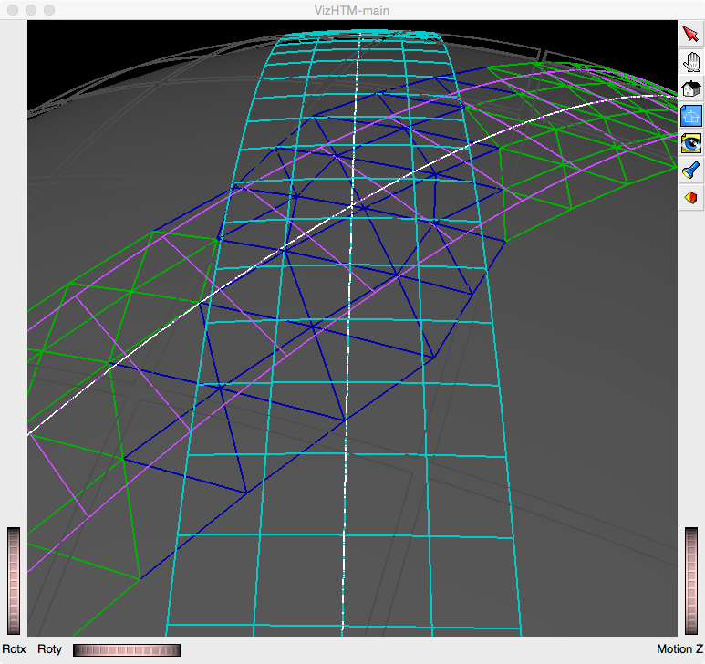
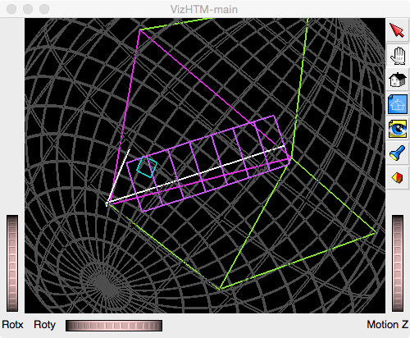
Level 5
Level 2
HtmRange Intersection
HSTM Intersection

