Slide 1

Vault 13 Networking
Meeting Room Network Design Proposal
Presentation by Michael Connell

Slide 2

Understanding Your Needs
"Seamless integration with minimal visible cabling."
"Capacity for 24 computers, distributed over three stations, as 8 per station.“

Slide 3
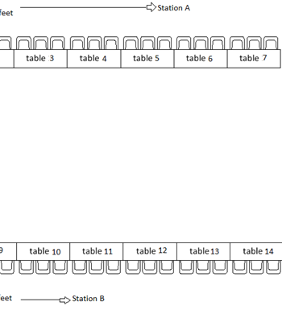
Network Design Overview
Plan: Run cables from the network rack to each station, concealed within the ceiling.
Distance to Station C is 25 feet, impacting total wire length required.
Total wire needed and time to complete project.
We can do this.

Slide 4
An Optimized Solution
Our Proposal: Introduction of network switches at each station.
Benefits:
Significant Cost Reduction: Substantially lower cabling expenses. We estimate a potential savings of approximately 65-70% on cabling costs alone.
Improves Organization: Simplifies cable management for a cleaner installation.
Reduce installation time by up to 40%.

Slide 5
Delivering Expertise & Choice
Our commitment: Understanding and meeting your needs.
Flexible solutions: Original plan or switch-based design.

Slide 6

Let’s build the Ideal Network for Your Meeting Room
Summary
We will deliver the high-quality solution to meet your needs
Questions and Discussion on next steps.
Reach me @ Vault13NW@team.net

