Slide 1

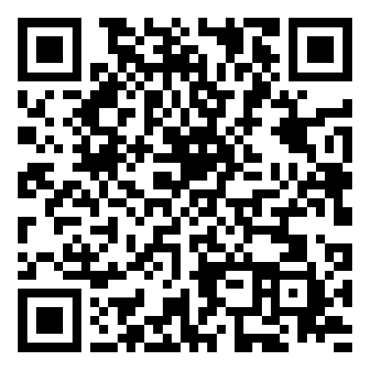
Smart Slides
Make Slides in a flash
How to use Smart Slides

Slide 2
Introduction
Exploring Process Models in Software Engineering
Focus: Waterfall, Agile, Scrum, XP
Importance of process models in guiding development for efficiency and quality.

Slide 3
Overview of Software Engineering Process Models
Description of various models: Waterfall, V-Model, Iterative, Spiral, Agile.
Each model's suitability for different project requirements.

Slide 4
Waterfall Model
Sequential phases: Requirements, Design, Implementation, Verification, Maintenance.
Best use cases and limitations of Waterfall.

Slide 5
Agile Software Development
Agile as a flexible, iterative approach.
Focus on customer satisfaction, continuous delivery, adaptability.

Slide 6
Advantages of the Agile Approach
Faster delivery, improved quality, better risk management.
Enhanced customer satisfaction, increased project control.

Slide 7
Challenges of Developing High-Quality Software
Addressing challenges: Changing requirements, time and budget constraints, technology advancements.
Maintaining quality in dynamic environments.

Slide 8
Agile's Response to Software Development Challenges
Agile's iterative development, customer collaboration, flexibility.
Adapting to changes and managing risks effectively.

Slide 9
Agile Manifesto and Its Influence
Core values and principles of the Agile Manifesto.
Revolutionizing software development practices.

Slide 10
Key Agile Methodologies: Scrum, XP, etc.
Overview of Scrum: Sprints, roles, ceremonies.
Extreme Programming (XP): Pair programming, test-driven development.

Slide 11
Real-World Success Stories
Case study from the VA: Agile methodology improving project outcomes.
Specific benefits achieved in a VA project.

Slide 12
Challenges in Adopting Agile
Common obstacles: Resistance to change, lack of skilled professionals.
Challenges in scaling Agile practices.

Slide 13
Conclusion
Summary of key points.
Reinforcing the importance of the right process model choice.

Slide 14
References
List of modern, easily accessible resources for further reading.

Slide 15
Thanks for using Smart Slides
Learn more about how to use this plugin by visiting https://smartslides.crisp.help/en/article/how-to-use-smart-slides-1w14fiw/
Example Prompts:
Make me a 5 slide presentation about the history of the united states and include charts with images of mountains and rivers
Make me a 5 slide tourist presentation about Norway and lofoten islands with varied layouts and images of the northern lights using
Create a presentation with 5 slides about Sydney with images of Bondi Beach and the Opera House use font size 46 for headings and 36 for content. Use this color #FF5A5F (red) and inlude lots of image slides

