Slide 1

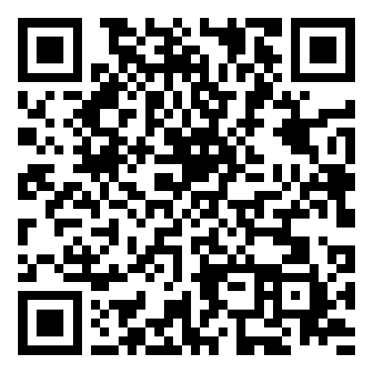
Smart Slides
Make Slides in a flash
How to use Smart Slides

Slide 2
Introduction
Exploring Process Models in Software Engineering
Focus: Waterfall, Agile, Scrum, XP

Slide 3
Overview of Software Engineering Process Models
Comparative analysis of various process models used in software development.

Slide 4
Waterfall Model
Definition and key characteristics of the Waterfall model.

Slide 5
Agile Software Development
Advantages of the Agile approach in software engineering.

Slide 6
Challenges of Developing High-Quality Software
Identifying the main challenges in software development.

Slide 7
Agile's Response to Software Development Challenges
How Agile methodologies address common development challenges.

Slide 8
Agile Manifesto and Its Influence
The principles of the Agile Manifesto and their impact on software development.

Slide 9
Key Agile Methodologies: Scrum, XP, etc.
Overview of Scrum, XP, and other Agile methodologies.

Slide 10
Real-World Success Stories
Case studies and examples of Agile's success in various projects.

Slide 11
Challenges in Adopting Agile
Discussing the hurdles faced by organizations in implementing Agile.

Slide 12
Conclusion
Summarizing the key points and findings of the presentation.

Slide 13
References
List of modern and accessible resources for further reading.

Slide 14
Thanks for using Smart Slides
Learn more about how to use this plugin by visiting https://smartslides.crisp.help/en/article/how-to-use-smart-slides-1w14fiw/
Example Prompts:
Make me a 5 slide presentation about the history of the united states and include charts with images of mountains and rivers
Make me a 5 slide tourist presentation about Norway and lofoten islands with varied layouts and images of the northern lights using
Create a presentation with 5 slides about Sydney with images of Bondi Beach and the Opera House use font size 46 for headings and 36 for content. Use this color #FF5A5F (red) and inlude lots of image slides

