Slide 1
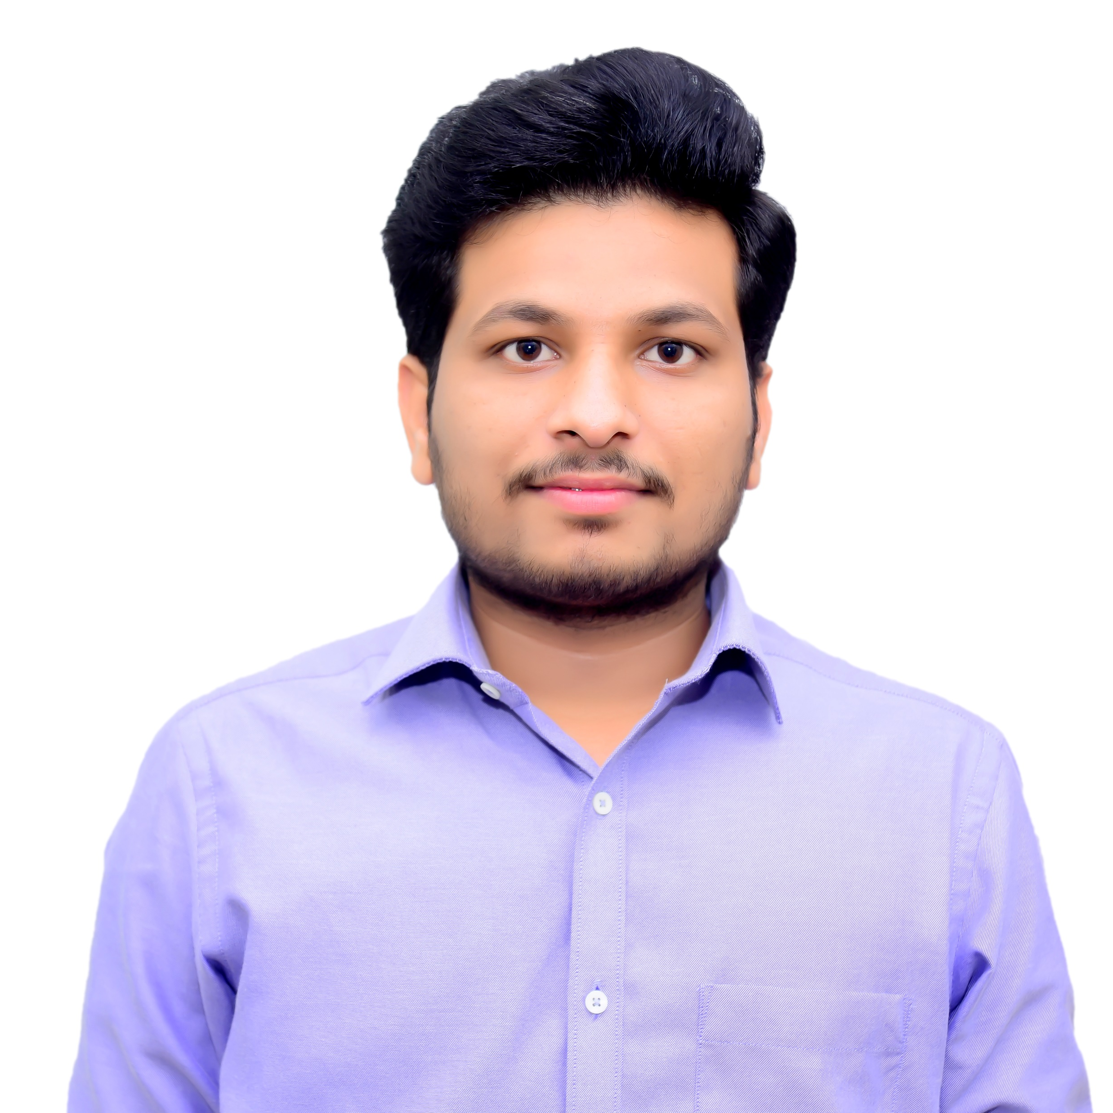
SHUBHAM PAWAR
Bachelor of Engineering
Computer Engineering
Year : 2018-2021
Analyst/Software Engineer
Skills
Mumbai
shubham.a.pawar@capgemini.com
Java | Java Basics, OOPS Concepts
Spring | Spring microservices, RestApi Spring Security.
UI Framework-Angular | Fundamentals components , JavaScript, Routing ,Life Cycle Method, Working with HTTP in Angular.
Database | MongoDB
UI Tech | HTML 5 & CSS 3,TypeScript, Optimized UI Designed
Tools | Visual Studio code, Postman, Spring Tool Suite
Add On skills | Communications, Team management. Peer learning
+91 9146180727
A4
Proficient in Java and OOPs concepts.
Hands on experience in creating Web Application with Spring Boot, Java, Rest API, Angular.
Hands on experience in developing web pages using HTML5, CSS3, TypeScript, JSON.
Practical understanding of rendering Spring Boot, REST API.
Implemented Rest API and Angular in case study and up skilling this knowledge continuously.
On Demand Car Wash System
Working on end-to-end case study of On Demand Car Wash System along with authentication, and Angular used for user interface.
Java and Angular for web developers in Degreed Platform
Completed this course with optimal Knowledge of Web API , RESTFUL services , Components.

