Slide 1
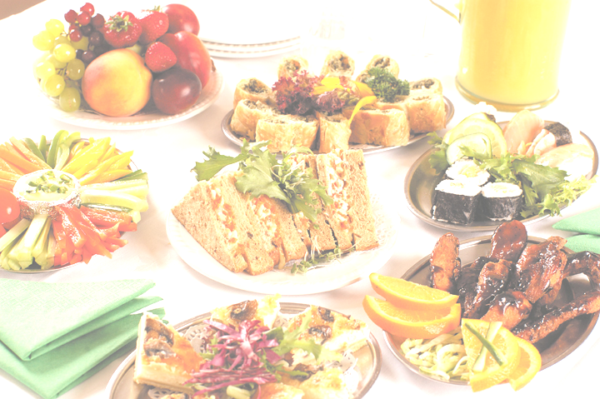
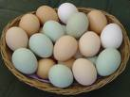
GCSE Food Technology
Exam Revision 2009
Research Context: EGGS
Design Theme: BUFFET PRODUCTS

Slide 2
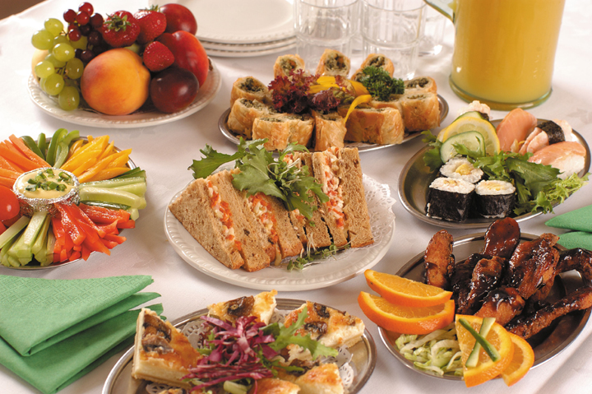
Garnish:
Eggs can be used to add garnish (decoration) to foods either poached or boiled and sliced.
Example: salad
Thickening:
Egg white coagulates (sets) at 60°C, the yolk sets at 70°C, so when these temperatures are reached they begin to set and thicken the mixture. Do not allow to exceed these temperatures of the mixture will set fully and curdle (scramble)
Example: custard
Emulsification:
Oil and water mixed together form an emulsion, but this will only last a short while then separate. The lecithin in egg yolks keeps the emulsion stable
Example: mayonnaise
Coagulation:
This is when the egg sets the mixture once it has exceeded 70°C.
Example: quiche filling
Binding:
The egg sets when cooked sticking other ingredients together
Example: burgers
Uses/functions of eggs in cooking
Enriching:
Adding richness and extra nutrition to foods
Example: rich shortcrust pastry
Coating:
Foods can be brushed with egg then dipped in breadcrumbs. During cooking the egg coagulates(sets) and hols the product together.
Example: fish cakes
Glazing:
Before cooking foods can be brushed with beaten egg. During baking the egg glaze goes golden brown.
Example: pasties, sausage rolls
Trapping air:
The protein in the egg white stretches when beaten and traps air.
Example: cake making

Slide 3
Fork buffet:
Food can be eaten with just a fork or spoon, no knife needed
Examples: Coronation chicken, potato salad, coleslaw, quiche, curried eggs, pasta salad, meringue nests, profiteroles, sponge fruit flan, trifle, gateau, cooked cheesecakes.
Hot buffet:
Most of the food is served hot.
Example: quiches, hot pastry dishes,
Mousakka, burgers, fried chicken,
egg fried rice, steamed sponge puddings,
custard.
What’s a buffet?
  A buffet is a meal that you serve yourself from an assortment of different foods
Cold Buffet:
Most of the food is served cold
Examples: coronation chicken,
quiche, mayonnaise based salads,
scotch eggs, glazed pastry products,
sponge flans, gateau's, profiteroles,
chicken goujons, mousses,
cooked cheesecakes, lemon meringue.
Finger buffet:
Foods that can be eaten with fingers
Examples: egg and mayonnaise sandwiches
mini quiche, sausage rolls, scotch eggs,
stuffed eggs, devilled eggs, chicken goujons,
fish goujons, mini pasties, meringues,
fruit sponge flans, mini fruit and custard tarts,
mini éclairs.

Slide 4
Emulsifier:
Mayonnaise
Pasta salad
Coronation chicken
Potato salad
Coleslaw
Devilled eggs
Thickening:
Trifle
Custards
Lemon meringue filling
Coagulation:
Quiche
Cooked cheesecake
Fried rice
Middle of scotch eggs
Stuffed eggs
Devilled eggs
How the eggs are used
Enriching:
Sweet pastry products – french apple flan
Binding:
Burgers
Trapping air:
Éclairs
Profiteroles
Cakes and gateaux
Meringues
Mousses
Sponge flan.
Bakewell tart
Glazing:
Any pastry product –
Pies
Vol au vents
Sausage rolls
Coating:
Scotch eggs
Fish and chicken goujons

Slide 5
Why are eggs good for you?
Energy value of eggs
A medium egg has an energy value of 78 kilocalories (324 kilojoules) and the consumption of one egg daily would contribute only
around 3% of the average energy requirement of an adult man; 4% for an adult woman. With their significant protein, vitamin and
mineral content and relatively low saturated fat content, eggs are a valuable component in a healthy diet.
Protein
Eggs are an excellent source of protein. Egg protein is of high biological value as it contains all the essential amino acids needed by
the human body. Eggs therefore complement other food proteins of lower biological value by providing the amino acids that are
in short supply in those foods. 12.5% of the weight of the egg is protein and it is found in both the yolk and the albumen.
Although protein is more concentrated around the yolk, there is in fact more protein in the albumen. On the evaluation scale most
commonly used for assessing protein, egg is at the highest point, 100, and is used as the reference standard against which all
other foods are assessed.
Vitamins
Eggs contain most of the recognised vitamins with the exception of vitamin C. The egg is a good source of all the B vitamins, plus
the fat soluble vitamin A. It also provides useful amounts of vitamin D, as well as some vitamin E.
Minerals
Eggs contain most of the minerals that the human body requires for health. In particular eggs are an excellent source of iodine,
required to make the thyroid hormone, and phosphorus, required for bone health. The egg provides significant amounts of zinc,
important for wound healing, growth and fighting infection; selenium, an important antioxidant; and calcium, needed for bone
and growth structure and nervous function. Eggs also contain significant amounts of iron, the vital ingredient of red blood cells,
but the availability of this iron to the body is uncertain.
Carbohydrate and dietary fibre
Eggs contain only traces of carbohydrate and no dietary fibre.
Fat
11.2% of the egg content is fat. The fat of an egg is found almost entirely in the yolk; there is less than 0.05% in the albumen.
Approximately 17% of an egg’s fatty acids are polyunsaturated, 44% monounsaturated and only 32% saturated.
Cholesterol
Cholesterol and Lecithin are fat-like substances and are essential to the structure and function of all cells in the body. Cholesterol
helps to maintain the flexibility and permeability of cell membranes and is also a raw material for the fatty lubricants that help to
keep the skin supple. Cholesterol is essential for the production of sex hormones, cortisol, vitamin D and bile salts.
Lecithin is involved in general lipid transportation in the blood and in the metabolism of cholesterol.

Slide 6
Egg storage and safety
Cooking eggs properly
If you cook eggs until both the white and yolk are solid this will kill any bacteria. If you are cooking a dish containing eggs, make
sure you cook it until the food is steaming hot all the way through.
Foods that are made with raw eggs and then not cooked, or only lightly cooked, can cause food poisoning. This is because any
bacteria in the eggs won't be killed.
All the following might contain raw eggs:
home-made mayonnaise
Béarnaise and hollandaise sauces
some salad dressings
ice cream
icing
mousse
tiramisu and other desserts
For the safest choice, you could use pasteurised egg instead (available from some supermarkets), because pasteurisation kills
bacteria.
If you're concerned, when you're eating out or buying food that isn't labelled and you're not sure whether a food contains raw
egg, ask the person serving you.
If you buy commercially produced mayonnaise, salad dressings, sauces, ice cream, desserts, or ready-made icing, these will
almost always have been made using pasteurised egg. Check the label but ask if you're not sure.
Storing eggs safely
Here are some tips to help you store your eggs safely:
Do store eggs in a cool, dry place, ideally in the fridge.
Do store eggs away from other foods. It's a good idea to use your fridge's egg tray, if you have one, because this helps to keep
eggs separate.
Do eat dishes containing eggs as soon as possible after you've prepared them, but if you're not planning to eat them straight
away, cool them quickly and then keep them in the fridge.
Don't use eggs after their 'best before' date for the safest choice.
Don't use eggs with damaged shells, because dirt or bacteria might have got inside them.

Slide 7
Egg storage and safety
Keeping eggs safe
Eating raw eggs, or eggs with runny yolks, or any food containing these, can cause food poisoning especially for anyone who is:
very young (babies to toddlers)
elderly
pregnant
already unwell
This is because some eggs contain salmonella bacteria, which can cause serious illness, especially for anyone in these groups. So if you are
preparing food for anyone in these groups always make sure eggs are cooked until the white and yolk are solid.
If you want to choose the safest option, you could use pasteurised egg for all foods that won't be cooked or will be only lightly cooked. And
the safest option, for example for caterers preparing food for these vulnerable groups, is to always use pasteurised egg.
There are three main issues that we should all be aware of:
avoiding the spread of bacteria
cooking eggs properly
storing eggs safely
Avoiding the spread of bacteria
Bacteria can spread very easily from eggs to other foods, hands, worktops, etc. There can be bacteria on the shell, as well as inside the egg, so
you need to be careful how you handle eggs, when they are still in the shell and after you have cracked them.
If you touch eggs, or get some egg white or yolk on your hands, you could spread bacteria to anything else you touch, whether it's food or the
fridge handle, so make sure you wash and dry your hands thoroughly.
If a whole egg, egg shell, or drips of white or yolk touch other foods, then bacteria can spread onto those foods.
Bacteria can also spread onto worktops, dishes and utensils that are touched by eggs, and then the bacteria can spread to other foods that
touch the worktops, dishes or utensils.
So remember to:
Keep eggs away from other foods, when they are still in the shell and after you have cracked them.
Be careful not to splash egg onto other foods, worktops or dishes.
Always wash and dry your hands thoroughly after touching eggs or working with them.
Clean surfaces, dishes and utensils thoroughly, using warm soapy water, after working with eggs.

Slide 8
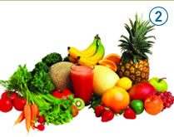
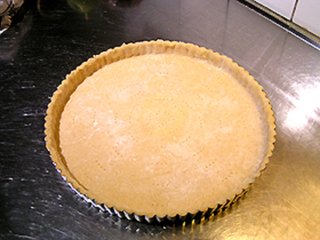
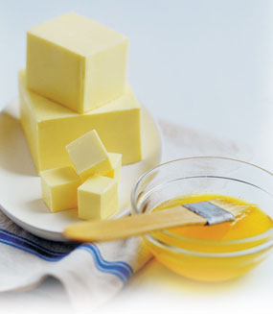
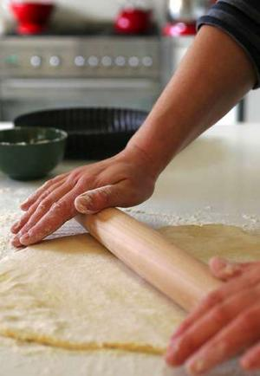
Properties and functions of ingredients
Primary ingredients:
Raw foods that have received little or no processing – i.e. fresh fruit or vegetables
Secondary ingredients:
Foods that have received more complex processing which makes them into composites or products – i.e. a pasta sauce, pastry case.
Components :
Individual ingredients which make up a product – i.e. flour, fat and water = pastry.
Composites:
Foods that have had some processing but are still not the final product – i.e. shortcrust pastry that still need to be turned into a pie.

Slide 9
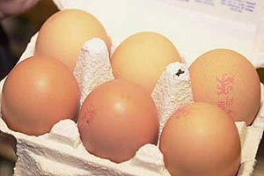
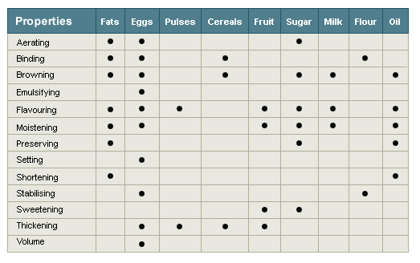
Properties and functions of ingredients
Food properties
Different foods have different working properties when treated in certain ways or combined with other foods. The table lists the working properties you need to know about.
Aerating makes a mixture lighter. Fats, eggs and sugar are used for aerating.
Binding helps to stick ingredients together. Fats, eggs, cereals and flour are used for binding, eg egg is used to bind together a biscuit mixture.
Browning adds a layer of colour to the mixture. Fats, eggs, cereals, sugar, milk, flour and oil are used for browning, eg when heated, egg glaze or sugar turns brown adding to the appearance of the food.
Emulsifying uses eggs to help mix two liquids that would normally stay separate, such as water and oil.
Flavouring helps to make something taste better, by adding fats, eggs, pulses, fruit, sugar, milk or oil.
Moistening helps to remove the dryness from foods. Fats, eggs, fruit, sugar, milk or oil are used for moistening.
Preserving helps food to last longer, through freezing, canning, jam-making pickling etc. Foodstuffs used in preserving are fats, sugar and oil.
Setting uses eggs to make foods firm.
Shortening is the use of oils and fats such as butter and lard, to reduce the development of gluten in pastry, which makes the pastry dough less stretchy. The fat coats the flour and prevents too much water from being absorbed during the mixing and produces a crumbly, short-textured, melt-in-the-mouth effect.
Stabilising helps food to keep its structure. Eggs and flour are used for stabilising.
Sweetening improves the flavour of certain foods by adding sugar or fruit, eg sugar will help to soften the sharp taste of grapefruit.
Thickening is the use of eggs, pulses, cereals and fruit to thicken liquids such as milk. (Usually heat is applied, as in the making of egg custard).
Volumising is the use of eggs to increase the volume or amount of space occupied by a substance. For example egg whites will trap air when whisked/beaten and will produce a mass of bubbles called a 'foam' - a process used in the making of meringues.
As you can see from the chart, most of these working properties can be found in many different foods:

Slide 10
Properties and functions of ingredients
STARCH
These are food products obtained from cereals, root vegetables and fruit. They can be used to thicken liquids. When heated the starch grains bust and absorb the liquid causing gelatinisation.
Starch particles do not dissolve in liquid
instead they form a suspension
Stirring or agitating the liquid keeps the particles suspended.
If the suspension is not stirred the particles form to the bottom forming lumps
When the liquid reaches 60°C the starch grains begin to absorb the liquid
At 80°C the particles break open and release starch making the mixture thick and viscose, this is called gelatinisation.
Gelatinisation is complete when the liquid reaches 100°C. The thickened liquid now forms a gel. On cooling the gel solidifies.
The reheating quality of starch can be poor as they often separate leaving a thin liquid behind.
(SINERESIS)
Smart Starches
These are starches that have been changed by the manufacturers to reach differently in different situations and are called MODIFIED STARCHES
Pregelatinised – allows them to thicken instantly – instant custard, pot noodles
No sineresis – allows starch product to be reheated easily – used in ready meals with sauces e.g. lasagne
Thickening – in low calorie products where less starch is used or more acid required – salad dressings
Fat replacement – currently under development is a starch that could replace some of the fat in low fat dishes like biscuits and cakes.

Slide 11
Properties and functions of ingredients
Fats and oils
Animal – pigs, cows, sheep
Vegetable – wheat, barley, oats, seeds, olives, beans, some fruit (avocado)
Fish – trout, mackerel, salmon, herring
Types
Fat is solid at room temperature –
soft margarine, butter, dripping, block margarine, low fat spread, suet.
Oil is liquid at room temperature – cream, sesame seed oil, fish oils, olive oil, vegetable oil, sunflower oil, rape-seed oil.
Saturated Fats –
mainly from animal sources, can increase blood cholesterol that leads to heart disease.
Polyunsaturated –
mainly from plant sources
Low fat products
Too much can cause obesity, too much saturated can result in heart disease. Using low fat products can help reduce these risks. Look for low fat or fat reduced on the packaging.
Function of fats:
What it does | Example …..
Adds flavour | Fat in biscuits, cakes, bread. Melted on vegetables, Olive oil drizzled on pasta
Makes food moist | Butter, margarine on bread and scones
Seals | Butter and lard help to preserve pâtés by sealing them
Shortens/changes texture | Shortbread, cakes and pastries have a crumbly texture because the flour particles are coated in fat
Aerates | In cake mixtures, butter and margarine help to trap air when creamed with sugar
Extends the shelf life | The addition of fat to baked products means that they stay moist for longer.

Slide 12
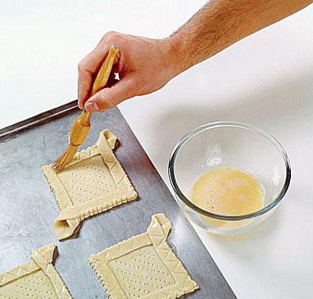
Properties and functions of ingredients
Sugar
Sugar cane and sugar beet are processed to produce different types of sugar -molasses, granulated, caster, dark brown, soft brown, muscavado, icing, demerara, cubes.
Functions of sugar
Cakes, biscuits –
to add sweetness and colour, prevent drying out, give texture and volume.
Jam –
to act as a preservative, help set the fruit.
Bread –
to speed up fermentation of the yeast
Ice cream –
to lower freezing point, add texture and volume
Creamed mixtures (cakes, biscuits) –
to lighten and help fat trap air.
Plain looking foods –
to decorate
Artificial sweeteners
These are lower in calories but are mainly used to sweeten as they often fail to duplicate other functions.
Hydrogenated sweeteners – Sorbitol, Mannitol, Xylitol, Hydrogenated Glucose Syrup.
Non-nutritive/intensive sweeteners – Saccharine, Aspartame, Acesulfame, Thaumarin
Eggs
Mostly from chickens but all bird eggs can be eaten.
Functions of Eggs
Aeration
Whisking stretches the protein and adds air bubbles. The air bubbles form a foam which partially coagulates. Used in sponge cakes, meringues and mousses
Emulsification
When oil and another liquid are forced together they emulsify. The addition of egg yolk (lecithin) stabalises the emulsification. – mayonnaise.
Coagulation
Eggs set and eventually go solid when heated. The egg white sets at 60°C, the yolk at 70°C. Used to set mixture like quiche, custard and lemon curd.
Other uses
Garnish
Chopped or sliced to decorate savoury products.
Glaze
Any part of the egg can be used to brush over a baked product to make it shine, particularly pastry and bread.

Slide 13
Properties and functions of ingredients
Dairy products
Milk
All mammals produce milk but the main ones we drink are cows. Increasing amounts of goats milk are now being drunk by those with an intolerance to cows milk.
Primary processing:
this takes the milk from the animal and treats it to make it safe to drink and use.
Pasteurised- this make the milk safe to use as it destroys and harmful bacteria. Milk is heated to 72°C for 15 seconds then cooled rapidly to 10°C or below before being packaged.
Homogenised –after pasteurisation the milk is forced through tiny holes to mix in the cream.
Sterilized – after pasteurisation and homogenisation the milk is bottled, sealed and heated to 110°C for 30 mins. This alters the taste.
Evaporated – water is evaporated off to make it more concentrated. It is then homogenised and packed into cans before heating to 120°C for 10 mins. The taste is altered and the milk is slightly thicker.
Dried – drying removes the water, this allows it to keep for several months. The milk is sprayed into a hot chamber, the liquid evaporated leaving behind a fine powder.
Skimmed – this has all the cream removed so is low in fat.
Semi-skimmed – this has some of the fat removed
UHT (Ultra Heat Treated) – The milk is heated to 140°C for 1 second before being cooled quickly then packaged. This milk will keep for a longer time.
Channel Island – milk is from Jersey and Guernsey cows and is 5% higher in fat.
Condensed Milk –water is evaporated from the milk then sugar is added to preserve it and make it thicker.
Nutritional Content
Sugar – lactose, Vitamin B, Calcium, Fat, Phosphorus, Protein, Vitamin A.
The amount of fat depends on the type of milk.
Functions of milk
To improve the nutritional value of a product – add protein, fat.
To add flavour.
Secondary Processing
Butter – made by churning the cream.
Function to improve flavour and moisture of a product.
Cream – extracted from the milk. The fat content depends on the type of cream. Double, single, whipping, clotted, crème fraîche, sour, sterilised.
Function to add flavour and richness.
Cheese – This is a solid form of milk 33% each of fat, protein and water. The cheese depends on the kind of milk and bacteria used and the method of production.
Function to add flavour, moisture and texture.
Yogurt – Made by adding a special bacteria to the milk which make it sourer and thickens the milk. Flavour and sugar can then be added.
Function – add flavour and texture but can reduce fat content.
Effects of heating can change the way milk products react – cheese melts and separated into protein and fat so should be heated slowly.
- milk hold air as it boils, this is good when making the frothy topping for coffee – cappuccino.

Slide 14
The 12 stages for food product development
Stages of food product development
Developing a new food product is similar in many ways to developing a new product of any kind. For most new foods there are 12 key stages in the development of the new product.
Brief is a problem is given to design team to solve.
Market research are methods of finding out information, including studying market trends and shopping habits, conducting surveys, using questionnaires and doing telephone interviews.
Design brief / design specification is the first attempt at listing the needs of the product, such as size, shape, weight, shelf life, sensory characteristics, costs, list of ingredients (with quantities) and equipment.
Generating of ideas that fit the specification.
Concept screening (prototyping) reduces the the number of ideas to a shortlist of five or six. Clear decisions are made on which ideas meet the specification and should be tested further.
Sensory evaluation (modifications) uses consumer panels to analyse the shortlist of ideas asking them to judge which best fit the set criteria.
Commercial viability is the assessment of whether projected sales value will cover the costs of production, ingredients, packaging etc., and leave sufficient profit.
Modifications provides the last chance to evaluate and change the product design; before manufacturing begins. The final manufacturing specification is prepared.
Manufacturing / first production run is a test-run making a small number of products to ensure the control checks and standards for consistency are in place.
Sampling the market involves sending out trial products to a target group of customers in a target geography, with a questionnaire to complete and return. Customer reaction is also tested in supermarkets.
Product launch uses advertising and other marketing techniques to make the public aware of the new product.
Future developments will depend on evaluation of how well the product performs, assessment of how it can be improved and how sales can be increased.

Slide 15



Factors that affect our choices and decision making
Market and societal factors
The food products market is affected by changing social and economic patterns. For example, many people have more income today compared with 20 years ago. This gives them more money to spend. People also lead busier lives, so they might do more shopping in supermarkets, than traditional shops, and buy more ready-made meals or eat out more, rather than cooking for themselves.
Food developers need to constantly rethink the type of foods that need to be on shop shelves, in order to take account these lifestyle changes. Customers expect to find a wider range of foods, including foreign dishes and food ingredients. There are several reasons for this:
We travel abroad more frequently and so are exposed to many new types of food.
We live in a multicultural community made up of many different races and religions - many with their own traditional cuisines.
There are also numerous cookery programmes on TV that encourage people to try new food ideas.
Many factors affect what people choose to eat. These include age, habits and presentation. Different sectors of the community will choose to eat different types of food, for example the factors that are most likely to convince teenagers to buy foods are convenience, trend, taste, cheapness, but teenagers do not generally care if food is environmentally-friendly.
Consumers are becoming more concerned about what they eat.
This might be because they have special dietary requirements, which means they can't eat certain products for religious or political reasons, or because certain foods make them feel unwell.
Some consumers are demanding healthier foods. Healthier diets have less fat, sugar, salt and more fibre. This is one reason why food producers put nutritional information on food packaging.
Increasingly people who are concerned about health, diet and the environment look for
products that are healthier, organic, fair trade or GM-free

Slide 16
Production methods
Production systems
In the food business, in common with other industries, the production process can be viewed as a system with the following elements:
The inputs include everything that goes into the system, most obviously the ingredients.
The processes include weighing, mixing, shaping and forming of mixtures, cooking, cooling and packaging, with checks throughout the process. Some of these processes and the production line may be controlled by computers. This is called Computer-Aided Manufacturing (CAM) and it helps to maintain consistency.
The output is the end-product complete with packaging, for example a packet of biscuits.
The feedback loop can happen at a variety of stages of production line, when the control checks flag up the need for alteration and improvement in the inputs or processes.

Slide 17
Production methods - continued
Manufacturing methods
There are different types of manufacturing system, each one suitable for different scales of production:
One-off production is when a single product is made to the individual needs of a customer, for example a designer wedding cake. This is classed as a luxury food item.
Batch production involves the making of a set number of identical products (large or small). Typically batch production is used in a bakery, where a certain number of several different types of bun, loaf, cake etc, will be made every morning.
Mass production is used to make foods on a large scale, either wholly or partially using machines. The production line involves individual tasks that will be carried out repetitively. This is time-efficient and helps to keep the costing of the product low.
Continuous-flow production is a method of high-volume production, used in foods such as milk and packet pizzas. Production lines run 24 hours a day. Where production line machines are controlled by computers this is called Computer-Aided Manufacture (CAM).

Slide 18
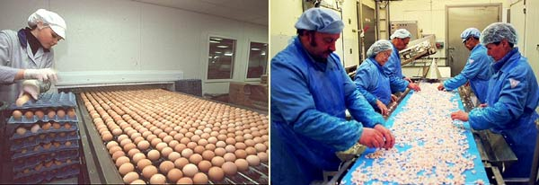
The Control of Substance Hazardous to Health (COSHH) regulations help to protect workers in the food and other industry from hazardous substances such as cleaning fluids and pesticides. It encourages employers to put safety procedures in place to prevent accidents.
Assured Safe Catering System (ASCS) is a set of procedures used by caterers to ensure food is always safe to eat. This is based on Hazard Analysis Critical Control Points (HACCP) principles.
Critical control points
Critical control points (CCPs) are pre-determined checks which take place at specified points in the food production or preparation process. They must be carefully documented, with details of the checks themselves, the processes being checked, any faults and remedial action taken. Some of these checks will be done by hand - others may be computerised under CAM. They will include checking:
ingredient measures
oven temperatures
cooking times
speeds at which machines and conveyor belts move
scanning for impurities, such as metal, and other potential hazards
Quality control
Safety in the food industry
Safety is vitally important in the food industry, for obvious reasons. As in any other type of production, the most important part of safety-consciousness is identifying and monitoring potential hazards (this is called hazard analysis) and taking steps to avoid them. There are three main types of hazard in food production:
A biological hazard is where foods become dangerously infected by bacteria. This might lead to food poisoning, such as salmonella.
A physical hazard occurs where foreign bodies, such as nuts and screws from factory machinery, personal jewellery and fingernails, fall into the food.
A chemical hazard is where potentially dangerous fluids or pesticides have found their way into food.

Slide 19
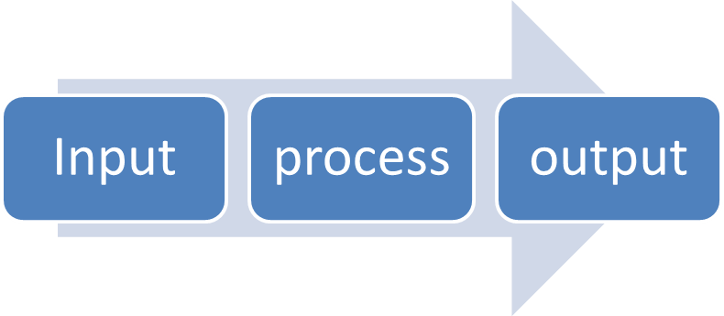
Control systems
Systems are the different processes that work together to enable a task to be completed.
Systems are used to:
Make the processes more efficient
Make the task easier
Make the task and process easier to check
A system is divided into three parts IMPUT, PROCESS, OUTPUT
This is the information, materials, foods, equipment, energy and other resources you need to carry out a task
This is what’s done with all the inputs during the completion of the task and could include measuring, mixing, heating, cooling etc.
This is the result of the processes – the final result of finished product.

Slide 20
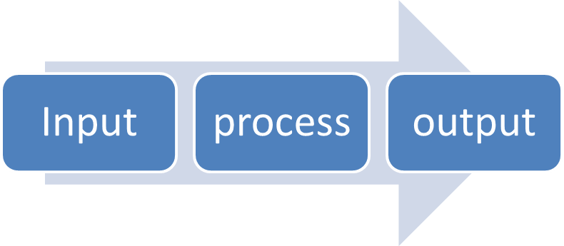
Control systems - continued
A production system also allows for FEEDBACK – this is important as it ensures good quality finished products.
EXAMPLE: production feedback for a quiche
Roll out pastry
Line flan case
OK
Add filling
Add egg and milk mixture
Add cheese
OK
Cook flan
Holes in pastry
Cheese uneven
Back to rolling out
Back for more
cheese
This monitoring may be done by computer which would return the product to the previous stage CAM

Slide 21




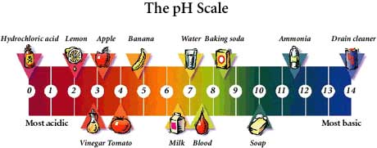


Quality Control
Ways to check quality:
Visual Check:
Raw ingredients and finished products checked this way by looking carefully at outcome
Micro-biological check:
Samples tested in a laboratory for levels of bacteria
pH check:
May be tested for acidity or alkalinity
Organoleptic check:
Final products tested for flavour, texture and aroma
Weight Check:
Products are weighed and tested at the packaging stage
(usually done by computer CAD)
Chemical Check:
Samples are tested in a lab to make sure they are free from contamination
Temperature check:
Samples are regularly checked by probe to ensure accurate temperatures for manufacture and storage.
Metal check:
Metal detectors are used to ensure the finished product has no metallic contamination

Slide 22
Quality Control in Mass Production
Mass produced products need to be of identical quality to ensure customers will continue to buy them. The manufacturer can follow the following pointers:
1. To ensure ACCURATE WEIGHT use electronic scales to weigh the ingredients and the final product to ensure it weighs within the levels of tolerance set.
2. To ensure ACCURATE SIZE or SHAPE manufacturers use standard moulds, templates and cutting devises
3. The same flavour and texture will be produced every time by making sure the identical STANDARD FOOD COMPONENTS and ACCURATELY MEASURED INGREDIENTS. Preparation, mixing and cooking times are also MEASURED ACCURATELY.
4. The SAME COLOUR is produced by using fixed ingredients, cooking times and temperatures. COLOUR can also be checked against a standard colour using CAM machines.
5. The PACKAGING of the product is also controlled
6. The NAME and CONTACT DETAILS for the manufacturer should appear on the PACKAGE in case the product is SUBSTANDARD

Slide 23
Recipe ideas for buffet foods
QUICHE LORRAINE
Ingredients
150g plain flour
25g white fat (lard, white vegetable fat)
50g butter or margarine (hard)
½ tsp salt
6 - 8 tsp water
1 small onion
100g bacon
2 eggs
125ml milk
Seasoning
100g grated cheese.
1 tomato
Method
Oven – Gas 6, 200 °C
Finely chop onion and bacon, lightly fry until soft but not coloured.
Beat egg and milk together with seasoning.
Put flour and salt in a mixing bowl.
Rub in fat (margarine and lard) until the mixture looks like breadcrumbs.
Stir in water with a table knife until it forms large lumps but is not sticky.
Gather together and knead lightly.
Roll out to a circle and line a flan ring or flan dish – make sure there are no holes.
Trim edges.
Add bacon, onion and egg mixture.
Sprinkle with grated cheese and top with slices of tomato.
Bake 20 - 30 minutes until golden and the filling is cooked.
SAUSAGE ROLLS
Ingredients
250g plain flour
50g white fat (lard, white vegetable fat)
75g butter or margarine (hard)
½ tsp salt
10 – 12 tsp water
500g sausages or sausage meat
1 beaten egg for glazing
Method
Oven – Gas 6, 200 °C
Put flour and salt in a mixing bowl.
Rub in fat (margarine and lard) until the mixture looks like breadcrumbs.
Stir in water with a table knife until it forms large lumps but is not sticky.
Gather together and knead lightly.
Roll to a rectangle 30cm x 20cm.
Cut in half 2 x 15cm x 20cm
Divide the sausage meat in half and lay down the centre of each pastry strip
Brush edges with beaten egg and roll up.
Glaze whole of roll.
Cut into equal size pieces.
Bake 15 – 20 minutes until golden and the sausage meat is cooked

Slide 24
Recipe Ideas of Buffet foods
FRENCH APPLE FLAN
Ingredients
150g plain flour
75g butter or margarine (hard)
25g caster sugar
1 egg yolk
½ tsp salt
3 - 4 tsp water
250g cooking apples
50g sugar
1 red eating apple
2 tablespoons apricot jam
Method
Oven – Gas 6, 200 °C
Put flour, caster sugar and salt in a mixing bowl.
Rub in margarine until the mixture looks like breadcrumbs.
Stir in egg yolk and water with a table knife until it forms large lumps but is not sticky.
Gather together and knead lightly.
Roll out to a circle and line a flan ring or flan dish – make sure there are no holes.
Trim edges, fork base then line with greaseproof paper and a layer of baking beans.
Bake 10 minutes until set but not coloured
Peel and cook cooking apples with sugar
Beat until smooth then pour into flan case.
Peel and thinly slice red apple and arrange in spiral over cooked apple
Brush with apricot jam (add a little water if the jam is too thick)
Bake for 20 – 25 minutes until the apple and pastry are cooked and golden
Cool slightly then remove the flan ring.
PROFITEROLES
Ingredients
70g plain flour
Pinch salt
150ml water
50g butter or margarine
2 eggs
300ml double or whipping cream
3 tablespoons icing sugar
175g plain chocolate
20g butter
3 tablespoons water
3 tablespoons golden syrup
1 teaspoon vanilla essence
Method
Oven – Gas 220°C, Gas 7
Mix together flour and salt.
Put water and butter/margarine into a pan and warm over a low heat until the butter melts.
Increase the heat and brink to the boil.
Remove from the heat and beat in the flour. Continue beating until the mixture forms a ball and leaves the side of the pan.
Cool slightly.
Beat eggs then add to the mixture a little at a time until the mixture is smooth and shiny and firm enough to stand in soft peaks YOU MAY NOT NEED ALL THE EGG.
Spoon 20 mounds of mixture onto baking trays – well apart to allow for rising.
Bake for 25 mins. Until risen and golden brown
Split and return to the oven for a further 5 mins. to dry. Cool on a wire tray.
When cold whisk cream and fill and pile into dish.
Place all icing ingredients in a small pan and melt over a low heat stirring all the time chocolate in a small bowl over a pan of hot but not boiling water. Pour sauce over pile.

Slide 25
Recipe Ideas of Buffet foods
LEMON MERINGUE PIE
Ingredients
150g plain flour
25g white fat (lard, white vegetable fat)
50g butter or margarine (hard)
½ tsp salt
6 - 8 tsp water
2 level tablespoons cornflour
50g granulated sugar
Grated rind and juice of 2 lemons
150ml water
2 egg yolks
15g butter
2 egg whites
75g caster sugar
Method
Oven – Gas 6, 200 °C
Put flour and salt in a mixing bowl.
Rub in fat (margarine and lard) until the mixture looks like breadcrumbs.
Stir in water with a table knife until it forms large lumps but is not sticky.
Gather together and knead lightly.
Roll out to a circle and line a flan ring or flan dish – make sure there are no holes.
Trim edges, fork base then line with greaseproof paper and a layer of baking beans.
Bake 15 - 20 minutes until golden and the pastry is cooked. Remove paper and flan ring.
Mix cornflour, lemon rind and juice, granulated sugar and water in a pan. Bring to the boil stirring all the time. Cool for a few minutes then beat in butter and egg yolks.
Pour into cooked pastry case.
Whisk egg whites until very stiff, then whisk in half the caster sugar.
Fold in remaining sugar with a tablespoon.
Spoon over filling.
Bake Gas 5, 180°C for 10 minutes until lightly golden.
Sponge fruit gateau
2 eggs
50g caster sugar
50g plain flour
Small tin fruit or small packet fresh fruit (strawberries, raspberries)
50g chopped nuts or grated chocolate
Small carton double or whipping cream
Method
Oven Gas 6, 200°C
Grease and line a swiss roll tin. (18cm x 30cm)
Whisk eggs and sugar until thick and creamy and holds a trail. (thick enough to write your name on)
Gently fold in the flour with a table spoon.
Pour into tin.
Bake for 10 – 15 minutes until firm to touch.
Tip onto a cooling tray and remove the paper.
Carefully whisk the cream until thick. (do not over whisk or you will have butter)
When cold cut into three equal slices and sandwich together with a little of the cream
Spread more of the cream around the sides then dip into the chopped nuts or grated chocolate.
Pipe any remaining cream around the top edge of the cake. Fill the centre with the fruit.

Slide 26
Recipe Ideas of Buffet foods
Mayonnaise
Ingredients
2 medium egg yolks
1 tsp Dijon mustard
300ml light olive oil
Good squeeze fresh lemon juice
Method
Sit a large bowl on a cloth to stop it moving. Put the egg yolks into the bowl with the Dijon mustard and a little seasoning and whisk well until smooth.
Gradually add the olive oil in a slow, steady stream, whisking all the time. You should have a smooth, quite thick mayonnaise that stands in peaks.
Add lemon juice to taste and briefly whisk.
If it's too thick, whisk in a few drops of warm water to give a good consistency.
Tip
You can also make this in a food processor, adding the oil through the feeder tube. It will keep in the fridge for 3-4 days.
Scotch Eggs recipe
Ingredients
8 large Lion Quality eggs
2 (454g) packs good quality sausages
60ml/4tbsp plain flour
225g/8oz fresh white breadcrumbs
vegetable oil for deep frying
Method
Place six of the eggs in a small pan, cover with cold water and slowly bring to the boil. Simmer for 7 mins. Drain the eggs then rinse in cold water. Tap the shells all over and peel away the shells.
Remove the sausage skins, place the meat in a bowl and mash with a fork. Divide the mixture into six.
Using floured hands shape each piece into a 1cm(3/8in) thick oval shape. Holding the sausage meat in your hand, place a boiled egg in the centre. Mould the meat around the egg to cover. Pat into a neat egg shape and set aside. Repeat with the remaining sausage meat and eggs.
Beat the remaining two eggs in a bowl; place the flour and breadcrumbs on two separate plates.
Roll each sausage covered egg in flour, then brush with egg. Roll in the breadcrumbs to coat. Repeat until all the eggs are covered. Chill for 10 mins.
Pour the oil into a deep pan until one third full (or use a deep fat fryer) Heat the oil to 160C.
Fry the eggs 2 at a time for 4-5 mins, turning until golden brown all over. Remove with a draining spoon then transfer to kitchen paper. Cook the remaining eggs in the same way. Leave to cool.
Serve cold with mustard and salad leaves.

Slide 27
Notes:

Slide 28
Notes:

