Slide 1

KEY WORDS in
Food Technology
By Janet Harper
Notes:
Janet Harper janeth@sweynepark.com
Produced as a slide show whilst a practical lesson might be going on for some “subliminal learning” to take place.
Have also used it as a plenary: Ticket out the door; “Tell me one definition you learnt today”.
If I have missed any important definitions out, please e-mail me!
Most illustrations taken from a Google search, others from www.nutrition.org.uk or www.bmesonline.org.uk

Slide 2
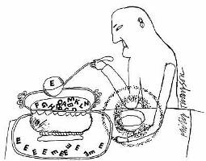
Additives
Substances added to food in small amounts to perform a function such as to preserve, colour or flavour a product.

Slide 3
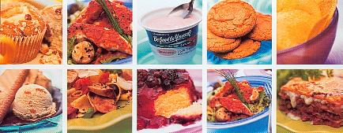
Aesthetics
The appreciation of good taste or good design. The product appeals to your senses.
“It looks appealing, I want to eat it!”

Slide 4
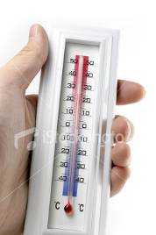
Ambient temperature
Normal room temperature.
20 - 25°C

Slide 5

Antibacterial
Working against or prohibiting the growth of bacteria.

Slide 6
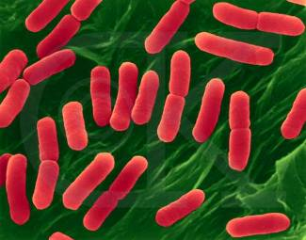
Bacteria
Small microscopic organisms found all about us. They multiply by splitting in two every 20 mins. (Binary fission)

Slide 7

Batch production
Producing a small quantity of identical products. For GCSE assume 50.

Slide 8
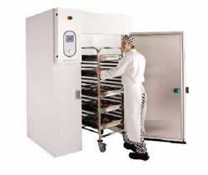
Blast chill
To cool food quickly by blasting it with cold air.

Slide 9
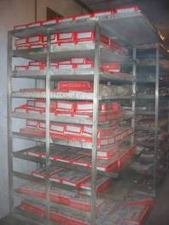

Blast freezing
Quickly freezing that makes small ice crystals which do less damage to the food than slow freezing.

Slide 10
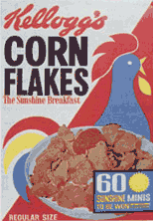
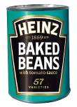
Brand
A particular make of product usually with a well known name e.g. Heinz baked beans.

Slide 11
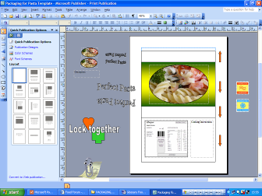
C.A.D.
Computer-aided design e.g. programs used for designing packaging.

Slide 12
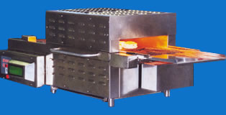
C.A.M.
Computer-aided manufacture.
e.g. using a computer to help control baking temperatures.
Travelling oven

Slide 13
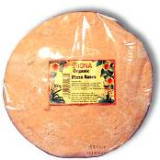

Component
A ready prepared part of something.
e.g. a ready made pizza base.

Slide 14

Consumer
A person who buys or uses products and services.

Slide 15
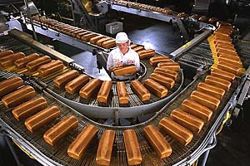
Continuous-flow production
Continuous processing 24/7.
Expensive to set up, cheap to run. Fewer people employed; usually computer controlled.

Slide 16
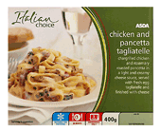
Cook-chill
Food that has been cooked, fast chilled and then stored at low temperatures.

Slide 17
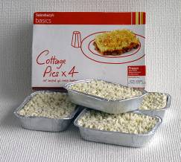
Cook-freeze
Food that has been cooked, fast frozen and then stored below freezing point.

Slide 18
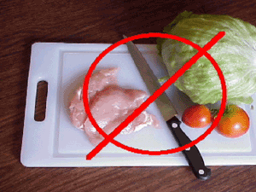
Cross contamination
The transfer of harmful bacteria from one area to another.

Slide 19
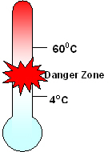
Danger zone
The temperature range in which bacteria thrive. 4 - 60°c.

Slide 20
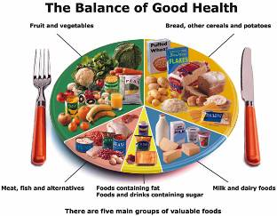
Diet
The food and drink that we eat.

Slide 21
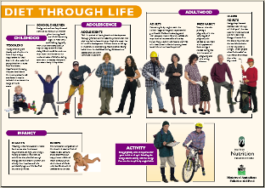
Dietary Reference Values DRV’s
DRV’s show the amount of food energy or other nutrients needed by people of different ages.

Slide 22
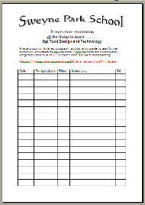
Due diligence
In food preparation this means that the company has set up systems to help avoid contamination of food products.
Fridge temperature

Slide 23
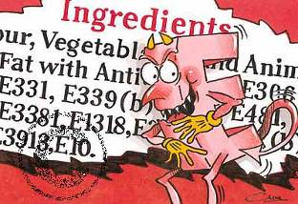
E numbers
The number given to an additive to show that it has been approved by the EU.

Slide 24
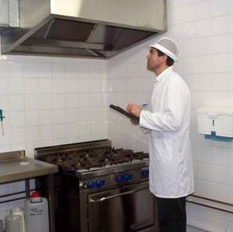
Environmental Health Officer EHO
The enforcement officer at local government level who covers public health such as the hygiene of food premises and food safety.

Slide 25
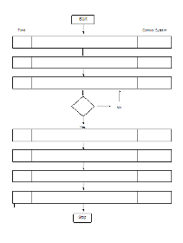
Flow diagram
Step by step chart or plan of a system or production process.

Slide 26
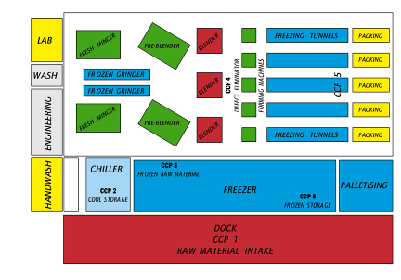
H.A.C.C.P.
Hazard analysis and critical control point.

Slide 27
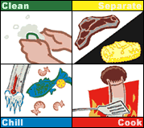
Hazard
Anything that can cause harm to the consumer.

Slide 28
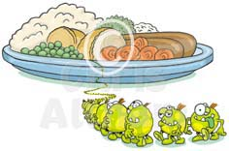
High risk area
The section in the food preparation area where food is most likely to be contaminated by bacteria.

Slide 29
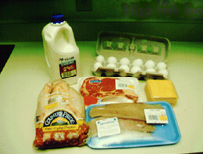
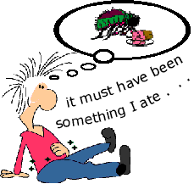
High risk foods
Those most likely to encourage bacterial growth. e.g. cooked meat, cooked poultry, fish, dairy foods.

Slide 30

Image board
A display of pictures and drawings to give ideas about a target group or a range of products.

Slide 31
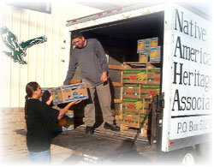
Just in time
Some factories & fast food outlets order stock just in time to manufacture the product.
They do not have room to store it
days / weeks in advance.

Slide 32
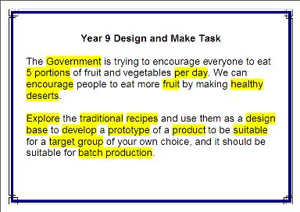
Key words
Important words that may relate to the design brief.

Slide 33






Logo
The symbol of a company used on products.

Slide 34
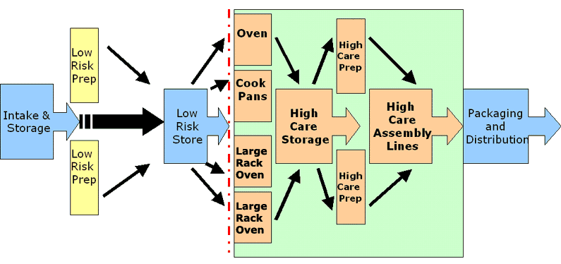
Low risk area
Section in the food preparation area where food is less likely to be contaminated by bacteria.

Slide 35
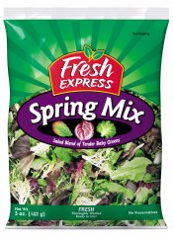
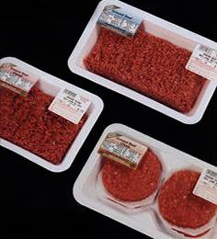
M.A.P.
Modified atmosphere packaging. Removing the air and flushing the packet with a gas.

Slide 36

Marketable product
One that appeals to people and will sell when it reaches the shops; to succeed, all products must be marketable.

Slide 37
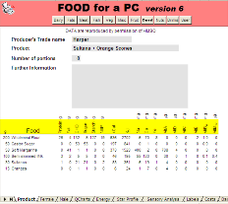
Modelling
To experiment with an idea without actually cooking it.
You can model the
nutritional value of a
food product by using
FOODP6.

Slide 38
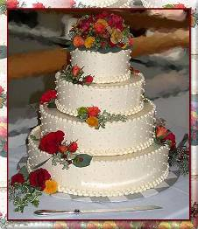
One-off production
One product is made, usually to order. It is unique. It can be expensive.

Slide 39


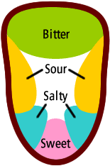

Organoleptic Testing
A posh term for sensory analysis. Using your sensory organs to test a product. In simple language, taste testing!

Slide 40
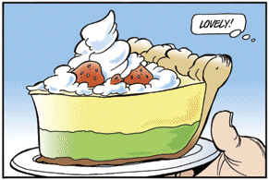
Portion
A portion for one is the amount of food that satisfies the need for one person.

Slide 41
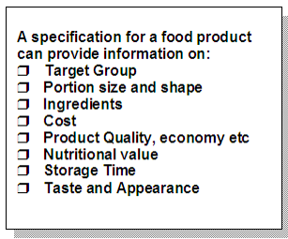
Product specification
The exact details needed to make the product.

Slide 42
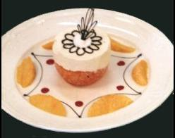
Prototype
A sample product to be used for trialling and market research.

Slide 43

Quality assurance
A system that is set up before a product is made and which lays down procedures for making a safe, quality product.

Slide 44

Quality control
The steps in the process of making a product to make sure that it meets the standards; faulty products are removed.

Slide 45
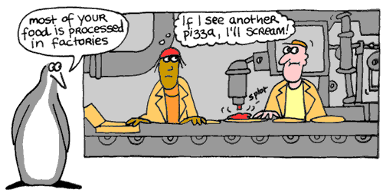
Repetitive-flow production
Assembly line production of a product, often using a conveyor belt. Used for producing large numbers.

Slide 46
Sensory descriptors
Words that describe taste, smell, texture and flavour.

Slide 47
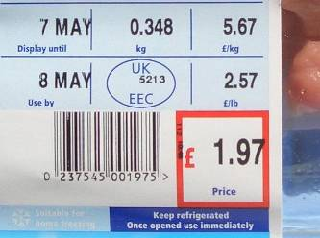
Shelf life
How long a food product can be kept, making sure it is safe to eat and good quality.

Slide 48
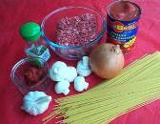
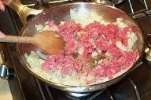
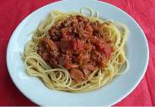
System
Made up of:-
Input
Ingredients
Process
Processing/cooking
Output
Finished product

Slide 49

Target group
The person or group of people that the product is aimed at.
e.g. teenagers, families.

Slide 50
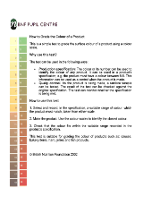
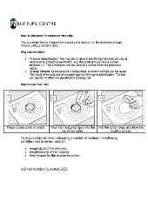
Tolerance level
The amount and flexibility allowed when making a product – in terms of weight, colour, size – so that it meets quality standards.
Using a colour chart
Testing Viscosity

Slide 51
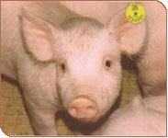
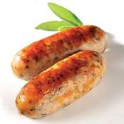
Traceability
Tracing a fault back to the point at which it occurred in order to remedy the fault and avoid it happening again.
From farm to fork

Slide 52
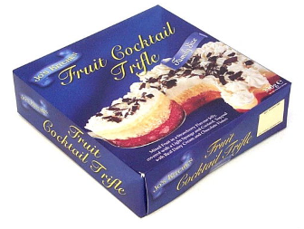
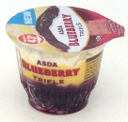
Trend
The likelihood of something happening.
e.g. there is a trend for more single portions.

