Slide 1
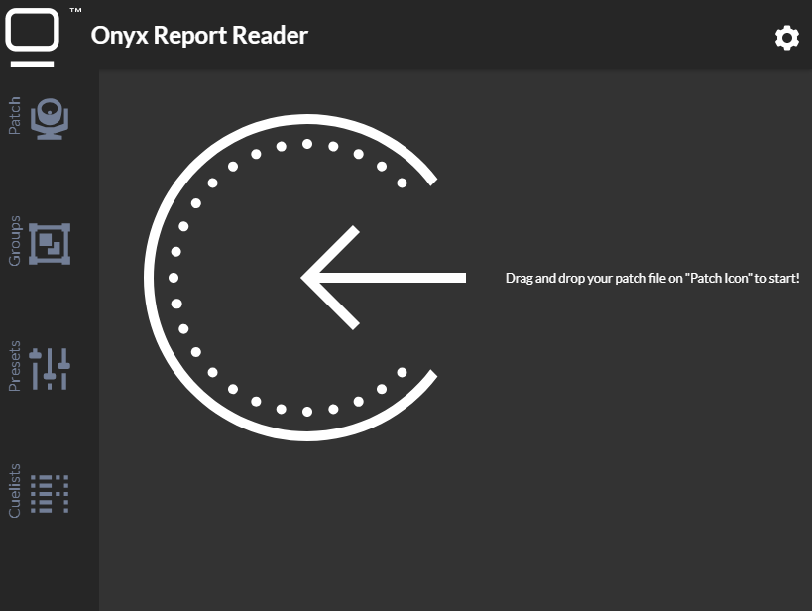
Header
Menu
Report upload
Content

Slide 2
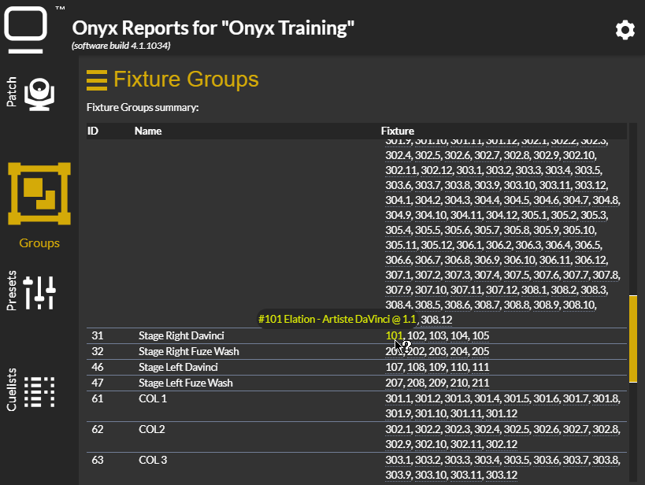
Show name & Onyx build version
Colored Icon = Active Report White Icon = Report Loaded
Last loaded report displayed

Slide 3
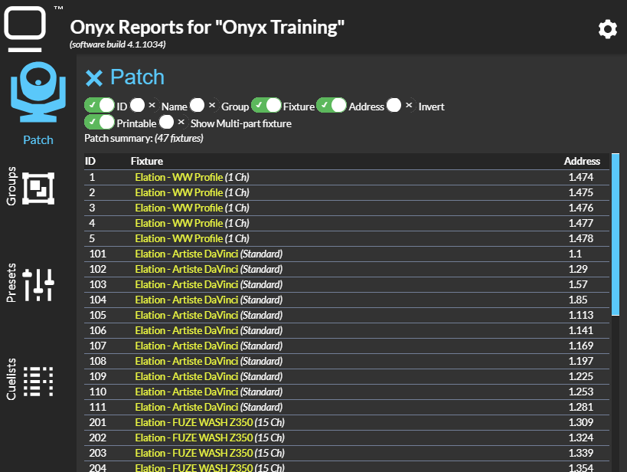
Content Menu

Slide 4
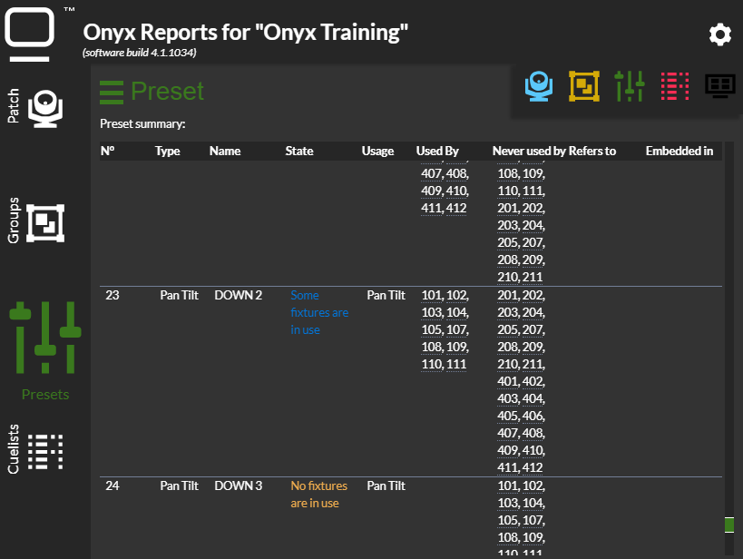
Reset Menu

